Slide 1
Academic Medical Centers as Learning Health Systems

Slide 2
This session is being recorded The recording link will be shared via email to all attendees and registrants This session will be closed captioned Please post questions for the presenters in the Q&A pod feature on Zoom throughout the session
Welcome!
Notes:
Chuck to open webinar with housekeeping slide & remarks

Slide 3
Lead, Change, Transform Health
New!
Health Infrastructures and Learning Systems
(HILS)-Online MS
Application deadlines: February 1, 2021 (preferred), June 1, 2021 (final)
Medicine.umich.edu/dlhs-hils-online

Slide 4
2020-2021 Seminar Series
October 20 - LHS as a Driver of Diversity, Equity, and Inclusion
Luis Belén, Chief Executive Officer of the National Health IT Collaborative for the Underserved (NHIT Collaborative)
Danielle Brooks, J.D., Director of Health Equity, Amerihealth Caritas
Melissa S. Creary, Ph.D., M.P.H., Assistant Professor, Department of Health Management and Policy School of Public Health
November 12 – Tony Bryk, President of the Carnegie Foundation for the Advancement of Teaching
January 21 – Rachel Richesson, Professor, Department of Learning Health Sciences
February xx – Program Hosted by the School of Dentistry
March 25 – Stefan Boes, Vice Principal of the Department Health Sciences and Medicine, Professor of Health Economics, Head of Health Sciences and Health Policy, Director Center for Health, Policy and Economics (CHPE)
Notes:
Chuck to welcome everyone back to the 2020-2021 LHS Collaboratory Seminar Series Review upcoming schedule

Slide 5
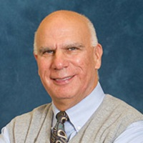
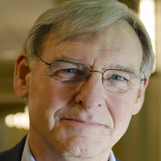
Today’s Program
Moderators
Charles P. Friedman Chair, of the Department of Learning Health Sciences, Josiah Macy Jr. Professor of Medical Education at the University of Michigan Medical School, as well as Professor of Information and Public Health
Douglas Van Houweling
Professor Emeritus of Information, School of Information and Professor Emeritus in Service of Learning Health Sciences, Medical School
Notes:
Chuck to review today’s program and speakers
Introduce himself and Doug – as Co-Chairs of LHS Collaboratory

Slide 6
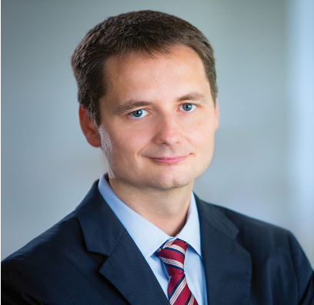
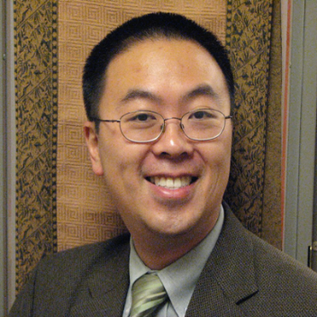
Today’s Program
Presenters
Michael Pencina, PhD Professor of Biostatistics and Bioinformatics Vice Dean for Data Science and Information Technology Duke University
Eric G. Poon, MD, MP Professor of Medicine Chief Health Information Officer Duke University
Notes:
Speakers from Duke: Michael, then Eric

Slide 7
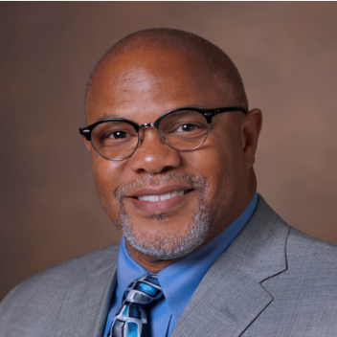
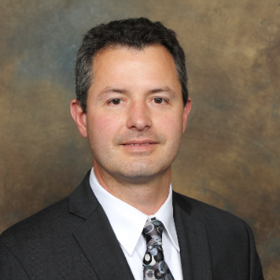
Today’s Program
Presenters
Kevin B. Johnson, MD, MS, FAAP, FACMI Cornelius Vanderbilt Professor & Chair, Department of Biomedical Informatics Professor, Department of Pediatrics Informatician-in-Chief Vanderbilt University Medical Center
Christopher J. Lindsell, PhD Professor of Biostatistics Co-director of the HEAlth Data Science, (HEADS) Center Vanderbilt University
Notes:
Speakers from Vanderbilt: Kevin, then Christopher

Slide 8
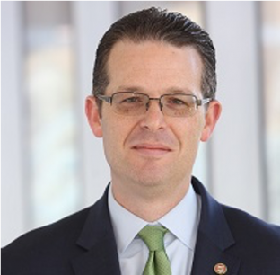
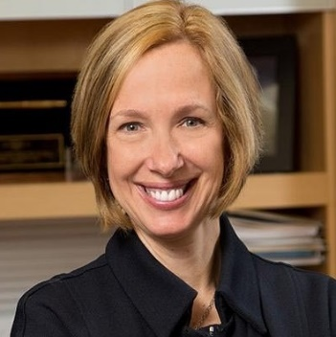
Today’s Program
Presenter
Philip R.O. Payne, PhD, FACMI, FAMIA Janet and Bernard Becker Professor and Director, Institute for Informatics (I2)
Associate Dean for Health Information and Data Science, Chief Data Scientist, Washington University School of Medicine
Discussant
Carol R. Bradford, M.D., M.S. Executive Vice Dean for Academic Affairs, Medical School Chief Academic Officer, Michigan Medicine Professor of Otolaryngology-Head and Neck Surgery
Notes:
Speaker from Wash U - Philip Discussant from UM - Carol

Slide 9
Origin of This Session
Dr. Poon organized a symposium of this title and theme (plus or minus) for the 2019 meeting of the American Medical Informatics Association
The “LHS” efforts of four institutions were presented: Duke, Michigan, Vanderbilt, and Wash U
The session drew widespread critical acclaim
I convinced my colleagues, speaking today, to be the ”talent” for the Collaboratory’s 2019-20 season-ending Symposium—in April
Guess what didn’t happen…

Slide 10
Better Late Than Never…
You all know what didn’t happen in April, and why
But here we all are, virtually, and five months later

Slide 11
The Plan for Today
The (Varying) LHS Journeys of Three Research-Oriented Academic Health Centers
Each institution will present for 25 mins, followed by 5 mins of moderated Q&A
Put your questions in the chat
Dr. Carol Bradford’s remarks
~ 15 mins of Q&A
Informal discussion from 11 to 11:30

Slide 12
Question and Answer Session ~ Break ~
Kevin B. Johnson
Christopher J. Lindsell
Notes:
Display during audience Q&A to remind them of speakers and to whom they may want to direct questions

Slide 13
Question and Answer Session ~ Break ~
Michael Pencina
Eric G. Poon
Notes:
Display during audience Q&A to remind them of speakers and to whom they may want to direct questions

Slide 14
Question and Answer Session ~ Break ~
Philip R.O. Payne
Notes:
Display during audience Q&A to remind them of speakers and to whom they may want to direct questions

Slide 15
Discussant Remarks
Carol R. Bradford
Notes:
Display while Carol is talking

Slide 16
Question and Answer Session
Kevin B. Johnson
Christopher J. Lindsell
Michael Pencina
Eric G. Poon
Philip R.O. Payne
Carol R. Bradford
Notes:
Display during final audience Q&A to remind them of speakers and to whom they may want to direct questions

Slide 17
Thank You!
Thank you for attending!
Please fill out the post-event survey.
A link to the webinar materials will be placed on the LHS Collaboratory website: http://dlhs-umi.ch/lhs-collaboratory%20
Join us on October 20, 2020: LHS as a Driver of Diversity, Equity, and Inclusion
Notes:
Doug to say some summary remarks, as time permits
Thank presenters, audience and provide closing reminders

