Slide 1
Clinical Decision Support Based on Risk Prediction Models
September 17, 2020

Slide 2
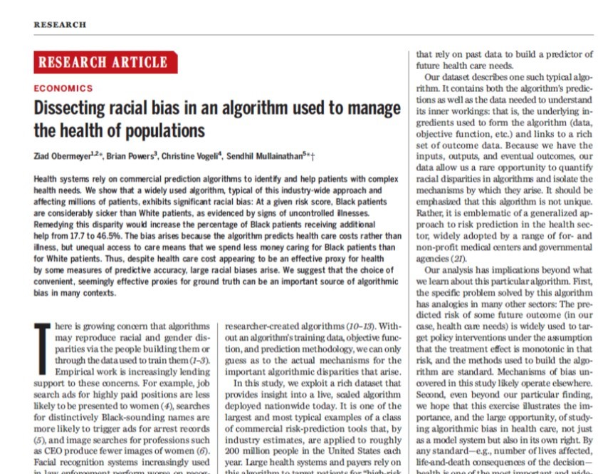
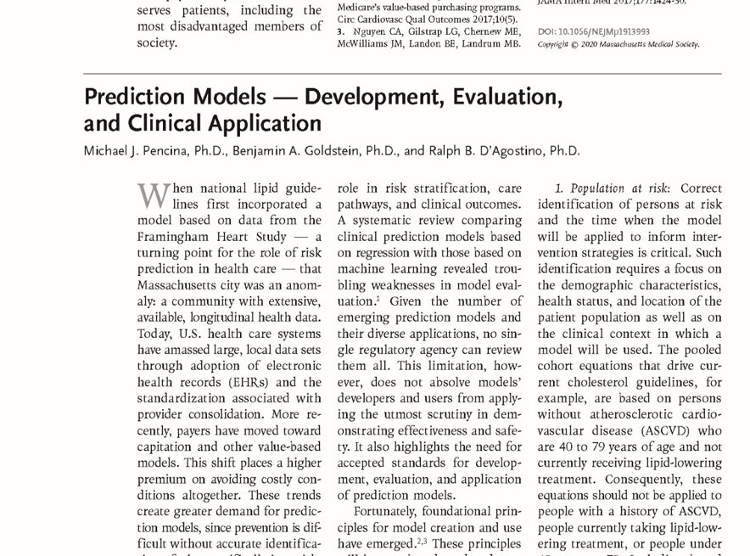
Advanced analytics meets clinical practice
“At a given risk score, Black patients are considerably sicker than White patients, as evidenced by signs of uncontrolled illnesses. Remedying this disparity would increase the percentage of Black patients receiving additional help from 17.7% to 46.5%. The bias arises because the algorithm predicts health care costs rather than illness…”
“Given the number of emerging prediction models and their diverse applications, no single regulatory agency can review them all. This limitation, however, does not absolve models’ developers and users from applying the utmost scrutiny in demonstrating effectiveness and safety.”

Slide 3
Principles
Consideration | Comment
1. Population at risk | Identify individuals at risk to whom the model will be applied, based on demographics, health status, location and clinical context
2. Outcome of interest | Use well-curated data, with outcomes that reflect the primary focus of care
3. Time horizon | Starting point and duration of follow-up should align with goals of interventions
4. Predictors | Decisions on choice and number of predictors factor: ease and time of collection, unbiasedness, model stability, interpretation
5. Mathematical Model | Balance performance with ability to understand, implement and maintain the model. Burden of proof placed on the more complex models. Be transparent and avoid black-box solutions.
6. Model Evaluation | Rigorously evaluate the model on data different from that used for development and collected in a setting that mirrors clinical application
7. Clinical Decision Support | To translate model into CDS, determine intended use and what should be displayed. Separate evaluation of the CDS is necessary, including comparison with current practice (ideally randomized)
8. Clinical Implementation | Requires incorporation into clinical workflows with training, performance engineering, monitoring and updating when necessary.

Slide 4
Medical device regulatory approval
Pre-Clinical
Pivotal
Post-marketing surveillance
Pilot
IDE approval
to move to trial
NDA approval
to market
Notes:
In envisioning an effective framework for our needs, we kept some other benchmarks in mind.
The idea of “software is a medical device” is an essential perspective in the FDA’s regulatory environment. Much of the CDS universe is considered a device under the 21st Century Cures Act.
The approval sequence for more traditional devices is instructive for this reason. It involves of progression of studies with key checkpoints at which results and proposed metrics are considered.

Slide 5
Process for Duke Health prediction models
Pre-Clinical
Pivotal
Post-marketing surveillance
Pilot
Retrospective
Prospective (Embedded)
Monitoring
Prospective (Silent)
Development
Feasibility Study (Silent)
Effectiveness Study (Embedded)
Clinical Use
…
Notes:
Keeping our ultimate goal and those key benchmarks in mind, we’ propose this process for evaluating, implementing and maintaining the effectiveness of predictive models within Duke Health. These five phases address:
The need for standards, clarity of ownership, and transparency
A way to prioritize models to be evaluated
The key checkpoints we should insert before taking a model to scale
Ongoing appraisal of these models, which is critical [AGAIN, YOU CAN SAY MORE ABOUT THIS ELEMENT]

Slide 6
Development
Feasibility Study (Silent)
Effectiveness Study (Embedded)
Clinical Use
…

Slide 7
People
REGULATORY
EVALUATION
MONITORING
CLINICAL DECISION SUPPORT EXECUTIVE COMMITTEE
Development
Feasibility Study (Silent)
Effectiveness Study (Embedded)
Clinical Use
…
Notes:
So that’s process.
Let’s talk about the human resources needed to realize that process:
DETAIL ABOUT THE TWO GOVERNING BODIES, THE TWO LEADS, THE EVALUATION TEAMS AND MODEL OPERATORS

Slide 8
Technology
Development
Feasibility Study (Silent)
Effectiveness Study (Embedded)
Clinical Use
CLINICAL DECISION SUPPORT EXECUTIVE COMMITTEE
…
REGISTRATION TOOL
MONITORING TOOL
Notes:
Finally, the process and the people running it will need new supports, specifically a way to manage from initial pre-registration through continuous improvement cycles as well as a way to monitor on an ongoing basis.

Slide 9
Clinical Decision Support Based on Risk Prediction Models

