Slide 1
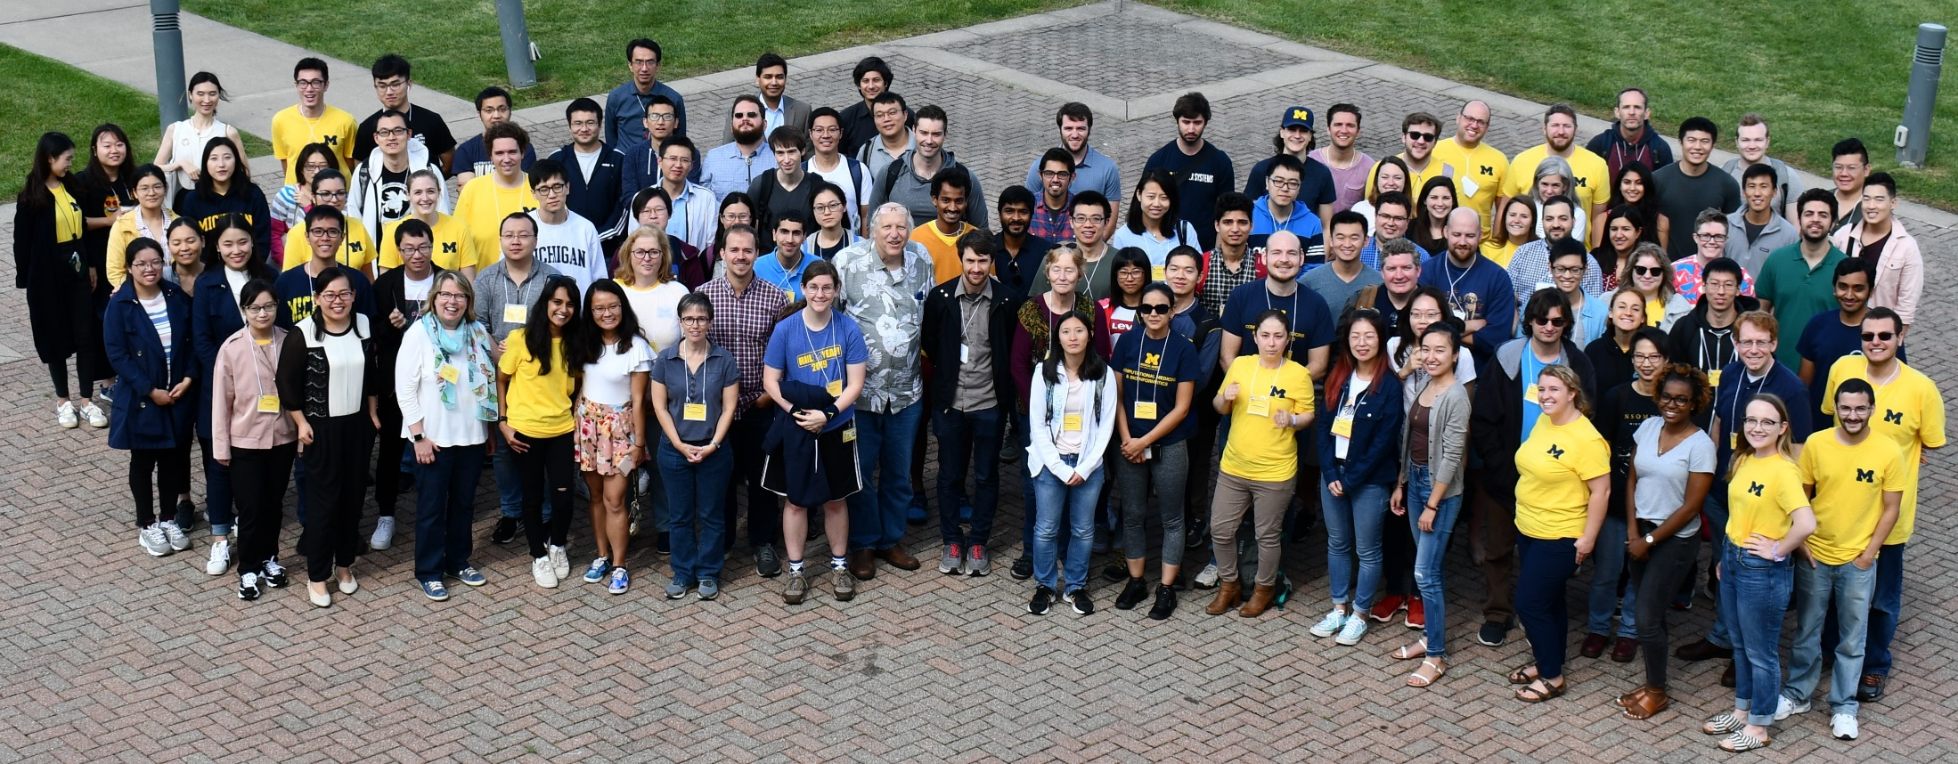
CCMB 2021 Fall Faculty Meeting
Welcome!
Group photo from 2019 DCMB Annual Retreat.

Slide 2
CCMB 2021 Fall Faculty Meeting Agenda
11:00 am to 11:05 am | Welcome to the next academic year during the continuing pandemic (Gil and Brian) a. Introduce CCMB-EC (Slide #3) b. Newsletter c. Webpage
11:05 am to 11:15 am | Introduction of new CCMB faculty from 2019, 2020, and 2021 (Gil and Brian) a. Clowney, Josie (eff. 1/15/2020) b. Gagnon-Bartsch, Johann (eff. 11/10/2020) c. Heemskerk, Idse (eff. 7/25/2019) d. Koutra, Danai (eff. 7/19/2019) e. Noll, Doug (eff. 8/23/2021) f. Rao, Rajesh (eff. 8/24/2020) g. Regier, Jeffrey (eff. 1/28/2020) h. Shi, Xu (eff. 1/15/2020) i. Srinivasan, Ashok (eff. 7/27/2020) j. Stidham, Ryan (eff. 12/3/2020) k. Vydiswaran, Vinod (eff. 5/7/2021) l. Ward, Kevin (eff. 8/25/2020) m. Wilson, Thomas E. (eff. 12/20/2019)
11:15 am to 11:25 am | Update on the growth and productivity of our education programs: PhD, MS, BA/MS, MS/PhD, dual degrees (Maureen, Margit, and Julia)
11:25 am to 11:37 am | 2020-2021 PhD graduates (photos, primary mentors, thesis title, next position, CCMB affiliate faculty who served on thesis committees) (Maureen, Margit, and Julia)
11:40am to 11:50 am | Highlights of DCMB/CCMB leadership in MIDAS (Kayvan and Ivo)
11:50 am to 12:00 pm | Wrap-Up (Gil and Brian)

Slide 3
DCMB Faculty Headcount by Category
DCMB Primary (all instructional track in DCMB) 19
DCMB Joint Faculty 18
DCMB Research (Research Scientists, Research 8 Professors, and Research Investigators
DCMB Adjunct 1
CCMB Affiliate 123

Slide 4
CCMB Executive Committee
Gil Omenn, CCMB Director
Brian Athey, DCMB Chair
Mary Freer, DCMB Administrator
Chuck Burant, Internal Medicine/Taubman Ctr
Margit Burmeister, Psychiatry/Human Genetics
Matthias Kretzler, Internal Med/Nephrology
Jun Li, Human Genetics
Alexey Nesvizhskii, Pathology
Evan Snitkin, Microbiology & Immunology
Liz Speliotes, Internal Med/Gastroenterology

Slide 5
Recently Appointed CCMB Affiliate Faculty
Those who joined between Aug 2019 – Aug 2020:
Clowney, Josie (eff. 1/15/2020)
Heemskerk, Idse (eff. 7/25/2019)
Koutra, Danai (eff. 7/19/2019)
Regier, Jeffrey (eff. 1/28/2020)
Shi, Xu (eff. 1/15/2020)
Srinivasan, Ashok (eff. 7/27/2020)
Wilson, Thomas E. (eff. 12/20/2019) *
New CCMB faculty members since August 2020:
Gagnon-Bartsch, Johann (eff. 11/10/2020)
Noll, Doug (eff. 8/23/2021)
Rao, Rajesh (eff. 8/24/2020)
Stidham, Ryan (eff. 12/3/2020) *
Vydiswaran, Vinod (eff. 5/7/2021)
Ward, Kevin (eff. 8/25/2020)
*Already presented at weekly DCMB/CCMB seminar
**Scheduled to present at weekly DCMB/CCMB seminar

Slide 6
New CCMB Affiliate Faculty (2019-2021)

Slide 7
New CCMB Affiliate Faculty (2019-2021)

Slide 8
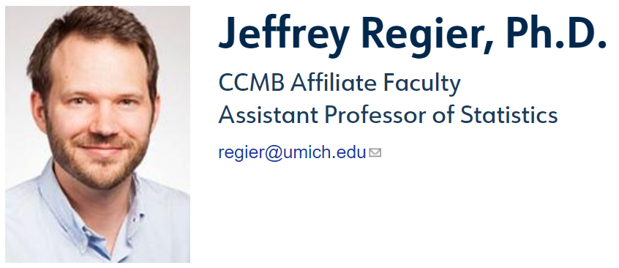
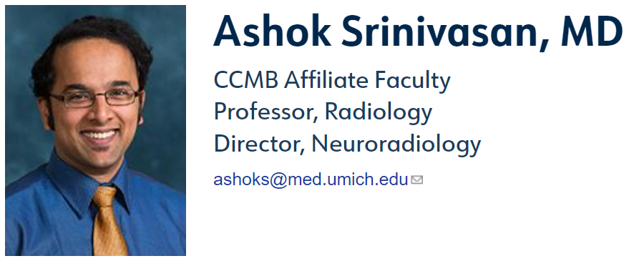
New CCMB Affiliate Faculty (2019-2021)

Slide 9
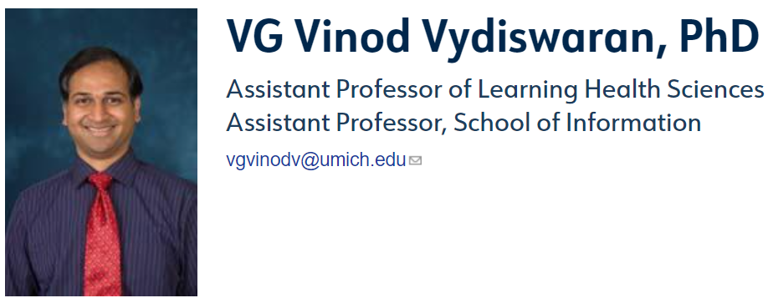
New CCMB Affiliate Faculty (2019-2021)

Slide 10
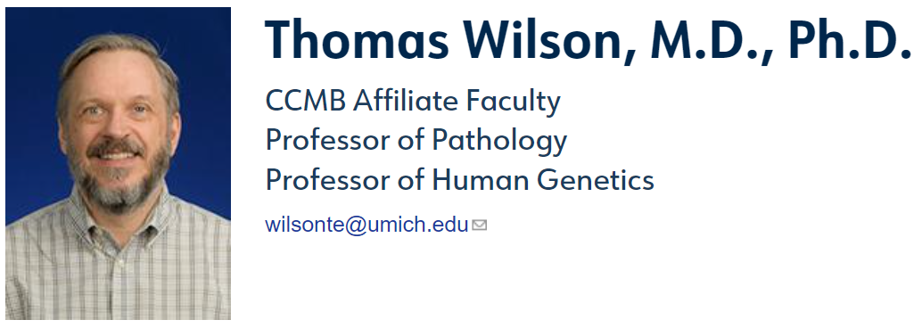
New CCMB Affiliate Faculty (2019-2021)

Slide 11
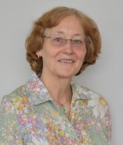
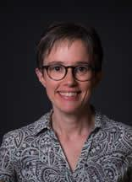
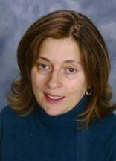
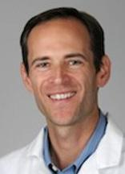
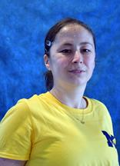
Incoming students!
Bioinformatics Grad Program Leadership
Directors:
Margit Burmeister Maureen Sartor
Director of Masters Program
Alla Karnovsky
Master’s advisors
Stephen Guest Cristina Mitrea

Slide 12
Fall 2021 Ph.D. and PIBS Incoming Class
We have the largest ever incoming PhD cohort this year!
12 incoming PIBS Bioinformatics students
7 Direct admit Bioinformatics students (including two MSTP)
8 students transitioned from MS to PhD

Slide 13
Fall 2021 M.S. Incoming Class
9 incoming Master’s students
7 incoming AMDP (Accelerated Master’s Degree Program) students
Each year we have more students accepted into our embedded MS program (often getting their PhD in a PIBS or engineering field). This year we have ~20-25.

Slide 14
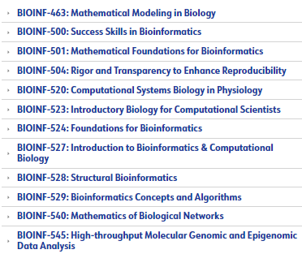
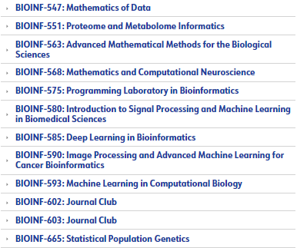
List of Classes

Slide 15
BIDS T32 - New This Year!
8 slots each year
Collaboration between BGP and MIDAS
Director:
Ivo Dinov
Co-Director: Maureen Sartor

Slide 16
Bioinformatics Stats from Rackham
https://tableau.dsc.umich.edu/t/UM-Public/views/RackhamDoctoralProgramStatistics/

Slide 17
2020-2021 Graduates
We’ve had more Bioinformatics PhD graduates this year than ever before!
PhD alumni
In 2020-2021 17 PhD students defended their dissertations
A total of 114 PhD students have completed the program
Master’s alumni
In 2020-2021 27 MS degrees were completed
Includes MS students, AMDP students, PhD students who also obtained a Bioinformatics Master’s during their studies
A total of 76 Master’s Program alumni, 13 AMDP alumni, 23 dual degree alumni

Slide 18
Ph.D. Graduates 2020 - 2021
Shengcheng Dong Advisor: Alan Boyle
Employment
Research Fellow, University of Michigan
Marlena Duda Advisors: Danai Koutra, Chandra Sripada
Employment
Postdoctoral Fellow, TRENDS Center
Negar Farzaneh Advisor: Kayvan Najarian
Employment
Research Fellow, University of Michigan
Li Guan Advisors: Michael Boehnke, Laura Scott

Slide 19
Ph.D. Graduates 2020 - 2021
Murchtricia Jones Advisor: Charles Brooks III
Employment
Assistant Professor, Carolina University
Louis Joslyn Advisors: Denise Kirschner, Jennifer Linderman
Employment
Scientist, Genentech
Zena Lapp Advisor: Evan Snitkin
Employment
Postdoctoral Associate, Duke University
Zhi Li Advisor: Kayvan Najarian
Siyu Li Advisor: Maureen Sartor
Employment
Researcher, AstraZeneca

Slide 20
Ph.D. Graduates 2020 - 2021
Stephen Lindsly Advisor: Indika Rajapakse
Employment
Mathworks
Edison Ong Advisor: Oliver He
Employment
Data Scientist, Glaxo Smith Kline
Narathip Reamaroon Advisor: Kayvan Najarian
Employment
Sr. Data Scientist, IDEXX Laboratories
Shriya Sethuraman Advisor: Andrzej Wierzbicki
Employment
Bioinformatics Scientist, Kyverna Therapeutics

Slide 21
Ph.D. Graduates 2020 - 2021
Nguyen (Josh) Vo Advisor: Arul Chinnaiyan
Employment
Research Fellow, University of Michigan
Brooke Wolford Advisors: Michael Boehnke, Cristen Willer
Employment
Postdoctoral Fellow, INTERVENE (EU project)
Yaya Zhai Advisor: Al Hero
Chengxin Zhang Advisor: Yang Zhang
Employment
Postdoctoral Fellow, Yale University

Slide 22
Center for Computational Drug Discovery (C²D²)

Slide 23
What is IUCRC?
Industry–University Cooperative Research Centers (IUCRC)
NSF-IUCRC:
“The IUCRC program generates breakthrough research by enabling close and sustained engagement between industry innovators, world-class academic teams and government agencies.”
There are several such centers and NSF encourages collaborations with other existing IUCRC.

Slide 24
Main Objectives
Addressing Data Challenge
Provide an industry-wide, secure centralized data hub for integration, curation, and sharing of pharmaceutical and patient data
Addressing AI/ML Algorithm Challenge
Develop, test, and validate advanced artificial intelligence and machine learning methods for drug discovery

Slide 25
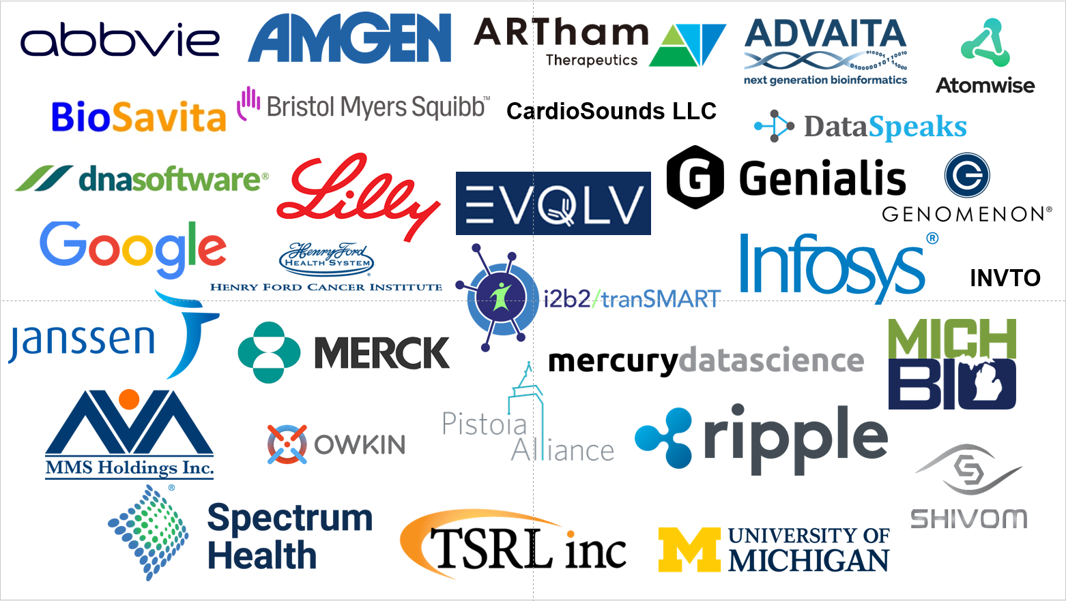
Welcome to The planning session!

Slide 26
Data Science for Biomedical Scientists Training Program

Slide 27
Goals
Introduce mains concepts in machine learning
Practice coding machine learning in Python
Present some ideas on how data science is often used in medicine and biology
Discuss how a clinical / biomedical career path can be enhanced using data sciences
Give some examples of successful inclusion of data science in career plans

Slide 28
Big Picture
A program to better introduce data science to biomedical scientists, with three components:
Workshop (Winter 2021)
Bootcamp (Summer 2021)
Follow-up meetings (Fall 2021)
Although the program was designed to help primarily researchers in biomedical sciences, the intention is to attempt to enhance the program to help other disciplines in the future

Slide 29
Participants
We had over 170 requests to participate in the bootcamp but unfortunately, we had planned the bootcamp for about 30 people
We ended up accepting about 50 participants out of 170
Priority was given to faculty
If successful, the training program will be repeated each year, hopefully accommodating more people

Slide 30
Contact Information
Kayvan Najarian E-mail: kayvan@med.umich.edu Web: http://www.najarianlab.ccmb.med.umich.edu

Slide 31
Examples of Recent CCMB/DCMB, MIDAS & Partners
R&D and Education Activities
Bridge2AI
New Team of Investigators from MIDAS/UM, USC, Utah, UCI and Purdue Proposes to develop unique NS Infrastructure –
ENAST – Enabling Neuroscience Across Space and Time in Health and Disease. This is the ENAST Program Outline
Interested? Contact (Ivo, Jag and Danai)

Slide 32
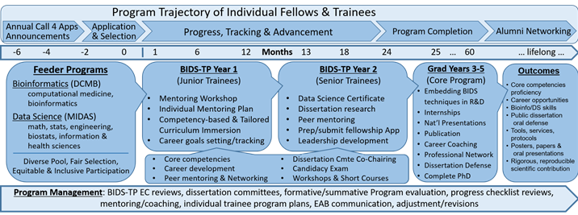
Examples of recent CCMB/DCMB, MIDAS & Partners
R&D and Education Activities
Biomedical Informatics and Data Science Training Program
(BIDS-TP)
New T32 TP launched Fall 2021, Annually 8-funded Fellows + 5-8 Trainees (independently supported), 1-2 year appointments.
Looking for BIDS-TP Mentors (https://bids-tp.umich.edu/faculty-mentors) & Nominees for Fall 2022 (https://bids-tp.umich.edu/fellows-and-trainees)
Interested? See Website: https://bids-tp.umich.edu | Contact (Ivo, Maureen)

