Slide 1


The Vanderbilt LHS Platform:
Learning from what we do, doing what we learn
Kevin B. Johnson, MD, MS
Cornelius Vanderbilt Professor and Chair
Department of Biomedical Informatics
Professor of Pediatrics
Informatician-in-Chief
Christopher J. Lindsell, PhD
Professor of Biostatistics and Biomedical Informatics
President, Association for Clinical and Translational Science
Co-Director, Center for Health Data Science
Notes:
Dr. Kevin Johnson, Chair of the Department of Biomedical Informatics at Vanderbilt University Medical Center, will discuss how Vanderbilt is developing a pipeline to connect their successful EHR-based CDS, ordersets, and forms modalities with their LHS to conduct pragmatic effectiveness trials. That pipeline takes advantage of their CTSA Studio Program9 to shape research ideas into hybrid designs10. These studios inform the next step, EHR-powered research workshops, designed to assess the feasibility of implementing the study design within the constraints of the EHR or the existing clinician-EHR workflow. Dr. Johnson will showcase a number of examples, including smoking cessation, pediatric obesity management, and genome-informed pharmacotherapy.

Slide 2
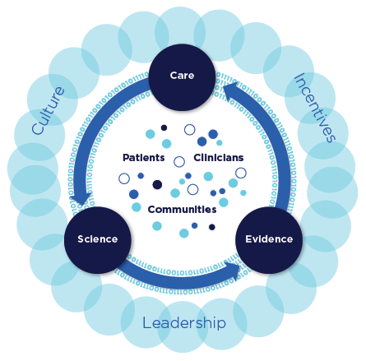
THE BIG PICTURE:
Bridging the gap between research and care
A MORE PRACTICAL APPROACH
Pragmatic clinical trials—practical studies of our own healthcare system that are done quickly with relevance and applicability to everyday practice
THE PAYOFF
Health care systems, providers, and patients are all engaged and all benefit by partnering in pragmatic clinical research
IOM 2013

Slide 3
The learning cycle
T1
T2
T3
Practice
Research
Personalized medicine
Predictive analytics
Operations
Quality
D
A
T
A

Slide 4
The learning cycle
T1
T2
T3
Practice
Research
Personalized medicine
Predictive analytics
Operations
Quality
D
A
T
A

Slide 5
Using data to inform practice - AVAIL

Slide 6
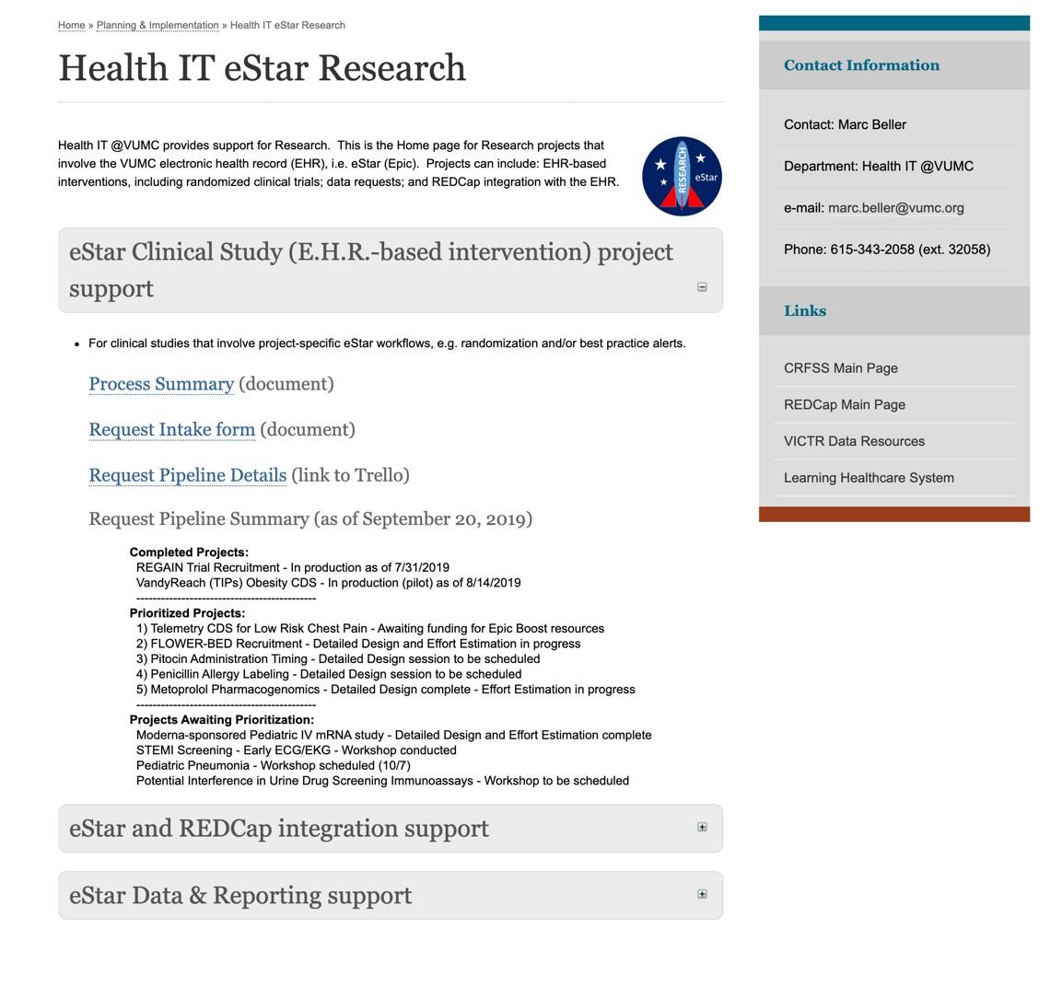
Research Portfolio

Slide 7
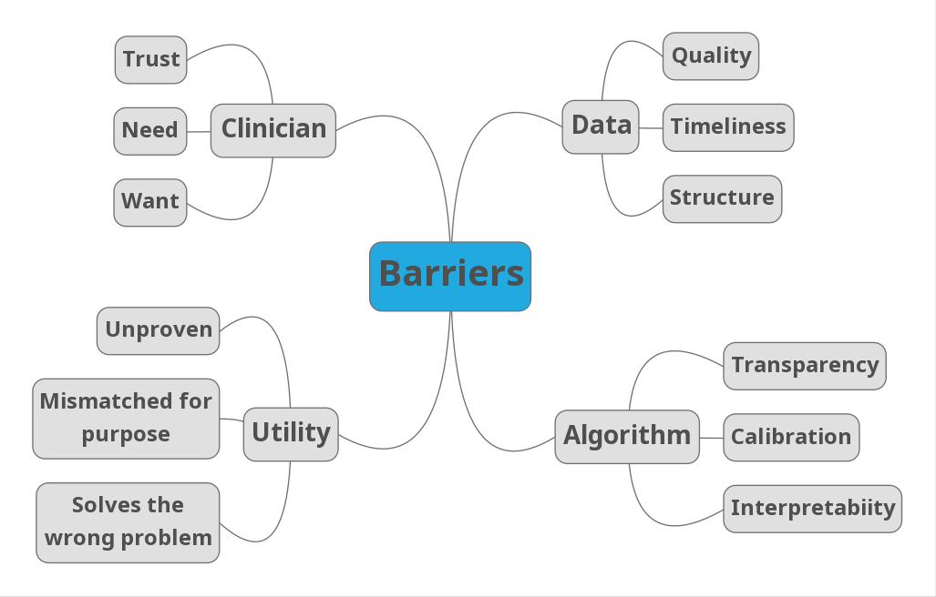

Slide 8
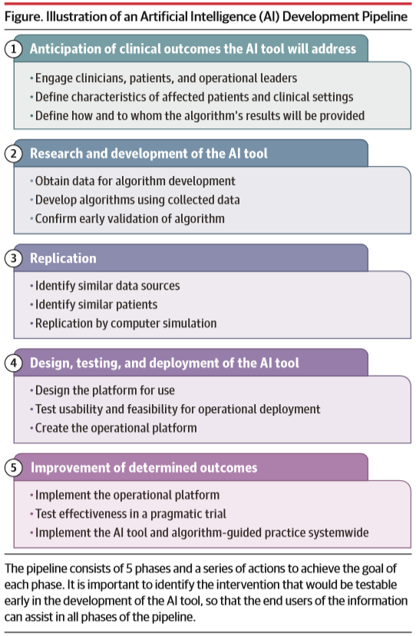
Lindsell CJ, Stead W, Johnson KB. JAMA 2020; 323(21):2141-2142

Slide 9
AVAIL Program Structure
DRAFT
Program Mission
AVAIL will explore all possible artificial intelligence opportunities, evaluate and effectively implement selected options in appropriate applications to further the VUMC mission and pillar goals.
Program Vision
VUMC will be regarded as an industry leader in artificial intelligence integration to augment operational efforts and improve patient experience, clinical outcomes and resource utilization to maximize the value presented to all VUMC constituents; most importantly, the patient.
Program Scope
AVAIL will review all programs designed to augment human decision making processes which utilize linear regression, logistic regression or any other advanced modeling technique within the VUMC enterprise.

Slide 10
AVAIL Program Leadership
Accountable
W. Sandberg R. Omary K. Johnson
Supportive
R. Starnes (PMO)
M. Sexton (OI)
Steering Committee
VUAH
J. Wanderer, SME
R. Steaban, CNO
MCJCH
Designated Representatives
VPH
Designated Representatives
VMG
Designated Representatives
Informed
S. McCarver
T. Nantais
M. Rush
J. Norton
W. Pinson
Enterprise
G. Bernard D. Byrne H. Domenico B. Stead N. Patel
B. Rothman B. Carlson J. Smith P. Shave
Cornelius Readmission Score Project
Project 2 Leadership Group
Project 3 Leadership Group

Slide 11
Project Progression
Project List
Cornelius PAC Score
Cornelius Readmission Score
CT-FFR
Predictive Discharge
Cardiac Surgery LOS Predictor
Inpatient Bed Capacity Management
Nurse Turnover Predictor
Fall Risk Assessment
PROM (Patient Reported Outcome Measures)
Suicide Risk Prediction
OB LOS Prediction
Prenatal Encephalopathy Prediction
Pre-term Birth Prediction
24 Hour Fragility Index
Acute Kidney Injury Risk Prediction
Lung Cancer Prediction
Precision Phenotyping Of Social And Behavioral Determinants Of Health From The Electronic Health Record
Cancer Patient Safety Learning Lab (Capsll)
ImageVU
RadX
LiverAI
Center For Computational Imaging
Word Cloud
Adherence Prediction
NASH Progression Prediction
Obesity Subtype Discovery
Heart Failure Subtype Discovery
ANA Progression Prediction
IPN Outcome Prediction
All Phenotype Discovery
ChartViz
VICC Template Optimization
Cornelius End Of Life Discussion Needed
Cornelius Pressure Ulcers
Cornelius Reintubation Risk
Cornelius Sepsis
Cornelius AKI
Cornelius Septic Shock
Cornelius Date Of Discharge, Long Hospital Stay
Cornelius Multiple Myeloma
Cornelius STEMI
Cornelius Patient Fall Risk
Research and Development
Obtain Research Data
Develop Algorithms
Replicate
Define Characteristics of Patterns & Clinical Settings
Identify Like Patients
Design, Test & Deploy
Design the Deployment Platform
Test Usability & Feasibility for Operational Deployment
Early Validation
“Replicate” in silico
Create Operational Deployment Platform
Improve The Outcome
Implement Operational Deployment Platform
Pragmatic Trial
Implement Algorithm-Guided Practice System Wide
1
2

Slide 12
The learning cycle
Pragmatic trial focus
T1
T2
T3
Practice
Research
Personalized medicine
Predictive analytics
Operations
Quality
D
A
T
A

Slide 13
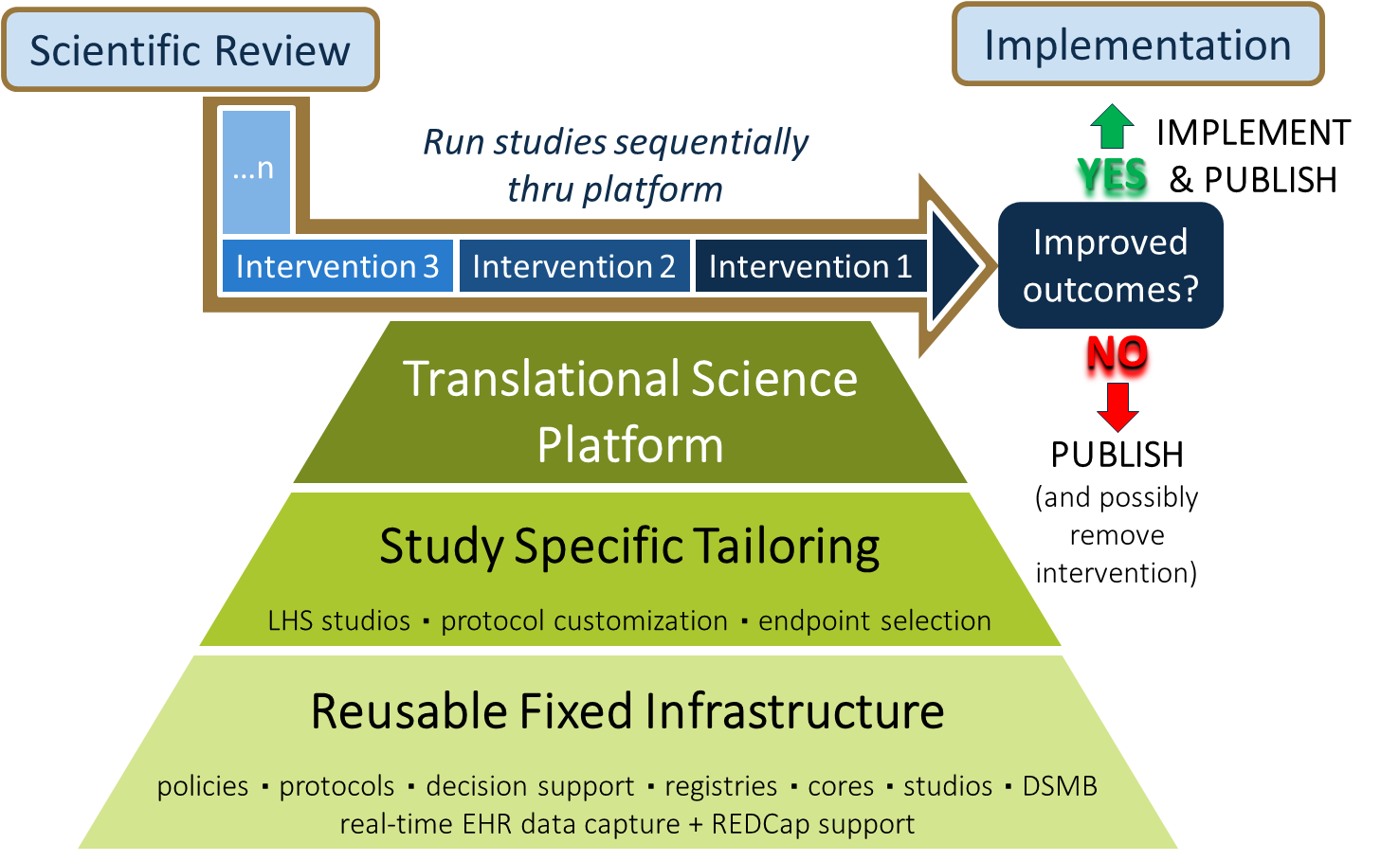

The LHS Platform Approach

Slide 14
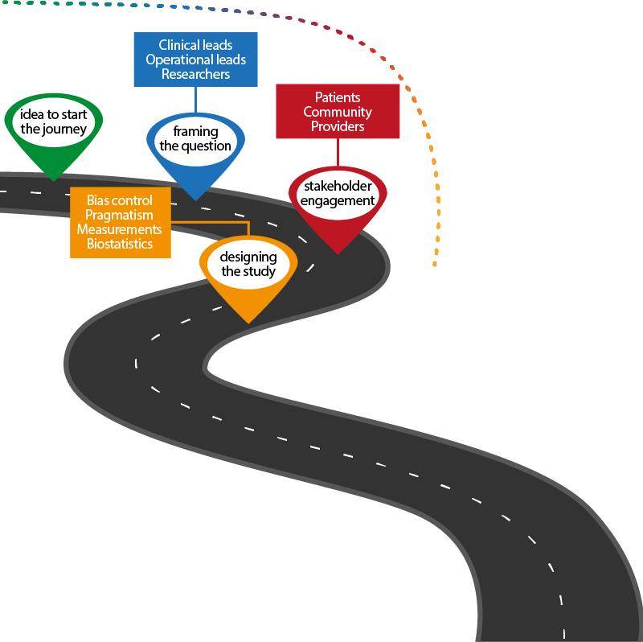
LHS discussion and brainstorming with pragmatic focus
Identification of collaborators
Literature/data review
Clinical trial design
Selection of appropriate endpoints
Regulatory considerations and guidance
Connection to other services as appropriate
Goal: executive summary

Slide 15
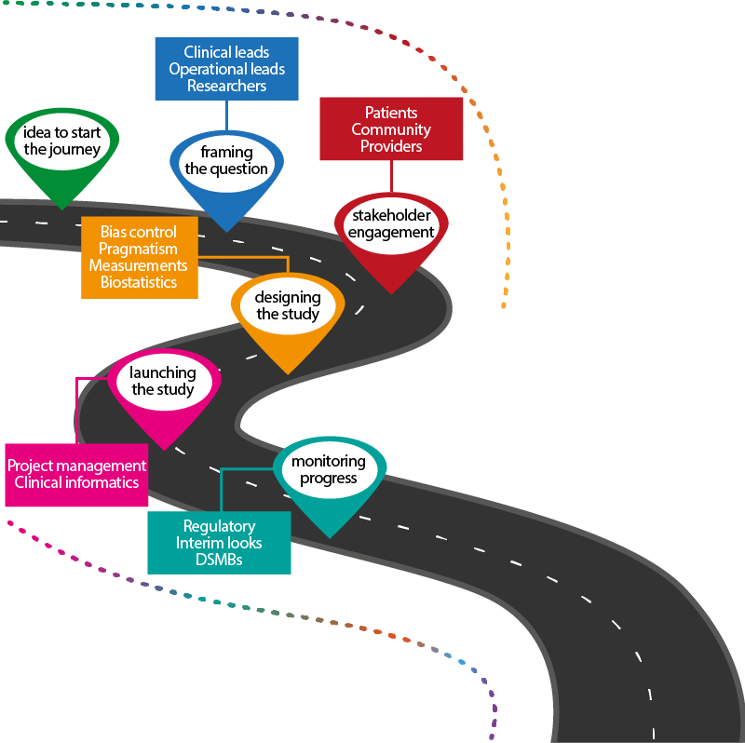
Project management
Core engagement
Studios
Recruitment/Consent elements
Protocol/SOP/IRB drafting
Statistical analysis plan
DSMB
clincialtrials.gov registration
Informatics consults
Data management and IT processes
Goal: protocol and study operational plan in motion

Slide 16
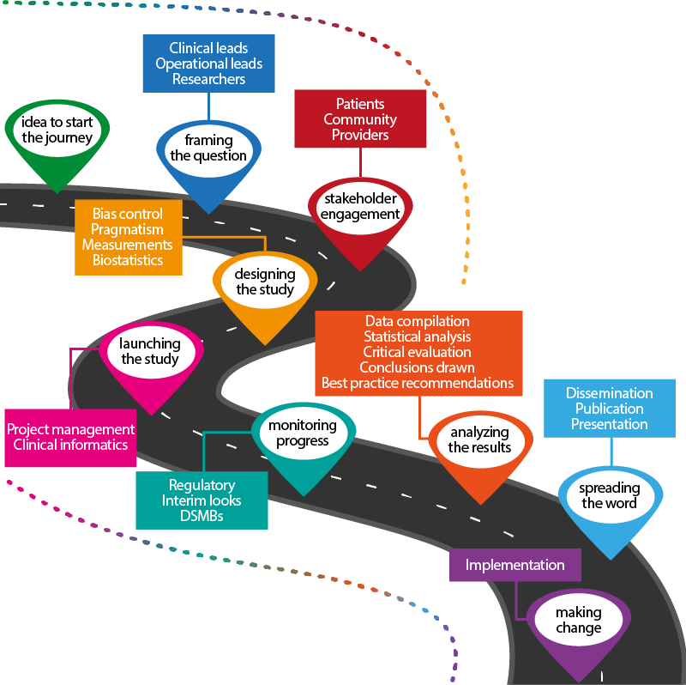
Data management support
Statistical analysis
Manuscript development
Dissemination Team engagement
Drafting and execution of dissemination plan
Advice on implementation?
Goal: robust, disseminated answer sufficient to
guide decision to
implement/de-implement

Slide 17
updated July 2020

Slide 18
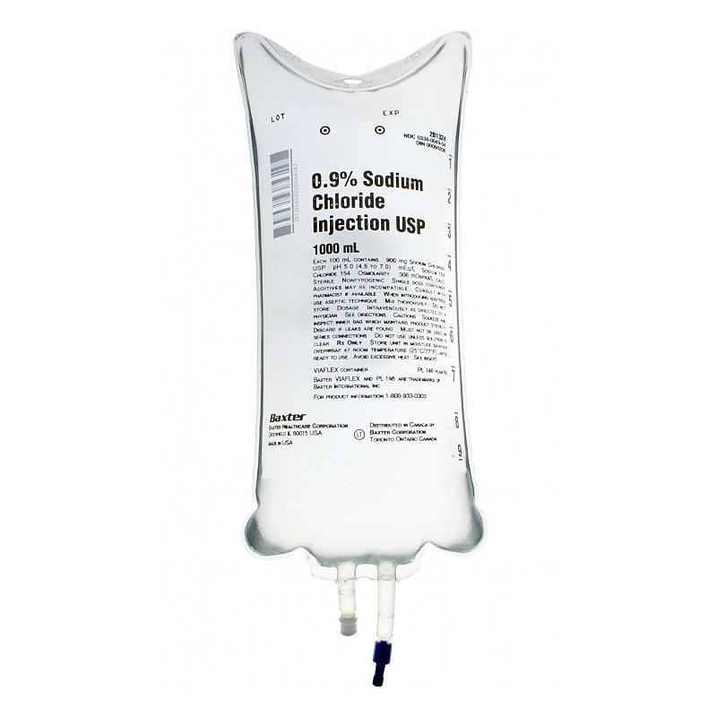
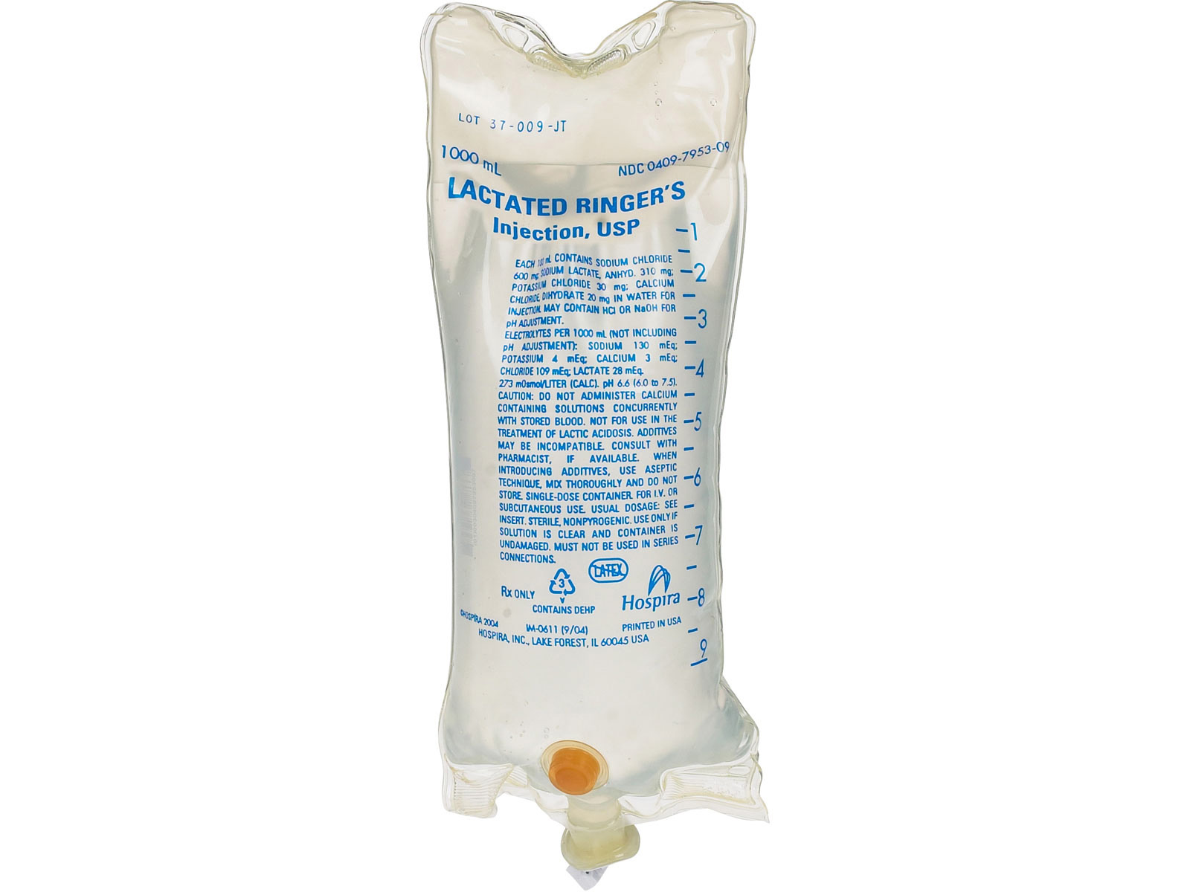
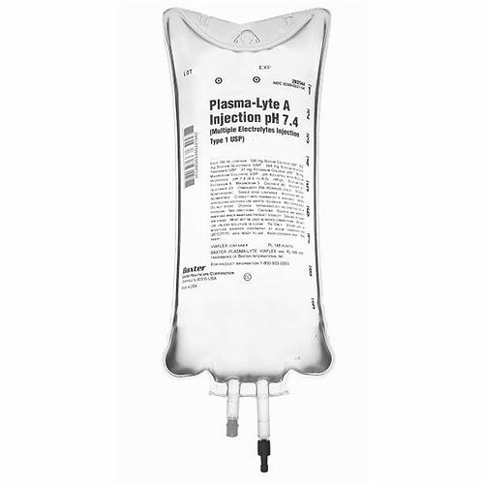
Ideation and Developing
Suicide Prevention CDS
Telehealth and Endo
Pediatric Blood Draws
SeQuEL
PROMS Neuro
Predictive Mortality Model
VDAT
Gestational Diabetes
LHS-Approved and Refining
Ketamine: Opioid Reduction
ATAP Weight Gain in ASD
Mobility Tech
Virtual Sitters
PALeR
Peds VTE
Phenotype Risk Scores
2° SMART-SAH
2° SMART-Trauma
Active and/or Near Launch
ICE-CAP – Peds Pneumonia
PILLAR: Benefits and Inhalers
Penicillin Allergy Labels
Addiction Bridge Clinic
COVID-19 Positioning
Trial Completed – Next Steps
SMART/SALT-ED
FUTR-30: Post-Discharge Phone Calls
AKI Model – Peds
COMPASS
ICU Recovery
CONTACT-PILOT
PROPER – Vent Support
2° SMART-Sepsis
TN DOH – OB Reduction
Chlorhexidine Usage
VSP Adherence
BIT/BERT
QuizTime: LHS Education
Balanced Crystalloids
Saline
-V-

Slide 19
The SMART and SALT-ED Trials
Hypothesis: Balanced crystalloids will result in a lower incidence of death, new RRT, or persistent renal dysfunction than saline.
Small difference could have large public health impact because of common use
Difference between groups is likely small
  Study sample size needs to be very large
Needs to be studied in the context of usual clinical practice – occurring in both areas
Sample size ~28,000 across ED and ICU trials
→ Large pragmatic trial within the LHS

Slide 20
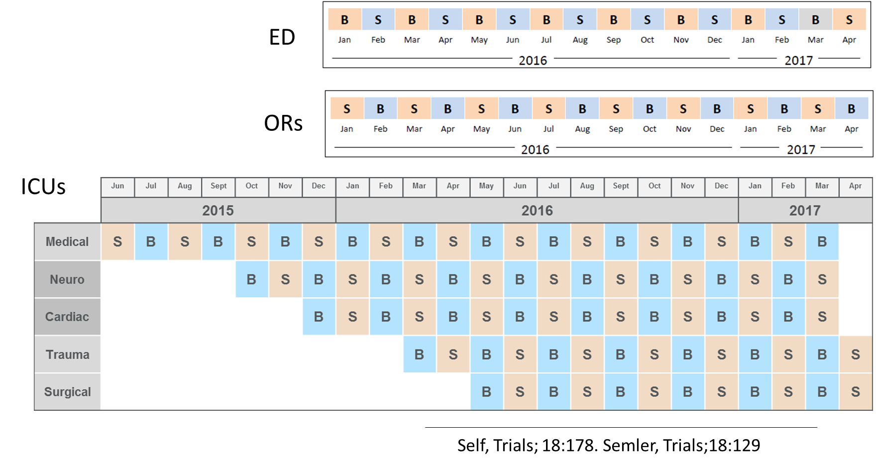
Cluster Multiple Cross Over Design

Slide 21
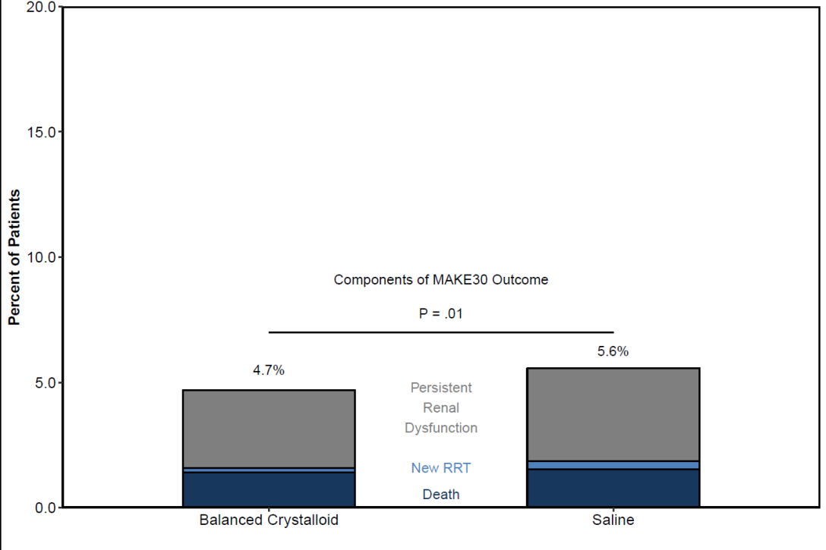

SALT-ED:
Non-critically ill ED adults
Primary Results
SMART (ICU):
Critically ill ICU adults
MAKE30
MAKE30
p = 0.04
15.4%
14.3%
Persist. Renal Dysf
New RRT
p = 0.01
4.7%
5.6%
Persist. Renal Dysf
Death
New RRT
Death
Balanced
Saline
Balanced
Saline
N = 13,347
N = 15,802

Slide 22
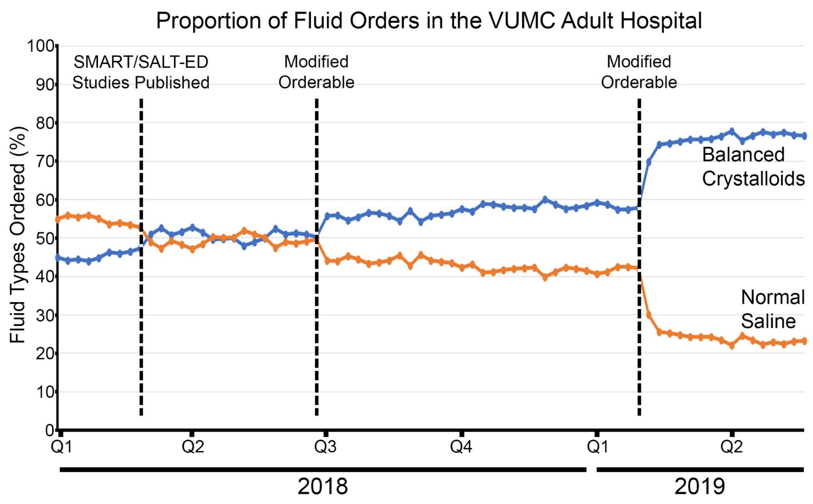
HOSPITAL-WIDE
Quiztime: Incorporating learners into the LHS

Slide 23


Slide 24


