Slide 1

The Learning
Health (Record) System
Philip R.O. Payne, PhD, FACMI, FAMIA
Janet and Bernard Becker Professor and Director, Institute for Informatics
Associate Dean for Health Information and Data Science and Chief Data Scientist
Washington University School of Medicine
Professor of Computer Science and Engineering
Washington University McKelvey School of Engineering
@prpayne5

Slide 2
COI and Disclosures
Research Funding: NLM, NCI, NIA, NCATS, All of Us, AHRQ, Centene Corporation
Academic Consulting: Case Western Reserve University, Cleveland Clinic, Stonybrook University, Geisinger Commonwealth School of Medicine, Indiana University, Regenstrief Institute, Georgetown University
International Partners: Fudan University (China), Clinica Alemana (Chile), Universidad del Desarrollo (Chile), IIT Bombay (India)
Other Consulting/Honoraria: American Medical Informatics Association (AMIA), Geisinger Health System, Roche Diagnostics
Editorial Boards: JAMIA Open (AE), BMC Medical Informatics and Decision Making
Corporate: Signet LLC, Aver, BioSTL/GlobalSTL, Cultivation Capital, aMoon, MDClone, HICAPPS SpA

Slide 3
How do we build a learning health system?
Instrument the care-delivery, laboratory, and everyday environments so that we can generate high-quality, deep phenotypes:
  Bio-molecular
  Imaging
  Clinical
  Behavioral
  Exposome
Improve access to data and analytical tools
Leverage technology to “close the evidence cycle”
Continuously measure, evaluate, and improve at a a systems-level

Slide 4
A “living laboratory” for creating the LHS?

Slide 5
The Electronic Health Record (EHR)
EHRs are real-time, patient-centered records that make information available instantly and securely to authorized users.
An EHR system is built to go beyond standard clinical data collected in a provider’s office and can be inclusive of a broader view of a patient’s care. EHRs can:
  Contain a patient’s medical history, diagnoses, medications, treatment plans, immunization dates, allergies, radiology images, and laboratory and test results
  Allow access to evidence-based tools that providers can use to make decisions about a patient’s care
  Automate and streamline provider workflow
EHRs are built to share information with other health care providers and organizations – such as laboratories, specialists, medical imaging facilities, pharmacies, emergency facilities, and school and workplace clinics – so they contain information from all clinicians involved in a patient’s care.
Source: www.healthit.gov

Slide 6
But wait, is the EHR really capable of being a “living laboratory”?
Workflow and human-factors issues cannot be adequately addressed, therefore we cannot rely on the EHR as a source of useful data
Data privacy and confidentiality concerns make it too difficult to extract data from the EHR for research and innovation purposes
Vendor constraints make it difficult build and deploy digital health interventions within the EHR
IT organizations create too many “roadblocks” to conducting research and innovation that leverages the EHR

Slide 7
Myth #1: workflow and human-factors issues cannot be adequately addressed, therefore we cannot rely on the EHR as a source of useful data

Slide 8
An informatics “tool box” for workflow and human-factors optimization
Time and motion studies
Human-factors and usability evaluation
Cognitive and decision analyses
Iterative user-centered design
Qualitative inquiry
Mixed methods

Slide 9
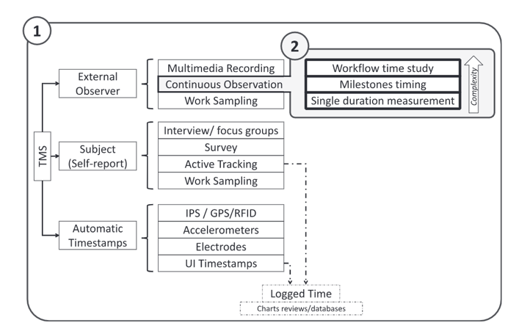
Time and motion studies
Studies on which the duration of an event is one of the variables of interest
  This includes methods via which data collection is based on external observers, self-reports and/or automatic time-stamps
The use of an external observer recording time data continuously
  continuous observation TMS

Slide 10
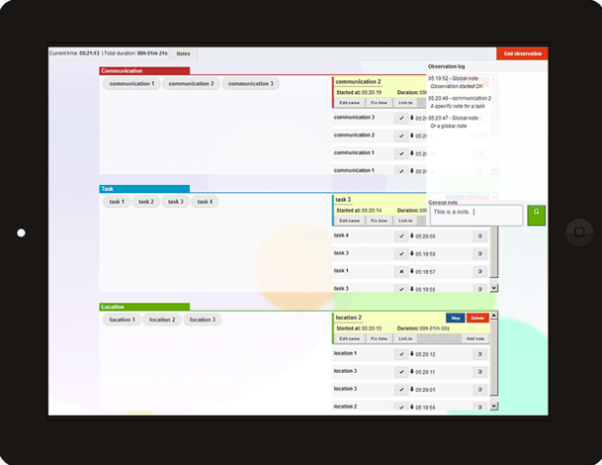
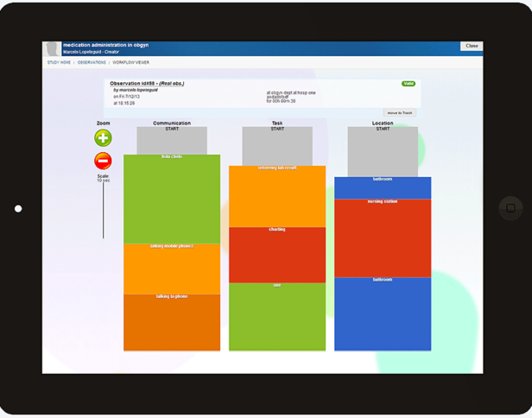
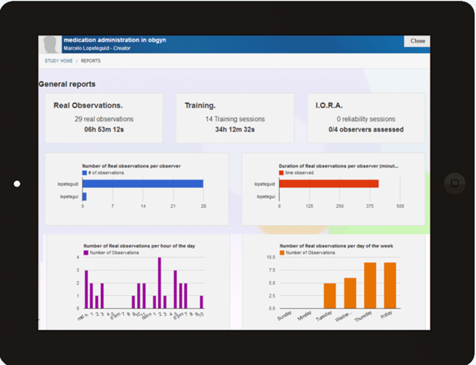
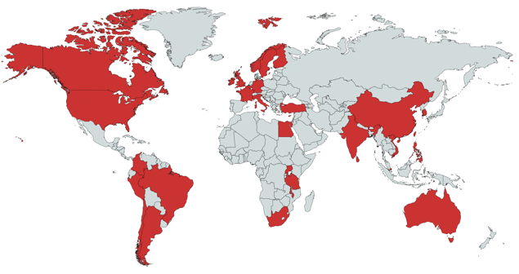
TimeCaT: a scalable TMS tool
Enables multi-observer TMS across sites and environments
Support the measurement of workflows in environments that involve multi-tasking
Assesses inter-observer reliability
Produces real-time reports that facilitate data-driven decision-making
>150 publications citing use of TimeCaT since 2016
Slides adapted from: Marcelo Lopetegui

Slide 11
Myth #2: data privacy and confidentiality concerns make it too difficult to extract data from the EHR for research and innovation purposes

Slide 12
Enabling responsible analyses of clinical data
De-identification (scrubbing)
Synthesis
Federated analytics
Differential privacy

Slide 13
Computational derivation of synthetic data: an abridged version…
Cohort identification
Feature selection
Synthesis
Summary analysis
Export
Sim Patient n
Real Patient 1
Real Patient n
Sim Patient 1
Distribution of
Feature 1
Distribution of
Feature 2
Distribution of
Feature 3
…
Distribution of
Feature n

Slide 14

Training ML algorithms on synthetic data: sepsis pilot study results (temporal prediction, -6h from standard diagnostic criteria)
 |  |  | real-trained | synth-trained
RBF SVM | Train | Accuracy | 0.925 | 0.911
 |  | Precision | 0.95 | 0.925
 |  | Recall | 0.817 | 0.799
 |  | F-Score | 0.879 | 0.858
 | 10-CV | Accuracy | 0.839 | 0.816
 |  | Precision | 0.802 | 0.754
 |  | Recall | 0.704 | 0.666
 |  | F-Score | 0.745 | 0.704
 | Test | Accuracy | 0.846 | 0.841
 |  | Precision | 0.836 | 0.845
 |  | Recall | 0.671 | 0.645
 |  | F-Score | 0.745 | 0.731
Trained on patient data
Tested on patient data
Trained on synthetic data
Tested on patient data
Slides adapted from: Andrew Michelson & Sean Yu

Slide 15
Myth #3: vendor constraints make it difficult build and deploy digital health interventions within the EHR

Slide 16
Instrumenting the EHR for innovation
APIs (FHIR, vendor-specific)
Common data models
Data interchange standards
Combined approaches

Slide 17
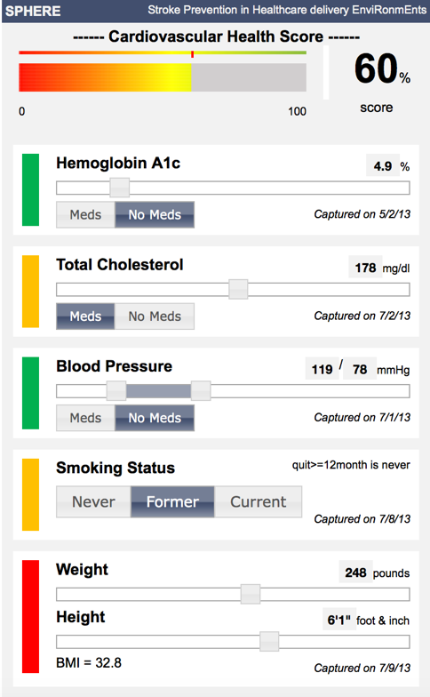
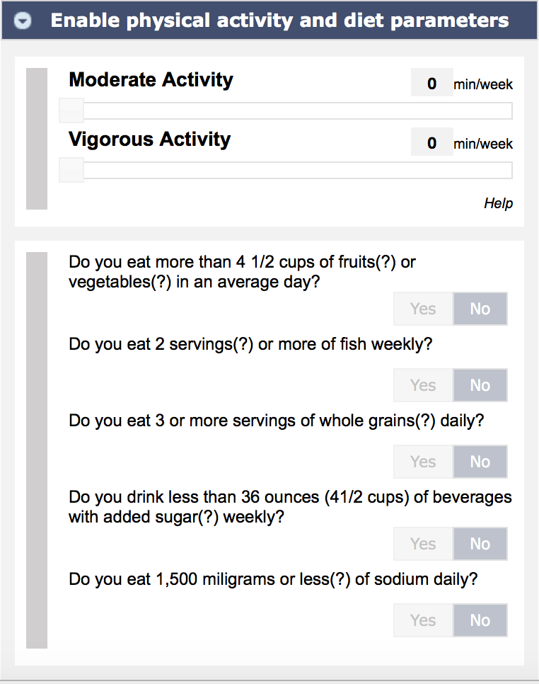
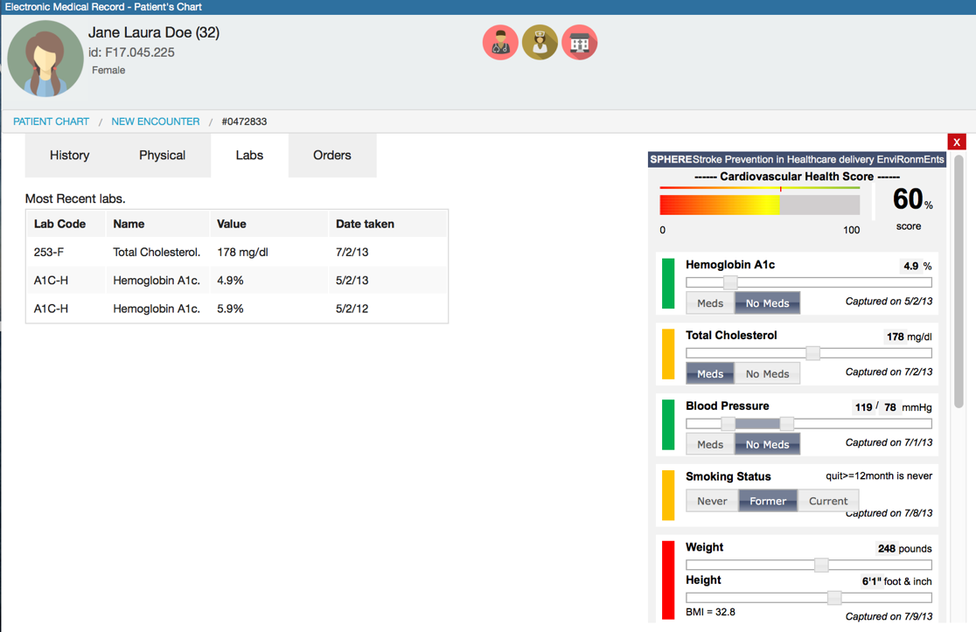
SPHERE CDSS platform (1): embedding decision support and visualization tools in existing EHR workflow
Patient-Centered Decision Making
Interactive Risk Visualization
Slides adapted from: Randi Foraker

Slide 18
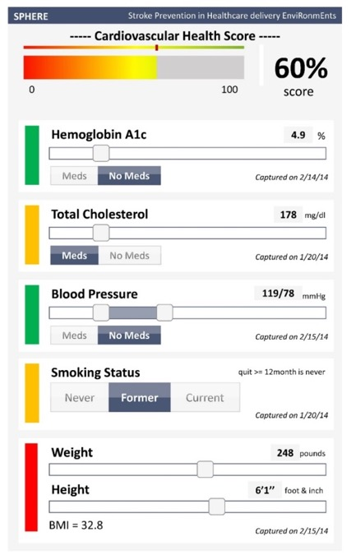
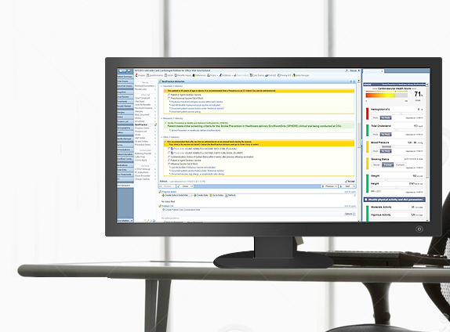
SPHERE CDSS platform (2): user centered design and
tight workflow coupling
Slides adapted from: Randi Foraker

Slide 19
Myth #4: IT organizations create too many “roadblocks” to conducting research and innovation that leverages the EHR

Slide 20
Healthcare IT (HIT)
Research Informatics (RI)
Basic and Pre-Clinical Research
Verification and Validation of New Evidence and Methods
Scaling and Delivery in “Real World” Settings
Optimization and Measurement of Impact
Technology Infrastructure
Data Management
High Performance Computing
Bioinformatics
Translational Bioinformatics
Shared Vision:
Rapid Learning
System(s)
Warehousing
Analytics
Translational Bioinformatics
Clinical Research Informatics
Technology Infrastructure
Applications
Security
Support
Clinical Informatics
Population Health Informatics

Slide 21
How should we focus our efforts in order to achieve this vision of a learning health (record) system?

Slide 22

Philip R.O. Payne, PhD, FACMI, FAMIA
informatics.wustl.edu
prpayne@wustl.edu
@prpayne5

