Slide 1
Machine Learning Applications for Anesthesiology:
Overcoming Hurdles to Clinician Trust and Use
Michael Mathis, M.D.
Assistant Professor of Anesthesiology Affiliated Faculty, Department of Computational Medicine & Bioinformatics
Associate Research Director, Multicenter Perioperative Outcomes Group

Slide 2
Disclosures
I have no personal financial, consulting, or contractual relationships with any vendor.
I am PI or Co-I on research grants:
National Institute of Health – NHLBI
Department of Defense

Slide 3
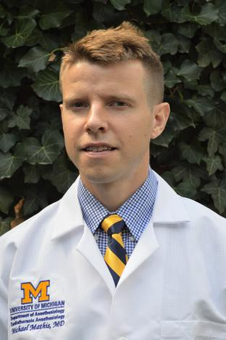
Questions?
Email: mathism@med.umich.edu
@Michael__Mathis

Slide 4
Overview
Set the stage for clinician conversations
Near-future examples of ML/AI that anesthesiologists might conceivably use
ML/AI logistical, social, and ethical dilemmas & what to do about them

Slide 5
Overview
Set the stage for clinician conversations
Near-future examples of ML/AI that anesthesiologists might conceivably use
ML/AI logistical, social, and ethical dilemmas & what to do about them

Slide 6
…first, clarify what you’re talking about:
Types of AI
Reactive AI | Limited Memory | Theory of Mind | Self-aware
Has no memory Task-specific | Past experiences inform future decisions Vulnerable to outliers or new situations | Understands human reasoning Learns with fewer examples, since understands motives / intent | Human-level intelligence that can bypass our own intelligence

Slide 7
…and then clarify what is the goal:
Not:
“Fundamental Theorem” of Biomedical Informatics ¹
Friedman, CP. A “Fundamental Theorem” of Biomedical Informatics. Journal of the American Medical Informatics Association. 2009;16(2):169-170.

Slide 8
…highlight strengths, weaknesses, and opportunities:
 | Machine Learners | Humans
Superpower | Rapid, “unbiased”, accurate predictions | Understand implications of clinical decisions
Fatal Flaw | Lack transparency Lack clinical judgment | High cost, slow

Slide 9
… motivate why clinicians should care:

Slide 10
…and finally, ease anxiety but limit the hype:
Mistakes matter
Consequences are not just annoying, but dangerous
Mistakes by a human preferred to mistakes by computer
Being “right” isn’t enough
…Need to be transparent and justified
Nobody likes to share
(and often can’t, even if we wanted to)

Slide 11
Overview
Set the stage for clinician conversations
Near-future examples of ML/AI that anesthesiologists might conceivably use
ML/AI logistical, social, and ethical dilemmas & what to do about them

Slide 12
Overview
Set the stage for clinician conversations
Near-future examples of ML/AI that anesthesiologists might conceivably use
ML/AI logistical, social, and ethical dilemmas & what to do about them

Slide 13
ML/AI Example: Hypotension Prediction
Hatib F, Jian Z, Buddi S, Lee C, Settels J, Sibert K, Rinehart J, Cannesson M: Machine-learning Algorithm to Predict Hypotension Based on High-fidelity Arterial Pressure Waveform Analysis. Anesthesiology 2018; 129:663–74

Slide 14
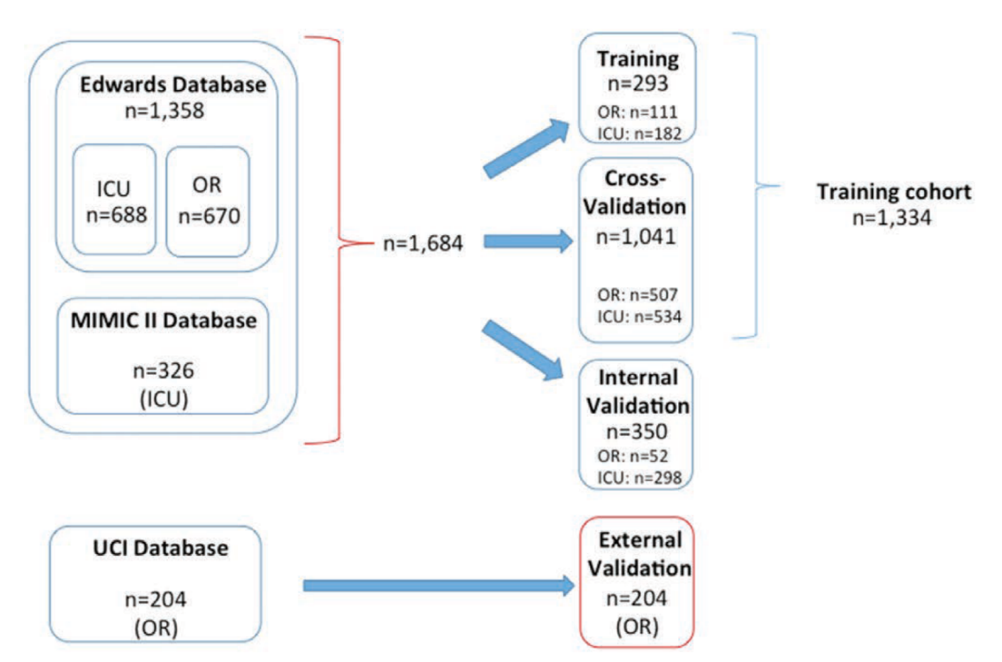
ML/AI Example: Hypotension Prediction
Goal: Use arterial line waveform to predict hypotension 10 minutes prior to event
Dataset: ICU & OR patient data at multiple centers

Slide 15
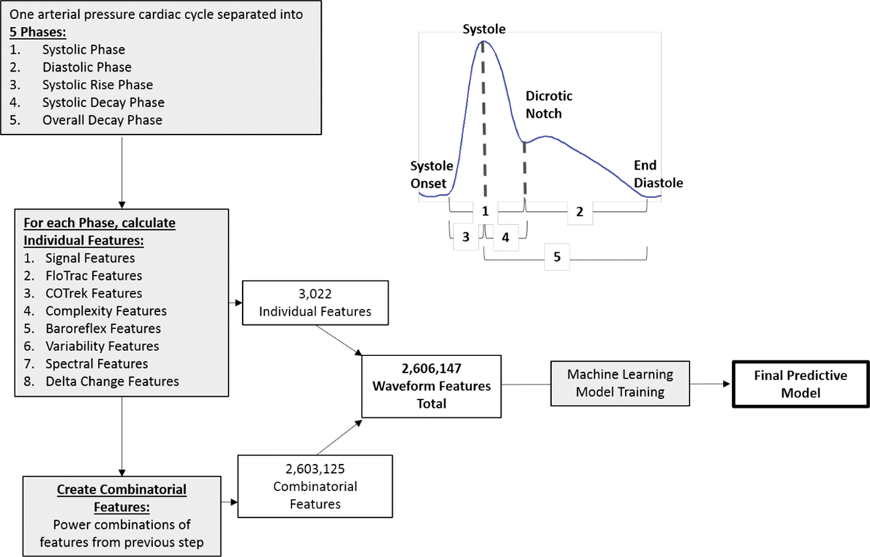
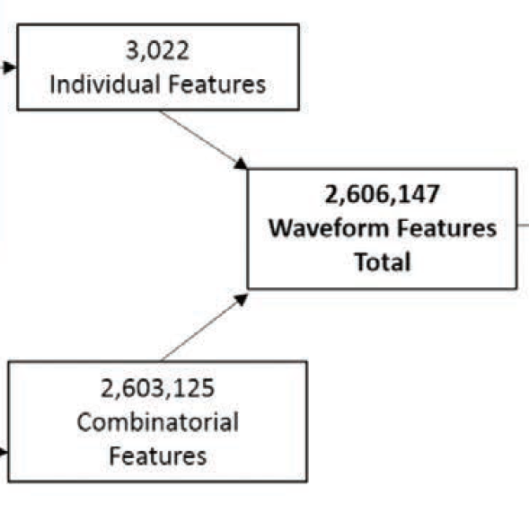
ML/AI Example: Hypotension Prediction
What does an arterial line offer beyond blood pressure?

Slide 16
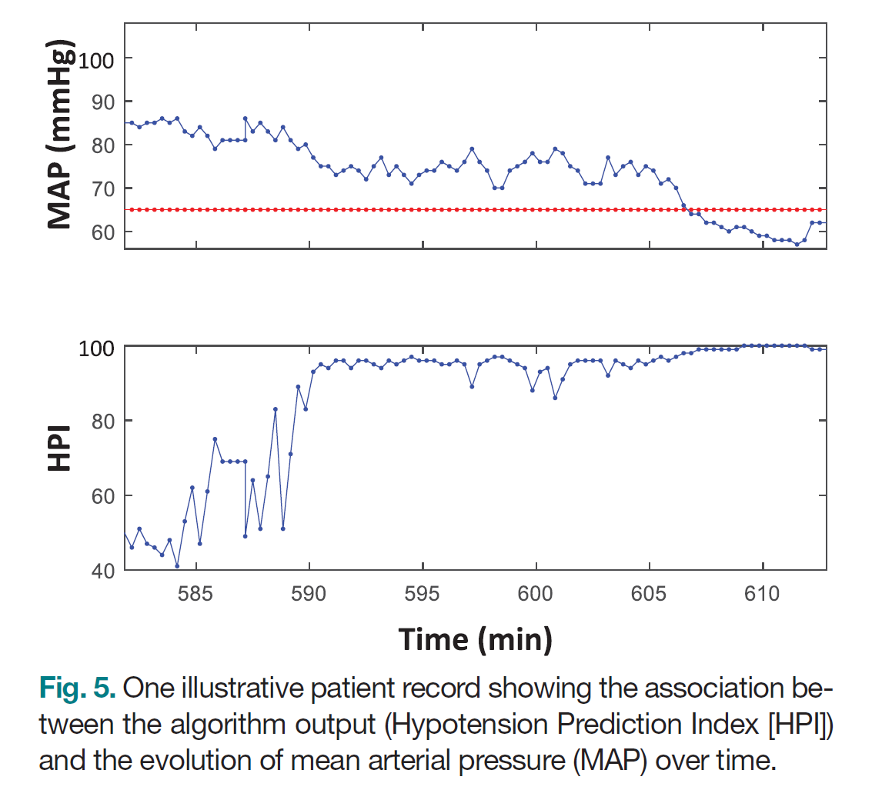
ML/AI Example: Hypotension Prediction
More than meets the eye?

Slide 17
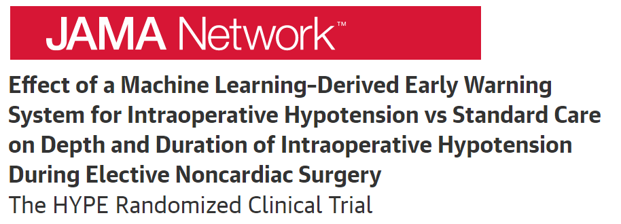
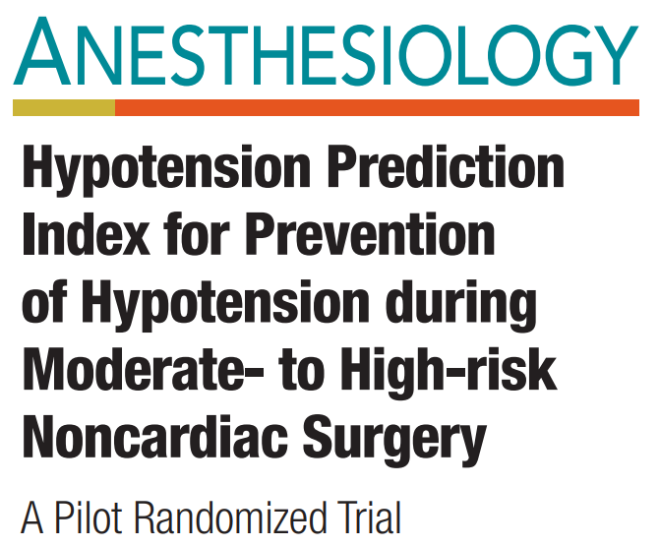
ML/AI Example: Hypotension Prediction
But can it prevent hypotension (or improve outcomes)?
Small, single center studies
ML-based warning systems yielded conflicting results
Further research in large, diverse populations needed to understand generalizability and effect on outcomes
Yes:
No:

Slide 18
Dilemma: AI/ML software clinical implementation
What is the potential for unintended harm… and how closely to regulate?
FDA evaluation steps for Software as a Medical Device (SaMD):

Slide 19
Dilemma: AI/ML software clinical implementation
What is the potential for unintended harm… and how closely to regulate?
FDA evaluation steps for Software as a Medical Device (SaMD):
#1: Association | #2: Analytical Validation | #3: Clinical Validation
Valid clinical association between SaMD output & clinical condition? | Processed inputs generate accurate, reliable, and precise outputs? | Achieves intended purpose in the context of clinical care?
Proposed Regulatory Framework for Modifications to Artificial Intelligence/Machine Learning (AI/ML)- Based Software as a Medical Device. US Food and Drug Administration. 2 April 2019

Slide 20
Dilemma: AI/ML software clinical implementation
Increasing Significance
Increasing Criticality
Proposed Regulatory Framework for Modifications to Artificial Intelligence/Machine Learning (AI/ML)- Based Software as a Medical Device. US Food and Drug Administration. 2 April 2019

Slide 21
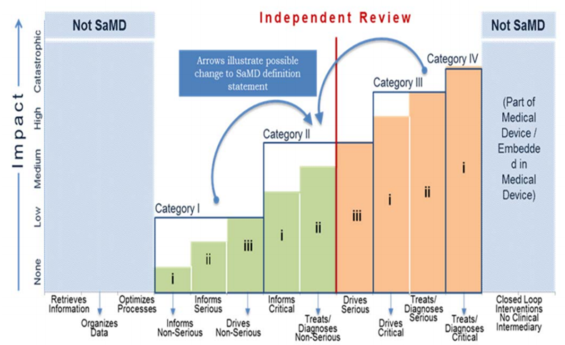
Dilemma: AI/ML software clinical implementation
Increasing Risk

Slide 22
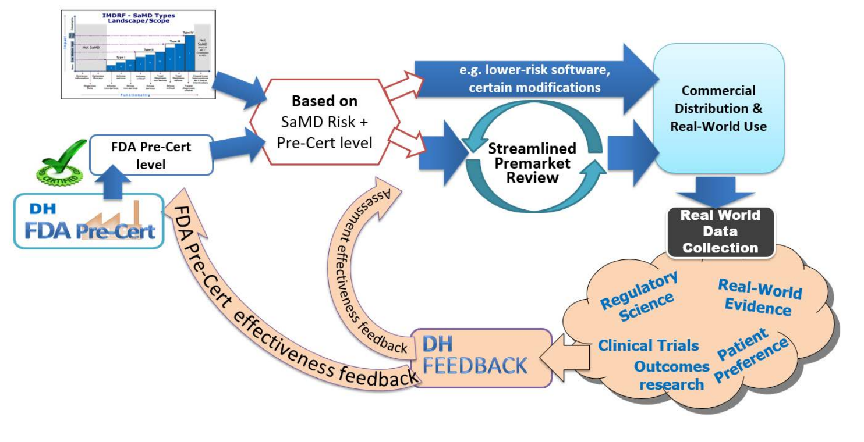
Dilemma: AI/ML software clinical implementation
FDA Pathway for SaMD independent review and certification
2. Review Determination
3. Streamlined
Review
Excellence Appraisal and Pre-Certification
4. Real World
Performance

Slide 23
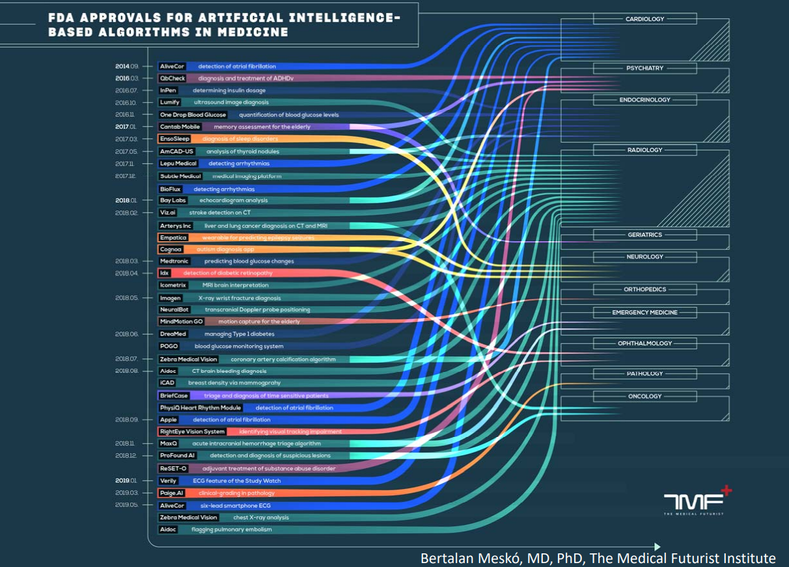
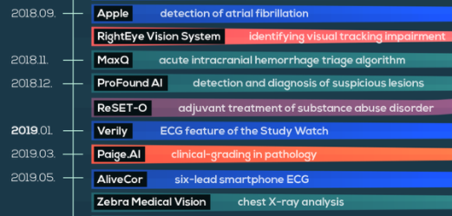
2014
2016
2017
2018
2019

Slide 24
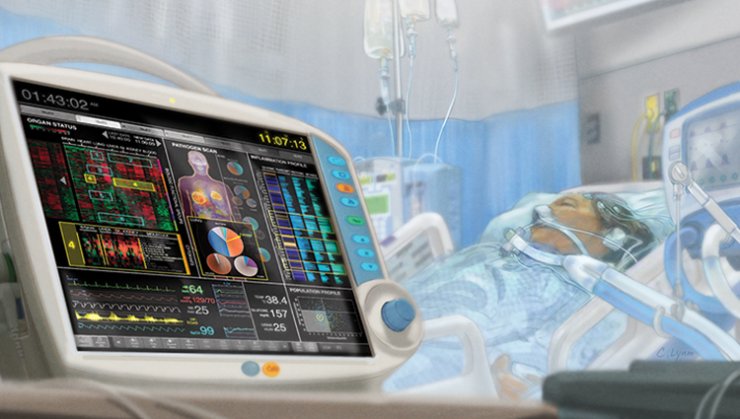
ML/AI example: ICU Deterioration Prediction
Validating a Widely Implemented
Deterioration Index Model Among Hospitalized COVID-19 Patients
Singh K, Valley TS, Tang S, Li BY, Kamran F, Sjoding MW, Wiens J, Otles E, Donnelly JP, Wei MY, McBride JP, Cao J, Penoza C, Ayanian JZ, Nallamothu BK: Validating a Widely Implemented Deterioration Index Model Among Hospitalized COVID-19 Patients. medRxiv 2020 doi:10.1101/2020.04.24.20079012

Slide 25
ML/AI example: ICU Deterioration Prediction
Goal: Early detection of patient deterioration
(ICU transfer, mechanical ventilation, or death)
Cohort: UMich COVID-19 patients admitted to non-ICU
Data Collected:
Demographics – Age, gender, race
Vitals – SBP, HR, RR, SpO₂
RN assessments – GCS, ECG rhythm, O₂ requirement
Lab values – CBC, chemistry, ABG

Slide 26
ML/AI example: ICU Deterioration Prediction
Model Output: Score 0-100, representing likelihood of deterioration
Algorithm performance:
AUC 0.76 (95% CI 0.68-0.84)
… so the model works modestly well, but:
How does it work?
Why should we trust it? (And in what situations?)
What should we do with the information?

Slide 27
Dilemma: Model Trust & Utility
Accurate + Transparent + Credible + Actionable
Accurate + Transparent + Credible
Accurate + Transparent
Accurate

Slide 28
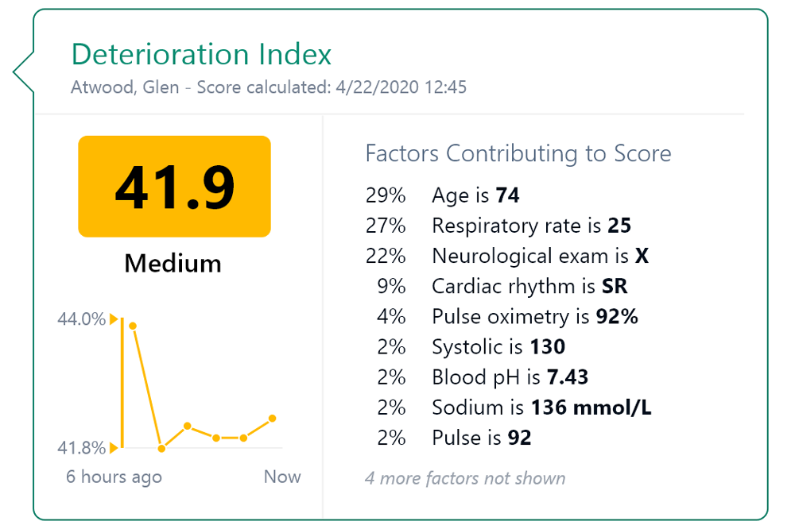
Dilemma: Model Trust & Utility
Credibility
Transparency
Actionability

Slide 29
ML/AI Example: Heart Failure Early Detection
Mathis MR, Engoren MC, Joo H, Maile MD, Aaronson KD, Burns ML, Sjoding MW, Douville NJ, Janda AM, Hu Y, Najarian K, Kheterpal S: Early Detection of Heart Failure With Reduced Ejection Fraction Using Perioperative Data Among Noncardiac Surgical Patients: A Machine-Learning Approach. Anesth Analg 2020; 130:1188–200

Slide 30
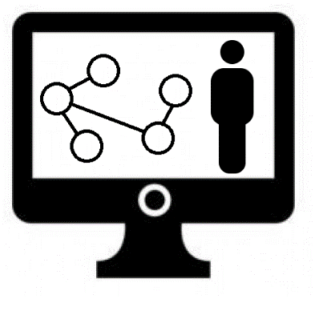
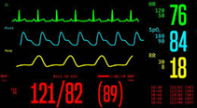
ML/AI Example: Heart Failure Early Detection
Goal: Use anesthesia record as “stress test” to detect undiagnosed early-stage heart failure
Compute probability of HF
Anesthesiologist Adjudication
+/- Cardiologist Follow-up
Periop
Timeline
Preop Evaluation
Intraop Period

Slide 31
ML/AI Example: Heart Failure Early Detection
Cohort: UMich surgical patients without preop D_{x} of HF
“Early HF” cases: Developed HF by 2 years postop
“Healthy” controls: No HF diagnosed by 2 years postop
Exclusions via careful hand review:
Cardiac / HF-related surgery
Acute postop HF as a result of the surgery

Slide 32
ML/AI Example: Heart Failure Early Detection
The intraoperative “stress test”….
Intraoperative Timeline
Laryngoscopy/intubation
Extubation
Pre-induction
Pre-incision
Maintenance
Pre-extubation
Peri-induction
Peri-incision
Peri-extubation
Peri-intubation
Post-extubation
Surgical incision
Patient arrives to operating room
Positive pressure ventilation
Transport from operating room

Slide 33
ML/AI Example: Heart Failure Early Detection
Intraoperative Segments
Collect data sources in each segment:
Blood pressure values
Other physiologic values
Ventilator values
Input/output fluid values
Intraoperative medications
Summarize data from each segment & source:
Minimum
Median/mean
Maximum
Standard deviation
(etc.)
1,195 Intraoperative Features
Machine Learning Model Training
Final Models
1,823 Total Features
Preoperative Data
628 Preoperative Features

Slide 34
Dilemma: Low Positive Predictive Value
True positive .
True positive + false positive
PPV =
Anesthesiologists specialize in preventing the rare adverse outcome
For prediction model to be clinically actionable, baseline prevalence needs to be non-rare, or model needs to be nearly perfect

Slide 35
ML/AI Example: Heart Failure Early Detection
High-sensitivity
ML screening algorithm
New Step: Reduce false positives
Confirmatory Testing
(NT-proBNP, TEE)
Compute probability of HF
Anesthesiologist Adjudication
+/- Cardiologist Follow-up
Periop
Timeline
Preop Evaluation
Intraop Period

Slide 36
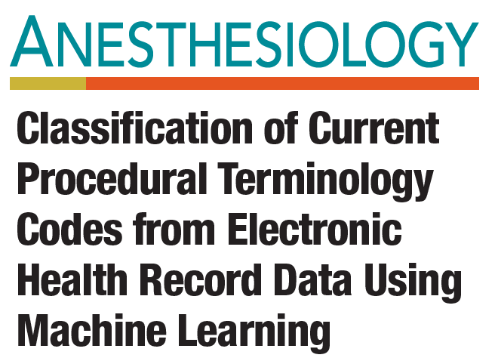
ML/AI Example: Anesthesia CPT Classification
Burns ML, Mathis MR, Vandervest J, Tan X, Lu B, Colquhoun DA, Shah N, Kheterpal S, Saager L: Classification of Current Procedural Terminology Codes from Electronic Health Record Data Using Machine Learning. Anesthesiology 2020; 132:738–49

Slide 37
ML/AI Example: Anesthesia CPT Classification
Goal: Improve anesthesia billing tasks dependent on timely classification of CPT codes
Anesthesiology procedure billing expensive & time-consuming
Largely dependent on reading free-text within anesthesia records

Slide 38
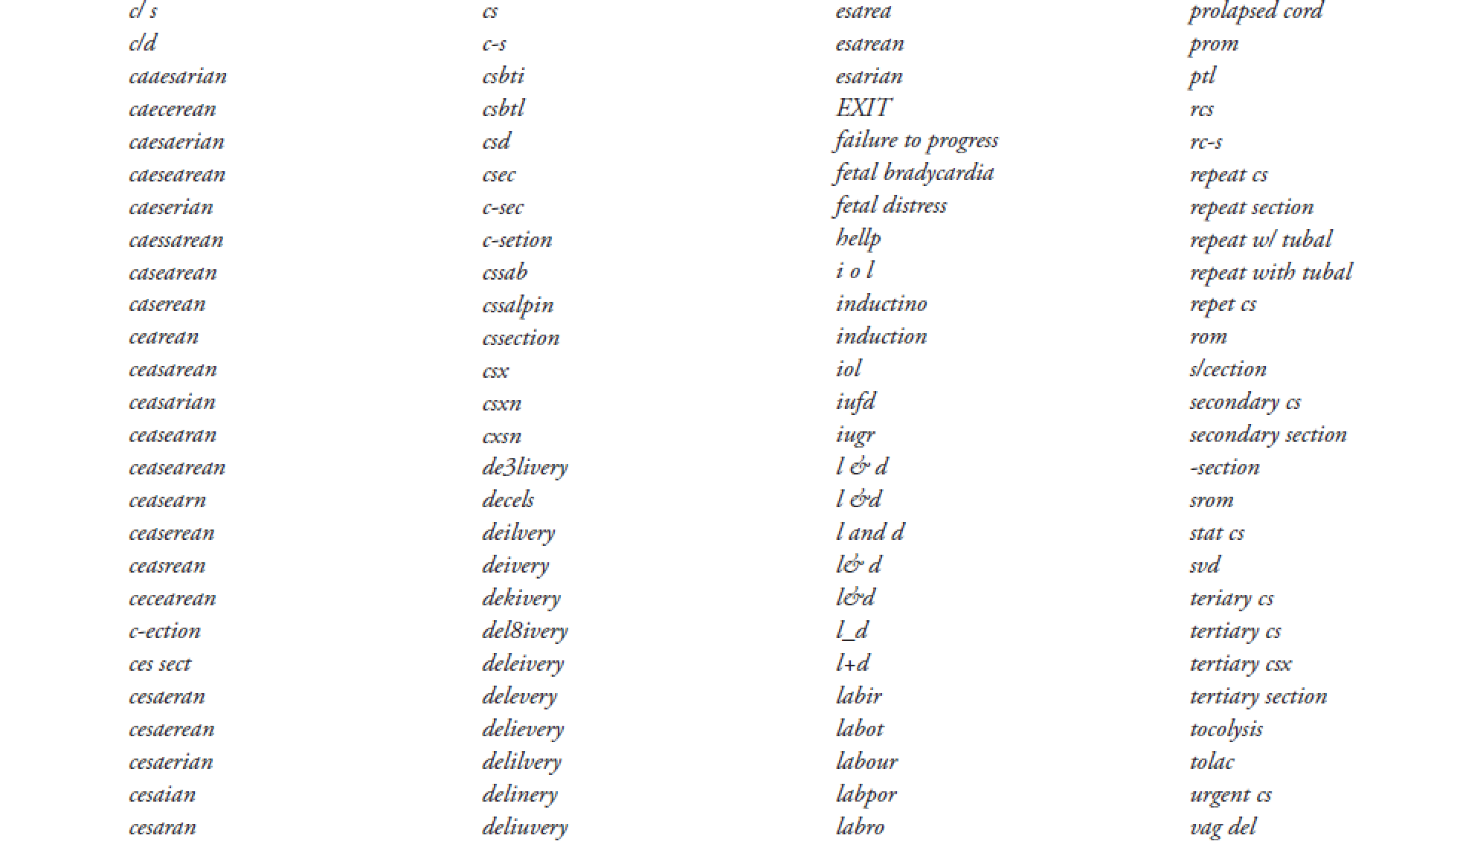
ML/AI Example: Anesthesia CPT Classification
Death by mis-spelling:

Slide 39
ML/AI Example: Anesthesia CPT Classification
Dataset: Info commonly available at end of surgery
Structured
Unstructured
Demographics
Comorbidities
Vitals
ASA Status
Procedure Duration
Procedure text
Natural Language Processing

Slide 40
ML/AI Example: Anesthesia CPT Classification
In an external dataset (hospital unseen by ML algorithm), classification accuracy for very high confidence cases was 95-97%
Median CPT processing times:
Billing specialist: 33 days
ML algorithm (for the CPT portion): 1.09 seconds
Time to revisit a ML implementation strategy…

Slide 41
…revisiting a ML implementation strategy:
Not:

Slide 42
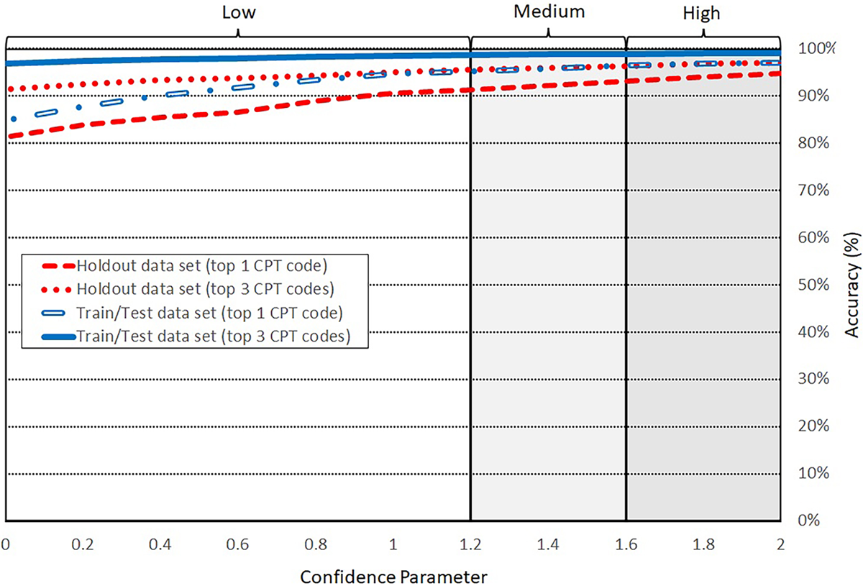
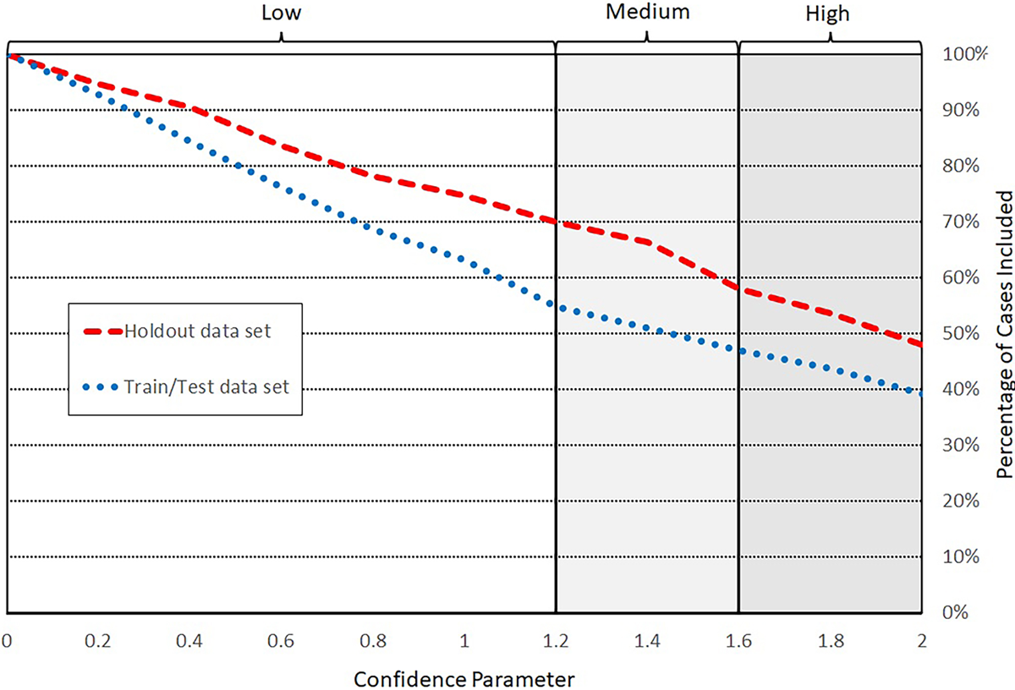
Dilemma: Role of humans vs. machine learners…

Slide 43
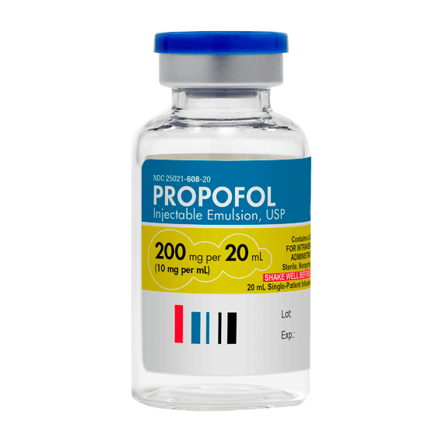
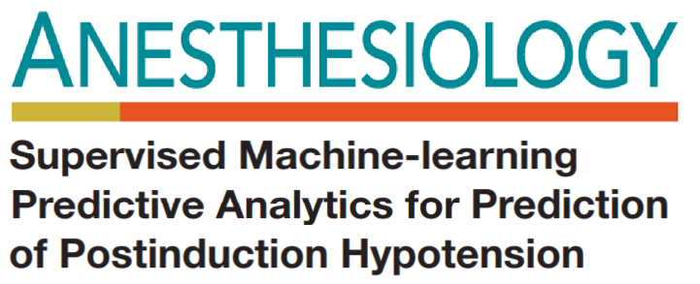
ML/AI example: Post-induction hypotension prediction
Kendale S, Kulkarni P, Rosenberg AD, Wang J: Supervised Machine-learning Predictive Analytics for Prediction of Postinduction Hypotension. Anesthesiology 2018; 129:675–88

Slide 44
ML/AI example: Post-induction hypotension prediction
Goal: Use data available prior to induction to predict likelihood of post-induction hypotension
Dataset: NYU surgical patients >12 years old
Medical History
Data
Perioperative Data
Demographics
Comorbidities
Home Meds
ASA Status
Intraoperative Meds
Intraoperative Physiologic

Slide 45
ML/AI example: Post-induction hypotension prediction
In a test dataset, the best prediction model yielded modest performance 10 minutes prior to induction:
AUC: 0.74 (95% CI 0.72-0.77)
…so what do we do with this information?

Slide 46
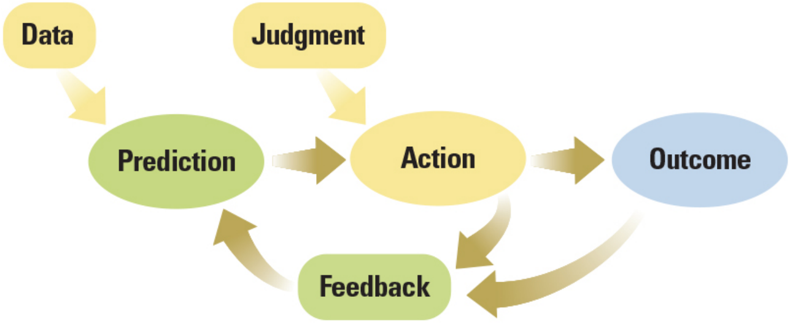
Dilemma: Quantifying Clinical Judgment

Slide 47
Dilemma: Quantifying Clinical Judgment
74yo male with carotid disease, severe pulmonary disease, chronic kidney disease → colectomy
ML Prediction algorithm
Post-induction Hypotension probability: 98%

Slide 48
Dilemma: Quantifying Clinical Judgment
74yo male with carotid disease, severe pulmonary disease, chronic kidney disease → colectomy
Post-induction Hypotension probability: 98%

Slide 49
Dilemma: Quantifying Clinical Judgment
74yo male with carotid disease, severe pulmonary disease, chronic kidney disease → colectomy
Post-induction Hypotension probability: 98%
Action
Do Nothing
Fluid Bolus
Vasopressor
Outcome: Stroke | Outcome: Pulm Complication | Outcome: AKI
1% | 10% | 10%
0.5% | 20% | 5%
0.5% | 10% | 20%

Slide 50
Dilemma: Quantifying Clinical Judgment
74yo male with carotid disease, severe pulmonary disease, chronic kidney disease → colectomy
Post-induction Hypotension probability: 98%
Action
Do Nothing
Fluid Bolus
Vasopressor
Outcome: Stroke | Outcome: Pulm Complication | Outcome: AKI
1% | 10% | 10%
0.5% | 20% | 5%
0.5% | 10% | 20%

Slide 51
Dilemma: Quantifying Clinical Judgment
74yo male with carotid disease, severe pulmonary disease, chronic kidney disease → colectomy
Post-induction Hypotension probability: 98%
Action
Do Nothing
Fluid Bolus
Vasopressor
Outcome: Stroke | Outcome: Pulm Complication | Outcome: AKI
1% | 10% | 10%
0.5% | 20% | 5%
0.5% | 10% | 20%

Slide 52
Dilemma: Quantifying Clinical Judgment
Judgment to be made… …what matters the most? …and by how much more?
Action
Do Nothing
Fluid Bolus
Vasopressor
Outcome: Stroke | Outcome: Pulm Complication | Outcome: AKI
1% | 10% | 10%
0.5% | 20% | 5%
0.5% | 10% | 20%

Slide 53
Dilemma: Quantifying Clinical Judgment
Judgments for Clinician Action = “Policy”
Action
Do Nothing
Fluid Bolus
Vasopressor
Outcome: Stroke | Outcome: Pulm Complication | Outcome: AKI
1% | 10% | 10%
0.5% | 20% | 5%
0.5% | 10% | 20%

Slide 54
Dilemma: Quantifying Clinical Judgment
Burden of Stroke: | Burden of Pulm Comp: | Burden of AKI:
100 | 2 | 1
Judgments for Clinician Action = “Policy”
Action
Do Nothing
Fluid Bolus
Vasopressor
Outcome: Stroke | Outcome: Pulm Complication | Outcome: AKI
1% | 10% | 10%
0.5% | 20% | 5%
0.5% | 10% | 20%

Slide 55
Dilemma: Quantifying Clinical Judgment
Burden of Stroke: | Burden of Pulm Comp: | Burden of AKI:
100 | 2 | 1
Judgments for Clinician Action = “Policy”
Who decides this?
Action
Do Nothing
Fluid Bolus
Vasopressor
Outcome: Stroke | Outcome: Pulm Complication | Outcome: AKI
Expected Burden
1.30
0.95
0.90
1% * 100 | 10% * 2 | 10% * 1
0.5% * 100 | 20% * 2 | 5% * 1
0.5% * 100 | 10% * 2 | 20% * 1

Slide 56
Dilemma: Quantifying Clinical Judgment
ML prediction:
Hypotension 98%

Slide 57
Dilemma: Quantifying Clinical Judgment
Burden of Stroke | Burden of Pulm Complication | Burden of AKI
ML prediction:
Hypotension 98%
Action | Outcome: Stroke | Outcome: Pulm Complication | Outcome: AKI
Do Nothing
Fluid Bolus
Vasopressor

Slide 58
Dilemma: Quantifying Clinical Judgment
Predict the Action (to infer judgment) rather than predict the Outcome?
(Caveat: propagates our own biases)

Slide 59
Dilemma: Quantifying Clinical Judgment

Slide 60
Take-Home Points
Machine learning for perioperative care is conceptually feasible

Slide 61
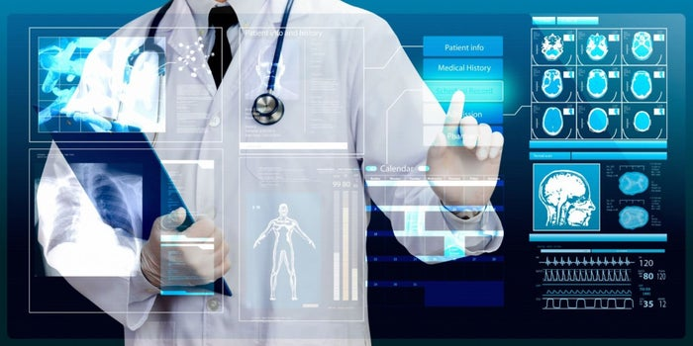
Take-Home Points
Next steps are to build clinician trust that ML algorithms are generalizable, safe, aware of bias, and clinically actionable

Slide 62
What you can do today
Promote literacy in AI/ML methods/interpretation
Focus on the right problems for AI/ML to solve
Seek the right AI/ML model inputs
Value transparency and actionability
Learn your biases …(and how they impact a ML model)

Slide 63
Thank you
References
Hatib F, Jian Z, Buddi S, Lee C, Settels J, Sibert K, Rinehart J, Cannesson M: Machine-learning Algorithm to Predict Hypotension Based on High-fidelity Arterial Pressure Waveform Analysis. Anesthesiology 2018; 129:663–74
Wijnberge M, Geerts BF, Hol L, Lemmers N, Mulder MP, Berge P, Schenk J, Terwindt LE, Hollmann MW, Vlaar AP, Others: Effect of a machine learning--derived early warning system for intraoperative hypotension vs standard care on depth and duration of intraoperative hypotension during elective noncardiac surgery: the HYPE randomized clinical trial. JAMA 2020; 323:1052–60
Maheshwari K, Shimada T, Yang D, Khanna S, Cywinski JB, Irefin SA, Ayad S, Turan A, Ruetzler K, Qiu Y, Saha P, Mascha EJ, Sessler DI. Hypotension Prediction Index for Prevention of Hypotension during Moderate- to High-risk Noncardiac Surgery: A Pilot Randomized Trial. Anesthesiology; Online ahead of Print, September 22, 2020.
Gerke S, Babic B, Evgeniou T, Cohen IG: The need for a system view to regulate artificial intelligence/machine learning-based software as medical device. NPJ Digit Med 2020; 3:53
Singh K, Valley TS, Tang S, Li BY, Kamran F, Sjoding MW, Wiens J, Otles E, Donnelly JP, Wei MY, McBride JP, Cao J, Penoza C, Ayanian JZ, Nallamothu BK: Validating a Widely Implemented Deterioration Index Model Among Hospitalized COVID-19 Patients. medRxiv 2020 doi:10.1101/2020.04.24.20079012
Mathis MR, Engoren MC, Joo H, Maile MD, Aaronson KD, Burns ML, Sjoding MW, Douville NJ, Janda AM, Hu Y, Najarian K, Kheterpal S: Early Detection of Heart Failure With Reduced Ejection Fraction Using Perioperative Data Among Noncardiac Surgical Patients: A Machine-Learning Approach. Anesth Analg 2020; 130:1188–200
Burns ML, Mathis MR, Vandervest J, Tan X, Lu B, Colquhoun DA, Shah N, Kheterpal S, Saager L: Classification of Current Procedural Terminology Codes from Electronic Health Record Data Using Machine Learning. Anesthesiology 2020; 132:738–49
Kendale S, Kulkarni P, Rosenberg AD, Wang J: Supervised Machine-learning Predictive Analytics for Prediction of Postinduction Hypotension. Anesthesiology 2018; 129:675–88

