Slide 1
Chronic hepatitis C: guidelines for screening and treatment
Lisa M. Glass, MD
Clinical Lecturer
Division of Gastroenterology and Hepatology

Slide 2
Hepatitis C Virus
Flavivirus: RNA virus
Dengue
West Nile
Yellow Fever
Zika
Heterogeneity:
Polymerase lacks proofreading capability resulting in many mutations and significant viral diversity
Allows escape from host immune system and medications as well as vaccines
Genotypes:
Six major genotypes (1-6) with >15 subtypes (ie 1a, 1b, 2a, 2b)

Slide 3
HCV distribution

Slide 4
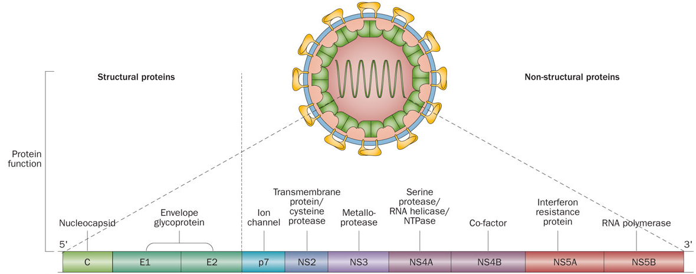
Hepatitis C Virus Genome
Morales, J. M. & Fabrizi, F. (2015) Hepatitis C and its impact on renal transplantation
Nat. Rev. Nephrol. doi:10.1038/nrneph.2015.5
Notes:
viral genome which is composed of 3000 AA that are processed into 11 viral proteins
Protein E binds with host hepatocyte receptors, which facilitates endocytosis
NS3/4A protease: Involved in unwinding the viral RNA and supports replication; Inactivates host-cell defenses therefore HCV can subvert host innate immune systems response that would otherwise block viral replication
NS5A: Required for RNA replication, formation of the membranous web and assembly of the HCV particles
NS5B: Important for the amplification of the virus in the host cell.

Slide 5
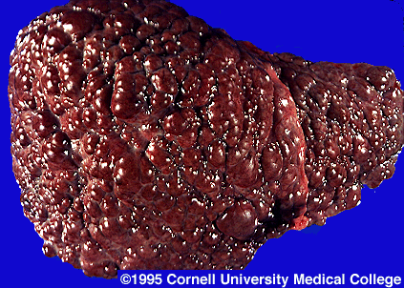
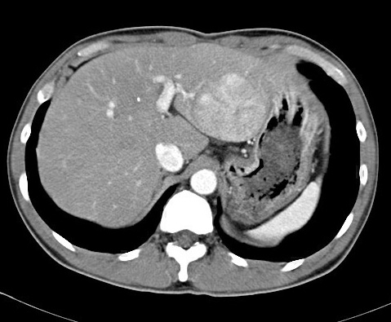
Exposure
75-85%
15-25%
Chronic infection
Spontaneous resolution
Up to 20% in 20 yr
No cirrhosis
Cirrhosis
1-4% per year
Liver failure
Hepatocellular carcinoma
Notes:
Chronic infection develops in 75-80% of patients-> 60-70% of pts will develop chronic liver disease→ cirrhosis develops in about 20% over 20-30 yrs→ 1-5% will develop end stage complications of cirrhosis (death or HCC)
*Rapid fibrosis progression in 30%; slow fibrosis progression in 40%; stable chronic infection in 30%
*Once people develop cirrhosis, 4%/year will decompensate; 3-5%/year will develop HCC
Acute infection:
First 6 months of HCV infection
25% are symptomatic
Jaundice, nausea, RUQ abdominal pain
Spontaneous Viral clearance:
Estimated at 14-50%
Dependent upon age (children may clear up to 50%), mode of infection (IVDU clear only ~20%, but reinfection is possible with ongoing use) and gender
Usually occurs within 12 weeks of infection, but can take up to 12 months

Slide 6
Hepatitis C Epidemiology
Acute hepatitis C infection:
Incidence in the United States is decreasing overall:
230K in 1980s → 17K 2011 → 31K in 2014
Increasing in young populations:
People <30 yrs (due to increased IVDU)
Chronic hepatitis C:
US prevalence of chronic hepatitis C (CHC) viral infection:
1999-2002: 1.3% or about 3.5 million people in the US
Accounts for 8,000 to 13,000 deaths each year in the US
Most common cause of hepatocellular carcinoma and indication for liver transplantation in the US
Smith BD et al. Am J Public Health. 2014
Notes:
**The US is among the countries considered to have a low prevalence rate (<1.5%); highest prevalence areas are in No. Arfrica, Middle East, and Central and East Asia (>3.5%)
**Prevalence data is based on NHANES (National Health and Nutrition Examination Survey) which did not include certain high-risk populations such as those who are incarcerated or homeless
**NHANES study conducted from 2001 through 2008 found that 50.3% of persons infected with HCV were unaware of their status

Slide 7
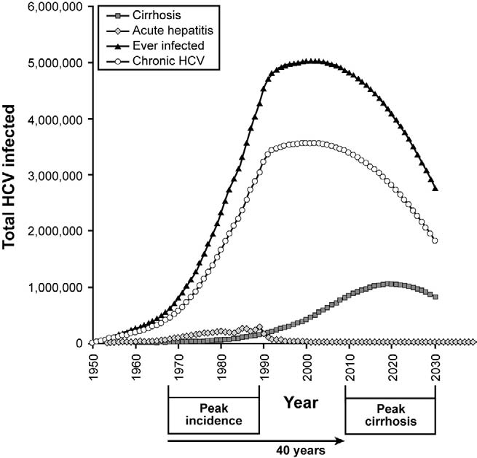
Prevalence of CHC cirrhosis is rising
Davis et al, Gastroenterology 2010;138:513
Notes:
Peak prevalence of C-HC in 2001
However peak prevalence of cirrhosis will be in ~2020 at 1 million in USA

Slide 8
CHC Epidemiology
Transmission:
Percutaneous exposure to blood
Vertical (mother-to-infant)
Sexual
Risk factors for CHC:
History of illicit drug use other than marijuana
Male gender
Black race
Low family income
High-school education or less
10 lifetime sexual partners
Incarceration (30% are HCV Ab +)
Notes:
--IVDU accounts for 60% of cases of acute hepatitis
--Highest risk for sexual transmission is unprotected MSM with HIV coinfection; sexual transmission in monogamous couples estimated at <0.6% annually

Slide 9
1998 CDC Screening Guidelines:
Risk-based screening for those who have:
Ever injected illegal drugs
Received clotting factors made before 1987
Received blood/organs before July 1992
Were ever on chronic hemodialysis
Have evidence of liver disease (elevated alanine aminotransferase [ALT] level)
Are infected with HIV
Are healthcare and public safety workers after needle stick/mucosal exposure to HCV-positive blood
Children born to HCV-positive women

Slide 10
Risk-based Screening
Failed to identify over 50% of CHC cases
Without a change in screening policy it was forecasted that CHC-related death rate would almost triple from 13,000 to 35,000 annually
Rein DB. Dig Liver Dis. 2011

Slide 11
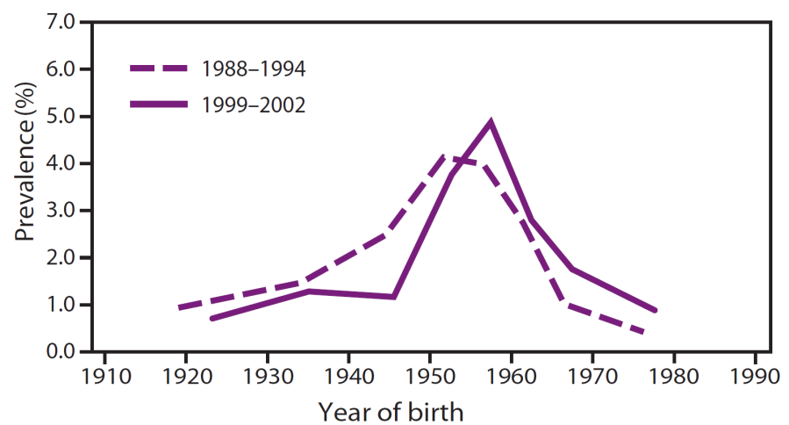
Birth Cohort Screening
NHANES data from 1988-1994, 1999-2002:
People born between 1945-1965 have a disproportionately high prevalence of HCV infection
NHANES data from 1999-2008:
3.25% of people born from 1945-1965 are HCV antibody positive (5 times higher than those born at other times)
Accounts for 76.5% of the anti-HCV prevalence in the United States
Correlates with the high exposure incidence in the 1970-1980s

Slide 12
Review of HCV Ab + results from 4 enhanced hepatitis surveillance sites from 2004-2010
110,000 cases reported
75,000 cases (68%) were among people born between 1945-1965
85,000 cases (77%) would be found using birth cohort and risk-based criteria
30,000 cases (27%) would be found using just risk-based criteria
Mahajan R. Research and Practice. 2013

Slide 13
Cost-effectiveness of birth-cohort screening:
Outcome | Risk-based testing | Birth-cohort testing | Difference
No. of screening tests administered | 14.8 million | 60.4 million | 45.6 million more tests
No of positive results | 262,000 | 1.1 million | 809,000 more cases identified
No. of patients treated | 135,000 | 552,000 | 416,000 more patients treated
No. of CHC-related deaths | 591,000 | 470,000 | 121,000 deaths averted
Estimated cost per quality-adjusted life year gained: $35,700
based on 12 weeks of DAA plus Peg-IFN and RBV
Rein DB. Annals of Int Med. 2012
Notes:
Assumed cost of DAA+PegIFN, RBV: $83,000

Slide 14
2012 CDC Screening Guidelines
Screening is recommended for those who:
Were born in the US between 1945 and 1965 without ascertainment of risk (birth cohort)
Ever injected illegal drugs
Received clotting factors made before 1987
Received blood/organs before July 1992
Were ever on chronic hemodialysis
Have evidence of liver disease (elevated alanine aminotransferase [ALT] level)
Are infected with HIV
Are healthcare and public safety workers after needle stick/mucosal exposure to HCV-positive blood
Children born to HCV-positive women

Slide 15
CHC Screening and Dx
HCV Antibody:
Detected 4–10 weeks after infection
Present in >97% by 6 months after exposure
Patients who clear infection will remain anti-HCV +
HCV RNA:
Detection of acute infection:
Present 2–3 weeks after infection
Confirmation of chronic infection
No need to monitor HCV VL if not actively treating

Slide 16
Patients with new CHC diagnosis:
Should be evaluated for:
Evidence of advanced chronic liver disease
Other blood-born pathogens:
HBV and HIV
Candidacy for potential treatment:
Possible contraindications in patients with active IVDU or high risk of relapse or demonstrated medical noncompliance
Should be protected from additional hepatotoxicity:
Undergo hepatitis A and B vaccination if susceptible
Reduce or discontinue alcohol consumption
Avoid new medicines, including over-the-counter and herbal agents
Should be counseled to reduce risk of transmission:
Do not donate blood, tissue, or semen
Do not share appliances that might come into contact with blood, such as toothbrushes, dental appliances, razors, and nail clippers

Slide 17
Goal of Treatment:
SVR12: negative (<12 IU/mL) HCV VL at 12 weeks after completion of therapy
Reduce liver inflammation
Reduce fibrosis and improve portal hypertension
Reduce mortality
Notes:
SVR12: 99% durable at 5 years of follow-up
--Improved AST/ALT and reduction of liver fibrosis; Liver Bx of >3k pts with SVR: 40-70% had improved fibrosis/necrosis; Cirrhosis resolved in 50%, improved portal HTN (splenomegaly, varices)
--70% reduction in risk of HCC
--90% reduction in mortality and OLT
--Cohort study of F0-1 patients over 20 years:
15 year suvival: +SVR: 93%; -SVR: 82%; No Tx: 88%
--Initiated prior to F3: greater mortality benefit

Slide 18
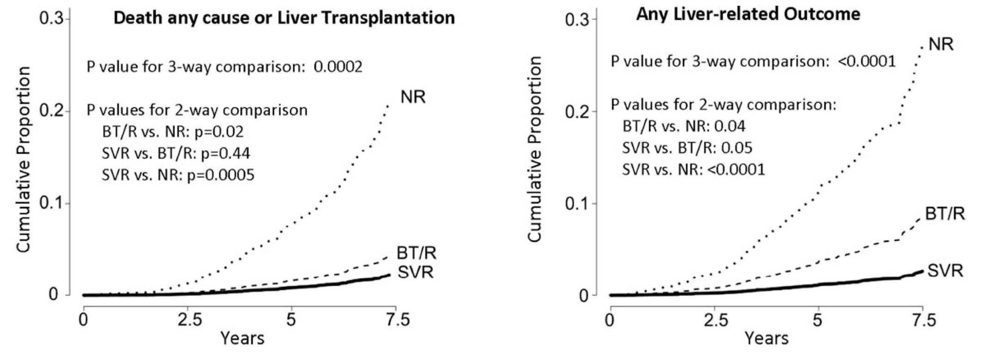
Why treat CHC?
HALT-C trial: advanced fibrosis (≥F3) and prior nonresponders
Some patients who were retreated achieved SVR
Comparison of outcomes among SVR, nonresponders (NR), or breakthrough/relapsers (BT/R)
Morgan, Hepatology 2010;52:833
Notes:
HALT-C trial:
Pt who achieved SVR had significant improvement in survival as well as reduced liver-related outcomes and need for transplant.

Slide 19
Prioritized Treatment:
Highest Priority Patients:
Advanced fibrosis: F3-4 (decompensating event annual risk 4-8% without tx)
Organ transplant
Extra-hepatic manifestations: Cryoglobulinemia with end organ damage, membranoproliferative glomerulonephritis, nephrotic syndrome
High Priority:
≥F2 fibrosis
Co-infection with HBV or HIV
Other CLD
Increased risk of transmission:
Incarcerated people
Active IVDU
Healthcare workers
Hemodialysis
Notes:
--SVR in patients with cirrhosis: reduces HCC, decompensation, and mortality
--OLT: 30% develop recurrent cirrhosis within 5 years of transplant; 4-7% develop cholestatic HCV

Slide 20
Is treatment cost-effective in the era of Direct Acting Antivirals?
Hepatitis C Treatment Costs That Yielded Cost-Effectiveness Thresholds Stratified
by Fibrosis Level:
Leidner AJ. Hepatology. 2015

Slide 21
Wholesale Acquisition Cost (WAC) for HCV DAAs in the US
DAA Combination | WAC x 12 week course (USD)
Sofosbuvir + Simeprevir | 150k
Sofosbuvir + Daclatasvir | 147k
Sofosbuvir/Ledipasvir (Harvoni) | 94.5k
Paritaprevir/Ritonavir/Ombitasvir + Dasabuvir (Viekira Pak) | 84k
Sofosbuvir (single drug) | 84k
Paritaprevir/Ritonavir/Ombitasvir (Technivie) | 77k
Sofosbuvir/Velpatasvir (Epclusa) | 74.8k
Elbasvir/Grazoprevir (Zepatier) | 54.6k

Slide 22
Pre-treatment Assessment:
Assessment of liver fibrosis:
Liver Bx
Liver Transient Elastography (Fibroscan)
APRI:
>1.0 suggests F3/4
FIB-4:
>3.25 suggests F3/4

Slide 23
Transient Elastography:

Slide 24
Sensitivity and Specificity of APRI and Fibroscan for Detecting Significant Fibrosis and Cirrhosis
 |  | APRI Low Cutoff | APRI High Cutoff | Transient Elastography
Significant Fibrosis Metavir ≥F2 | Sensitivity Specificity | 82 (77-86) 57 (49-65) | 39 (32-47) 92 (89-94) | 79 (74-84) 83 (77-88)
Cirrhosis Metavir F4 | Sensitivity Specificity | 77 (73-81) 78 (74-81) | 48 (41-56) 94 (91-95) | 89 (84-92) 91 (89-93)
Values in % (95% CI)
Requires 3 hours of fasting
Contraindicated in pregnancy
Not reliable with ascites, extreme obesity, active inflammation (ALT >100), or
congestion of the liver
WHO HCV Guidelines April 2014 Table 6.5

Slide 25
MI Medicaid Requirements for DAA Approval
Metavir Score of F3-F4 documented by one of the following:
APRI above 1.5
Fibrosure greater than or equal to 0.59
Fibroscan greater or equal to 9.5
Liver biopsy demonstrating F3 or F4
Ultrasound/MRI or CT of abdomen which demonstrates one of the following documented in the radiology report: cirrhosis, esophageal varices, ascites, splenomegaly
Clinical decompensation

Slide 26
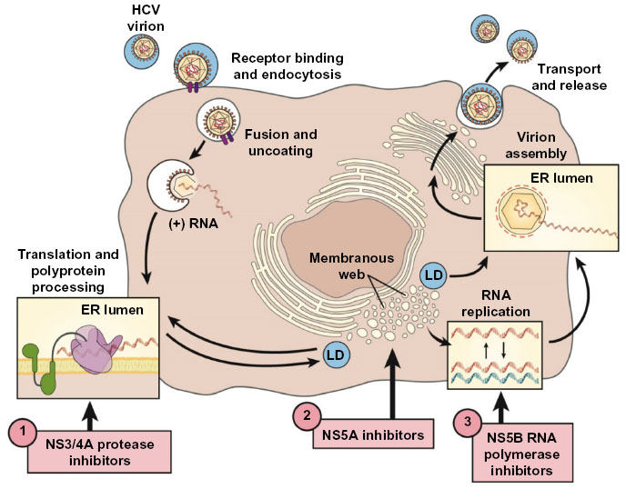
CHC Treatment: HCV Replication Cycle and Drug Targets
Ledipasvir Velpatasvir
Ombitasvir
Elbasvir
Declatasvir
Simeprevir
Paritaprevir
Grazoprevir
Sofosbuvir (Nuc)
Dasabuvir (non-Nuc)
Kayali Z. Pharmgenomics Pers Med. 2014
Notes:
Entry/Uncoating of HCV viral particle into the hepatocyte requires interaction between viral envelope glycoproteins (E1 and E2) and several host receptors (Scavenger receptor class B type 1, CD81, Occludin and Claudin 1). Potential new therapies are targeted to this step- receptor Abs)
Translation and protein processing at the rough endoplasmic reticulum (targets: NS3/4A protease inhibitors)
Polyprotein is processed into membranous web (composed of double-membrane vesicles close to lipid droplets) (Targets: NS5A inhibitors)
Replication: Viral RNA is amplified in the membranous web (Target: NS5B inhibitors); inhibitors are pan-genotypic; can act by either A. nucleoside analogue: mimic natural substrate and become incorporated into the newly synthesized RNA and prevents its elongation; or B. nonnucleoside inhibitors that can bind to the enzyme and impair polymerase activity
Assembly and secretion; Virus particles are assembled (encapsulated) in close association with the host cell machinery that synthesizes very-low-density lipoproteins, and is then secreted as a lipoviroparticle

Slide 27
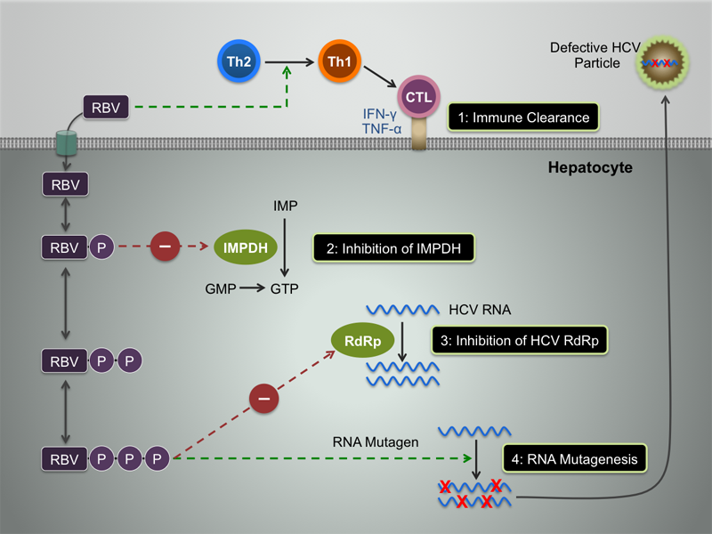
Potential mechanism of action of Ribavirin in CHC treatment
Hepatitis Web Study. University of Washington.
Notes:
1. Induction of Th1 immune response
2. Depletion of GTP that could decrease viral protein synthesis and limit viral replication
3. direct inhibition of HCV replication
4. induction of mutagenesis, leading to production of defective viral particles.

Slide 28
HCV Treatment Regimens:
Use this link for updated AASLD/IDSA guidelines:
http://www.hcvguidelines.org
Potential drug interactions:
http://hep-druginteractions.org

Slide 29
Harvoni, GT1, Treatment-Naïve:
Harvoni (ledipasvir (NS5A inhibitor)/sofosbuvir (NS5B inhibitor):
Non-cirrhotic, low VL (<6 million IU/mL): 8 weeks; SVR12: 98%
Non-cirrhotic, high VL (>6 million IU/mL): 12 weeks; SVR12: 97-99%
Compensated Cirrhotic, any VL: 12 weeks; SVR12: 97%

Slide 32
Harvoni, GT1, Treatment-Experienced:
Harvoni:
Non-cirrhotic: 12 weeks
Cirrhotic:
-RBV 24 weeks
+RBV: 12 weeks

Slide 33
Notes:
Orange bars are 12 week regimens and Blue are 24 weeks
Similar SVR in pt’s without cirrhosis in both groups
Patients with cirrhosis had improved SVR in the 24 week group

Slide 38
Viekira, GT1, Treatment-Naïve, Non-cirrhotic:
Viekira:
1A: + weight-based RBV 12 weeks
1B: -RBV 12 weeks
Feld J, NEJM 2014, Ferenci P, NEJM 2014

Slide 39
Viekira, GT1, Treatment-Naïve, CTP A Cirrhosis:
Viekira:
1A: + weight-based RBV x 24 weeks (alternative regimen)
1B: no RBV 12 weeks
TURQUOISE-III: Abstract from EASL 06, 2015

Slide 40
Viekira, GT1, Treatment-Experienced, Non-cirrhotic:
Viekira:
1A: + weight-based RBV for 12 weeks
1B: -RV for 12 weeks
Zeuzem S, NEJM 2014; Andreone P, Gastroenterology 2014

Slide 41
Viekira, GT1, Treatment-Experienced, CTP A Cirrhosis:
Viekira:
1A: + weight-based RBV for 24 weeks (alternative regimen)
1B: -RBV for 12 weeks
TURQUOISE-III: Abstract from EASL, 2015

Slide 43
Zepatier, GT1, Treatment naïve, +/- Cirrhosis:
Elbasvir (NS5A inhibitor)/Grazoprevir (second-generation NS3/4A protease inhibitor):
GT1a without NS5A RAV: 12 weeks
GT1a with NS5A RAV: + weight-based RBV x 16 weeks
GT1b: 12 weeks

Slide 44
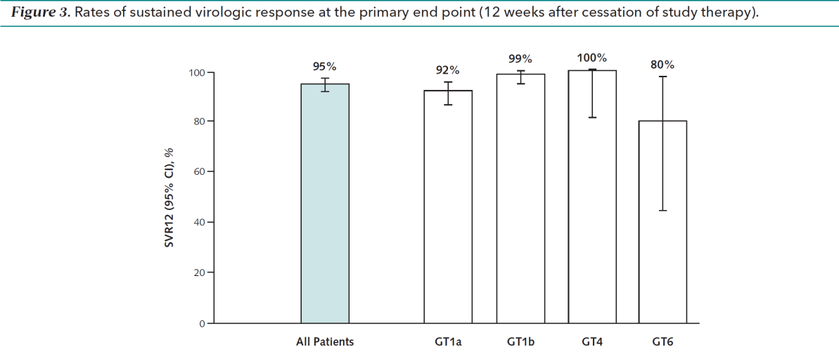
Zepatier, GT1, Treatment naïve, +/- Cirrhosis:
Genotype 1a: Patients with SVR12/Patients
with specified result:
With baseline RAVs 11/19 (58 [34-80])
No baseline RAVs 133/135 (99 [95-100])
Zeuzem et al. Annals of Int Med. 2015

Slide 45
Zepatier, GT1, Treatment-Exp, +/- Cirrhosis:
Elbasvir (NS5A inhibitor)/Grazoprevir (second-generation NS3/4A protease inhibitor):
GT1a without NS5A RAV: 12 weeks
GT1a with NS5A RAV: + weight-based RBV x 16 weeks
GT1b: 12 weeks

Slide 46
Epclusa, GT1, Treatment naïve/Treatment-Exp, +/- Cirrhosis:
Sofosbuvir (NS5B inhibitor) /Velpatasvir (NS5A inhibitor) x 12 weeks

Slide 47
Sofosbuvir/Velpatasvir x 12 weeks, GT1, Tx-Naïve/Tx-Exp, +/- Cirrhosis
ASTRAL-1: Feld JJ, NEJM, 2015; 373: 2599

Slide 48
Genotype 1 HCV:
Tx History | Cirrhosis Status | Treatment Options | Alternative
Naïve, HCV RNA <6 mill IU/mL | Non-cirrhotic | Harvoni (Ledipasvir/Sofosbuvir) x 8 weeks
Naïve, HCV RNA >6 mill IU/mL | Non-cirrhotic or CTP A Cirrhotic | *Harvoni (Ledipasvir/Sofosbuvir) x 12 weeks | *Viekira (Ombitasvir/Paritaprevir/ Ritonavir +Dasabuvir) + WB-RBV for 24 weeks (GT1a CTP A Cirrhotic)
 |  | *Viekira (Ombitasvir/Paritaprevir/ Ritonavir +Dasabuvir) x 12 weeks; (non-cirrhotic GT1a or any fibrosis GT1b)
 |  | *Zepatier (elbasvir/grazoprevir) x 12 weeks if GT1b or GT1a without NS5A RAV; with NS5A RAV +/- cirrhosis x 16 weeks and add RBV
 |  | *Epclusa (Sofosbuvir/Velpatasvir) x 12 weeks
Tx-Experienced (PegIFN/RBV) | Non-Cirrhotic | *Harvoni (Ledipasvir/Sofosbuvir) x 12 weeks | *Zepatier (elbasvir/grazoprevir) + RBV x 16 weeks GT1a with NS5A RAV
 |  | *Viekira (Ombitasvir/Paritaprevir/ Ritonavir +Dasabuvir) x 12 weeks; GT1a: add weight-based RBV, GT1b: RBV not needed
 |  | *Zepatier (Elbasvir/Grazoprevir) x 12 weeks if GT1b or GT1a without NS5A RAV
 |  | *Epclusa (Sofosbuvir/Velpatasvir) x 12 weeks
 | CTP A Cirrhotic | *Harvoni (Ledipasvir/Sofosbuvir) + RBV x 12 weeks | *Harvoni (Ledipasvir/Sofosbuvir) x 24 weeks
 |  | *Zepatier (Elbasvir/Grazoprevir) x 12 weeks if GT1b or GT1a without NS5A RAV
 |  |  | *Viekira (Ombitasvir/Paritaprevir/ Ritonavir +Dasabuvir) +RBV x 24 weeks (CTP A Cirrhotic with GT1a)
 |  | * Viekira (Ombitasvir/Paritaprevir/ Ritonavir +Dasabuvir) x 12 weeks if GT1b
 |  |  | *Zepatier (Elbasvir/Grazoprevir) + RBV x 16 weeks if cirrhotic with NS5A RAV
 |  | *Epclusa (Sofosbuvir/Velpatasvir) x 12 weeks

Slide 49
Special Population: GT1/4 decompensated cirrhosis (CTP B and C):
Harvoni (ledipasvir/sofosbuvir)+ low-dose RBV for 12 weeks. RV should be started at 600mg and increased Q2 weeks as tolerated
Epclusa (Velpatasvir/Sofosbuvir) + WB RBV x 12 weeks
Flamm SL, Everson GT, Charlton M et al. Gastroenterology, 2015
ASTRAL-4: Curry MP, NEJM 2015

Slide 50
Special Population: GT1/4, Advanced renal insufficiency (CrCl <30 mL/min):
GT1a, Non-cirrhotic or CTP A cirrhosis, Tx-naïve or Tx-exp:
Zepatier: [Elbasvir/grazoprevir] x 12 weeks
C-Surfer Trial: Roth D et al. The Lancet, 2015.

Slide 51
Epclusa, GT2, Tx-naïve/Tx-exp, +/- Cirrhosis
Epclusa x 12 weeks

Slide 52
Sofosbuvir/Velpatasvir x 12 weeks, GT2, Tx-Naïve/Tx-Exp, +/- Cirrhosis
ASTRAL-1: Feld JJ, NEJM, 2015; 373: 2599

Slide 53
Genotype 2 HCV
Treatment History | Cirrhosis status | Treatment Options | Alternative
Naive | Non-cirrhotic | *Epcusa x 12 weeks | *Daclatasvir + sofosbuvir x 12 weeks
 | CTP- A Cirrhotic | *Epclusa x 12 weeks | *Daclatasvir + Sofosbuvir x 16-24 weeks
Experienced | Non-cirrhotic | *Epclusa x 12 weeks | *Daclatasvir + sofosbuvir x 12 weeks
 | CTP-A Cirrhotic | *Epclusa x 12 weeks | *Daclatasvir + Sofosbuvir x 16-24 weeks
Naïve or Experienced | CTP B or C Cirrhotic | *Epclusa + WB RBV x 12 weeks *Daclatasvir + Sofosbuvir + low dose RBV x 12 weeks

Slide 54
Daclatasvir/Sofosbuvir, GT3, Treatment-Naïve:
Daclatasvir (NS5A inhibitor)/Sofosbuvir (NS5B inhibitor):
Non-cirrhotics: 12 weeks
Cirrhotics: 24 weeks (+/- RV)

Slide 55
Daclatasvir/Sofosbuvir, GT3, Treatment-Experienced:
Daclatasvir/Sofosbuvir:
Non-cirrhotics: 12 weeks
Cirrhotics: +RV 24 weeks

Slide 56
Epclusa, GT3, Tx-Naïve, +/- Cirrhosis
Epclusa (Sofosbuvir/Velpatasvir):
Non-cirrhotics: 12 weeks
Cirrhotics*: 12 weeks
*Test for NS5A Y93H RAV in treatment naïve patients with cirrhosis and in treatment experienced patients with no cirrhosis, if Y93H present, add RBV

Slide 57
Epclusa, GT3, Tx-Exp, +/- Cirrhosis
Epclusa (Sofosbuvir/Velpatasvir):
Non-cirrhotics*: 12 weeks
Cirrhotics: +WB RBV x 12 weeks
*Test for NS5A Y93H RAV in treatment naïve patients with cirrhosis and in treatment experienced patients with no cirrhosis, if Y93H present, add RBV

Slide 58
Genotype 3 HCV
Treatment History | Cirrhosis Status | Treatment Options
Naive | Non-cirrhotic | *Epclusa x 12 weeks *Daclatasvir + Sofosbuvir x 12 weeks
 | CTP A cirrhotic | *Epclusa x 12 weeks *Daclatasvir + Sofosbuvir +/- RBV x 24 weeks
Experienced | Non-cirrhotic | *Epclusa x 12 weeks *Daclatasvir + Sofosbuvir x 12 weeks
 | CTP A cirrhotic | *Epclusa + WB RBV x 12 weeks *Daclatasvir + Sofosbuvir + RBV x 24 weeks
Naïve or Experienced | CTP B or C Cirrhotic | *Daclatasvir + Sofosbuvir + low dose RBV x 12 weeks

Slide 59
HCV Treatment in Special Populations
 | Harvoni | Viekira Pak / Technivie | Epclusa | Zepatier
HIV coinfection | Infrequent drug interactions | Frequent drug interactions | Infrequent drug interactions | Frequent drug interactions
Hepatic impairment | No dose adjustment for Child A/B/C cirrhosis | Child A: caution, no dose adjustment Child B/C not recommended | No dose adjustment for Child A/B/C cirrhosis | Child A: no dose adjustment, Child B/C not recommended
Renal impairment | Dose not determined for GFR <30 | No dose adjustment (caution if RBV needed) | Dose not determined for GFR<30 | No dose adjustment (caution if RBV needed)
Liver transplant recipient | Minimal dose adjustment of cyclosporine/ tacrolimus | Not to be used with tacrolimus, caution with cyclosporine | Minimal dose adjustment of cyclosporine/ tacrolimus | Not to be used with cyclosporine, caution with tacrolimus

Slide 60
Monitoring Patients During Treatment
 | Pre-Rx | Wk 2# | Wk 4 | End of Rx | FU Wk 12 | FU Wk 48
Clinic visit | X |  | X |  | X
HCV RNA | X |  | X | X | X | X
CBC | X | X | X | X | X | X
Liver panel | X | X | X | X | X | X
Cr/INR | X |  |  | X⁺ |  | X⁺
⁺Optional, to consider in cirrhotics
#For patients receiving RBV, Viekira Pak or Techivie

Slide 61
Birth Control During Treatment
If RBV needed:
Double methods of birth control during and for 6 months after stopping treatment, apply to both male and female HCV patients on treatment
If RBV not needed, suggestion:
Male patients: no birth control required of patient or partner
Female patients of reproductive age: effective birth control during treatment and for 1 month afterwards, female patients on ethinyl estradiol containing contraceptives must stop before Viekira, can resume 2 weeks after completion of treatment, switch to alternate effective contraception during this period

