Slide 1
Evaluation of Elbow, Hand, and Wrist Injuries
Zoë J. Foster, MD
October 19, 2016

Slide 2
Objectives
Review of the anatomy relevant to the upper extremity.
Evaluation of common elbow pathologies.
Evaluation of common wrist and hand pathologies.

Slide 3
Case
Middle aged construction worker presenting with several weeks of anterior elbow pain.
No trauma.
Worse with lifting roofing shingles
Treating with NSAIDs (which help) but needs to get his current job done.

Slide 4
Elbow Anatomy
From: Kane SF, Lynch JH, Taylor JC. Evaluation of Elbow Pain in Adults. American Family Physician. 2014; 89(8): 649-657.

Slide 5
Differential diagnosis for ANTERIOR elbow pain
Anterior capsule strain
Biceps tendinopathy
Gout
Intra-articular loose body
Osteoarthritis
Pronator syndrome
Rheumatoid arthritis
Fracture or dislocation
From: Kane SF, Lynch JH, Taylor JC. Evaluation of Elbow Pain in Adults. American Family Physician. 2014; 89(8): 649-657

Slide 6
Sail Sign
From: Black WS, Becker JA. Common Forearm Fractures in Adults. American Family Physician. 2009; 80: 1096-1102.

Slide 7
Biceps Tendonitis
Insidious course of anterior elbow pain
Weak elbow flexion may be an additional complaint.
Exam: tenderness over distal biceps tendon
Increased with resisted elbow flexion and forearm supination.
In advanced cases, may be unable to fully extend the elbow.

Slide 8
Rupture Long Head Biceps
Depression near the groove of the subdeltoid region and bunching up of muscle distally.

Slide 9
On physical examination, with the elbow flexed at 90, passive supination and pronation of the forearm should reveal a normal “piston-like” movement of the biceps muscle belly. Absence of this motion indicates a complete tear.

Slide 10
Hook Test
Used to assess continuity of the biceps tendon. The examiner’s finger is used to hook under the distal biceps tendon. The tendon is ruptured if the examiner’s finger does not meet resistance.
From: Kane SF, Lynch JH, Taylor JC. Evaluation of Elbow Pain in Adults. American Family Physician. 2014; 89(8): 649-657.

Slide 11
Case
Left handed data entry clerk with several months of lateral elbow pain.
Insidious onset. No trauma.
Worse with mouse work and use of her number pad.
Somewhat better with changes to her work station ergonomics and with trying to use her mouse right handed.

Slide 12
Differential diagnosis of LATERAL elbow pain
Lateral epicondylitis (tennis elbow)
Osteochondral defect
Plica
Posterolateral rotatory instability
Radial tunnel/posterior interosseous nerve syndrome
Avascular necrosis of the capitellum (Panner’s disease)
From: Kane SF, Lynch JH, Taylor JC. Evaluation of Elbow Pain in Adults. American Family Physician. 2014; 89(8): 649-657

Slide 13
Lateral Epicondylitis
Overuse tendinopathy.
Affects 1-3% of the population annually.
Most patients are in their 30s-40s.
Usually develops as a result of occupational rather than recreational activities.
Exam:
Maximal tenderness 1cm distal to the lateral epicondyle.
Pain and decreased strength with resisted gripping, wrist supination and wrist extension.

Slide 14
Lateral Epicondylitis
From: Kane SF, Lynch JH, Taylor JC. Evaluation of Elbow Pain in Adults. American Family Physician. 2014; 89(8): 649-657

Slide 15
Lateral Epicondylitis

Slide 16
Radial Tunnel
Should be considered in patients with refractory tennis elbow!
Point of maximal tenderness is over the radial head.
From: Chumbley EM, O’Connor FG, Nirschl RP. Evaluation of Overuse Elbow Injuries. American Family Physician. 2000;61(3):691-700

Slide 17
Posterior Interosseous Nerve Syndrome
Injury to the deep branch of the radial nerve
Presenting symptom is usually generalized weakness of the hand
Weakness of digit and wrist extension (more prominent in the digits)
Consider this diagnosis in tennis elbow cases with motor involvement.

Slide 18
Case
Right handed senior high school baseball pitcher with recurrence of medial elbow pain that had resolved over the winter season.
Worse with acceleration and release phases of his pitch.

Slide 19
Differential Diagnosis of MEDIAL elbow pain
Medial epicondylitis (golfer’s elbow)
Cubital tunnel syndrome
Ulnar collateral ligament (UCL) injury
Valgus extension overload syndrome
Medial apophysitis (little leaguer’s elbow)
Medial epicondyle avulsion
From: Kane SF, Lynch JH, Taylor JC. Evaluation of Elbow Pain in Adults. American Family Physician. 2014; 89(8): 649-657

Slide 20
Medial Epicondylitis

Slide 21
Cubital Tunnel Syndrome
Acute contusion or chronic compression of the ulnar nerve at the elbow.
Symptoms:
Paresthesias in the 4th and 5th digits.
Elbow pain radiating to the hand.
Symptoms worsen with prolonged or repetitive elbow flexion.
Wartenburg’s test: inability to adduct the little finger when all fingers are passively abducted

Slide 22
UCL
Most commonly occurs in throwing activities.
Insidious onset of vague medial elbow pain.
MRI can identify partial and complete tears.
From: Kane SF, Lynch JH, Taylor JC. Evaluation of Elbow Pain in Adults. American Family Physician. 2014; 89(8): 649-657

Slide 23
Moving Valgus Stress Test
The shoulder is in 90 degrees of abduction and external rotation. While constant valgus torque on the elbow is maintained, the elbow is quickly flexed and extended. A positive result is pain between 70 and 120 degrees of flexion.
From: Kane SF, Lynch JH, Taylor JC. Evaluation of Elbow Pain in Adults. American Family Physician. 2014; 89(8): 649-657

Slide 24
Milking Maneuver
The elbow is flexed to 90 degrees while a valgus force is applied to the elbow by gently pulling the patient’s thumb in the posterior direction. A positive finding is pain, instability, and apprehension.
From: Kane SF, Lynch JH, Taylor JC. Evaluation of Elbow Pain in Adults. American Family Physician. 2014; 89(8): 649-657

Slide 25
Case
59 year old diabetic man with painless swelling over left posterior elbow present for years. Recently enlarging.
Rolls his own cigarettes while standing leaning with this elbow on his kitchen counter.

Slide 26
Differential diagnosis of POSTERIOR elbow pain
Olecranon bursitis
Olecranon stress fracture
Olecranon apophysitis
Olecranon osteochrondral defect (OCD)
Osteoarthritis
Posterior impingement
Triceps tendinopathy

Slide 27
Olecranon Bursitis
Most common superficial bursitis.
Can be septic (associated with pain, warmth and erythema; half of cases will have a fever) or aseptic.
Avoid aspiration, unless diagnosis is uncertain or to relieve symptoms in refractory cases.

Slide 28
Case
Small child worked into your schedule because she’s not using her left arm.
Parents are concerned for shoulder problem.
Symptoms started earlier today after she didn’t want to leave the playground.

Slide 29
Nursemaid’s Elbow

Slide 30
Nursemaid’s Elbow Dislocation: Reduction
Pronation with extension method:
Clinician’s hands are placed in same way as for supination and flexion maneuver.
Forearm is fully pronated.
Then fully extended or even flexed.
A click may be felt as the dislocation reduces.
A second effort may be made with slight traction on the joint.

Slide 31
Nursemaid’s Elbow Dislocation: Reduction
Supination with flexion:
Hold the elbow with thumb of the physician’s hand over the radial head. The other hand holds the patient’s wrist or hand.
Examiner fully supinates the forearm.
Followed by flexing the elbow.
Will often be associated with a click as the ligament returns to its anatomical position.

Slide 32
Case
39yo male who hit a rock and flew over the handlebars of his bike landing on outstretched hands.
Now with pain and swelling in the lateral wrist.

Slide 33
Wrist Anatomy
From: Daniels JM; Zook EG; Lynch JM. Hand and Wrist Injuries: Part I. Nonemergent Evaluation. American Family Physician. 2004; 69: 1949-56.

Slide 34
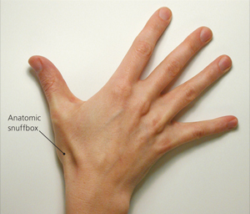
Scaphoid Fracture
Extensor pollicis longus
Extensor pollicis brevis
Abductor pollicis longus
Notes:
.

Slide 35
Scaphoid shift test
Physician’s thumb is placed on the scaphoid tubercle, while the patient’s wrist is in ulnar deviation. Pressure is applied dorsally. The patient radially deviates the wrist. Great pain indicates ligamentous instability of the wrist.
From: Daniels JM; Zook EG; Lynch JM. Hand and Wrist Injuries: Part I. Nonemergent Evaluation. American Family Physician. 2004; 69: 1949-56.

Slide 36
Shuck test (for perilunate instability)
Wrist is held in flexion by the physician and the patient extends fingers. The physician resists this movement. Significant parascaphoid inflammation, radial carpal, or midcarpal instability may cause considerable pain with this maneuver.
From: Daniels JM; Zook EG; Lynch JM. Hand and Wrist Injuries: Part I. Nonemergent Evaluation. American Family Physician. 2004; 69: 1949-56.

Slide 37
Colles Fracture
Distal radius fracture.
Most common in young adults and older persons.
May be unstable with closed reduction and casting.

Slide 38
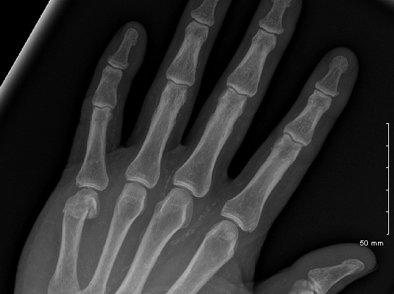
Case
56 year old diabetic kicked in the hand by his grandson during a fight. Now presenting to After Hours with pain and swelling in the medial hand.

Slide 39
Boxer’s Fracture
Fracture at the neck of the 5th metacarpal.
Should be splinted for 6 weeks with the finger in 70-90 degrees of flexion using an ulnar gutter splint.
Need to exclude “fight bite”
Penetration of a tooth over the dorsum of the hand near the 3rd MC.
Antibiotic prophylaxis is indicated.
Surgical intervention (irrigation and debridement) improves prognosis.

Slide 40
From: Leggit JC, Meko CJ. Acute Finger Injuries: Part II. Fractures, Dislocations and Thumb Injuries. America Family Physician. 2006; 73(5): 827-834.

Slide 41
Case
41 year old right handed physician with numbness and tingling into 1st through 4th digits on her right hand that is waking her from sleep at night.
She relates the onset of symptoms to transitioning to a new EMR at work that requires more typing on her part.

Slide 42
Flexor Tendons at the Wrist

Slide 43
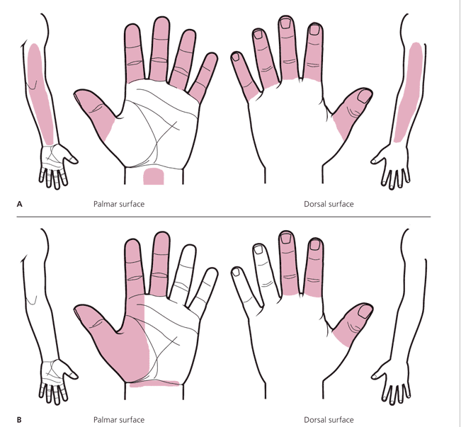
Classic
Pattern
Probable
Pattern
From: LeBlanc KE, Cestia W. Carpal Tunnel Syndrome. American Family Physician. 2011;83(8):952-958.
Notes:
In the classic pattern, symptoms affect at least two of digits 1, 2, or 3. It permits symptoms in the fourth and fifth digits, wrist pain, and radiation of pain proximal to the wrist, but it does not allow symptoms on the palm or dorsum of the hand.
(B) The probable pattern has the same symptom pattern as the classic pattern, except palmar symptoms are allowed unless confined solely to the ulnar aspect. In the possible pattern (not shown), symptoms involve only one of digits 1, 2, or 3.

Slide 44
Exam in Carpal Tunnel
Phalen’s: reproduction of tingly sensation by having patient place wrist in maximal flexion for 60 seconds. (sensitivity 57%, specificity 58%)
Tinel’s: production of paresthesias in the median nerve distribution by percussion over the volar wrist (sensitivity 36%, specificity 75%)
Atrophy of thenar musculature: late finding (sensitivity 16%, specificity 90%)
Weakness of abductor pollicis brevis: raising the thumb perpendicular to the palm as the physician applies downward pressure on the distal phalanx, resisting thumb abduction (sensitivity and specificity 65%)

Slide 45
Forearm in supination and wrist slightly extended.
Identify palmaris longus tendon
Inject (25 gauge, 1.25” needle) 1cm proximal to the mist distal wrist crease
Direct needle at 45 degree angle and slide distally until needle is under midpoint of retinaculum.
Give as a slow bolus injection (20mg triamcinolone without lidocaine).
From: LeBlanc KE, Cestia W. Carpal Tunnel Syndrome. American Family Physician. 2011; 83: 952-958.

Slide 46
Pronator Syndrome
Compression of the median nerve by the pronator teres muscle.
Symptoms:
Pain in the proximal volar forearm and paresthesias of thumb, index and long fingers.
Aggravated by repetitive pronation and supination.
Usually insidious onset
Absence of nighttime symptoms.
From: Chumbley EM, O’Connor FG, Nirschl RP. Evaluation of Overuse Elbow Injuries. American Family Physician. 2000;61(3):691-700

Slide 47
Pronator Compression Test
Pressure is placed over the pronator muscle in both upper extremities. A positive test is indicated by reproductions of paresthesia in the lateral 3 ½ digits in less than 30 seconds.
From: Lee ML, LaStayo PC. Pronator Syndrome and Other Nerve Compressions That Mimic Carpal Tunnel Syndrome. Journal of Orthopedic and Sports Physical Therapy. 2004; 34: 601-609.

Slide 48
Case
20 year old new mother with radial sided wrist pain since birth of her infant 8 weeks ago.
Worse with lifting up baby or changing diapers.
Tried an old wrist splint at home without relief.

Slide 49
Extensor Tendons at the Wrist

Slide 50
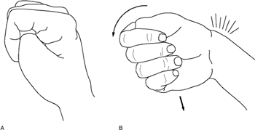
De Quervain’s Tenosynovitis
Finkelstein’s test
From: Shehab R, Mirabelli MH. Evaluation and Diagnosis of Wrist Pain: A Case.Based Approach. American Family Physician. 2013; 87(8): 568-73.

Slide 51
Case
Varsity high school football player who injured his ring finger in Friday night’s game while grabbing an opponent’s jersey during a tackle.
Pain and swelling over volar DIP.
Inability to fully flex the ring finger at the DIP joint.

Slide 52
Common Finger Injuries
Mallet finger (extensor tendon injury at the DIP joint)
Jersey finger (FDP injury)
Central slip extensor tendon injury
“Jammed” fingers (collateral ligament injuries)
Volar plate injury
Skier’s (gamekeeper’s) thumb (UCL injury)

Slide 53
Mallet Finger
From: Leggit JC, Meko CJ. Acute Finger Injuries: Part I. Tendons and Ligaments. America Family Physician. 2006; 73(5): 810-816.

Slide 54
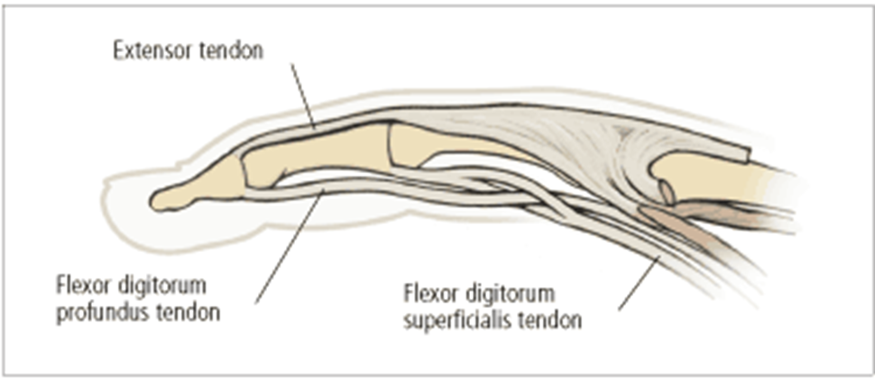
Jersey Finger
From: Leggit JC, Meko CJ. Acute Finger Injuries: Part I. Tendons and Ligaments. America Family Physician. 2006; 73(5): 810-816

Slide 55
Evaluating flexor digitorum tendon injury
(A) The profundus test is performed by holding the affected finger’s MCP and PIP joints in extension and asking the patient to flex the DIP joint. The other fingers should be flexed at the MCP and PIP joints. (B) The superficialis test is performed by holding the unaffected fingers in extension and asking the patient to flex the injured finger.
From: Leggit JC, Meko CJ. Acute Finger Injuries: Part I. Tendons and Ligaments. America Family Physician. 2006; 73(5): 810-816

Slide 56
Finger Deformities
Boutonniere deformity
Swan neck deformity

Slide 57
Central Slip Extensor Tendon Injury
From: Leggit JC, Meko CJ. Acute Finger Injuries: Part I. Tendons and Ligaments. America Family Physician. 2006; 73(5): 810-816

Slide 58
Volar Plate Injury
From: Leggit JC, Meko CJ. Acute Finger Injuries: Part I. Tendons and Ligaments. America Family Physician. 2006; 73(5): 810-816

Slide 59
Jammed Fingers
Result from forced radial or ulnar deviation of any of the IP joints (usually the PIP).
Present as pain located only at the affected ligament.
Evaluate by applying varus or valgus stress to the joint being held in 30 flexion (and the MCP in 90 flexion)
Can be treated with buddy taping.

Slide 60
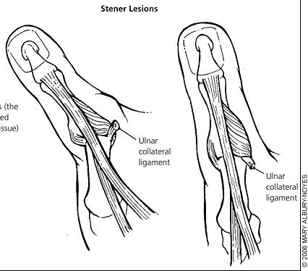
Skier’s Thumb
From: Leggit JC, Meko CJ. Acute Finger Injuries: Part II. Fractures, Dislocations and Thumb Injuries. America Family Physician. 2006; 73(5): 827-834.

Slide 61
Questions?

