Slide 1
Evaluation of Hip Pain
Bob Kiningham, MD, FACSM
Dept. of Family Medicine
University of Michigan Health system

Slide 2
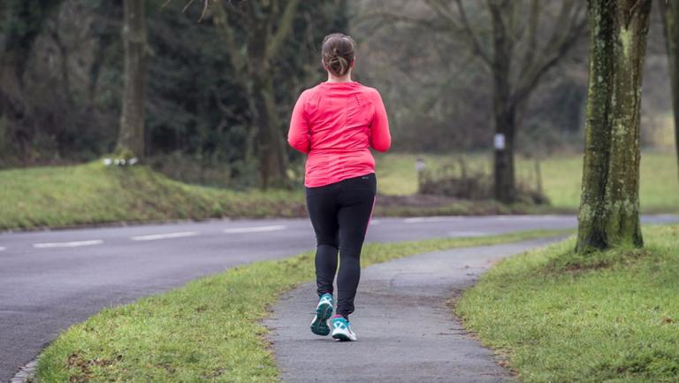
Case Study 1
44 year old woman with 3 month h/o lateral and posterior hip pain, right greater than left. Worse with prolonged standing and running. Used to jog 8-10 miles a week, but has stopped for past month because of lateral hip pain. No acute injury.

Slide 3
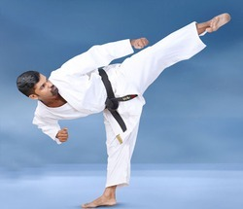
Case Study 2
25 year old martial arts instructor with a 3 year history of right groin pain. No acute injury. Worse after activity, particularly more intense martial arts work-outs. Feels better if he avoids activity, but returns with resumption of activity, even after several days of rest. Otherwise healthy, no medications.

Slide 4

Case Study 3
22 year old male soccer player with 2 month history of left sided groin pain. Worse with cutting and lateral movements. Diagnosed with hip adductor strain and participated in a rehab program, but no improvement. Pelvic and hip x-rays are normal.

Slide 5
Hip Anatomy
Layer Concept
I. Osteochondral
    Femur
    Acetabulum
    Innominate
II. Inert
    Capsule
    Labrum
    Ligamentous Complex
    Ligamentum Teres
Draovitch et al. Curr Rev Musculoskelet Med 2012;5:1-8

Slide 6
Hip Anatomy
Layer Concept
III. Contractile
    Musculature crossing hip
    Lumbosacral muscles
    Pelvic floor
IV. Neuromechanical
    Thoraco-lumbar mechanics
    Neuro-vascular structures
    Regional mechanoreceptors

Slide 7
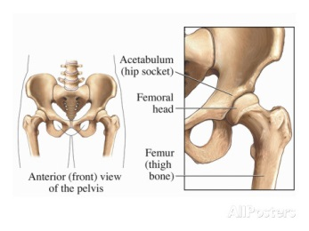
Hip Anatomy
Layer 1: Osteochondral

Slide 8
Hip Anatomy
Layer 1: Osteochondral
Purpose
    Joint congruence
    Arthrokinematic movement
Pathology
  Developmental
    Dysplasia
  Dynamic
    Cam/pincer impingement

Slide 9
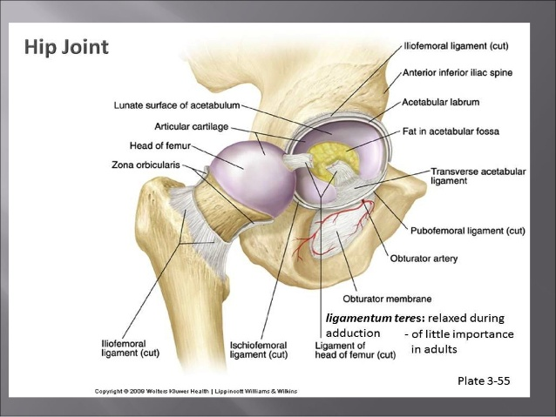
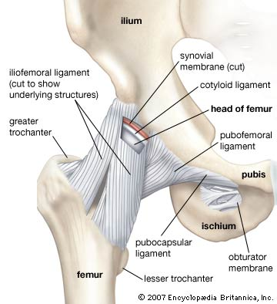
Hip Anatomy
Layer II: Inert

Slide 10
Hip Anatomy
Layer II: Inert
Purpose
    Static stability
Pathology
    Labral tear
    Capsular instability
    Ligamentum teres tear
    Adhesive capsulitis

Slide 11
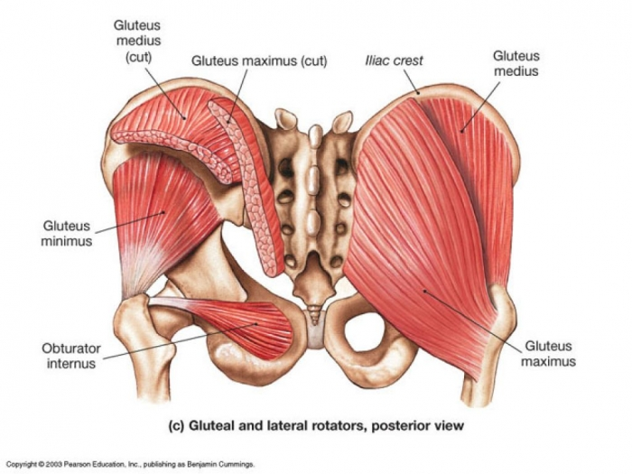
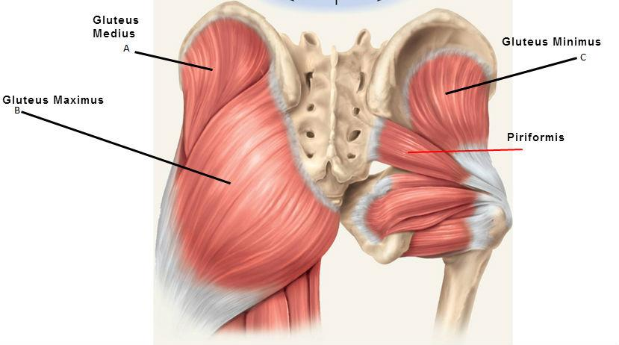
Hip Anatomy
Layer III: Contractile

Slide 12
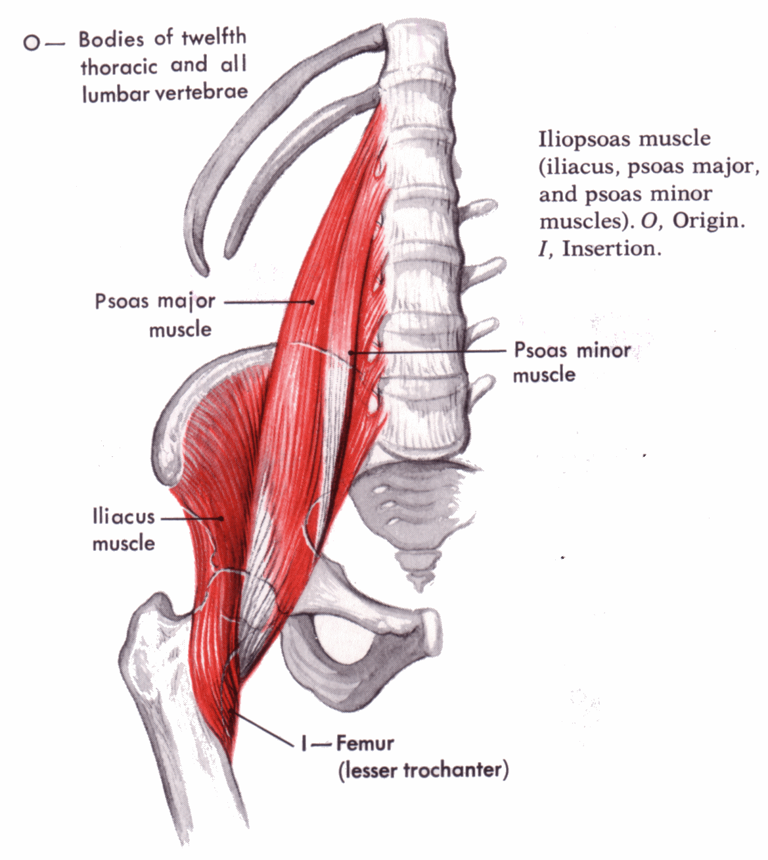
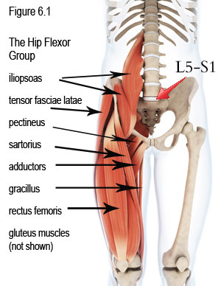
Hip Anatomy
Layer III: Contractile

Slide 13
Hip Anatomy
Layer III: Contractile
Purpose
    Dynamic stability of hip, pelvis, and trunk
Pathology
    Tendonopathies
    IT band syndrome
    Greater trochanteric bursitis

Slide 14
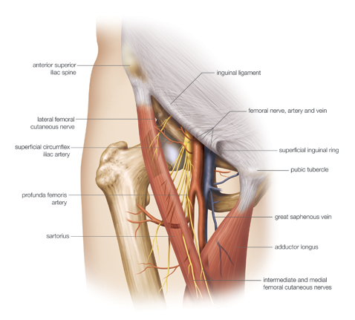
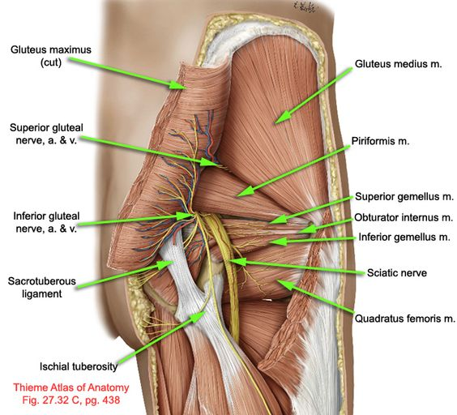
Hip Anatomy
Layer IV: Neuro-mechanical

Slide 15
Hip Anatomy
Layer IV: Neuro-mechanical
Purpose
    Communicating, timing, and sequencing of the kinematic chain
Pathology
  Neural
    Pain syndromes, neuromuscular dysfunction, nerve entrapments, spinal nerve pain
  Mechanical
    Pelvic posture over femur
    Osteitis pubis
    Sacro-iliac dysfunction

Slide 16
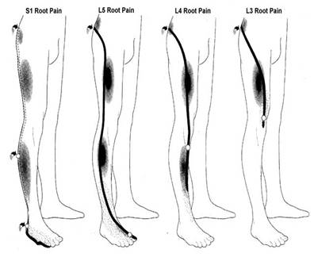
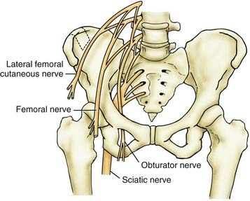
Neural Cause of Groin Pain

Slide 17
Evaluation of Hip Pain
History
Onset: Acute or chronic
Location: Anterior, posterior, medial (groin) or lateral
Exacerbating and alleviating factors
Previous history of hip/back pain
Prior treatments
Impact on life and goals of treatment

Slide 18
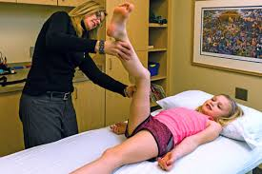
Physical Exam
Observation
Active range of motion
Passive range of motion
Resisted muscle testing
Palpation
Special tests

Slide 19
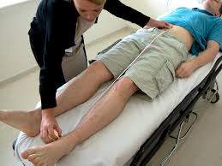
Observation
Muscle atrophy, limb asymmetry
Gait
Spinal alignment
    Shoulder/iliac crest height
    True and functional leg length discrepancy
    Lumbar lordosis
    Scoliosis

Slide 20
Gait Analysis
Antalgic gait
    Sign of hip joint pain
Trendelenburg gait
    Sign of hip abductor (gluteus medius and minimus) weakness
Pelvic rotational wink
    Intra-articular pathology or hip flexion contracture
Excessive external or internal rotation
Short leg limp

Slide 21
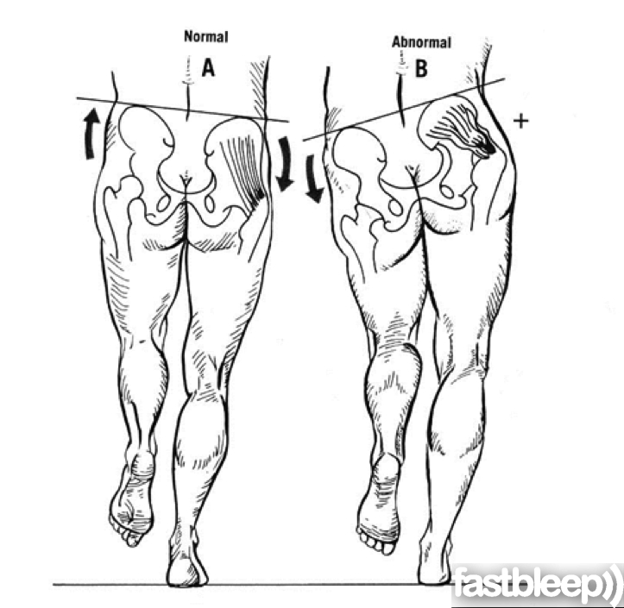
Trendelenburg Test

Slide 22
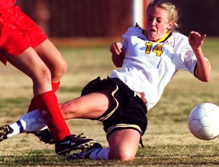
Physical Exam
Active Range of Motion
Flexion/extension
Abduction/adduction
Internal/external rotation

Slide 23
Physical Exam
Passive Range of Motion
Flexion/extension
    Flexion tested supine
    Extension best tested with contralateral hip flexed
Abduction/adduction
Internal/external rotation
    Tested seated, supine, or prone
    Decreased internal rotation is a sign of intra-articular hip pathology

Slide 24
Physical Exam
Passive Range of Motion
Flexion: 110-120 degrees
Extension: 10-15 degrees
Abduction: 30-50 degrees
Adduction: 20-30 degrees
External rotation: 30-45 degrees
Internal rotation: 20-35 degrees

Slide 25
Passive ROM
Specialized Tests: Supine
Thomas test
    Patient holds non-affected leg in flexed position
    Inability to maintain fully extended hip on the other side indicates hip flexor contracture
Rectus femoris stretch test
    Patient lies supine with lower leg hanging off table at 90 degrees
    Patient pulls knee of other leg up toward chest
    Positive test is when the hanging limb extends in response to contralateral hip flexion

Slide 26
Passive ROM
Specialized Tests: Supine
FADDIR (Flexion/Adduction/Internal rotation)
    Hip at 90 degrees of flexion, adduction, and IR
    Positive test: anterior or anteromedial pain
    Indicative of impingement of anterior and anterolateral part of femoral neck against superior and anterior acetabular rim

Slide 27
Passive ROM
Specialized Tests: Supine
FABER (Flexion/Abduction/External rotation)
    Figure of 4 position
    Apply downward pressure to knee
    Lateral pain: superolateral and lateral FAI
    Groin pain: iliopsoas pathology or anterior capsule irritation or adductor strain/tightness
    Posterolateral pain: ischio-trochanteric impingment
    Posterior pain: SI joint pathology

Slide 28
Passive ROM
Specialized Tests: Supine
McCarthy’s test
  Dynamic external rotatory impingement test (DEXRIT)
  Dynamic internal rotatory impingement test (DIRI)
    Contralateral leg maximally flexed and the affected hip brought to 90 degrees of flexion
    DEXRIT: Passively ranged through wide arc of abduction and ER
    DIRI: Passively ranged through arc of adduction and IR

Slide 29
Passive ROM
Specialized Tests: Lateral Position
Passive adduction tests (Ober’s test)
    Patient on unaffected hip with shoulders perpendicular to the table. Assess full passive hip adduction
      Hip and knee in extension: tensor fascia lata (TFL)/IT band
      0 degrees of hip extension and 45-90 degrees of knee flexion: releases ITB and puts tension on gluteus medius
      Shoulders rotated back onto table, hip flexion and knee extension: hip adduction tenses the gluteus maximus

Slide 30
Physical Exam
Resisted Muscle Testing
Flexion/extension
    Flexion tested seated and supine
    Extension tested prone
Abduction/adduction
    Abduction and adduction tested in the lateral position or supine
Internal/external rotation
    Tested prone or seated

Slide 31
Specific Muscle Testing
Sartorius
    Patient supine with hip flexed, abducted, externally rotated. Knee flexed to 90 degrees
    Patient resists downward pressure on foot
Medial hamstrings (semimembranosus, semitendinosus)
    Patient supine with hip and knee flexed, leg internally rotated. Patient resists extension of knee
Lateral hamstrings( biceps femoris)
    As above with leg externally rotated

Slide 32
Specific Muscle Testing
Iliopsoas
    Patient supine, hips and knees extended
    Patient raises heels off table to about 15 degrees
    Iliopsoas is only active hip flexor in this position
Gluteus maximus
    Patient prone with knee flexed to 90 degrees
    Have patient raise (extend) the thigh up against examiner’s resistance

Slide 33
Specific Muscle Testing
Piriformis
    Patient prone with knees flexed to 90 degrees and hips fully internally rotated
    Ask patient to bring feet together against examiner’s resistance
    May recreate sciatica attributable to piriformis syndrome

Slide 34
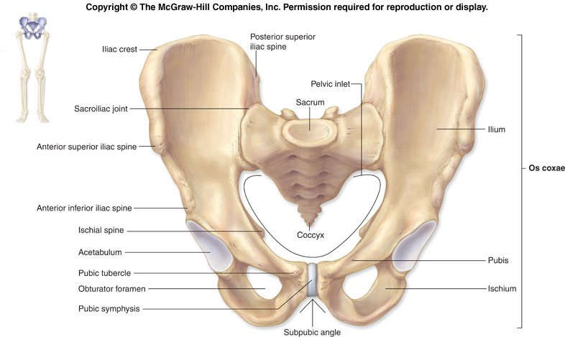
Physical Exam
Palpation in Supine Position
Abdominal fascial hernias
Iliac crest
Ilioinguinal ligament
ASIS
AIIS
Pubic symphysis
Pubic ramus

Slide 35
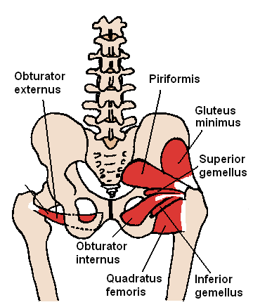
Physical Exam
Palpation in Prone Position
Ischial tuberosity
Sciatic notch
Piriformis muscle.
Sciatic nerve

Slide 36
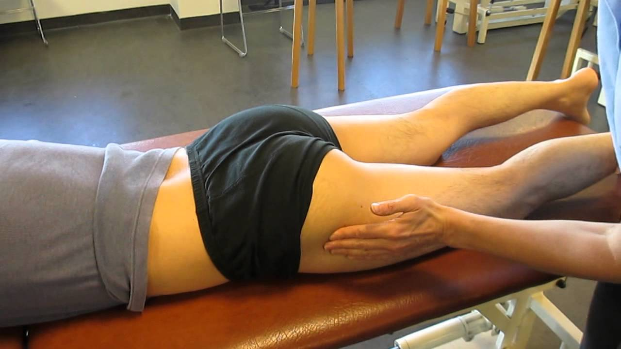
Physical Exam
Palpation in Lateral Position
Iliac crest
Greater trochanter
Tensor fascia latae and IT band

Slide 37
Anterior Hip Pain
Intra-articular
Osteoarthritis
Stress fracture
Inflammatory arthritis
Avascular necrosis of femoral head
Acetabular labral tear
Articular cartilage injuries
Ligamentum teres injuries

Slide 38
Anterior Hip Pain
Extra-Articular
Hip flexor strain
Iliopsoas bursitis
Snapping hip syndromes
Avulsions/apophysitis

Slide 39
Groin Pain
Adductor strains
Osteitis pubis
Athletic pubalgia
Nerve entrapment syndromes

Slide 40
Lateral Hip Pain
Greater trochanteric bursitis
Gluteus medius tendinopathy/dysfunction
IT band syndrome
Meralgia paresthetica

Slide 41
Posterior Hip Pain
Referred from lumbar spine
Piriformis syndrome
Sacroiliac joint dysfunction
High hamstring strain or ischial tuberosity avulsion

Slide 42
Case Study 1
44 year old woman with 3 month h/o lateral and posterior hip pain, right greater than left. Worse with prolonged standing and running. Used to jog 8-10 miles a week, but has stopped for past month because of lateral hip pain. No acute injury.

Slide 43
Trendelenburg Test

Slide 44
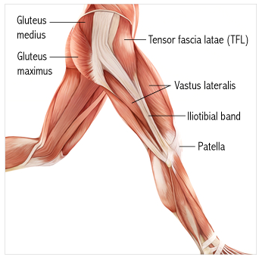
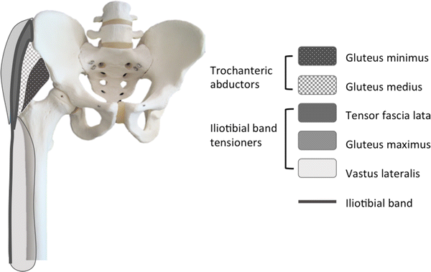
Gluteal Tendinopathy
Grimaldi et al. Sports Med 2015;45:1107-19

Slide 45
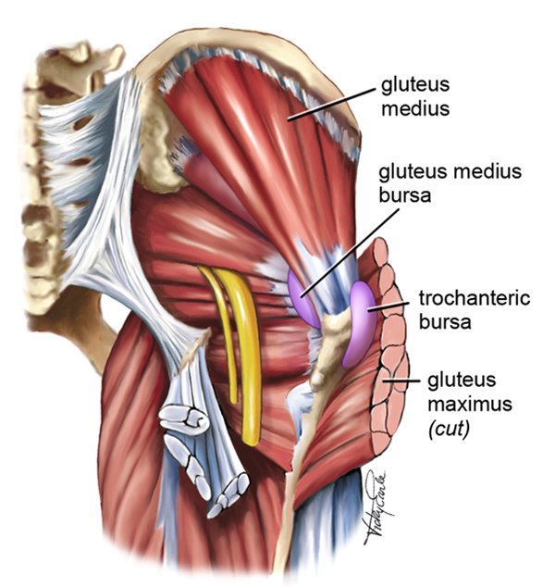
Gluteus Medius/Minimus Tendinopathy
Karim Khan, Karim. Lateral hip pain-more likely gluetues medius tendinopathy than trochanteric burstis. 21 Nov, 10. http://blogs.bmj.com/

Slide 46
Gluteal Tendinopathy
Gluteus medius (GMe) and minimus (GMi) are primary hip abductors
GMe is the main pelvic stabilizer during single-leg stance, preventing the contralateral pelvis from tilting downward.
Gluteal tendinopathy is the most prevalent of all lower limb tendinopathies
Gluteal tendinopathy incorporates what used to be called greater trochanteric bursitis, and is also at the root of IT band syndrome.

Slide 47
Gluteal Tendinopathy
Secondary hip abductors are the ITB-tensing muscles (30%in single leg stance)
  Upper portion of gluteus maximus, tensor fascia lata, and vastus lateralis
The ITB compresses the GMe and GMi tendons at their insertion on the greater trochanter
Hip adduction increases ITB tension and increases its’ contribution to hip control
  Increases compressive load on the GMe and GMi tendons

Slide 48
Gluteal Tendinopathy
Clinical Presentation
Lateral hip pain of gradual onset
Often associated with changes in work load or physical activity, particularly running
Pain can progress to night pain (prohibiting sleeping on the affected side)
Single leg loading tasks – walking/running, standing on one leg to dress, climbing stairs/hills – are particularly painful
Stiffness with extending hip when getting out of a chair

Slide 49
Gluteal Tendinopathy
Physical Exam
Tenderness over greater trochanter
Trendelenburg variations (sustained single-leg stance tests)
Resisted hip abduction – best done with the hip adducted
Resisted external derotation test
Ober test
FABER (Patrick test)

Slide 50
Gluteal Tendinopathy
Treatment
Hip abductor and flexor strengthening
Decreased peak hip adduction in running – increasing cadence
Corticosteroid injection
    May cause further tendon degeneration
Dry needling and PRP

Slide 51
Case Study 2
25 year old martial arts instructor with a 3 year history of right groin pain. No acute injury. Worse after activity, particularly more intense martial arts work-outs. Feels better if he avoids activity, but returns with resumption of activity, even after several days of rest. Otherwise healthy, no medications.

Slide 52
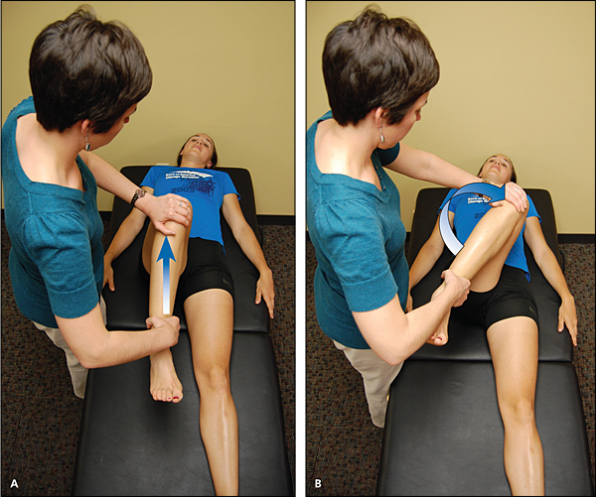
Case Study 2
Physical Exam
Decreased internal rotation with pain on right compared to left
Pain with FADIR test
Good strength without pain with resisted hip flexion, abduction, and adduction
Wilson et al. Am Fam Physician 2014;89:27-34

Slide 53
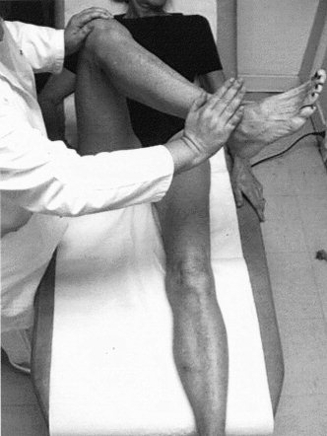
Resisted External Derotation Test
Lequesne et al. Arthritis Rheum 2008; 59:241-246

Slide 54
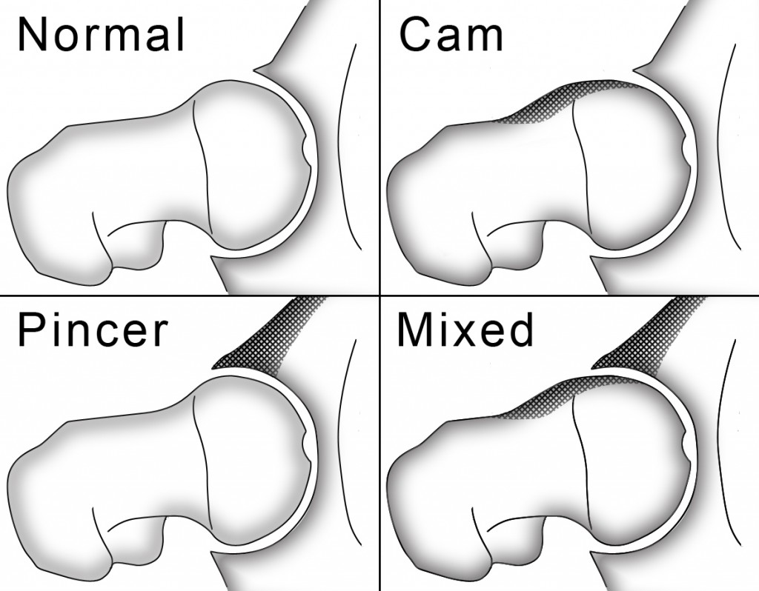
Femoral Acetabular Impingment

Slide 55
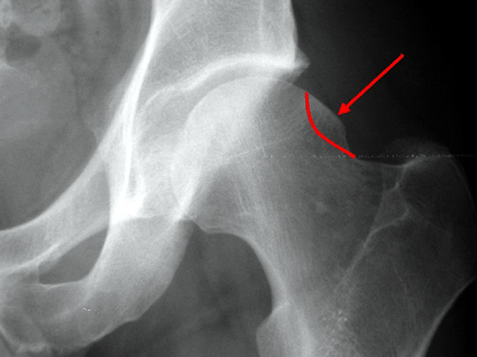
Femoral Acetabular Impingement
Cam-type
  Usually young men
  Due to shear forces applied from the aspherical portion of the femoral head as it articulates with the acetabulum
  Results in chondral delamination and detachment

Slide 56
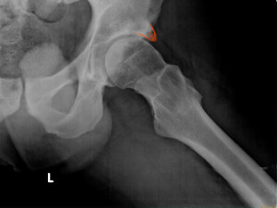
Femoral Acetabular Impingement
Pincer-type
More common in women
Results from repetitive contact stress of a normal femoral head-neck against an abnormal area of the acetabulum
Results in degeneration and tearing of the labrum

Slide 57
Case Study 3
22 year old male soccer player with 2 month history of left sided groin pain. Worse with cutting and lateral movements. Diagnosed with hip adductor strain and participated in a rehab program, but no improvement. Pelvic and hip x-rays are normal.

Slide 58
Chronic Groin Pain
Differential Diagnoses
Adductor longus dysfunction
Osteitis pubis
Athletic pubalgia, sports hernia, etc
Nerve entrapment syndromes
    Genital branch of genitofemoral nerve
    Obturator nerve
Hip joint pathology
    FAI, capsulolabral injuries, chondral defects
Caudill et al. Br J Sports Med 2008;42:954-964

Slide 59
Athletic Pubalgia
Inguinal Disruption
Insidious onset of unilateral groin pain worse with dynamic (sudden) movement
Most common in male soccer, ice hockey, and tennis players
Historically, multiple names (e.g., sportsman’s hernia) and proposed etiologies

Slide 60
Inguinal Disruption
Diagnostic Criteria
At least 3 out of the following 5 clinical signs
  Pinpoint tenderness over the pubic tubercle at the insertion of the conjoint tendon
  Palpable tenderness over the deep inguinal ring
  Pain and/or dilation of the external ring with no obvious hernia evident
  Pain at the origin of the adductor longus tendon
  Dull, diffuse pain in the groin, often radiating to the perineum and inner thigh or across the midline
Sheen et al. Br J Sports Med 2014;48:1079-1087

Slide 61
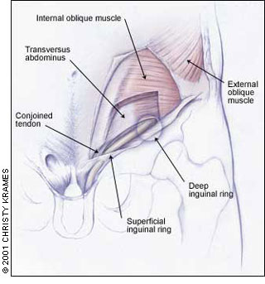
Athletic Pubalgia
Conjoint tendon: lower part of the common aponeurosis of the internal abdominal oblique and the transverse abdominal. Inserts behind the superficial inguinal ring and forms the medial part of the posterior wall of the inguinal canal.

Slide 62
Athletic Pubalgia
Etiology
Imbalance of strength, endurance, coordination and/or extensibility between the stronger leg muscles and weaker abdominal muscles
Causes increased shear forces across the pubic symphysis and subsequent tearing of the transversalis fascia, conjoint tendon, inguinal canal or overlying musculature
Caudill et al. Br J Sports Med 2008;42:954-964

Slide 63
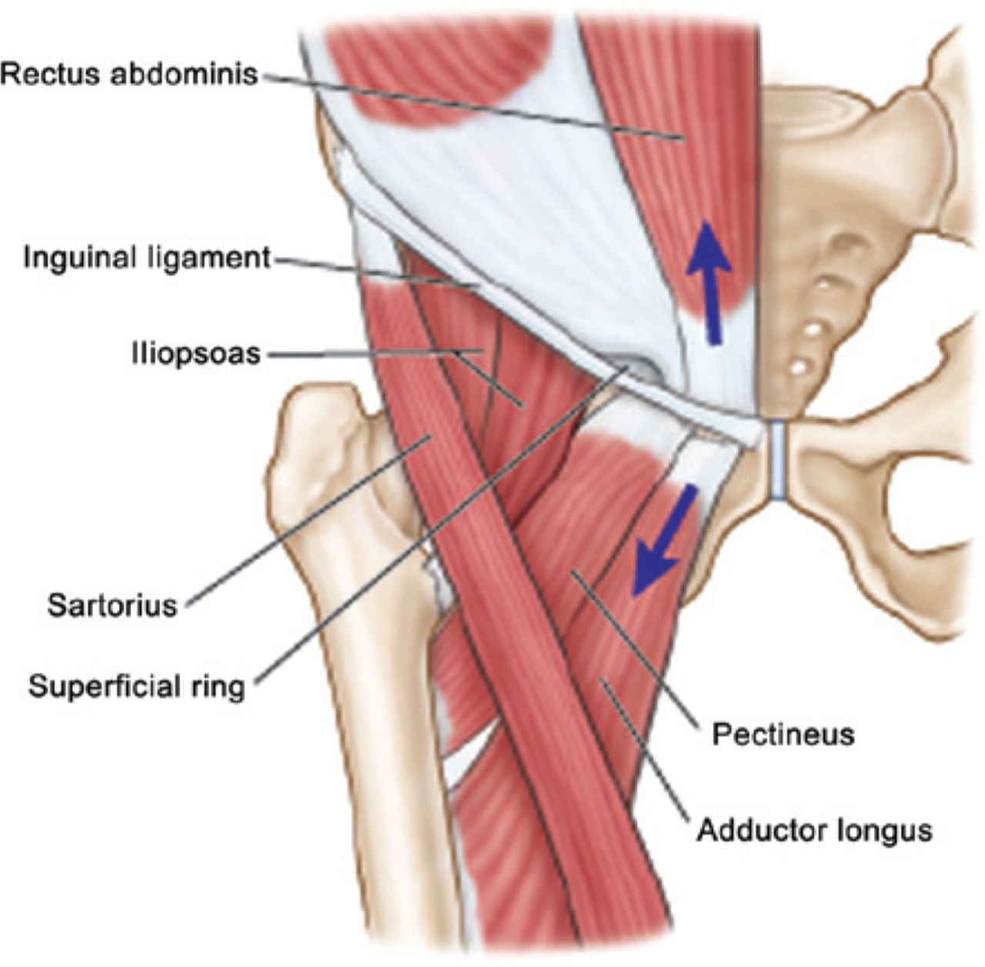
Athletic Pubalgia
MRI findings: tears involving the rectus abdominis-adductor aponeurosis , 1-2 cm lateral to the pubic symphysis
Omar et al. RadioGraphics 2008;28:1415-1438

Slide 64
Athletic Pubalgia
Treatment
Correcting muscle imbalances between hip adductors, hip flexors, and abdominal muscles
Tendinopathy injections?
Surgery?

