Slide 1
“I Can’t Sleep!” Insomnia Case Discussions
Anita Valanju Shelgikar, MD
October 20, 2016

Slide 2
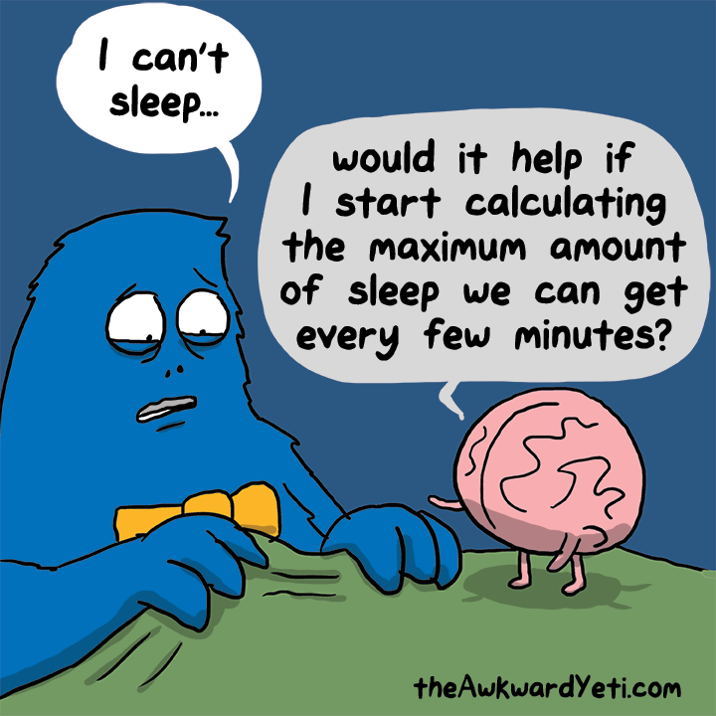
Objectives
Review common pharmacologic treatments for insomnia
Review cognitive-behavioral therapy for insomnia
Discuss use of mobile technologies in the treatment of insomnia

Slide 3
Key Points
Hypnotics may be considered for acute insomnia but are rarely an effective sole treatment for chronic insomnia
Cognitive-behavioral therapy for insomnia offers better long-term success for patients with chronic insomnia
Mobile applications may be a useful adjunct for treatment of chronic insomnia in carefully selected patients

Slide 4
Diagnostic criteria for insomnia
One or more of:
Difficulty initiating sleep
Difficulty maintaining sleep
Waking up earlier than desired
Resistance to going to bed on appropriate schedule
Difficulty sleeping without parent or caregiver intervention
One or more of:
Fatigue/malaise
Attention, concentration, or memory impairment
Impaired social, family, occupational, or academic performance
Mood disturbance/irritability
Daytime sleepiness
Behavioral problems
Reduced motivation/energy/ initiative
Proneness for errors/accidents
Concerns about or dissatisfaction with sleep
Complaints not explained by inadequate opportunity or circumstances
Sleep disturbance and associated daytime symptoms occur at least 3 times/week
Sleep/wake difficulty not better explained by another sleep disorder
Short-term
Present for ≤ 3 months
Chronic
Present for ≥ 3 months

Slide 5
Case discussion #1
73 year old woman referred by her primary care physician for evaluation of insomnia
Neck, upper back and head pain (acetominophen)
Using zolpidem 2.5 mg for a few years
Trazodone caused nightmares
Drinks wine at night
Uses melatonin sometimes
Regular exercise and massage therapy
Which are the insomnia treatments tried?
Notes:
History obtained from chart review; I read the sleep study but did not see the patient in clinic.
General sleep:
Bedroom partner: No
Bedtime: 10:30 pm
Wake time: 6-7 am
Sleep-onset latency: a few minutes (with Ambien)
Awakenings from sleep: 2-3
Nocturia: 2 times
Difficulty falling back asleep: Not with Ambien or wine;
Position: mostly sides
She gets into bed and reads until she is tired. She is usually falling asleep at close to 11 pm. She has a glass of wine at 10 pm or 10:30. If she does not fall asleep in an hour, she will have another glass of wine. If she does not take Ambien, she starts to stiffen up and gets pain all over. She discovered a glass of wine works better for the muscle tightness. She used to take tramadol and Ativan. It is not easier to fall asleep if she goes to bed later.
Excessive daytime sleepiness: No
Daytime fatigue/tiredness: Yes, she has had to push herself for many years to get going
Caffeine or stimulant use to stay awake: No
Drowsiness when driving: No
Naps: No
Symptoms of sleep-disordered breathing:
Snoring: Yes
Gasping/choking during sleep: No
Witnessed apneas: Unsure due to lack of bedpartner
Unrefreshed upon awakening: Yes
Morning headaches: Yes
Dry mouth: Yes, uses biotene
Nasal allergies: Yes, takes Sudafed 2-3 times per day; she gets a headache in her sinuses as if she has a cold.
Acid reflux: yes, takes Prilosec

Slide 6
What categories of medications have you prescribed for insomnia?

Slide 7
Antidepressants
Supplements
Benzodiazepines
Opioids or other analgesics
Muscle relaxants
Antiepileptic drugs
Antihistamines
Z Drugs
(BzRAs)

Slide 8
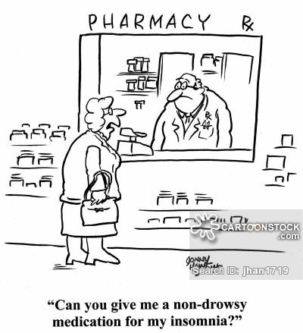
The search for the perfect hypnotic…

Slide 9
Do you proceed with medications have for insomnia in a certain sequence?

Slide 10
Recommended general sequence of medication trials
Short-intermediate acting benzodiazepine receptor agonists (BZD or newer BzRAs) or ramelteon:
Examples:
Eszopiclone
Zaleplon
Temazepam
Alternate short-intermediate acting BzRAs or ramelteon if the initial agent has been unsuccessful
Sedating antidepressants, especially when used in conjunction with treating comorbid depression/anxiety:
Examples:
Trazodone
Amitriptyline
Doxepin,
Mirtazapine
J Clin Sleep Med 2008;4(5):487-504
Notes:
Go over FDA recommendations for zolpidem dosing

Slide 11
Recommended general sequence of medication trials (cont.)
Combined BzRA or ramelteon and sedating antidepressant
Other sedating agents
Examples
Anti-epilepsy medications
gabapentin, tiagabine
Atypicall antipsychotics
quetiapine, olanzapine
Antipsychotics may only be suitable for patients with comorbid insomnia who may benefit from the primary action of these drugs as well as from the sedating effect.
J Clin Sleep Med 2008;4(5):487-504
Notes:
Go over FDA recommendations for zolpidem dosing

Slide 12
What categories of medications are not recommended for treatment of insomnia?

Slide 13
Medications not recommended
Over-the-counter antihistamine or antihistamine/analgesic type drugs (OTC “sleep aids”)
Herbal and nutritional substances
Examples:
Valerian
Melatonin
*Relative lack of efficacy and safety data
Older approved drugs for insomnia
Examples:
Barbiturates
Barbiturate-type drugs
Chloral hydrate
J Clin Sleep Med 2008;4(5):487-504
Notes:
Go over FDA recommendations for zolpidem dosing

Slide 14
Guidelines: medications for chronic insomnia
Pharmacological treatment should be accompanied by patient education regarding:
(1) treatment goals and expectations
(2) safety concerns
(3) potential side effects and drug interactions
(4) other treatment modalities (cognitive and behavioral treatments)
(5) potential for dosage escalation
(6) rebound insomnia
J Clin Sleep Med 2008;4(5):487-504
Notes:
Go over FDA recommendations for zolpidem dosing

Slide 15
Guidelines: medications for chronic insomnia
Patients should be followed on a regular basis
Every few weeks in the initial period of treatment when possible
Assess for effectiveness, possible side effects, and need for ongoing medication.
Efforts should be made to:
Employ the lowest effective maintenance dosage of
Taper medication when conditions allow
Medication tapering and discontinuation are facilitated by cognitive and behavioral therapy for insomnia
J Clin Sleep Med 2008;4(5):487-504
Notes:
Go over FDA recommendations for zolpidem dosing

Slide 16
Back to case discussion #1
73 year old woman referred by her primary care physician for evaluation of insomnia
Neck, upper back and head pain (acetominophen)
Using zolpidem 2.5 mg for a few years
Trazodone caused nightmares
Drinks wine at night
Uses melatonin sometimes
Regular exercise and massage therapy
Which are the insomnia treatments tried?
Notes:
History obtained from chart review; I read the sleep study but did not see the patient in clinic.
General sleep:
Bedroom partner: No
Bedtime: 10:30 pm
Wake time: 6-7 am
Sleep-onset latency: a few minutes (with Ambien)
Awakenings from sleep: 2-3
Nocturia: 2 times
Difficulty falling back asleep: Not with Ambien or wine;
Position: mostly sides
She gets into bed and reads until she is tired. She is usually falling asleep at close to 11 pm. She has a glass of wine at 10 pm or 10:30. If she does not fall asleep in an hour, she will have another glass of wine. If she does not take Ambien, she starts to stiffen up and gets pain all over. She discovered a glass of wine works better for the muscle tightness. She used to take tramadol and Ativan. It is not easier to fall asleep if she goes to bed later.
Excessive daytime sleepiness: No
Daytime fatigue/tiredness: Yes, she has had to push herself for many years to get going
Caffeine or stimulant use to stay awake: No
Drowsiness when driving: No
Naps: No
Symptoms of sleep-disordered breathing:
Snoring: Yes
Gasping/choking during sleep: No
Witnessed apneas: Unsure due to lack of bedpartner
Unrefreshed upon awakening: Yes
Morning headaches: Yes
Dry mouth: Yes, uses biotene
Nasal allergies: Yes, takes Sudafed 2-3 times per day; she gets a headache in her sinuses as if she has a cold.
Acid reflux: yes, takes Prilosec

Slide 17
Physical exam
BP: 135/68
Pulse: 75
Resp: 16
Height: 1.651 m (5' 5")
Weight: 69.4 kg (153 lb)
SpO2: 96%
Body mass index is 25.46 kg/(m^2).
Neck Circumference : 15 in
Elongated soft palate/uvula: Yes
Friedman class IV
Tonsil size: absent
Overjet: 3 mm
Crossbite: No
Tongue scalloping: Yes
Notes:
She has tried melatonin in the past, which has not helped and trazodone caused nightmares. Her primary care physician does not want her taking Ambien on a nightly basis due to side effects in more elderly patients.

Slide 18
How would you proceed?

Slide 19
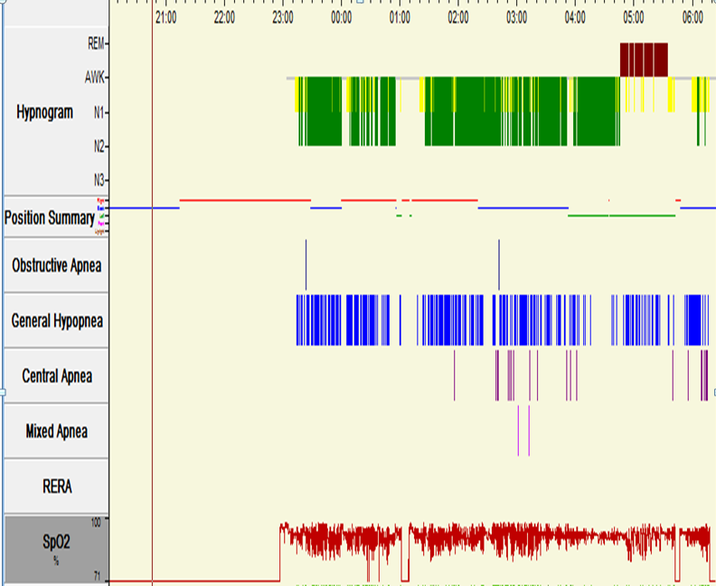

Slide 20
“Interpretation: This baseline polysomnogram shows severe obstructive sleep apnea that persists in all observed stages of sleep and sleeping positions. Somniloquy was observed. The patient took two doses of zolpidem during the study.”
Notes:
The patient's 2-D echocardiogram from 11/5/2009 showed grade 1 diastolic dysfunction with low normal left ventricular systolic function of 55%.

Slide 21
Case discussion #1: Take home points
Minimize hypnotic use when possible
Lowest possible dose
Monotherapy
Assess for hypnotic side effects, particularly those that may pose a safety risk
Explore other sleep-related symptoms
You may discover another (treatable) sleep disorder
Successful treatment of comorbid sleep disorders may allow hypnotic taper or discontinuation
Notes:
History obtained from chart review; I read the sleep study but did not see the patient in clinic.
General sleep:
Bedroom partner: No
Bedtime: 10:30 pm
Wake time: 6-7 am
Sleep-onset latency: a few minutes (with Ambien)
Awakenings from sleep: 2-3
Nocturia: 2 times
Difficulty falling back asleep: Not with Ambien or wine;
Position: mostly sides
She gets into bed and reads until she is tired. She is usually falling asleep at close to 11 pm. She has a glass of wine at 10 pm or 10:30. If she does not fall asleep in an hour, she will have another glass of wine. If she does not take Ambien, she starts to stiffen up and gets pain all over. She discovered a glass of wine works better for the muscle tightness. She used to take tramadol and Ativan. It is not easier to fall asleep if she goes to bed later.
Excessive daytime sleepiness: No
Daytime fatigue/tiredness: Yes, she has had to push herself for many years to get going
Caffeine or stimulant use to stay awake: No
Drowsiness when driving: No
Naps: No
Symptoms of sleep-disordered breathing:
Snoring: Yes
Gasping/choking during sleep: No
Witnessed apneas: Unsure due to lack of bedpartner
Unrefreshed upon awakening: Yes
Morning headaches: Yes
Dry mouth: Yes, uses biotene
Nasal allergies: Yes, takes Sudafed 2-3 times per day; she gets a headache in her sinuses as if she has a cold.
Acid reflux: yes, takes Prilosec

Slide 22
Case discussion #2
65 year old woman presented to an outside facility may years ago with frequent nocturnal awakenings, snoring and witnessed apneas
Diagnosed with obstructive sleep apnea, currently treated with nightly use of bi-level positive airway pressure (PAP)
Says she sleeps well and “prefers to have a long sleep schedule because I like to have a shorter day”

Slide 23
Case discussion #2 (cont.)
Sleeps from 10 or 11 pm, falls asleep within 10 to 90 minutes “depending on the day”
Has 1 nocturnal awakening to urinate then falls back asleep easily
Has used medications to help with sleep for “so many years I can’t remember what it’s like to sleep without them”
Notes:
Ms. Smith sleeps with husband. She goes to bed at 10-11pm and gets out of bed at 10-11am. Sleep onset is within 10-1.5 hours minutes. There is one awakening caused by urination and usually without difficulty resuming sleep. Naps: no napping
This is preferred sleep schedule, she likes having a shorter day

Slide 24
Case discussion #2: past medical history
Chronic insomnia
Left carotid artery stenosis
Iron deficiency anemia
Hyperlipidemia
Biliary cirrhosis
Vitamin D deficiency
Statin intolerance
Ischemic cardiomyopathy
Memory loss
COPD
Obstructive sleep apnea
Non-alcoholic cirrhosis
Asthma
Essential hypertension
Diabetes type 2
CAD
Chronic pain
Chronic use of opiate drugs therapeutic purposes
Notes:
OSA on BiPAP.
She is doing well on the current settings of 15/11cm of water.
She has excellent compliance.
We have asked her to obtain copies of her baseline polysomnogram and titration and have them faxed to our office.
She denied the need for any supplies today but will call if she needs them.
2. Possible RLS.
She has some mild discomfort in her legs at bedtime but this is improved with OTC topical creams. This is likely due to her history of anemia for which she is taking iron supplementation and follows with hematology.
Possible Insomnia.
It is not clear that Ms. Smith has insomnia. She has been on these medications for years and has not tried sleeping without them. She also reported that her ideal sleep time was 11-12 hours (an an attempt to decrease her time awake) which may be much longer than her physiologic need and there is concern that she is using medication to achieve this. We discussed with Ms. Smith that she has a prolonged QT on her EKG from 1/26/15 which can be caused by trazodone and amitriptyline and advised that she reduce or discontinue at least one, if not both of these medications. She is not interested in addressing this further.

Slide 25
Case discussion #2: medications
Amitriptyline 50 mg
Aspirin 81 mg
Atenolol 50 mg
Ferrous sulfate 325 mg X 2
Gabapentin 800 mg
Insulin
Ipratropium inhaler
Metformin 1,000 mg x 2
Lisinopril 5 mg
Ranitidine 20 mg
Trazodone 300 mg
Tramadol 50-100 mg
Notes:
OSA on BiPAP.
She is doing well on the current settings of 15/11cm of water.
She has excellent compliance.
We have asked her to obtain copies of her baseline polysomnogram and titration and have them faxed to our office.
She denied the need for any supplies today but will call if she needs them.
2. Possible RLS.
She has some mild discomfort in her legs at bedtime but this is improved with OTC topical creams. This is likely due to her history of anemia for which she is taking iron supplementation and follows with hematology.
Possible Insomnia.
It is not clear that Ms. Smith has insomnia. She has been on these medications for years and has not tried sleeping without them. She also reported that her ideal sleep time was 11-12 hours (an an attempt to decrease her time awake) which may be much longer than her physiologic need and there is concern that she is using medication to achieve this. We discussed with Ms. Smith that she has a prolonged QT on her EKG from 1/26/15 which can be caused by trazodone and amitriptyline and advised that she reduce or discontinue at least one, if not both of these medications. She is not interested in addressing this further.

Slide 26
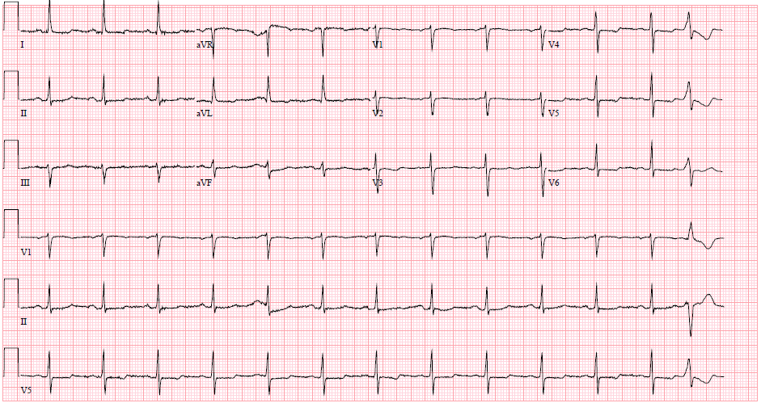
Which of those medications can cause this?
Vent. Rate : 079 BPM
Atrial Rate : 079 BPM P-R Int : 166 ms
QRS Dur : 088 ms QT Int : 420 ms
P-R-T Axes : 044 003 036 degrees QTc Int : 482 ms
Sinus rhythm with occasional premature ventricular complexes Nonspecific ST and T wave abnormality Prolonged QT Abnormal ECG
Notes:
60 year old woman
Prolonged QT on her EKG from 1/26/15 which can be caused by trazodone and amitriptyline and advised that she reduce or discontinue at least one, if not both of these medications. She is not interested in addressing this further.

Slide 27
Case discussion #2: medications
Amitriptyline 50 mg
Aspirin 81 mg
Atenolol 50 mg
Ferrous sulfate 325 mg X 2
Gabapentin 800 mg
Insulin
Ipratropium inhaler
Metformin 1,000 mg x 2
Lisinopril 5 mg
Ranitidine 20 mg
Trazodone 300 mg
Tramadol 50-100 mg
v
Notes:
OSA on BiPAP.
She is doing well on the current settings of 15/11cm of water.
She has excellent compliance.
We have asked her to obtain copies of her baseline polysomnogram and titration and have them faxed to our office.
She denied the need for any supplies today but will call if she needs them.
2. Possible RLS.
She has some mild discomfort in her legs at bedtime but this is improved with OTC topical creams. This is likely due to her history of anemia for which she is taking iron supplementation and follows with hematology.
Possible Insomnia.
It is not clear that Ms. Smith has insomnia. She has been on these medications for years and has not tried sleeping without them. She also reported that her ideal sleep time was 11-12 hours (an an attempt to decrease her time awake) which may be much longer than her physiologic need and there is concern that she is using medication to achieve this. We discussed with Ms. Smith that she has a prolonged QT on her EKG from 1/26/15 which can be caused by trazodone and amitriptyline and advised that she reduce or discontinue at least one, if not both of these medications. She is not interested in addressing this further.

Slide 28
Case discussion #2: Take home points
Minimize hypnotic use when possible
Lowest possible dose
Monotherapy
Assess for hypnotic side effects, particularly those that may pose a safety risk
Explore other sleep-related symptoms
You may discover another (treatable) sleep disorder
Successful treatment of comorbid sleep disorders may allow hypnotic taper or discontinuation
Notes:
History obtained from chart review; I read the sleep study but did not see the patient in clinic.
General sleep:
Bedroom partner: No
Bedtime: 10:30 pm
Wake time: 6-7 am
Sleep-onset latency: a few minutes (with Ambien)
Awakenings from sleep: 2-3
Nocturia: 2 times
Difficulty falling back asleep: Not with Ambien or wine;
Position: mostly sides
She gets into bed and reads until she is tired. She is usually falling asleep at close to 11 pm. She has a glass of wine at 10 pm or 10:30. If she does not fall asleep in an hour, she will have another glass of wine. If she does not take Ambien, she starts to stiffen up and gets pain all over. She discovered a glass of wine works better for the muscle tightness. She used to take tramadol and Ativan. It is not easier to fall asleep if she goes to bed later.
Excessive daytime sleepiness: No
Daytime fatigue/tiredness: Yes, she has had to push herself for many years to get going
Caffeine or stimulant use to stay awake: No
Drowsiness when driving: No
Naps: No
Symptoms of sleep-disordered breathing:
Snoring: Yes
Gasping/choking during sleep: No
Witnessed apneas: Unsure due to lack of bedpartner
Unrefreshed upon awakening: Yes
Morning headaches: Yes
Dry mouth: Yes, uses biotene
Nasal allergies: Yes, takes Sudafed 2-3 times per day; she gets a headache in her sinuses as if she has a cold.
Acid reflux: yes, takes Prilosec

Slide 29
Her comorbid sleep disorder is already treated. What other insomnia treatment option is there to facilitate medication taper or discontinuation?

Slide 30
When is cognitive-behavioral therapy for insomnia (CBT-I) indicated?
Sleep disturbance is chronic
Medication tolerance, adverse side effects, or contraindication
Clear evidence of poor sleep practices
Clear evidence of circadian abnormalities
Patient preference
Child and adolescent patients

Slide 31
When should CBT-I NOT be the first line treatment?
Adjustment insomnia
Presence of an untreated/unstable comorbid disorder
Insomnia may resolve with treatment of the comorbid disorder
CBT-I therapy components may exacerbate co-occurring illness (e.g., SRBD)
Comorbid condition influences patient’s ability and/or motivation to participate in CBT-I
Patient preference

Slide 32
CBT-I vs. pharmacotherapy: Direct comparison
n=46 older adults with chronic primary insomnia randomized to
6 weeks of CBT-I, zopiclone, or placebo
Total Wake Time (min)
*
*
*
*p<.001
Sivertsen B. JAMA 2006;295:2851-8.

Slide 33
What is the conceptual framework underlying CBT-I?

Slide 34
Model of acute and chronic insomnia
THRESHOLD
Perpetuating Factors
Precipitating Factors
Predisposing Factors
Adapted from Spielman A. Psychiatr Clin North Am 1987; 10: 541-53

Slide 35
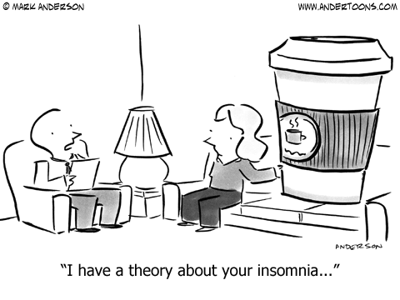
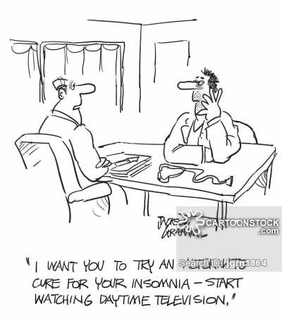
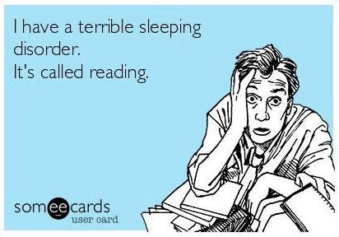
Notes:
Examples of maladaptive behaviors – inadequate sleep hygiene

Slide 36
Cognitive-behavioral therapy for insomnia (CBT-I): Treatment components
BEHAVIORAL
Sleep Restriction
Stimulus Control
Relaxation
COGNITIVE
Beliefs/Attitudes
EDUCATIONAL
Sleep Hygiene
TREATMENT TARGETS
Excessive time in bed
Irregular sleep schedules
Sleep incompatible activities
Hyperarousal
TREATMENT TARGETS
Unrealistic sleep expectations
Misconceptions about sleep
Sleep anticipatory anxiety
Poor cognitive coping skills
TREATMENT TARGETS
Inadequate sleep hygiene
Adapted from Morin CM.

Slide 37
Maintenance treatment of insomnia
Overall remission rates after follow-up:
43% (CBT-I alone) vs.
56% (CBT-I + zolpidem)
% patients achieving remission
JAMA 2009;301(19):2005-15
Notes:
160 chronic insomnia patients received 6 weeks of acute treatment and then no vs. monthly (CBT-I group) or prn vs. taper (CBT/zolpidem)

Slide 38
CBT-I
Pluses
Minuses
With adherence to therapy, it works well
Patients are equipped with strategies to employ in case of insomnia relapse
Minimal (if any) long-term side effects
It takes time
Cost; insurance coverage
Visit frequency
Limited access to behavioral sleep medicine specialists

Slide 39
my patient is interested but can’t do CBT-I…

Slide 40
Case discussion #3
73 year old man with difficulty maintaining sleep
Complicated by chronic back pain
First evaluated 4 years ago (outside facility)
Diagnosed with sleep-disordered breating
Now doing very well with nightly PAP therapy use
Insomnia persists despite PAP use
Referral placed to behavioral sleep medicine clinic

Slide 41
Behavioral sleep medicine evaluation
Consider avoiding evening dozing or not returning to sleep in the morning to increase homeostatic sleep drive
Methadone during the day may worsen sleepiness
“Given that he lives 1.5 hours away and has no other psychiatric comorbidities, he is a good candidate for Sleepio.com, an online sleep treatment program.”

Slide 42
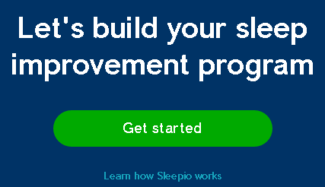
Please note:
This is not an endorsement, only an example.

Slide 43
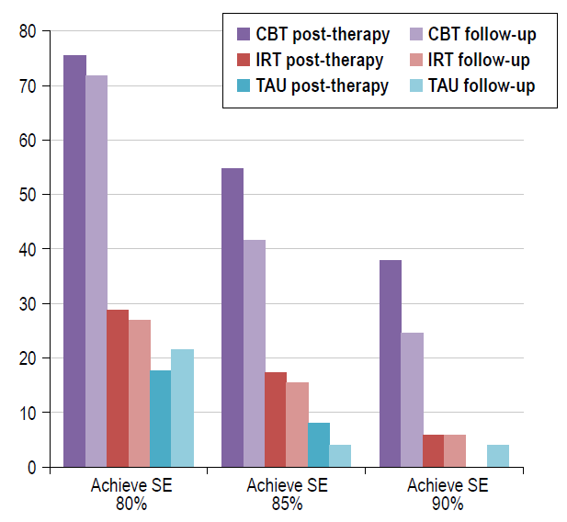
Percentage of patients within each treatment arm achieving sleep efficiency (SE) clinical end-points with Sleepio.
SLEEP 2012;35(6):769-781.
Notes:
Study Objectives: The internet provides a pervasive milieu for healthcare delivery. The purpose of this study was to determine the effectiveness of
a novel web-based cognitive behavioral therapy (CBT) course delivered by an automated virtual therapist, when compared with a credible placebo;
an approach required because web products may be intrinsically engaging, and vulnerable to placebo response.
Design: Randomized, placebo-controlled trial comprising 3 arms: CBT, imagery relief therapy (IRT: placebo), treatment as usual (TAU).
Setting: Online community of participants in the UK.
Participants: One hundred sixty-four adults (120 F: [mean age 49y (18-78y)] meeting proposed DSM-5 criteria for Insomnia Disorder, randomly
assigned to CBT (n = 55; 40 F), IRT placebo (n = 55; 42 F) or TAU (n = 54; 38 F).
Interventions: CBT and IRT each comprised 6 online sessions delivered by an animated personal therapist, with automated web and email support.
Participants also had access to a video library/back catalogue of session content and Wikipedia style articles. Online CBT users had access
to a moderated social network/community of users. TAU comprised no restrictions on usual care and access to an online sleep diary.
Measurements and Results: Major assessments at baseline, post-treatment, and at follow-up 8-weeks post-treatment; outcomes appraised by
online sleep diaries and clinical status. On the primary endpoint of sleep efficiency (SE; total time asleep expressed as a percentage of the total
time spent in bed), online CBT was associated with sustained improvement at post-treatment (+20%) relative to both TAU (+6%; d = 0.95) and IRT
(+6%: d = 1.06), and at 8 weeks (+20%) relative to IRT (+7%: d = 1.00) and TAU (+9%: d = 0.69) These findings were mirrored across a range of
sleep diary measures. Clinical benefits of CBT were evidenced by modest superiority over placebo on daytime outcomes (d = 0.23-0.37) and by
substantial improved sleep-wake functioning on the Sleep Condition Indicator (range of d = 0.77-1.20). Three-quarters of CBT participants (76%
[CBT] vs. 29% [IRT] and 18% [TAU]) completed treatment with SE > 80%, more than half (55% [CBT] vs. 17% [IRT] and 8% [TAU]) with SE > 85%,
and over one-third (38% [CBT] vs. 6% [IRT] and 0% [TAU]) with SE > 90%; these improvements were largely maintained during follow-up.
Conclusion: CBT delivered using a media-rich web application with automated support and a community forum is effective in improving the sleep
and associated daytime functioning of adults with insomnia disorder.

Slide 44
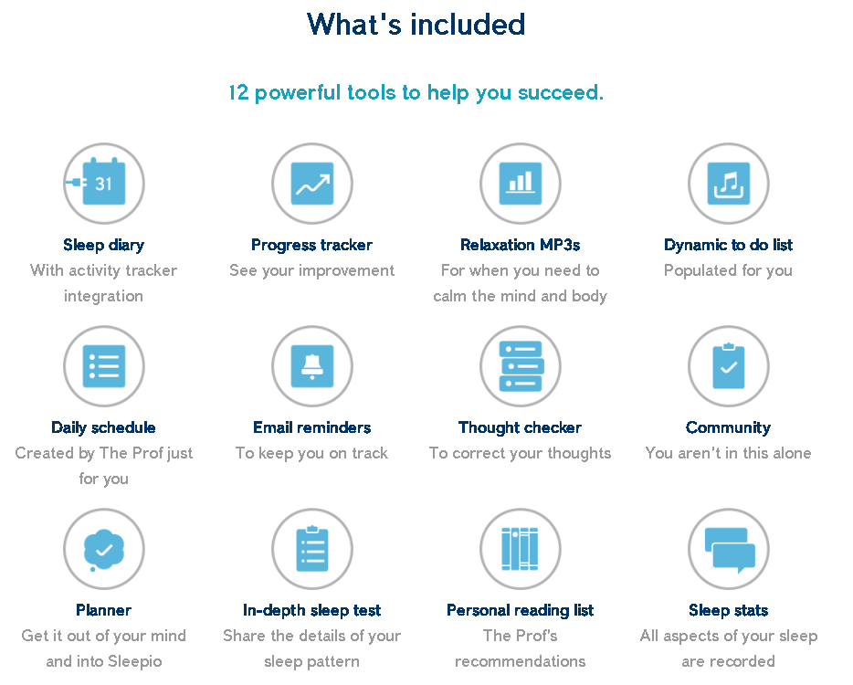
www.sleepio.com

Slide 45
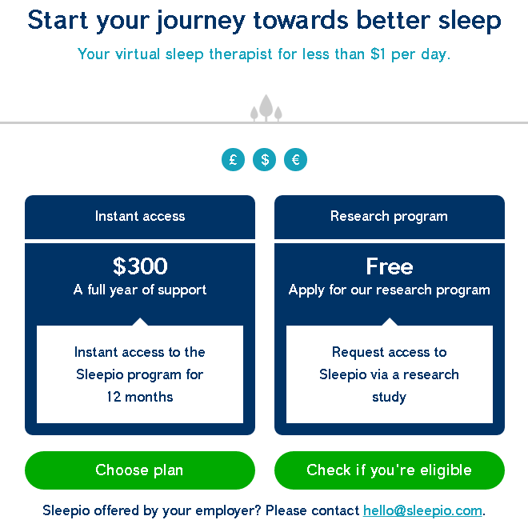
www.sleepio.com

Slide 46
Case discussion #3: clinical follow-up
Finds online sleep treatment to be “very helpful”
He has eliminated his afternoon nap
Has helped him to achieve total nocturnal sleep time of 6 hours per night
Now trying to eliminate his morning nap
Has led to further improvement in his nocturnal sleep
“Improved 60-70%" since his first clinic visit

Slide 47
Online CBT-I
Pluses
Minuses
Convenient
Schedule flexibility
Need reliable internet connection and comfort
Cost; insurance coverage
Limited, if any, face-to-face monitoring during course
Another option to consider for your patients

Slide 48
Case discussion #3: Take home points
Consider cognitive-behavioral therapy for treatment of chronic insomnia
“Real world” access is sometimes difficult due to issues with insurance coverage and logistics of frequent clinic visits
Consider other modalities (e.g. online) for cognitive and behavioral management of insomnia in appropriate patients
Notes:
History obtained from chart review; I read the sleep study but did not see the patient in clinic.
General sleep:
Bedroom partner: No
Bedtime: 10:30 pm
Wake time: 6-7 am
Sleep-onset latency: a few minutes (with Ambien)
Awakenings from sleep: 2-3
Nocturia: 2 times
Difficulty falling back asleep: Not with Ambien or wine;
Position: mostly sides
She gets into bed and reads until she is tired. She is usually falling asleep at close to 11 pm. She has a glass of wine at 10 pm or 10:30. If she does not fall asleep in an hour, she will have another glass of wine. If she does not take Ambien, she starts to stiffen up and gets pain all over. She discovered a glass of wine works better for the muscle tightness. She used to take tramadol and Ativan. It is not easier to fall asleep if she goes to bed later.
Excessive daytime sleepiness: No
Daytime fatigue/tiredness: Yes, she has had to push herself for many years to get going
Caffeine or stimulant use to stay awake: No
Drowsiness when driving: No
Naps: No
Symptoms of sleep-disordered breathing:
Snoring: Yes
Gasping/choking during sleep: No
Witnessed apneas: Unsure due to lack of bedpartner
Unrefreshed upon awakening: Yes
Morning headaches: Yes
Dry mouth: Yes, uses biotene
Nasal allergies: Yes, takes Sudafed 2-3 times per day; she gets a headache in her sinuses as if she has a cold.
Acid reflux: yes, takes Prilosec

Slide 49
Key Points
Hypnotics may be considered for acute insomnia but are rarely an effective sole treatment for chronic insomnia
Cognitive-behavioral therapy for insomnia offers better long-term success for patients with chronic insomnia
Mobile applications may be a useful adjunct for treatment of chronic insomnia in carefully selected patients

