Slide 1
Seniors with Memory Loss: A Primer
Praveen Dayalu, MD
Clinical Associate Professor
Department of Neurology
University of Michigan

Slide 2
Cognitive domains
Executive function (frontal, hemispheric white matter)
Memory (medial temporal lobes/ hippocampus)
Language (left hemisphere, usually)
Visuospatial (occipital, parietal)

Slide 3
Cerebral hemisphere and lobes

Slide 4
What Is Dementia?
Impairment in intellectual function affecting more than one cognitive domains
Interferes with social or occupational function
Decline from a previous level
Not explained by delirium or major psychiatric disease

Slide 5
Mild Cognitive Impairment
Cognitive decline abnormal for age and education but does not interfere with function and activities
“At risk” state to develop a degenerative dementia
When memory loss predominates, termed Amnestic MCI. This has ~15% per year of conversion to AD.

Slide 6
Hepatic, renal, or
thyroid disease
Deficiency (B12)
Toxins, OSA
Trauma, tumor,
MS, HIV, syphilis,
NPH, subdurals,
vasculitis, CJD
Cognitive decline
Depression
Other psych
Delirium
Drug induced
Dementias
(“big four”)
Alcohol
Recreational
Prescriptions !
Alzheimer
Vascular
Lewy body / PD
Frontotemporal
Alone, or
With dementia
Many causes!

Slide 7
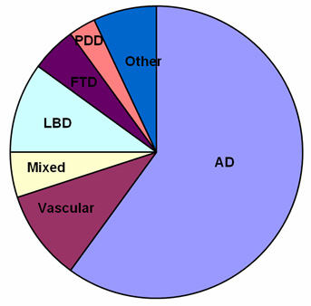
“Primary” dementias: the big ones
AD= Alzheimer’s
LBD= Lewy Body dementia
PD= Parkinson disease dementia
FTD= Frontotemporal dementia
Vascular

Slide 8
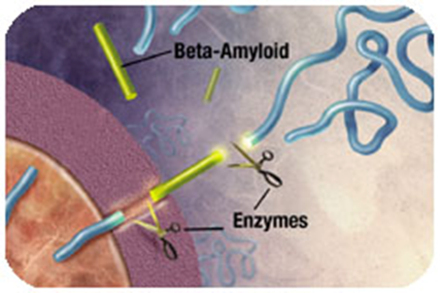
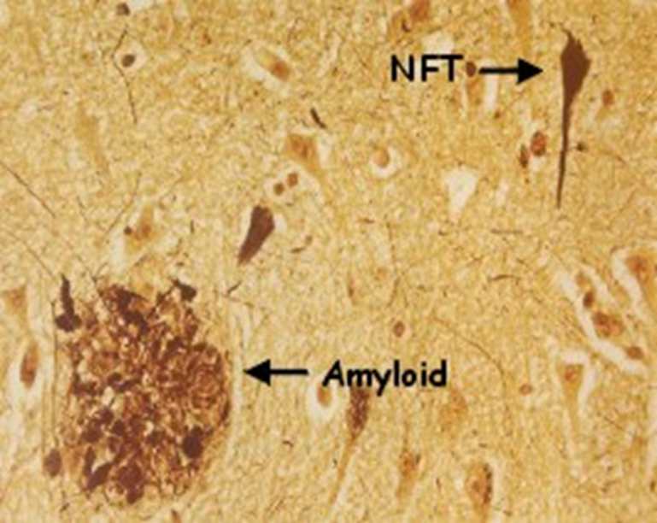
Alzheimer Disease (AD)
Commonest neurodegenerative and dementing disease
Prevalence doubles every 5 years after 65; ~50% of those older than 85

Slide 9
AD Risk Factors
Age!!
Mild cognitive impairment (MCI)
ApoE-e4 positivity
Family hx in first degree relative (especially if younger onset)
Vascular risk (diabetes, heart disease, etc.)
Low education and physical/social activity
Female sex

Slide 10
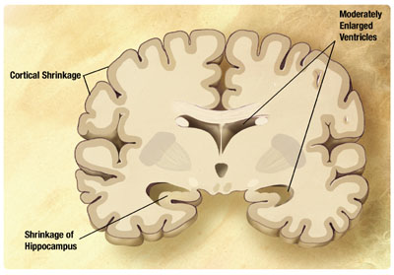
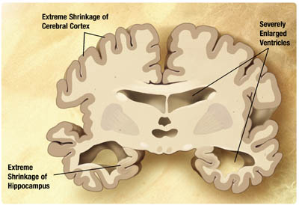
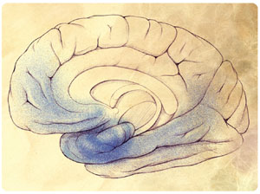
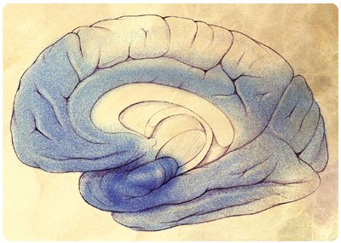
Mild-moderate AD Severe AD

Slide 11
AD Clinical Features
Earliest cognitive symptoms are usually poor short term memory; loss of orientation
Smooth, usually slow decline without dramatic short-term fluctuations
Other domains involved with time
So common that many variations are seen

Slide 12
AD: Behavioral & Psych
Depression, anxiety
Irritability, hostility, apathy
Delusions, hallucinations
Sleep-wake changes
Sundowning
Agitation

Slide 13
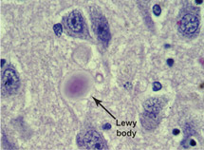
Dementia with Lewy Bodies (DLB)
Relatively earlier occipital and basal ganglia degeneration
Similar to Parkinson disease dementia
α-synuclein aggregates into Lewy bodies
Concurrent AD pathology is common

Slide 14
DLB Clinical Features
Dementia (early on, visuospatial and executive) PLUS
Core features
Parkinsonism
Recurrent early visual hallucinations
Fluctuations (clue: recurrent delirium evaluations)
Suggestive features include REM sleep disorder (dream enactment) & neuroleptic sensitivity

Slide 15
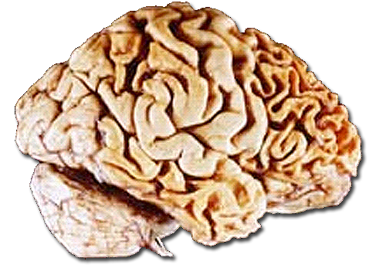
Frontotemporal Dementia (FTD)
Average age of onset 58, rather than very old
Often familial (30-50%)
Overlap with progressive supranuclear palsy, ALS, and corticobasal degeneration
Pathologic aggregates of tau or TDP-43

Slide 16
FTD clinical features
Behavior and personality change (may be initially misdiagnosed as a psychiatric disorder)
Executive dysfunction
Progressive non-fluent aphasia
May see parkinsonism or muscle weakness

Slide 17
Vascular Dementia
Suspect when
Abrupt onset and/or stepwise decline
Fluctuating course
H/o stroke
Focal neurologic symptoms or signs
Usually see bilateral infarcts
Often associated with executive dysfunction, gait disorder, apathy, incontinence

Slide 18
“...evidence of chronic small vessel ischemic disease involving subcortical white matter”
This is nondiagnostic and very common with age
Changes may or may not be symptomatic
≠ “Vascular dementia”
Don’t tell patients
“Your scan showed strokes.”

Slide 19
Hepatic, renal, or
thyroid disease
Deficiency (B12)
Toxins, OSA
Trauma, tumor,
MS, HIV, syphilis,
NPH, subdurals,
vasculitis, CJD
Cognitive decline
Depression
Other psych
Delirium
Drug induced
Dementias
(“big four”)
Alcohol
Recreational
Prescriptions !
Alzheimer
Vascular
Lewy body / PD
Frontotemporal
Alone, or
With dementia
Many causes!

Slide 20
The HPI is critical !
Ask a close informant
Duration, rate, smoothness?
Associated symptoms (headache, trouble with vision, speech, strength, coordination, gait)
What domains are affected?
Repeats self? Forgets recent things? Appointments? Month & year?
Trouble with appliances? Trouble planning?
Change in personality, judgment, behavior?
Navigation problems? Hallucinations?
Word finding problems?
How is function affected?
Finances, chores, hobbies, driving, occupation, social

Slide 21
Fill out the picture
Medical problems and risk factors?
Neurologic history (stroke, trauma, infection)?
Educational background?
Family history?
Alcohol and drugs?
Medications?
Remember, your first goal is to exclude readily treatable causes…

Slide 22
Differential diagnosis in dementia: Commoner treatable causes
Structural brain lesion (subdural bleed)
Thyroid disease
B12 deficiency
Untreated sleep apnea
Depression or anxiety
Alcoholism
Meds: Benzos, opioids, anticholinergics (diphenhydramine, bladder drugs, tricyclics), neuroleptics, dopaminergics, other sedatives

Slide 23
Examination
General neurologic exam
Any focalities that suggest stroke?
Signs of parkinsonism or a gait disorder?
Cognitive screen
Mini-mental (MMSE)
Mini-cog
Montreal Cognitive Assessment (MoCA)

Slide 24
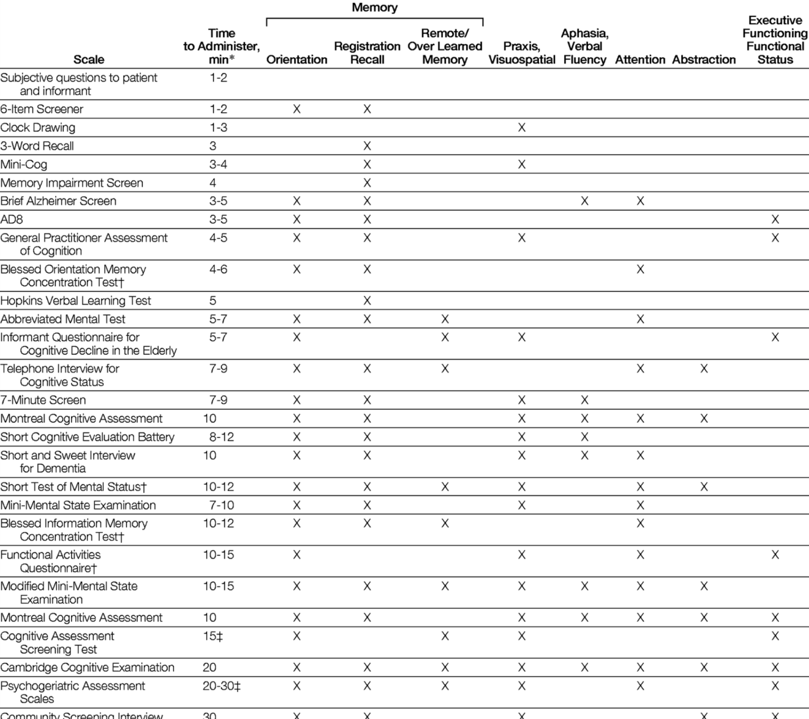
Holsinger et al JAMA. 2007;297(21):2391-2404

Slide 25
Diagnostic testing
There is no “dementia test panel”
For slowly progressive “typical” dementia in adults >65, most essential tests: B₁₂, TSH, brain image (CT is ok)
Neuropsychology testing can help but not mandatory
FDG- PET approved to differentiate AD from FTD
Amyloid-PET has just been approved
PET studies have little value in most cases and are expensive
For younger patients, or rapid or atypical course, workup may be “tiered” to target range of diagnoses, emphasizing treatable causes

Slide 26
Why properly diagnose?
There may be a readily treatable cause
Some degenerative dementias do have symptomatic pharmacotherapies
Patients and families want to know and understand what they are dealing with
Helps long-term planning
Facilitates research efforts
Facilitates advocacy/ support group participation

Slide 27
Drug treatment?
No current treatment slows down neuronal loss in the brain
Cholinesterase inhibitors (donepezil, rivastigmine, galantamine)?
- Modest symptom improvement in AD
- Sometimes marked improvements in PDD/ DLB
Memantine? Modest benefit in AD

