Slide 1
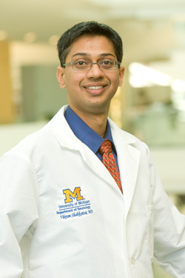
Ataxia
Vikram Shakkottai’s lab is exploring functional changes in cerebellar neurons as a therapeutic target for ataxia. Using mouse models of inherited ataxia, the lab seeks to find alterations in firing properties of cerebellar neurons that predict their vulnerability to neurodegeneration.
His lab is also working on determining whether currently approved drugs, and novel ion channel modulators can improve symptoms in patients with ataxia.
MD: Christian Medical College, India
PhD: University of California-Irvine
Residency: Barnes Jewish Hospital and Washington University

Slide 2
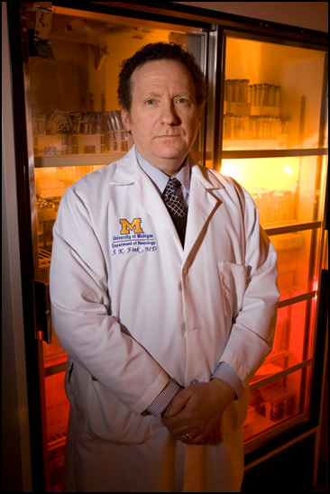
Neurogenetics
John Fink’s research focuses on identifying the genetic causes of various neurologic disorders (particularly the spastic paraplegias), analyzing the molecular pathogenesis of discovered genes, and creating animal and induced pluripotent stem cell models of these disorders to study molecular mechanisms and treatments.
MD: Medical College of Ohio
Residency: University of Virginia
Fellowship: National Institutes of Health

Slide 3
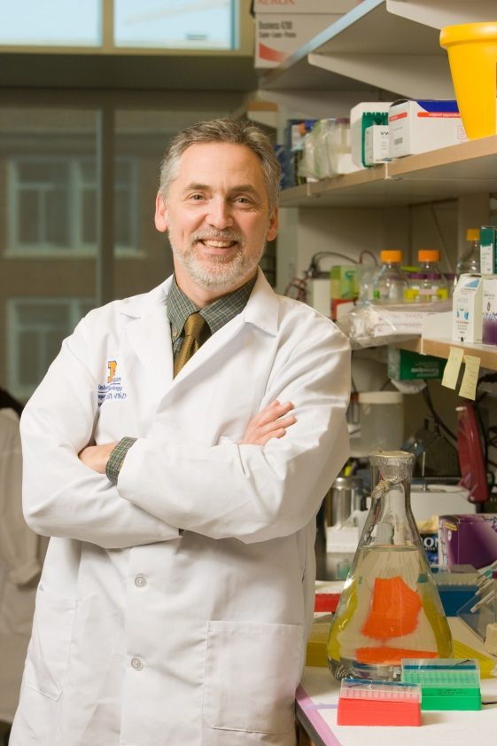
Cognitive Disorders
Hank Paulson explores molecular mechanisms underlying a variety of age-related neuro degenerative diseases, including AD, FTD, HD and the ataxias. The Paulson Lab is also committed to finding ways to treat these devastating and fatal disorders, using RNAi approaches and cell based drug screens.
MD: Yale University
PhD: Yale University
Residency: University of Pennsylvania
Fellowship: University of Pennsylvania

Slide 4
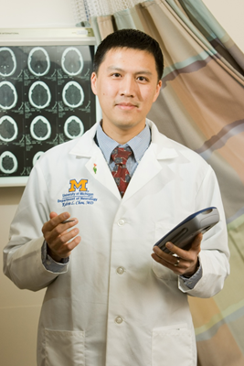
Movement Disorders
Kelvin Chou is focused on improving the ability to treat movement disorders patients through DBS by understanding the relationships between patient baseline characteristics, DBS targeting, and the clinical effects of stimulation. He is also interested in non-invasive methods for improving essential tremor, as well as gaining a better understanding of non-motor features of PD.
MD: University of Michigan
Residency: University of Pennsylvania
Fellowship: Pennsylvania Hospital

Slide 5
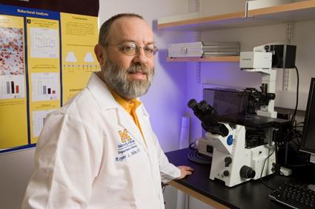
Movement Disorders
Roger Albin’s research is in basal ganglia diseases pathogenesis and pathophysiology. Areas of focus include
Investigation of brain changes underlying movement disorders with positron emission tomography and other imaging modalities.
Treatment refractory features of Parkinson disease.
The development of new imaging biomarkers for dementias.
MD: University of Pittsburgh
Residency: University of Michigan
Fellowship: University of Michigan

Slide 6
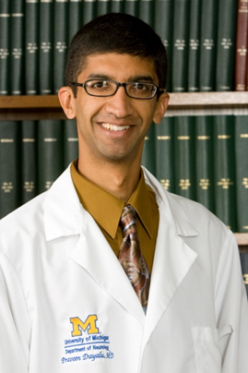
Movement Disorders
Praveen Dayalu is using PET imaging of the brain and heart to study patterns of neurodegeneration in Multiple System Atrophy.
He is also the site investigator in a trial of high-dose creatine in Huntington disease as a potential disease-modifying therapy.
MD: Case Western Reserve University
Residency: University of Michigan
Fellowship: University of Michigan

Slide 7
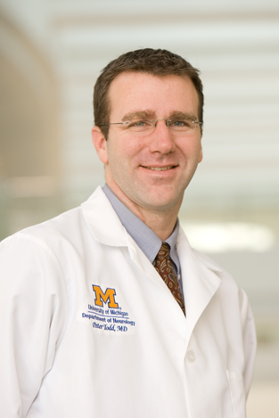
Neurogenetics
Peter Todd sees patients with Movement disorders and inherited neurological diseases. He directs the Neurogenetics Clinical research program and is co-director of the UM Fragile X clinical research consortium clinic and the UM multidisciplinary ataxia clinic.
Dr. Todd’s research focuses on how nucleotide repeats cause neurological disease. He studies ataxias, with a specific emphasis on Fragile X-associated Tremor Ataxia Syndrome (FXTAS), as well as common causes of ALS and muscular dystrophy. Current studies hope to develop novel therapeutics based on a better understanding of disease mechanisms.
MD: University of Wisconsin
PhD: University of Wisconsin
Residency: University of Pennsylvania
Fellowship: University of Michigan

Slide 8
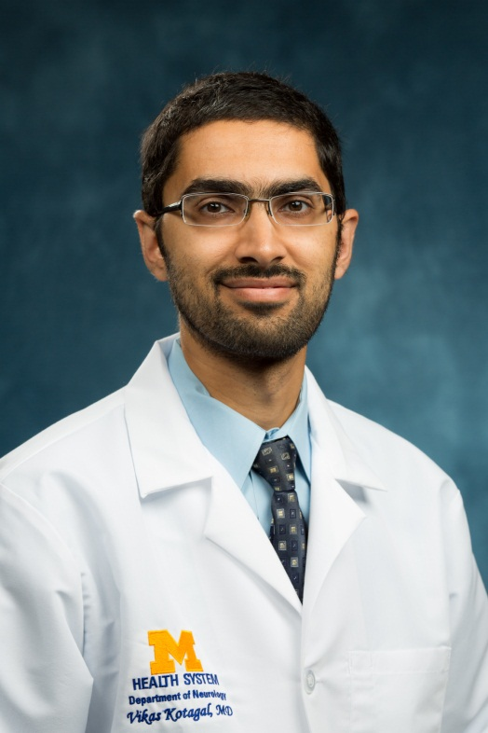
Movement Disorders
Vikas Kotagal is interested in the overlap between normal aging and common neurodegenerative diseases. His research aims to discover novel treatment strategies for Parkinson disease by defining the causes of medically-refractory gait and balance disorders in these patients.
MD: University of Minnesota
MS: University of Michigan
Residency: University of Michigan
Fellowship: University of Michigan

Slide 9
Movement Disorders
Nic Bohnen’s research interests include brain PET and MR imaging in patients with Parkinson' and other neurodegenerative disorders. Dr. Bohnen’s research involves the study of the neurobiological mechanism of falls and mobility impairment in patients with Parkinson’s disease.
MD: Radboud University Nijemegen, Netherlands
PhD: University of Limburg, Netherlands
Residency: Mayo Clinic

Slide 10
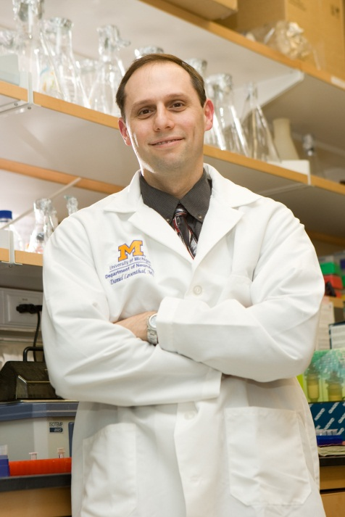
Movement Disorders
Dan Leventhal’s laboratory studies how the basal ganglia interact with each other and other brain structures. He uses high density electrophysiological recordings combined with optogenetic interventions in awake, behaving rodents. His specific areas of interest include Parkinson Disease and dystonia, including mechanisms of action of deep brain stimulation.
MD: Case Western Reserve University
PhD: Case Western Reserve University
Residency: University of Michigan
Fellowship: University of Michigan

