Slide 1
Office Management of Concussion
Andrea Aagesen, DO
Assistant Professor
Department of Physical Medicine and Rehabilitation
Michigan NeuroSport
Eastern Michigan University Team Physician
Sports Medicine for the Primary Care Physician
October 19 , 2016

Slide 2
Financial Disclosures
I have no relevant financial relationships with the manufacturer(s) of any commercial product(s) and/or provider(s) of commercial services discussed in this CME activity.

Slide 3
Outline
Concussion Definition
Pathophysiology of Concussion
Incidence of concussion and associated risk factors
Diagnosing concussions
Managing concussions
Common Pitfalls

Slide 4
Objectives
Recognize the typical symptoms associated with a concussed patient and the variable ways that these symptoms may present following an injury.
Recognize the comorbidities that are commonly associated with patients who have a more protracted recovery course.
Understand appropriate treatment following acute concussions. Including how to safely return to play and return to learn.

Slide 5
Concussion
Mild traumatic brain injury
Complex pathophysiological process induced by biomechanical forces
Physical forces acting on the brain
Disrupts brain function usually without structural injury
Causes one or more signs & symptoms, typically resolves spontaneously within days-weeks
May or may not involve loss of consciousness
Notes:
Direct or indirect forces acting on the brain

Slide 6
Concussion Pathophysiology
Physical forces disrupts brain function
Cascade for ionic, metabolic, and pathophysiological events
Microscopic axonal injury
→Increased energy demand
Decreased cerebral blood flow
Mitochondrial dysfunction
→decreased energy supply

Slide 7
Neurometabolic Cascade
increased energy demand
+
decreased CBF (50%)
&
impaired
cellular efficiency
ENERGY CRISIS
J Athvl Train. 2001 Jul-Sep; 36(3): 228–235.
Notes:
A demonstrated cellular process, the ‘neurometabolic cascade’ underlying the clinical presentation of a concussive injury describes a complex cascade of ionic, metabolic and pathophysiological events that is accompanied
by microscopic axonal injury.8–10 This disruption of ionic balance and normal metabolism requires energy to re-establish
homeostasis. However, the need for increased energy occurs in the presence of decreased cerebral blood flow and ongoing mitochondrial
dysfunction, resulting in an imbalance of energy supply and demand.8 10 11 Until normal brain cellular function is restored, animal and human studies support the concept of increased postconcussive vulnerability, showing that a second
injury before the brain has recovered results in worsening cellular metabolic changes and more significant cognitive deficits.8 9 11–16
Experimental evidence further suggests the concussed brain is less responsive to physiological neural activation.9 10 Thus, excessive
cognitive or physical activity before complete recovery may result in prolonged dysfunction. Some of these pathophysiological
perturbations are more pronounced in youth, raising concern that the immature brain may be even more susceptible to
repeat concussions before complete recovery.9
-Aagesen, Andrea

Slide 8
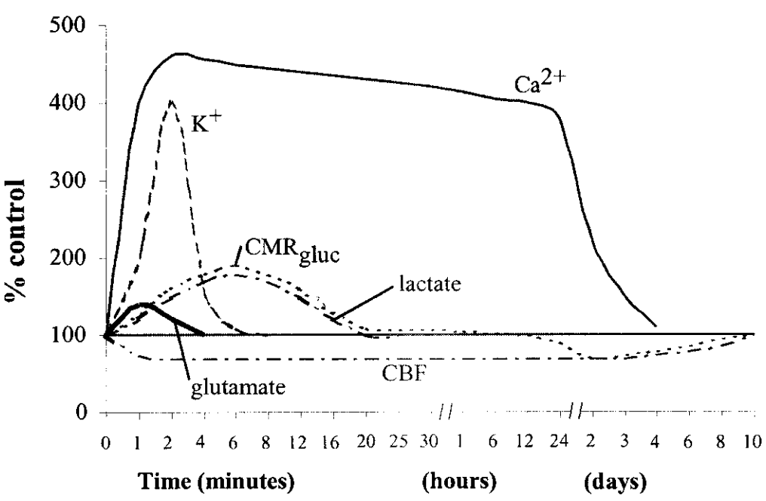
Ionic Imbalance from Neurometabolic Cascade
J Athvl Train. 2001 Jul-Sep; 36(3): 228–235.

Slide 9
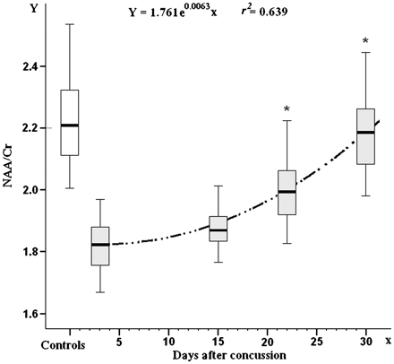
Brain Metabolism following mTBI
Proton magnetic resonance spectroscopy
Recovery of neuronal metabolism marker in 40 athletes following concussion
N-acetylaspartate/creatine-containing compounds ratio
Concussive head injury→ window of brain vulnerability from cellular energetic metabolism impairment
Symptom recovering 3-15 days.
Normalized metabolism by 30 days.
Brain 2010; 133(11): 3232-3242.
Notes:
Assessment of brain metabolism at 3, 15, 22 and 30 days post-injury through proton magnetic resonance spectroscopy for the determination of N-acetylaspartate, creatine and choline-containing compounds.
recovery of the N-acetylaspartate/creatine-containing compounds ratio occurring in 40 athletes following concussion and reporting the equation and the best fit curve to the data
Concussive head injury→ opens a temporary window of brain vulnerability due to the impairment of cellular energetic metabolism. As experimentally demonstrated, a second mild injury occurring during this period can lead to severe brain damage, a condition clinically described as the second impact syndrome. To corroborate the validity of proton magnetic resonance spectroscopy in monitoring cerebral metabolic changes following mild traumatic brain injury, apart from the magnetic field strength (1.5 or 3.0 T) and mode of acquisition, we undertook a multicentre prospective study in which a cohort of 40 athletes suffering from concussion and a group of 30 control healthy subjects were admitted. Athletes (aged 16-35 years) were recruited and examined at three different institutions between September 2007 and June 2009. They underwent assessment of brain metabolism at 3, 15, 22 and 30 days post-injury through proton magnetic resonance spectroscopy for the determination of N-acetylaspartate, creatine and choline-containing compounds. Values of these representative brain metabolites were compared with those observed in the group of non-injured controls. Comparison of spectroscopic data, obtained in controls using different field strength and/or mode of acquisition, did not show any difference in the brain metabolite ratios. Athletes with concussion exhibited the most significant alteration of metabolite ratios at Day 3 post-injury (N-acetylaspartate/creatine: -17.6%, N-acetylaspartate/choline: -21.4%; P < 0.001 with respect to controls). On average, metabolic disturbance gradually recovered, initially in a slow fashion and, following Day 15, more rapidly. At 30 days post-injury, all athletes showed complete recovery, having metabolite ratios returned to values detected in controls. Athletes self-declared symptom clearance between 3 and 15 days after concussion. Results indicate that N-acetylaspartate determination by proton magnetic resonance spectroscopy represents a non-invasive tool to accurately measure changes in cerebral energy metabolism occurring in mild traumatic brain injury. In particular, this metabolic evaluation may significantly improve, along with other clinical assessments, the management of athletes suffering from concussion. Further studies to verify the effects of a second concussive event occurring at different time points of the recovery curve of brain metabolism are needed.

Slide 10
Concussion Recovery

Slide 11
Concussion Recovery Timeline
Typical Concussion
Repeat Injury
DYSFUNCTION
TIME
Onset
Resolution

Slide 12
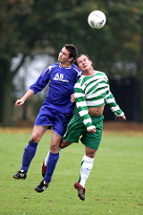
Case: JR and TS
16 year old with head to head impact when going up to head a soccer ball.
Immediately felt “stunned” and a little unsteady.
Developed headache and mild nausea at sideline.
ATC and coach removed player from game

Slide 13
Sideline Assessment and Management
Removed from play and assessed by a licensed healthcare provider trained in the evaluation and management of concussions. (Michigan Law)
Symptoms checklist
Cognitive evaluation
Balance tests
Neurological physical examination
No same day return to play.
Monitored for deteriorating physical or mental status

Slide 14
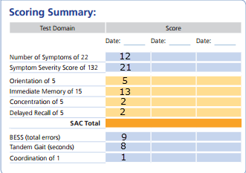
Sideline Assessment of JR and TS
16 year old with headache, mild nausea following head to head impact in soccer.
ATC evaluated at sideline with SCAT 3

Slide 15
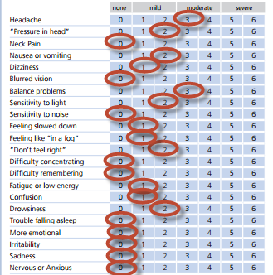
Sideline Assessment of JR and TS
Symptom Evaluation
SCAT Symptoms= 12
SCAT Severity Score= 21

Slide 16
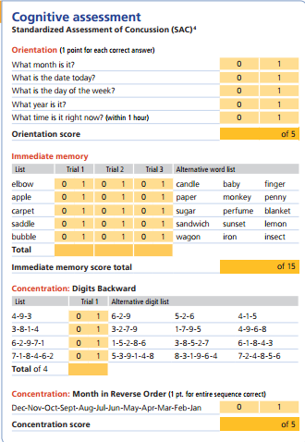
Sideline Assessment of JR and TS
Cognitive Assessment
Orientation 5/5
Immediate memory 13/15
Concentration (numbers): 2/4
Concentration (months): 0/1
Delayed Recall: 2/5

Slide 17
Sideline Assessment of JR and TS
Balance Assessment with Modified Bess (non-dominant)
Double leg stance: 1 error/20 s
Single leg stance: 5 errors/20 s
Tandem Stance: 3 errors/20 s
Tandem Gait: 8 seconds.
BESS Balance testing errors:
Hands lifted off iliac crest
Opening eyes
Step, stumble, or fall
Moving hip into > 30 degrees abduction
Lifting forefoot or heel
Remaining out of test position > 5 s

Slide 18
Diagnosis of Concussion
Clinical Diagnosis
Graded symptom checklists
- Objective tool for assessing a variety of concussive symptom
- Track the severity of symptoms over serial evaluations.
Standardized assessment tools / Neurologic examination
- Provides a helpful structure for the evaluation
- Limited validation of tools

Slide 19
Clinical History
Injury Mechanism
Detailed Symptom Inventory (number, severity and duration of symptoms)
Recall/memory of injury
Past concussions or head injuries (severity, duration of symptoms, residual symptoms)
Sports, positions and individual playing style
Pre-injury mood disorders, learning disorders, attention deficit disorders (ADD/ADHD) and migraines
Notes:
Purpose of these history questions is to
assess the patient’s symptom burden which often, but not always, correlates to the duration of symptoms and help identify ways for patient to alleviate specific symptoms.
Evaluate the mechanism of injury:
to consider additional injuries (neck trauma, laceration, fracture)
determine if the concussive symptoms occurred from a relatively mild impact (may influence return to play after recovery)
Identify technique errors and areas for improvement to prevent future injuries. (tackling technique, improper use of equipment)
Identify co-morbid conditions that correlate with prolonged recovery which will influence your anticipatory guidance (for example, I may not give the typical timeline of concussion recover to a patient with ADHD knowing they will likely fall on the longer end but do let them know that recovery is a little slower in this population.

Slide 20
Back to the Case: JR and TS
16 year old with headache, mild nausea following head to head impact in soccer.
Symptoms worsened that evening and the next day
Nausea h
Photophobia
Headache h
Blurry vision
Drowsy
Slowed thinking

Slide 21
Signs and Symptoms of Concussion
Headache
Nausea
Vomiting
Dazed
Stunned
Fatigue
Light Sensitivity
Sound Sensitivity
Balance problems
Vision Problems
Irritability
Sadness
More emotional
Nervousness
Feeling "foggy"
Feeling slowed down
Difficulty concentrating
Difficulty remembering
Confused about recent events
Answers questions slowly
Repeats Questions
Drowsiness
Sleeping more than usual
Sleeping less than usual
Difficulty falling asleep
PEDIATRICS Vol. 126 No. 3 September 1, 2010

Slide 22
Risk Factor for Sports Concussions
Increased Risk of Concussion
Prolonged Recovery
Past concussion
Female athletes
Certain sports, positions and individual playing styles
Number, severity and duration of symptoms
H/o migraines, depression, mood disorders, or anxiety, and developmental disorders (learning disabilities, ADHD)
Youth
Harmon KG, et al. Br J Sports Med 2013;47:15–26

Slide 23
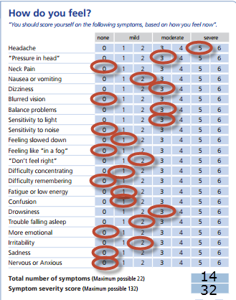
Clinical History of JR and TS
Injury Mechanism: head to head impact
Detailed Symptom Inventory (number, severity and duration of symptoms)
Recall/memory of injury: full memory
Past concussions or head injuries: 1 prior concussion, recovered in 2 weeks, no residual symptoms.
Sports, positions and individual playing style: forward
Pre-injury mood disorders, learning disorders, attention deficit disorders (ADD/ADHD) and migraines: none

Slide 24
Goals of Physical Examination
Establish current mental status and degrees of impaired coordination
Rule out more serious neurologic injury
Evaluate spine for associated injury
Identify impairments for individualized treatment

Slide 25
Head and Neck Examination
Head Examination
Facial and skull bony tenderness and detention
Lacerations/swelling
TM rupture
Neck Examination
Bony tenderness (spinous process, mastoid process)
Full ACTIVE ROM without pain (flexion, extension, rotation)
Isometric Strength testing of neck
Spurling’s maneuver (only if passive ROM is not painful)
Strength of upper and lower extremities, Pronator Drift
Subocciptal/ paraspinal muscles

Slide 26
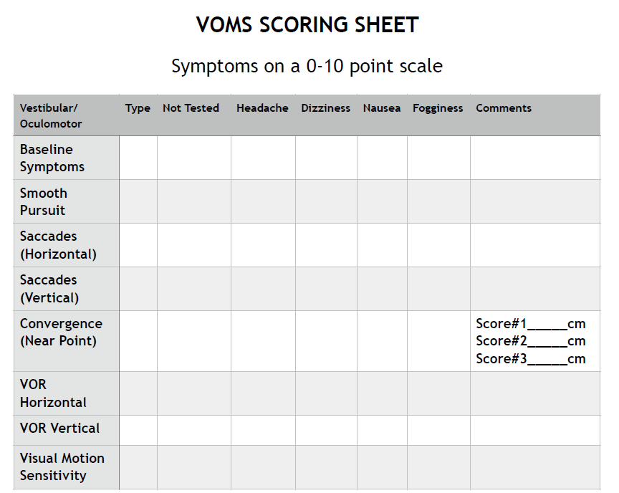
Vestibular/Oculo-motor Screen
Smooth Pursuit: follows a moving target while seated (3 ft from pt)
Saccades: quickly follow a target between two points (3ft away, 1.5 ft to right/left OR above/below eye level)
Convergence: view a near target without double vision (target at arms length moving toward nose, >6cm is abnormal)
Vestibulo-ocular reflex*: ability to stabilize vision as the head moves (focus on object 3 ft away while moving head)
Visual Motion Sensitivity*: ability to inhibit vestibular –induced eye movements using vision (rotate head and arm focus on thumb)
(Mucha, Collins et al. 2014)
Notes:
is 90% accurate in identifying patients with concussion. Requiring only minimal equipment, such as a tape measure and a metronome, it has been shown to be a reliable and consistent tool for concussion assessment when used in combination with clinical interview, symptom evaluation, and computerized neurocognitive testing.
VOR (odds ratio [OR], 3.89; P < .001) and VMS (OR, 3.37; P < .01) components of the VOMS were most predictive of being in the concussed group

Slide 27
Goals of Physical Examination
Establish current mental status and degrees of impaired coordination
Rule out more serious neurologic injury
Evaluate spine for associated injury
Identify impairments for individualized treatment

Slide 28
Physical Examination Findings
Common with Concussion
May Indicate more Serious injury
Mental Status: may be impaired
Balance: Impaired tandem gait or single leg balance, abnormal BESS
CN: nystagmus, saccades
Strength: Normal, symmetric
DTR: normal
FTN: may be slightly abnormal
GAIT: tandem gait my be ataxic, casual gait should be normal.
Mental Status: significantly impaired
Balance: Rhomberg, postural instability
CN: unequal or fixed pupils, visual field deficit, abnormal EOM
Strength: asymmetric, focal weakness
DTR: hyper-reflexia, Babinski, clonus, Hoffman’s reflex
FTN: discoordination
GAIT: ataxic
Notes:
Common Concussion findings are mostly related to impaired coordination and reaction time.
More serious neurologic deficit typicall requies additional imaging and is rarely seen with a concussion alone;
CN: brainstem lesion
DTR: hyper-reflexia, babinski, or hoffman’s reflex suggests upper motor neuron lesion (brain/spinal cord)
FTN: suggests discorrdination
GAIT: may be cerebellar dysfuntion

Slide 29
Neurologic Examination
Cognition/ Mental Status
Orientation (day, date, time, month, year)
Immediate memory (5 items, 3 trials)
Delayed recall (5 items after 5 minutes)
Concentration (3, 4, and 5 digits backwards, months/WORLD backwards, serial sevens)
Affect
Coordination
finger-nose-finger/ finger-to-nose
heel-to-shin
rapid finger movements
CN testing:
EOM evaluation (nystagmus, convergence insufficiency)
Speech
Visual Fields
Pupils
VOMS (Vestibular/Ocular-Motor Screening)
Balance assessment
Modified BESS/ single leg stance
Tandem gait
Rhomberg test

Slide 30
Red Flags for ED referral / Urgent work up
Glascow Coma Score < 14
Concern for intracranial process
Evidence of a skull fracture (bruising under eyes, behind ears, or swelling of the head)
Concern symptoms are not related to recent minor head trauma
Severe or progressively worsening headache
Seizure activity
Unusual behavior
Lethargy
Unsteady casual gait/ataxia
Slurred speech
Weakness or numbness in extremities
Focal neurologic examination
CLIN PEDIATR October 2015 vol. 54no. 11 1031-1037

Slide 31
Indications for NeuroImaging
Concerning signs/symptoms for an Intracranial Process:
Severe headaches
Focal neurologic findings on examination
Repeated emesis
Significant drowsiness/difficulty waking
LOC greater than 30 seconds
Worsening signs/symptoms

Slide 32
NeuroImaging
Computed Tomography (CT)
Magnetic Resonance Imaging (MRI)
Not recommended for routine concussion evaluation
Sensitive for skull fracture and intracranial hemorrhage
Test of choice in first 24-48 hours after injury
Will not rule out chronic subdural or neurobehavioral dysfunction
Not recommended for routine concussion evaluation
More sensitive for cerebral contusion, petechial hemorrhage, white matter injury, posterior fossa abnormalities
Gradient Echo and perfusion and diffusion tensor imaging may detect white matter injury better but clinical usefulness is not established.
Notes:
Ataxia is best evaluated with MRI even acutely.

Slide 33
Goals of Physical Examination
Establish current mental status and degrees of impaired coordination
Rule out more serious neurologic injury
Evaluate spine for associated injury
Identify impairments for individualized treatment

Slide 34
Physical Examination of JR and TS
Examination
Plan
Full Neck ROM without pain. Negative Spurling’s maneuver
Full UE, LE, and neck Strength
Tender over hypertonic subocciptals
Symmetric Reflexes, no clonus, Negative Babinski, Negative Hoffman’s reflex
→ No neck imaging indicated
→ Physical Therapy, neck stretching
→ No head imaging indicated

Slide 35
Physical Examination of JR and TS
Physical Examination
Plan
Orientation and immediate memory intact. Delayed recall 4/5 items
Concentration: error with 5 digits backwards. 1 error with serial sevens, months backward intact
Coordination: intact FNF, HTS
Balance: 1 error with single leg stance and tandem stance.
→ No testing/exams in school
→ May need accommodations to repeat assignments, instructions, may need repetition and/or assistance in school
→Balance training, avoid bike riding, elevated surfaces

Slide 36
Physical Examination of JR and TS
Physical Examination
Plan
CN/VOMS: + nystagmus, saccades and dizziness with VOMS testing
Strength: Normal, symmetric
→ Refer to vestibular PT
→ Limit reading homework until improves

Slide 37
Neurocognitive Testing
Objective measure for subtle cognitive impairments
More sensitive than office examination
Not required for most concussions
Should NOT be used in isolation
Helpful in the post concussion management of patients with persistent symptoms a and/or a more complicated course.
Notes:
Sleep, fatigue, motivation affect testing results

Slide 38
Neurocognitive Testing
Computerized testing compares to individual's pre-season baseline
Paper and pencil NP testing is more comprehensive (assess for other conditions such as ADHD, Depression)

Slide 39
Acute Concussion Management
Remove from Play/sports
Rest
RTP protocol when symptom free
Depression
Isolation
Hypervigilance

Slide 40
Acute Concussion Management
Remove from Play/sports
Rest
Decrease symptom burden
Treat impairments found on examination
Gradual return to learn
RTP protocol when symptom free
→ Relative Rest

Slide 41
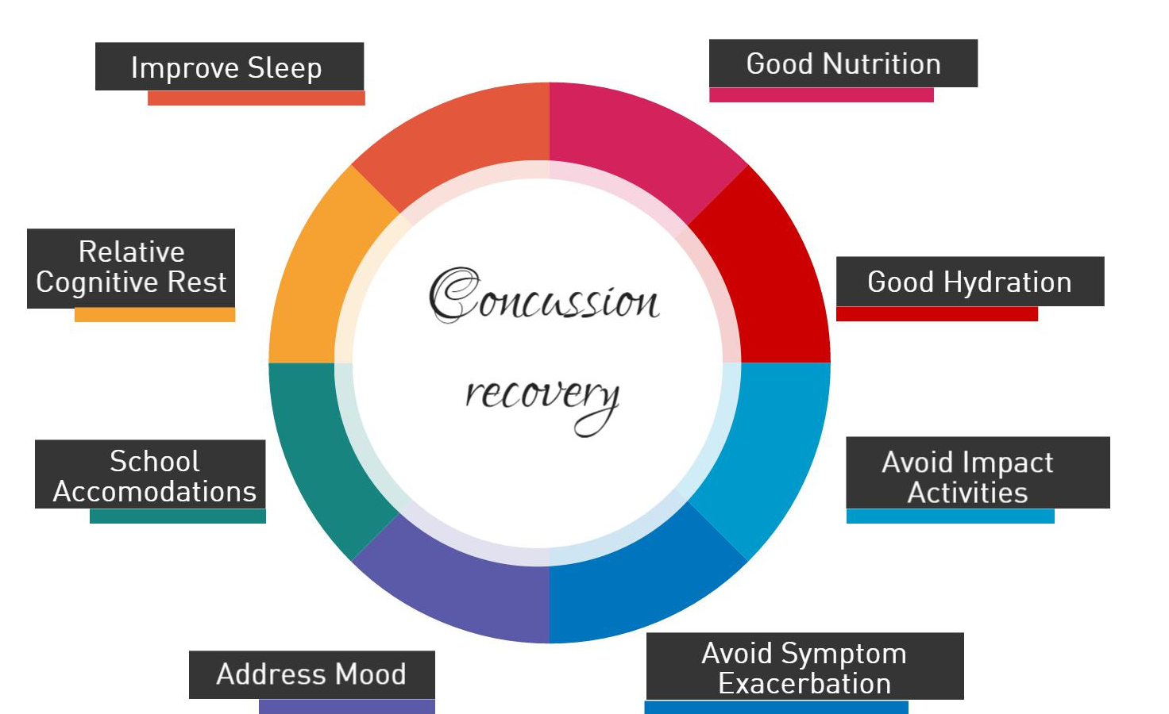
Concussion Management Prevent Injury & Decrease Symptom Burden
Notes:
Sleep
Sleep is commonly disrupted with a concussion
Naps are fine as long as it does not disrupt sleep
Educate patient and family on sleep hygiene if not improving
Education/Communication:
Provide anticipatory guidance and concussion education
Educate patient and family on avoiding symptom exacerbation
Provide letter to school documenting injury, restrictions, and accommodations
Close follow up until full recovery.
Nutrition
Encourage adequate fluid intake (athletes are often only used to drinking water during practice)
Dehydration and poor nutrition can mimic many concussive symptoms.
Mood
Monitor for signs of depression (particularly in athletes with prolonged recovery)
Encourage counseling/treatment if present

Slide 42
Decrease the symptom burden for JR and TS
Nausea→ avoid reading or looking at phone in the car
Photophobia→ sun glasses, adjust seating away from windows in class, turn out lights when possible
Blurry vision→ limit reading to small amounts. Listen in class. Limit computer/ gaming
Vestibular Ocular Motor Impairment, nystagmus→ Vestibular PT, Limit reading homework until improves
Drowsy→ allow naps as needed if not affecting sleep overnight.
Neck spasms→ Physical Therapy, neck stretching
Impaired Concentration/Memory→ No testing/exams in school, May need accommodations to repeat assignments/instructions, may need repetition/assistance
Impaired Balance→ Balance training, avoid bike riding, elevated surfaces

Slide 43
Back to JR: Concussion Recovery
Attended school part time initially but avoided reading
Eliminated screen time (video games and school work)
School accommodations: no tests/quizzes, extended time for school, homework forgiveness, shortened school days as needed (not required)
Neck Stretches: chin tuck and neck flexion, PT if not improving
Vestibular PT Referral: 3 sessions with home exercises

Slide 44
Back to TS: Concussion Recovery
Rested for 2 days, then return to school full time
Wore sun glasses for light sensitivity
Studied for exam 4 days post injury and completed writing assignments, studying took longer than normal and increased symptoms but able to learn
Frequently texts and play some video games
Stopped sports but returned to weight lifting 5 days post injury

Slide 45
Just Right vs Too Soon
JR symptoms resolved with rest after 7 days
Started Activity progression after 24 hours symptom free
Returned to soccer game after 14 days after injury
TS symptoms continued for 15 days, started to decreased after 2nd appointment and decreasing exacerbating activities
Started Activity progression after 36 hours symptom free
Returned to soccer 24 days after injury

Slide 46
JW and TS Concussion Recovery Timeline
JW
DYSFUNCTION
TS
TIME
Onset
Resolution

Slide 47
Return to Learn: Start at HOME
Begin when symptoms allow
Quite home environment for short periods of time (15-20 minutes)
Start with core subjects if able, but may tolerate some subjects better than others
When tolerating 30-45 minutes of studying without symptom excalation, may begin returning to school

Slide 48
Return to Learn: Back to School
Shortened days with rest breaks, core classes. Avoid symptom exacerbation
Alternative or shortened assignments/homework or forgive assignments
Provide student with written instructions, class notes, recordings, additional instruction when needed.
Avoid noisy environments such as hallways, cafeteria, recess, gym, band, movies
Encourage rest breaks whenever symptoms increase. Put head down, leave class, lay down, return home if needed
Avoid testing until recovered

Slide 49
Sample School Accomodations Note
To whom it may concern:
This patient is currently under my medical care for treatment of a concussion. Please make school accommodations to assist with his recovery process. These may include, but are not limited to, rest breaks during class, homework, and examination as dictated by symptoms exacerbation; repetition and written instructions for assignments/instructions; extended time for assignments and examinations or forgiveness of projects or assignments; allow to wear sunglasses and provide seating away from bring lights and noisy environments; lighter workload; and/or shortened school day as necessary. He should not return to gym class or sports at this time and should not have additional coursework to make up for missed gym class.

Slide 50
When to stop REST

Slide 51
Support for Transition to Classroom
PEDIATRICS April 2006

Slide 52
Returning to Play
Requirements to begin RTP Progression:
Normal neurologic examination
Full resolution of all symptoms and off of all analgesic medications for at least 24 hours.
Back to full school without symptoms exacerbation or cognitive difficulties
Back to academic baseline (pass computerized NP testing if performed)

Slide 53
RTP Considerations
Evaluate prior to beginning return to play protocol and re-evaluate athlete prior to return to full contact competition.
Must complete each stage without symptoms returning during activity or for the following 24 hours.
May perform one stage for multiple days for younger athletes or more complex cases.
If symptoms return the progression should be stopped until symptom free again and then return to the previous phase

Slide 54
Graduated RTP Protocol (Zurich 2012)
Rehabilitation Stage | Functional Exercise at each stage | Objective of Each Stage
No Activity | Physical and Cognitive Rest | Recovery
Light Aerobic Exercise | Walking, swimming, stationary bike, <70% maximum MR. No resistance training. | Increase HR
Sports Specific Exercise | Skating drills in ice hockey, running drills, No head impact activities | Add Movement
Non-contact training drills | Progression to more complex training drills. May start progressive resistance training | Exercise, coordination and cognitive load
Full-contact practice | Full practice (following medical clearance) | Restore confidence and assess functional skills by coaching staff
Return to Play | Normal game play

Slide 55
Legislature
Michigan Legislature (June 30, 2013):
Immediately remove from activity if suspected of sustaining a concussion
He/she shall not return to physical activity until he or she has been evaluated by an “appropriate health professional” and receives written clearance authorizing the youth athlete’s return to physical
MHSAA Concussion Protocol:
Only an M.D., D.O., Physician’s Assistant or Nurse Practitioner
Must be in writing and must be unconditional
Clearance may not be on the same date on which the athlete was removed from play.

Slide 56
Concussion Recovery Timeline
Typical Concussion
Repeat Injury
Post concussive Syndrome
DYSFUNCTION
Excessive exertion
TIME
Onset
Resolution

Slide 57
Post Concussive Syndrome
Diagnosis
Cognitive deficits in attention or memory
Three of the following:
Fatigue
Sleep disturbances
Headache
Dizziness
Irritability
Affective disturbance
Apathy
Personality changes
Treadmill testing
Should have reproduction or exacerbation of symptoms
If no symptoms occur with exercising to exhaustion, other causes are likely
Repeated neurocognitive testing is widely used
Treatment:
Multidisciplinary treatment

Slide 58
Summary
Sport-related concussions are common.
Symptoms of a concussion typically resolve in 7 to 14 days in the majority of cases.
Some athletes may take weeks to months to recover and may benefit from a concussion specialist
Concussion has many signs and symptoms. Some overlap with other medical conditions.
Results of CT or MRI are generally are normal with a concussion.
Neuropsychological testing can provide objective data and is one tool in the complete management of a sport-related concussion.
Athletes with concussion should rest, both physically and cognitively, until their symptoms have resolved. They should follow a return to play progression once symptom free.
Teachers and school administrators should work with students to modify workloads to avoid exacerbation of symptoms.

Slide 59
References
Giza CC, Hovda DA (2001). The Neurometabolic Cascade of Concussion. Journal of Athletic Training. 2001;36(3):228-235.
Halstead, ME; Walter, KD (2010). Clinical Report—Sport-Related Concussion in Children and Adolescents. Pediatrics. Vol. 126 No. 3 September 1, 2010. pp. 597 -615
Harmon KG, et al (2013). American Medical Society for Sports Medicine position statement: concussion in sport. Br J Sports Med 47:15–26.
Kirkwood, MW; Yeates, KO; Wilson, PE (2006). Review Article: Pediatric Sport-Related Concussion: A Review of the Clinical Management of an Oft-Neglected Population. Pediatrics April 2006; 117:4 1359-1371
Leddy, J., et al. (2016). "The Role of Controlled Exercise in Concussion Management." Pm r 8(3 Suppl): S91-s100.
McCrory, P; Meeuwisse MH; et al (2012). Consensus statement on concussion in sport: the 4th International Conference on Concussion in Sport held in Zurich, November 2012 Br J Sports Med 2013;47:5 250-258
Mucha, A., et al. (2014). "A Brief Vestibular/Ocular Motor Screening (VOMS) assessment to evaluate concussions: preliminary findings." Am J Sports Med 42(10): 2479-2486.
Reisener, A; et al (2015). The Central Role of Community-Practicing Pediatricians in Contemporary Concussion Care: A Case Study of Children’s Healthcare of Atlanta’s Concussion Program. CLIN PEDIATR October 2015 vol. 54 no. 11 1031-1037.
Vagnozzi, R., et al. (2010). Assessment of metabolic brain damage and recovery following mild traumatic brain injury: a multicentre, proton magnetic resonance spectroscopic study in concussed patients. Brain 133(11): 3232-3242.

Slide 60
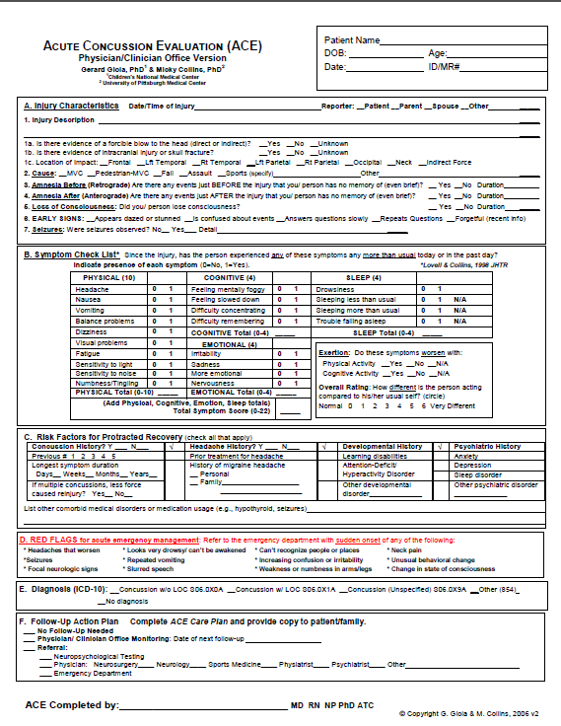
Resources
ACE Physicians Office Version
https://www.cdc.gov/headsup/providers/tools.html

Slide 61
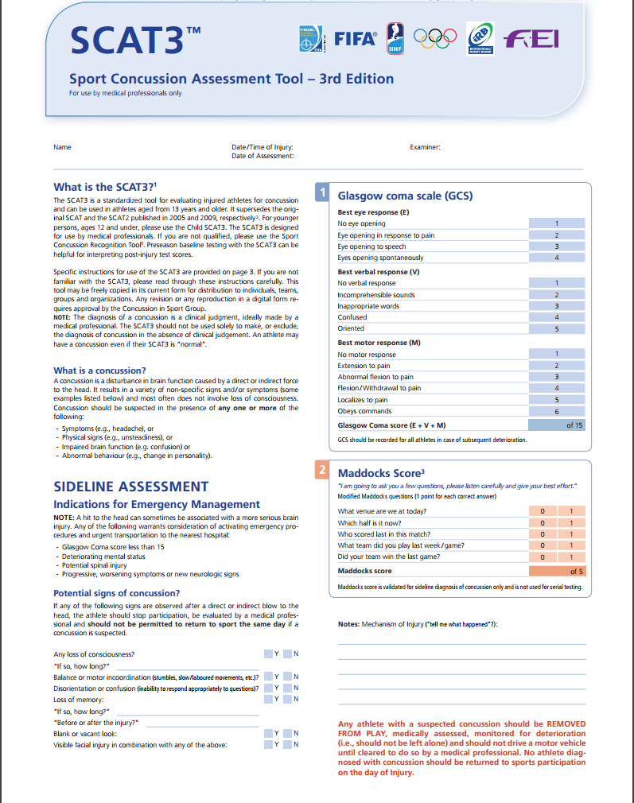
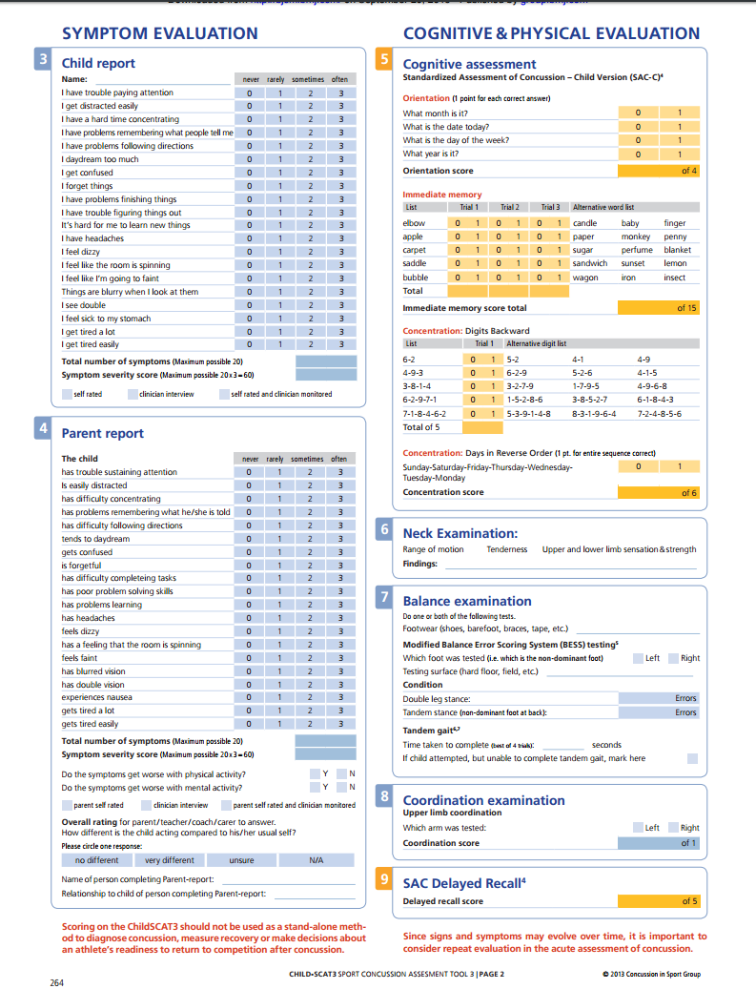
Resources
SCAT3
http://bjsm.bmj.com/content/47/5/259.full.pdf
Child SCAT3
http://bjsm.bmj.com/content/47/5/263.full.pdf

Slide 62
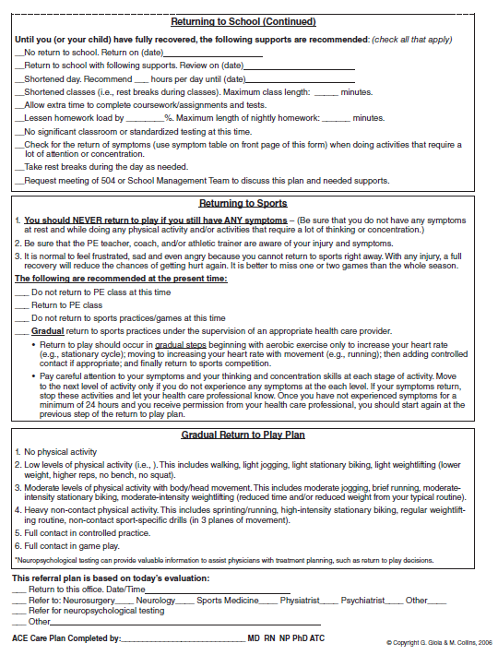
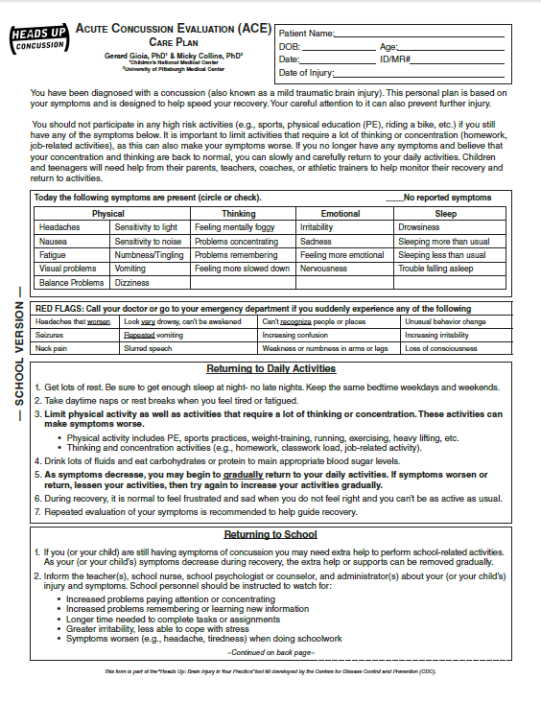
Patient Instructions
ACE Care Plan
https://www.cdc.gov/headsup/providers/discharge-materials.html

