Slide 1
Physical Therapy Program for Pelvic Floor Dysfunction
Jennifer Shifferd, MSPT, CLT WCS

Slide 2
History of Pelvic Floor Program
Section on Women’s Health was begun in the American Physical Therapy Association >35 years ago.
The section started with a focus on treating women in the childbearing year with pelvic floor disorders post partum.
Overtime, our interests expanded to women throughout the lifecycle.
With our emphasis on specializing on anatomy and function of the pelvic floor, care is available to men with similar dysfunctions.
Many physical therapists also care for the pediatric population with problems of daytime incontinence and bedwetting.
Pelvic floor program established at University of Michigan Hospital in fall of 1999.

Slide 3
PROGRAM GROWTH
University of Michigan Hospital
Burlington Building
Canton Health Center
Northville Health Center

Slide 4
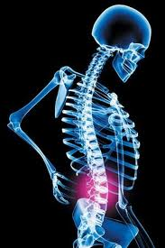
PROGRAM DEVELOPMENT
CLINIC RESIDENCY IN WOMEN’S/MEN’S HEALTH
Obstetrics, osteoporosis, oncology and pelvic floor dysfunction

Slide 5
PROGRAM DEVELOPMENT
Pediatric Pelvic Floor Program
Milestones is offering pediatric pelvic floor. Currently they have two trained pediatric pelvic floor therapists on staff. Pediatric services are also being offered at Canton Clinic as well. Kim Erickson is the lead and liaison for pediatric pelvic floor program.

Slide 6
Common Diagnoses Referred
Urinary / Fecal Incontinence
Dysfunctional Voiding / Constipation
Prolapse
Vulvodynia / Vestibulitis
Vaginal / Rectal / Pelvic Pain
Lower Quadrant Abdominal Pain
Abdominal / Pelvic Floor Scar Tissue
Post Prostatectomy
Oncology
Pre / Post Natal Care
Pediatric Pelvic Floor Dysfunction
Gender Reassignment

Slide 7
Functions of the Pelvic Floor
The pelvic floor is part of our core musculature.
Functions include;
Visceral support
Sphincteric support (urethral meatus and anus)
Sexual-contracting muscles to respond to arousal and to enhance enjoyment.

Slide 8
Pelvic Floor Pain
Pelvic floor muscle spasm occurs from trauma to and or around pelvis, back and abdomen including;
joint malalignment, pelvic fracture, habitual postures, strenuous physical activity, childbirth, sexual abuse, surgery and pelvic inflammation.

Slide 9
Pelvic Floor Dysfunctions
Dyspareunia
Vulvodynia/Vulvar Vestibulitis
Vaginissmus
Levator ani syndrome
Anismus
Coccygodynia
LBP/herniated disc
Pudendal Nerve Entrapment
Scar adhesions
Interstitial Cystitis
Endometriosis
Trauma/PTSD

Slide 10
Pelvic Floor Dysfunctions
Dyspareunia- pain with thrusting or penetration
Symptoms; pain with initial entry, pain with deep penetration, friction with thrusting
Grades of Severity;
Discomfort, but has intercourse
Frequently limits intercourse
Incapacitating problem, abstinence

Slide 11
Prevalence of Dyspareunia
As many as 60 percent of women experience dyspareunia when the term is broadly defined as episodes of pain with intercourse. Women with symptoms severe enough to require medical attention comprise a much smaller group. Many of those with persistent symptoms do not seek medical attention.
LORI J. HEIM, LTC, USAF, MC, Eglin Air Force Base, Florida Am Fam Physician. 2001 Apr 15;63(8):1535-1545.

Slide 12
Postpartum Sexual Function
Vaginal dryness
Anal sphincter lacerations less sexual activity
Decreased libido
Only small % postpartum women with sexual problems seek medical attention

Slide 13
Changes in Pelvic Floor Following Breast Cancer Treatment
Vaginal dryness, discomfort with intercourse
The vulval area also changes with ageing, as fatty tissue reduces and the labia majora (outer lips of the vagina) and the hood of skin covering the clitoris may contract. If sensitive areas become more exposed, chafing can occur.
Pelvic floor muscles become weaker and urination may become more frequent and difficult to control.

Slide 14
Gynecologic Cancer
Common sequelae post surgery and radiation treatments;
Constipation
diarrhea
Urinary incontinence
Vaginal dryness
Dysparuenia
Vaginal and rectal stenosis
Urinary frequency and urgency

Slide 15
Post Menopausal Changes
Decrease in estrogen levels as women approach and pass menopause leads to dryness and thinning of vaginal tissues that can cause intercourse to be painful.
Without sufficient lubrication can lead to tearing and bleeding of vaginal tissues.

Slide 16
Pelvic Floor Dysfunctions
Vaginissmus is the involuntary tightness of the vagina during attempted intercourse.
May be due to surgical or sexual trauma
Protective response

Slide 17
Pelvic Floor Dysfunctions
Vulvodynia- chronic vulvar discomfort
Symptoms; burning, stinging, irritation or rawness
Causes; yeast infections, STD’s, eczema, lichens, chemical induced reaction (spermicides, detergents, vaginal sprays, deoderants), chronic alteration of vaginal ph, vulvar trauma, surgery

Slide 18
Pelvic Floor Dysfunctions
Vulvar Vestibulitis- pain at vestibule 3-9 o’clock (Q-tip test)
Symptoms; severe pain with palpation to vestibule or vaginal entry
Causes; STD’s, high levels of oxylates, surgery, ph imbalance of vagina
most experts do not recommend surgery for women with this disorder unless symptoms are severe and other treatments have not been effective. Low oxylate diet and calcium citrate may reduce symptoms by decreasing oxylate levels in urine.
Some women have pain because they have sensitivity to plant oxalates, which form crystals and lodge in the vulvar tissue but this theory is controversial and has not been scientifically validated.

Slide 19
Pelvic Floor Dysfunctions
Levator Ani Syndrome- spasm of deepest muscle layer
Symptoms include pain, pressure or ache in vagina and rectum
Referred pain to thigh, coccyx, sacrum and lower abdomen
Repeated straining during defecation can promote pain/throbbing
Men often misdiagnosed with prostatis
Can lead to erectile dysfunction

Slide 20
Pelvic Floor Dysfunctions
Anismus-pain in rectum, anus restricting anal opening
Causes; hemorrhoids, fissures, trauma

Slide 21
Pelvic Floor Dysfunctions
Coccygodynia- pain in coccyx and rectal region
Causes; most often due to injury from fall, arthritic changes, pelvic floor muscle spasm, birthing in lithotomy position

Slide 22
Pelvic Floor Dysfunctions
LBP-low back pain due to herniated disc, foraminal stenosis, surgery, degenerative disc disease may contribute to pelvic floor muscle spasm, weakness and decrease in bowel and bladder control with extensive nerve compression.
Large herniations can compress the cauda equina, leading to symptoms/signs of saddle anaesthesia, urinary retention and incontinence
Cauda equine contains the nerve roots L1-L5 and S1-S5

Slide 23
Pudendal Nerve Entrapment Sites
Between Sacrotuberous and Sacrospinous ligaments
At the pudendal canal, the pudendal nerve can be compressed by the falciform process of the sacrotuberous ligament
If thickened, the obturator fascia also may act as an entrapment site
Obturator internus-can compress nerve at Alcock’s Canal

Slide 24
Pelvic Floor Anatomy

Slide 25
Pelvic Floor Dysfunctions
Scar adhesions-restricted mobility of myofascial tissue of abdomen, LB, pelvic floor
Symptoms; burning pain
Causes; tearing with child birth, episiotomy, LB and abdominal surgeries

Slide 26
Pelvic Floor Dysfunctions
Interstitial Cystitis- ulcerations of inner bladder
Symptoms; bladder, abdominal and pelvic floor pain, urinary frequency, urgency
Increased muscle tightness closes down urethra and gives sensation of having to go to the bathroom.

Slide 27
Pelvic Floor Dysfunctions
Endometriosis- tissue that lines uterus grows outside of uterus. Tissue becomes trapped, irritating surrounding tissue, forming adhesions. This can become painful especially during menses.

Slide 29
Current Challenges in Female Veteran Health
PTSD (in both men and women)
> risk for UTI due to poor hygenic conditions, decreased access to bathrooms, postponed urination, fluid restriction
POP due to strenuous activity
Eileen M. Resnick, Monica Mallampalli, and Christine L. Carter. Journal of Women's Health. August 2012, 21(9): 895-900. doi:10.1089/jwh.2012.3644.

Slide 30
Physical Therapy Evaluation
Physician referral required by state law
Evaluation:
History
Spinal/ postural assessment
Pelvic floor muscle strength
Pelvic floor coordination
Pelvic floor flexibility

Slide 31
Physical Therapy Treatment
Spinal/pelvic alignment
Abdominal visceral/fascial releases
Ultrasound
Ultrasound/estim combo
TENS- electrical stimulation to LB, abdomen and pelvic floor
Soft tissue mobilization, trigger point releases to trunk, pelvic floor and hip rotators.
Scar tissue mobilization
Laser therapy
Physio Touch
SEMG for relaxation
Core strengthening

Slide 32
Muscle Energy Technique for Sacral Torsion

Slide 33
Visceral Mobilization

Slide 34
PT Treatment - Ultrasound
The ultrasound waves that pass through the skin cause a vibration of the local tissues. Can have a heating effect through a continuous transmission or non-thermal when pulsed. Causes increases in tissue relaxation, local blood flow, and scar tissue breakdown.

Slide 35
PT Treatment – US/estim combo

Slide 36
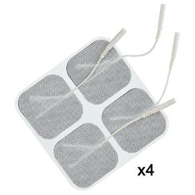
EMSI TENS UNIT

Slide 37
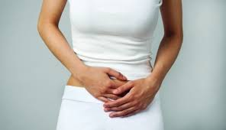
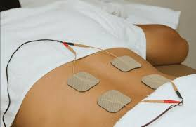
TENS TREATMENT

Slide 38
PT Treatment – Low Level Laser
The laser helps to achieve a faster rate of healing and pain relief by stimulating normal cellular function for faster repair and inhibiting inflammation and nerve conduction for pain relief.

Slide 39
PT Treatment – LED for lymphedema
LED is used to stimulate lymphatic drainage to reduce edema

Slide 40
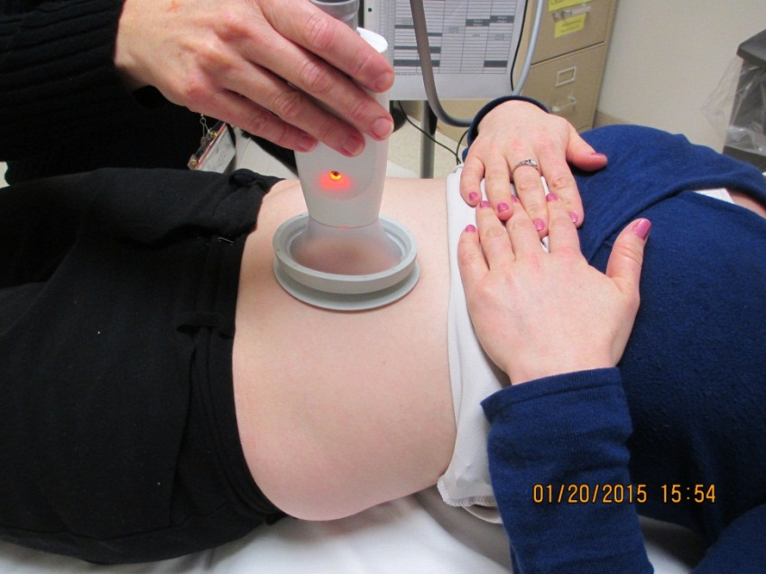
PT Treatment - Physio Touch
Physio Touch is an adjunct to manual therapy. Negative pressure pulls skin and fascia away from body creating a fascial traction. Relieves tension in tissue and improves fluid exchange, muscle tone, tissue length and tissue hydration.

Slide 41
Treatment of Pelvic Floor Dysfunction
Pelvic floor muscle re-education
Biofeedback
Manual
SEMG

Slide 42
Biofeedback
Surface electrodes placed perianally or rectal/vaginal probe with computer screen.
Manual and verbal feedback from PT
For home treatment;
iEase
Biofeedback with vaginal/rectal probe

Slide 43
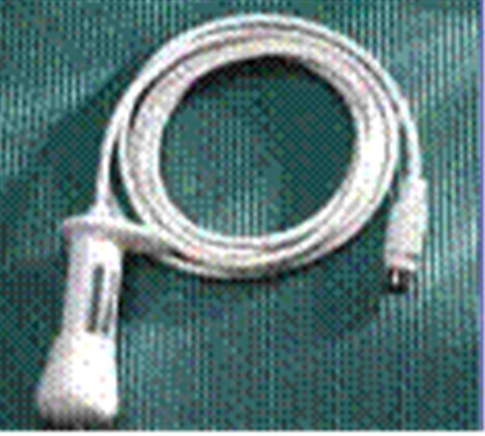
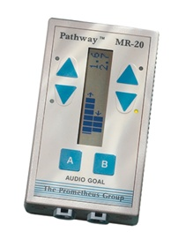
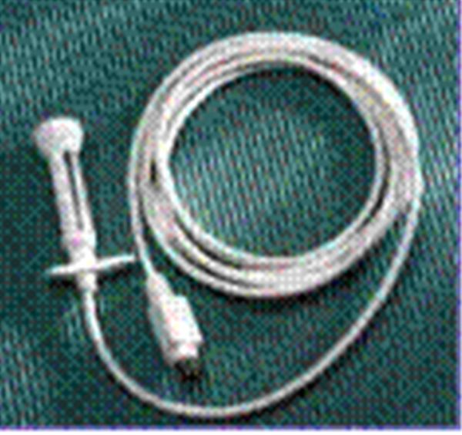
Home Program Devices

Slide 44
Home Biofeedback

Slide 45
Pelvic Floor Treatment
Home program:
Self spinal/pelvic alignment corrections
SI belt
Self scar tissue mobilization
Self external/internal pelvic floor releases
Core strengthening
Trunk, hip, LE stretches

Slide 46
Dilator Therapy
Used for vaginal or rectal stretching, trigger point releases in cases of pelvic muscle spasm and pain.

Slide 47
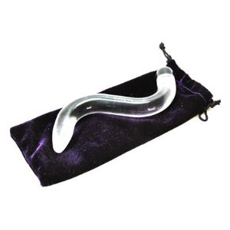
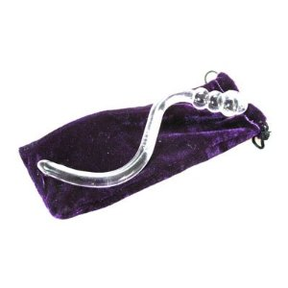
Crystal Wand Vaginal Dilator

Slide 48
Vaginismus dilator set

Slide 49
CORE STRENGTHENING

Slide 50
Physical Therapy Treatment
Address all the factors contributing to the patient’s dysfunction
Educate and provide home program for symptom management
Recommend counseling if history of sexual abuse
Handle with care

Slide 51
Treatment Plan
Pelvic floor pain, muscle spasm:
Frequency/duration of treatment: 1 to 2 times per week, 8-12 visits x 4-12 weeks. This may vary depending on evaluation
Pelvic floor muscle weakness:
Frequency / duration of treatment: 2-4 visits x 4-8 weeks. This may vary depending on evaluation.

Slide 52
How to locate a Pelvic Floor PT
Physical therapists that treat pelvic floor dysfunctions
Contact us for Michigan PTs ( data base)
www.womenshealthapta.org

Slide 53
How to Refer to PT
Requirements for PT prescription:
Document Patient Diagnosis
MD signature
Evaluate and Treat x 3 months
Place PT order in MiChart
For MD’s and PA’s outside the U of Mi system;
Fax prescription to UH OP PT @ 734-936-7016
Fax to our Canton facility @ 734-844-7798
Fax to our Burlington Clinic @ 734-763-3751
Fax to our Northville Clinic @ 248-305-4400
Call UH OP PT @ 734-936-7070, Canton facility @ 734-844-2020, Burlington Clinic @ 734-763-6464 or our Northville clinic @ 248-305-4807 with any questions

Slide 54
Questions

