Slide 1
Pulmonary Problems in Athletes
Zoë J. Foster, MD
October 19, 2016

Slide 2
Learning Objectives
Generate a differential diagnosis for rhinitis, cough, and wheezing in athletes.
Define terms including: EIA, EIB, and VCD.
Discuss how the pathogenesis of asthma differs in athletes compared to sedentary individuals.
Consider respiratory conditions in special settings, including athletes with sickle cell trait (SCT) and SCUBA divers.

Slide 3
Case 1: M.
49 y.o. woman who wants you to complete her health form for a SCUBA diving class.
PMH: asthma
PSH: cholecystectomy, bariatric surgery
MEDS: none
Do you complete her form?

Slide 4
Clearance for SCUBA Diving
Could the condition predispose to a diving illness?
Could the condition be provoked by diving?
Could the condition compromise the diver's safety or performance underwater?

Slide 5
Pulmonary Disorders and SCUBA Diving
Absolute contraindications:
H/o spontaneous pneumothorax
Impaired exercise performance d/t respiratory disease
Relative contraindications:
Asthma or reactive airway disease
EIB
Solid/cystic/cavitary lesions
Prior PTX d/t surgery, trauma or over inflation
Immersion pulmonary edema
Interstitial lung disease

Slide 6
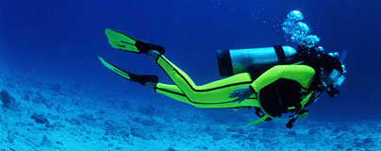
Asthma and SCUBA Diving
Criteria for clearance prior to SCUBA diving:
Asymptomatic adult with past history of childhood asthma.
Well controlled asthma with known triggers and normal PFTs with a reduction of < 20% in peak mid-expiratory flow after exercise.
No evidence of cold-induced wheezing or exercise-induced bronchospasm.

Slide 7
Case 1: M.
Spirometry was normal.
Pt. reported no wheezing or medication use in the past 5 yrs.
Was cleared to scuba dive.

Slide 8
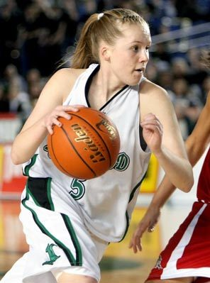
Case 2: L.
11 y.o. girl brought in by mom for coughing and wheezing during a basketball tournament.
Was playing in a game this weekend and they had to pull her out d/t wheezing. She was on the bench coughing for about 2 hours before she was “back to normal”.

Slide 9
Case 2: L.
PMH: eczema as a child
PSH: none
Meds: occasional MVI
ALL: NKDA
SocHx: 6th grade. No smokers at home. Pet cats. Plays basketball 4 hours per week.
FamHx: Dad with asthma
Vitals: wt 115#, BP 110/60, pulse 68
HEENT: TMs pearly gray, nasal mucosa with clear rhinorrhea, no pharyngeal erythema, no anterior cervical LAD
CV: RRR, no m/r/g
Resp: CTA, no wheezing
Peak flow: 280, 250, 280

Slide 10
Differential Diagnosis for Wheezing?
Deconditioning
Bronchitis or other viral URI
Exercise-induced bronchospasm (EIB)
Exercise-induced asthma (EIA)
Exercise-induced hyperventilation (EIAH)
Paradoxical vocal cord dysfunction (VCD)
Exercise-induced anaphylaxis
GERD

Slide 11
Differential Diagnosis for Coughing?
Viral/bacterial upper or lower respiratory tract infection
Upper airway cough syndrome – related to rhinitis, sinusitis, laryngitis or other upper airway conditions
Spontaneous pneumothorax
Bronchiectasis
Asthma or EIB
Laryngeal trauma
GERD
Environmental exposures

Slide 12
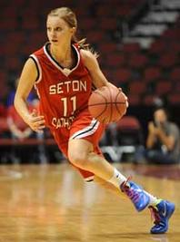
Exercise-induced Hyperventilation
Also known as “pseudo-asthma syndrome”.
Hyperventilation during exercise causing respiratory symptoms (wheezing, chest tightness), not directly related to bronchial obstruction.

Slide 13
Exercise-Induced Anaphylaxis
Wide variety of exercise is implicated.
Symptoms include: generalized pruritus (92%), urticaria (83%), angioedema (78%), respiratory symptoms (59%), syncope (32%).
2:1 female predominance.
Can show familial pattern.
Associated with hx of allergic rhinitis or eczema.
Subtype associated with ingestion of specific foods.

Slide 14
Food-dependent Exercise-Induced Anaphylaxis
Symptoms are usually induced by physical exercise after food ingestion.
Causative foods include: shellfish, wheat products, vegetables, fruits, nuts, eggs, mushrooms, corn, garlic, rice, and meat.
Aspirin and NSAID ingestion has been documented to induce symptoms or to provoke more severe symptoms.

Slide 15
Paradoxical Vocal Cord Dysfunction (PVCD)
Upper airway obstruction associated with the paradoxical adduction/closure of the vocal folds occurring primarily on inhalation, and sometimes during exhalation.
Presentation can range from mild dyspnea to acute, severe respiratory distress.
Without hypoxemia.
Many patients point to or grab their throats when describing respiratory symptoms.
Incidence is as high as 27% of young, physically active adults
Frequently comorbid with asthma in as many as 40% of pediatric patients and 38% of adults.
Ratio of 3:1 females to males
The underpinnings of PVCM are poorly understood and more a matter of conjecture than of science.
Generally does not respond to pharmacologic treatment for asthma.

Slide 16
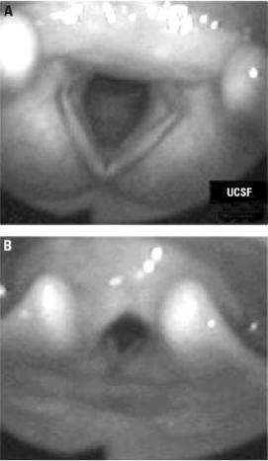
Diagnosis of PVCD
Laryngoscopy is considered the gold standard for diagnosis.

Slide 17
Treatment of PVCD
Termination of unnecessary medications
Reassurance (that condition is benign and oxygenation is normal despite dyspnea)
Speech therapy as primary treatment
To abort acute attacks:
Panting, sniffing, pursed lipped breathing on exhalation, nasal inhalation
Heliox (works by decreasing work of breathing)
Benzodiazepines

Slide 18
Exercise-Induced Asthma (EIA)
Condition in which exercise induces symptoms of asthma in patients who have asthma.
Possibly because of poor control of the disease.
In individuals with intermittent asthma, EIA may be the only expression of asthma.
EIA is found in 8-10% of normal child population and in approximately 35% of children with current asthma.
Symptoms usually occur shortly after heavy exercise.
Wheezing will be expiratory.

Slide 19
Exercise-Induced Bronchospasm (EIB)
Describes airway obstruction that occurs in association with exercise.
Without regard to the presence of chronic asthma.
Defined as ≥ 10% reduction in FEV1 after exercise.
More common in endurance sport athletes or in sports that require high minute ventilation.
Prevalence ranges from 11 to 50%
Approaches 90% in athletes with asthma.
5-10% of athletes with EIB have no concomitant respiratory or allergic disease.

Slide 20
Symptoms of EIB
Coughing, wheezing, chest tightness and unusual SOB
Occurring during strenuous exercise and peaking about 5-10 minutes after exercise.
Children and adolescents may have more nonspecific symptoms:
Poor performance or “feeling out of shape”,
Parents may note inability to keep up with peers
Abdominal pain, headaches, muscle cramps, fatigue, dizziness or chest pain.

Slide 21
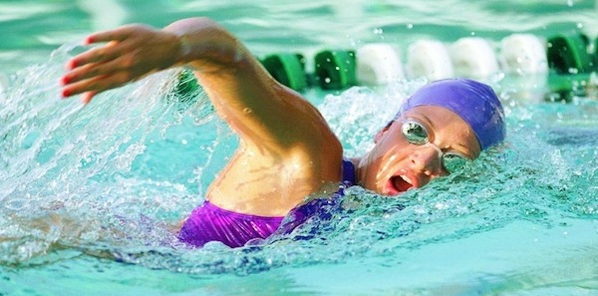
Pathophysiology of EIA/EIB.
Considered a chronic inflammatory condition.
EIA usually an eosinophilic inflammation.
EIB usually a neutrophilic or mixed inflammation.
Inflammation causes increase in airway hyper-responsiveness.

Slide 22
Diagnosis of EIB or EIA
Based on a detailed history suggestive of EIB or EIA.
For EIA, consider spirometry.
Preferred method of measuring airflow limitation and reversibility.
A normal FEV1 does not preclude EIA.
For EIB, consider a pulmonary function test coupled with an appropriate exercise challenge.
Lack of a gold standard test for the diagnosis of EIB in the literature.

Slide 23
Pearls
Symptoms occurring during the first 5 minutes of exercise are usually not indicative of EIB.
More likely related to other changes in pulmonary function, poorly controlled underlying asthma, poor conditioning, or chest wall injury.

Slide 24
Case 2: L. - Diagnosis
Baseline spirometry with mild obstructive pattern.
At 15 minutes post-exercise, significant decrease in small airway flow indicating EIB (FEV₁ 2.61L).
Full recovery with albuterol (FEV₁ 2.90L; 11% change from post-exercise reading).
Diagnosis: exercise-induced asthma

Slide 25
EIA/EIB Treatment – 1st Line
Short-acting inhaled β-agonists
Albuterol, pirbuterol (Maxair), terbutaline
For prophylaxis
For management of acute bronchospasm
Albuterol
Most commonly used pre-exercise medication.
2 puffs administered 15 minutes prior to exercise.
Side effects include tremor, palpitations, increased heart rate.

Slide 26
Issues with β-Agonists
Inhaled β-agonists are permitted by the NCAA.
Daily treatment with β-agonists can enhance the severity of EIB.
Recovery from EIB after a standard dose of β-agonists is slower and additional doses are often required when either LABAs or SABAs are used daily.
Long-acting β-agonists produce sustained improvement in pulmonary function persisting, on average, for more than 12 hours.
Are not recommended for use as monotherapy.

Slide 27
EIA/EIB Treatment: 2nd Line
Inhaled corticosteroids:
Fluticasone (Flovent), triamcinolone (Azmacort), budesonide (Pulmicort), flunisolide (AeroBid), beclomethasone (QVAR)
Have been demonstrated to be useful in tx of EIB
Require four weeks to achieve maximal effect
Side effects: oral candidiasis, hoarseness
Consider adding long-acting β-agonist (LABA) if symptoms not well controlled on corticosteroids alone.

Slide 28
EIA/EIB treatment: 2nd line
Leukotriene receptor antagonists
Montelukast (Singulair), zafirlukast (Accolate)
A single dose can protect against EIB for up to 12 hours after administration.
Benefit is not reduced over time when used on a regular basis as monotherapy.
Can be tried alone in those who do not meet WADA or IOC criteria for inhaled corticosteroid use.

Slide 29
Non-Pharmacologic Treatment Measures
Increase physical conditioning.
High intensity warm up for at least 10 minutes prior to beginning exercise.
Cover mouth and nose with scarf/mask in cold weather.
Avoid aeroallergens and pollutants.
Diet changes.

Slide 30
Case 2: L. - Treatment
Albuterol MDI, 2 puffs po prior to exercise
Intermittently helps with sx control
Loratadine (Claritin) 10mg QD
Not taking consistently
Montelukast (Singulair) 10mg QD
Not taking regularly
Fluticasone (Flovent) 110mcg, 2 puffs po BID
Didn’t like being on steroids
Ranitidine (Zantac) 150mg QD
No change in symptoms

Slide 31
Case 3: C.
41 y.o. recreational marathon runner
Notes recurrent URI symptoms including rhinitis and cough.

Slide 32
Why is she getting sick so often?
Studies show that strenuous or chronic exercise is associated with increased incidence of URIs in athletes.
Lifestyle variables – high stress levels, sleep deprivation, dietary unawareness – are important co-factors in the immune response.

Slide 33
Differential Diagnosis of Rhinitis
Allergic rhinitis
Non-allergic rhinitis
Exercise-induced rhinitis

Slide 34
Exercise-Induced Rhinitis
Affects more than 1/3 of athletes.
Triggers include:
Exposure to airborne allergens during training
Cold air
Various pollutants
Which cause airway inflammation and epithelial damage.

Slide 35
Exercise-Induced Rhinitis
Treatment:
Allergen avoidance
Reduction of irritant exposure
Medications:
Nasal corticosteroids
Nasal anticholingerics
Leukotriene receptor antagonists
Antihistamines
Immunotherapy
Consider testing to rule out asthma

Slide 36
Case 4: B.
21 y.o. 238# African-American collegiate lineman who fell to his hands and knees on the field during the first day of practice.
Was running back-to-back 100 yard sprints.
Complains to the ATC of leg and back cramps.

Slide 37
Case 4: B.
Observation: sweating, panting overweight athlete; anxious appearing
Vitals: T 99.9, tachycardic, tachypnic
CV: tachy but regular
Resp: CTA B, no w/r/r
Musc: no palpable muscle spasms, muscles seem weak against resistance

Slide 38
Case 4: B. - Differential Diagnosis
Deconditioning
Heat exhaustion or heat stroke
Asthma attack
Spontaneous pneumothorax
Cardiac issue
Muscle cramps
Anxiety attack
Exertional sickling collapse

Slide 39
Spontaneous Pneumothorax
2000 cases in the US annually
10% associated with athletic activity.
Most often seen in males in their late teens to early 30s; generally in those with a taller slender build
Presentation can be varied:
Most commonly dyspnea and pleuritic chest pain
Chronic cough
10% may have no complaint at all

Slide 40
Exertional Sickling Collapse: Symptoms
Player who typically slumps to the ground, may complain of pain (typically low back and legs), muscle weakness, feel like they “can’t go on”.
Communicative.
Muscles are not “locked up”.
Muscle weakness exceeds muscle pain.
Tachypnea (d/t lactic acidosis).

Slide 41
Exertional Sickling Collapse: Triggers
In athlete with sickle cell trait
Maximal exertion sustained for at least a few minutes
Abrupt increase in intensity of training
Training at unfamiliar altitude
Suboptimal physical conditioning

Slide 42
Exertional Sickling Collapse: Treatment
Monitor vital signs
Supplemental oxygen by face mask
Cool athlete if needed
Start IV line and be ready for CPR
Transport to hospital if not immediately improving
IS A MEDICAL EMERGENCY!

Slide 43
Sickle Cell Trait
Condition resulting from inheritance of one gene for sickle hemoglobin (HgbS) and one gene for normal hemoglobin.
Incidence in the general population:
8% of African Americans
0.5% of Hispanics
0.2% of whites

Slide 44
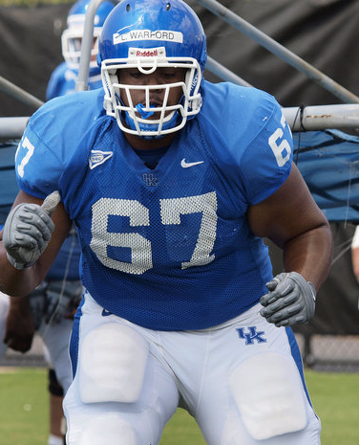
Sickle Tell Trait
Testing now mandated for all Division I student athletes.

Slide 45
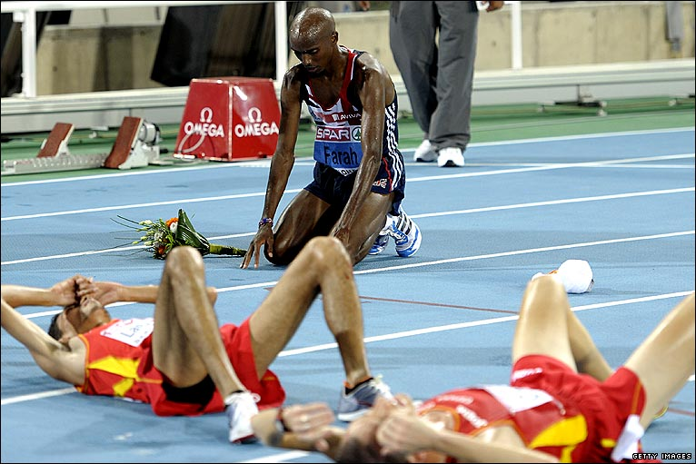
Thank you!

