Slide 1
The Low FODMAP Diet
for IBS
Lauren Van Dam, MS, RD
Senior GI Dietitian
Division of Gastroenterology

Slide 2
Overview
What are FODMAPs?
Mechanisms
Supporting data
Which foods contain FODMAPs?
Nutrition counseling approach

Slide 3
Patient referrals & the low FODMAP diet
Majority of referrals (~70%) are for IBS/FODMAP diet
Who else may benefit from low FODMAP diet:
IBD (in remission), high ileostomy output
Celiac disease (commonly overlapped with IBS; negative serologies/biopsy)*
Gastroparesis/IBS overlap*
SIBO
*along with other dietary modifications

Slide 4
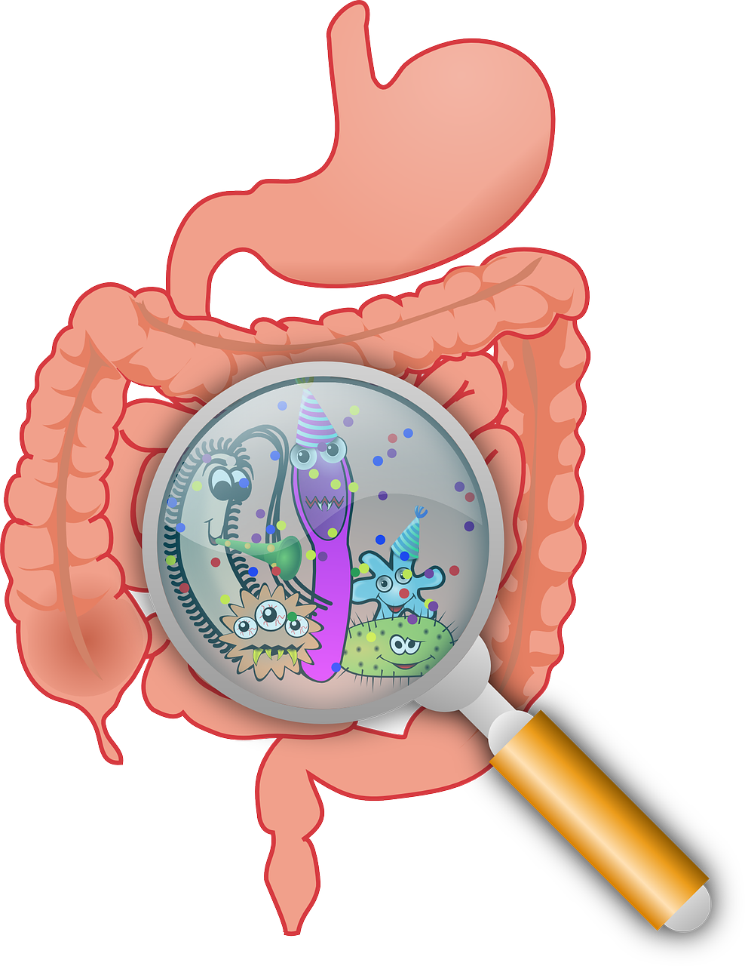
FODMAPs
Fermentable
Oligosaccharides – few simple sugars linked together (fructans, galactans)
Disaccharides – double sugar (lactose)
Monosaccharides – single sugar (fructose)
And
Polyols – sugar alcohols (sorbitol, mannitol, isomalt, xylitol, glycerol)

Slide 5
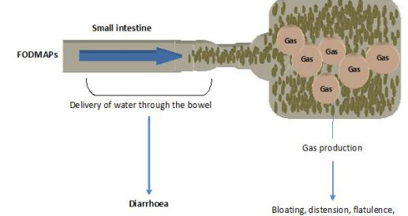
Short chain carbohydrates
Poorly absorbed in the small intestine & delivered to the colon
Rapidly fermentable by gut bacteria resulting in gas and SCFA
Small, osmotically active molecules increasing water load to the colon
Cumulative effect of FODMAPs produces symptoms in IBS patients

Slide 6
Mechanisms of Individual FODMAPs
Lactose: with reduced activity of brush border enzyme lactase
  Lactase splits lactose into glucose + galactose which can then be absorbed
Fructose: slow, low-capacity transport mechanism across epithelium
  Glucose facilitates absorption across the transporter
  1:1 ratio of fructose to glucose is considered FODMAP friendly
  >0.2g excess fructose compared to glucose per serving is high FODMAP
Fructans/Galactans: humans lack digestive enzyme
  Therefore not broken down and 100% of people malabsorb
Polyols: too large for passive diffusion
  Has a laxative effect (i.e. prunes)

Slide 7
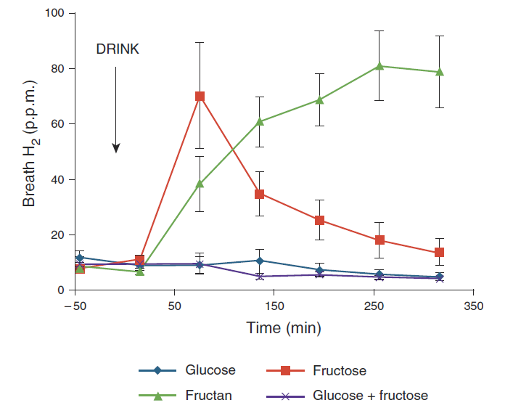
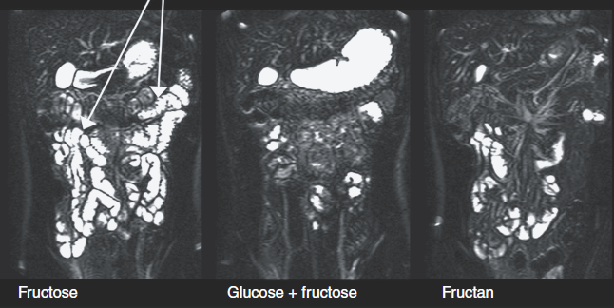
FODMAPs exert osmotic & fermentation related effects which trigger symptoms in IBS
• Fructose but not inulin distends the small bowel with water.
• Adding glucose to fructose reduces the effect of fructose on SBWC and breath hydrogen.
• Inulin distends the colon with gas more than fructose, but causes few symptoms in healthy volunteers.
Murray et al. Am J Gastroeterol 2014;109:110

Slide 8
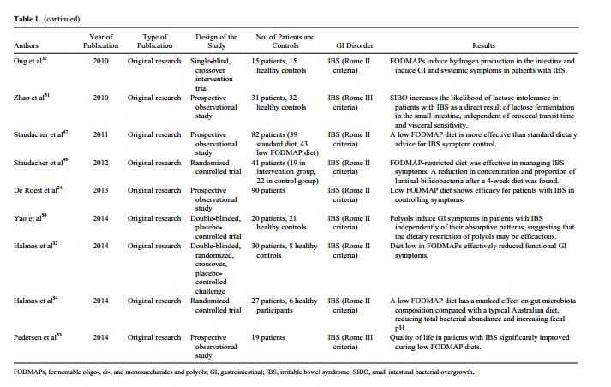
Role of FODMAP in Patients with IBS: A Review
Mansueto et al. Nutrition in Clinical Practice. 2015 665-682.

Slide 9
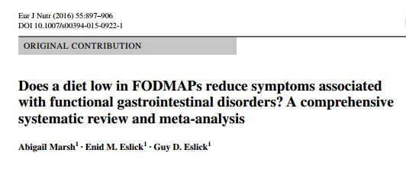
Included: Six RCTs and 16 non-randomized interventions
There was a significant decrease in IBS SSS scores for those individuals on a low FODMAP diet in both the RCTs (OR 0.44, 95 % CI 0.25– 0.76, p = 0.00) and
non-randomized interventions (OR 0.03, 95 % CI 0.01–0.2, p = 0.02)
Significant improvement in the IBS-QOL score for RCTs (OR 1.84, 95 % CI 1.12–3.03,
p = 0.39) and for non-randomized interventions (OR 3.18, 95 % CI 1.60–6.31, p = 0.89).
Following a low FODMAP diet was found to significantly reduce symptom severity for abdominal pain (OR 1.81, 95 % CI 1.13–2.88, p = 0.56), bloating (OR 1.75, 95 % CI 1.07–2.87, p = 0.45) and overall symptoms (OR 1.81, 95 % CI 1.11–2.95, p = 0.4) in the RCTs.

Slide 10
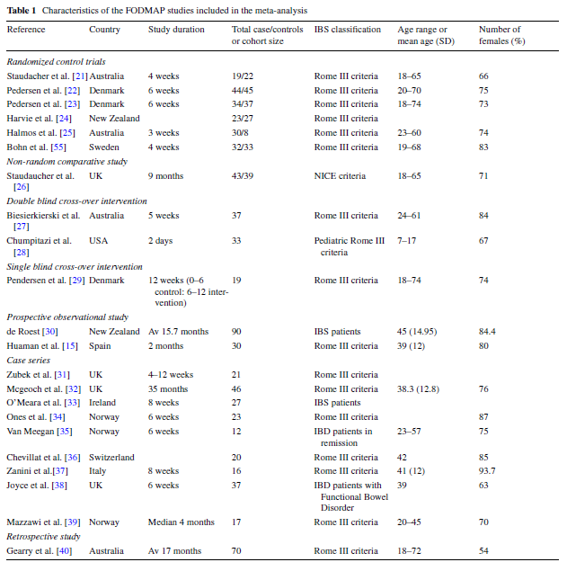

Slide 11
US RCT Comparing the Low FODMAP Diet vs m-NICE Guidelines in IBS-D
Compare the efficacy of the low-FODMAP diet to a diet based upon modified guidance from the National Institute for Health and Care Excellence (mNICE) in US adults with IBS-D
Single center trial at UMHS
Dietitian guided mNICE recommendations:
    Small frequent meals
    Caffeine and alcohol in moderation
    Avoidance of known trigger foods
    Avoidance polyols (sugar-free gum, etc)
Eswaran, Chey, et al. 2016
Notes:
m-NICE: Classic NICE guidelines advise patients to avoid sorbitol containing foods such as sugar-free gum. The modifiied NICE guidelines used for this trial did not specifically advise pts to exclude foods that contain FODMAPs
-Eat at regular intervals and Avoid long gaps between meals
Question for Shanti:
-Limit fruit to 3 portions per day?

Slide 12
Endpoints
Primary endpoint:
Adequate relief of overall IBS symptoms during 50% or more of the last 2 weeks of study period (weeks 3-4)
Secondary Endpoints
A decrease in mean daily Bristol Stool Form Scale value of ≥1 compared to baseline for 2/4 weeks
≥30% reduction in mean daily abdominal pain score for 2/4 weeks
≥30% reduction in mean daily bloating score for 2/4 weeks
Notes:
and the individual components of the composite endpoint (≥30% reduction in mean daily abdominal pain score for 2/4 weeks or a decrease in mean daily BSFS value of ≥1 compared to baseline for 2/4 weeks
Given the imptc of bloating in ibs, we also included the proportion of patients with at least 30% reduction in abdominal pain

Slide 13
Baseline Characteristics
Baseline Symptom Severity
Symptom | Low FODMAP | mNICE | p-value
 | N = 50 | N = 42
Abd Pain Score | 5.10 ± 1.5 | 5.06 ± 1.34 | p = .9051
Bloating Score | 4.87 ± 1.83 | 5.01 ± 2.07 | p = .7195
Urgency Score | 4.98 ± 1.93 | 5.39 ± 2.1 | p = .3347
Bristol Stool Form | 5.21 ± .60 | 5.25 ± .70 | p = .7710
Stool Frequency | 3.45 ± 1.66 | 3.37 ± 1.76 | p = .8204
Notes:
Symptom severity was similar at baseline for each arm
Also, demographics for each group were evenly matched.

Slide 14
Weekly Abdominal Symptom Scores
P values refer to the change WITHIN group comparing to baseline score
Eswaran, Chey et al. DDW 2016

Slide 15
Overall IBS- QOL Scores
p < .0015
p<.0001
p=.03
Mean Value
Baseline
Week 4
Baseline
Week 4
Notes:
When measuring IBS-QOL scores, Higher is better.
Both diets led to SS improvements in QOL from baseline, as evidence by higher IBS-QOL scores at the end of the study period
However, The magnitude of change with the low fodmap diet was 16 points compared to an increase of 5 with the mnice diet, which is signficantly greater.
The low FODMAP arm brought the IBS-QOL score from 53—69, which was SS. This improvement was not seen in the mnice group.
This degree of change was of 16 v 5, was SS as well

Slide 16
Study Conclusions
Both dietitian-taught interventions improved IBS symptoms
The low FODMAP diet led to significantly greater improvements in abdominal symptoms
  Abdominal pain
  Bloating
Modest improvements in stool consistency
Benefits extend beyond GI symptoms
This study supports a role for low FODMAP diet in the treatment of IBS-D patients
Notes:
Patients on a LFD were twice as likely to experience improvement in their abdominal pain and bloating
…and provides more evidence that dietary strategies for IBS are helpful.

Slide 17
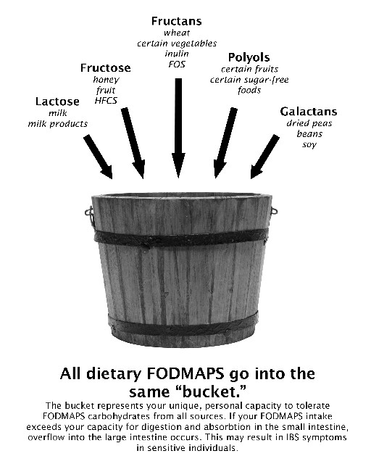
FODMAP Counseling Approach
Prepping the Patient:
2 part diet: elimination phase, challenge phase
Explain mechanisms of FODMAPs, bucket concept
Education emphasizes on what they can eat vs focusing on what they can not
Label reading and hidden sources of FODMAPs
Cooking and recipe modifications
Grocery shopping and dining out tips
Personalized plan based on patient likes/dislikes, allergies, cooking skills, lifestyle
Resources and recipes

Slide 18
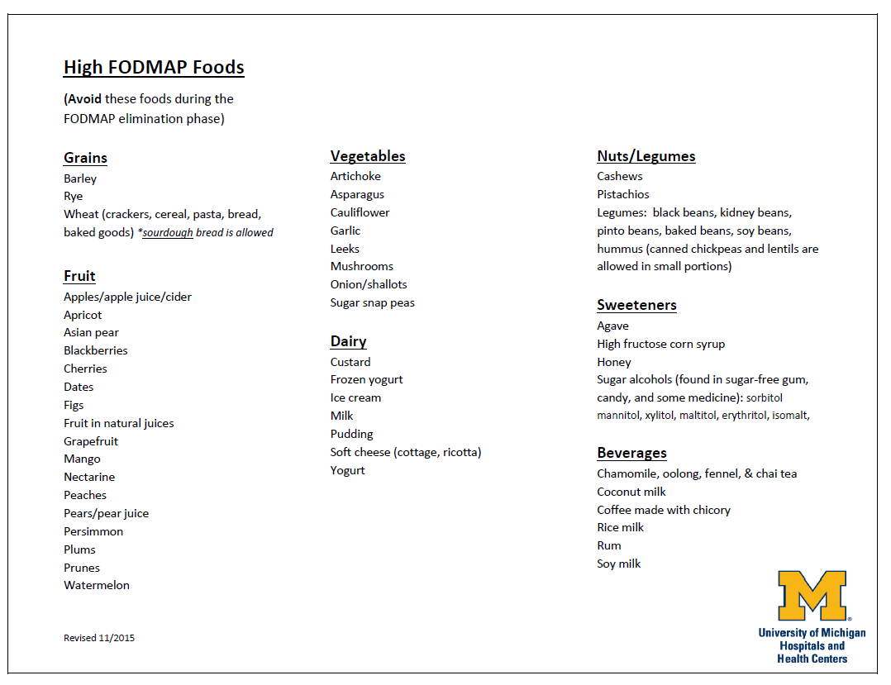

Slide 19
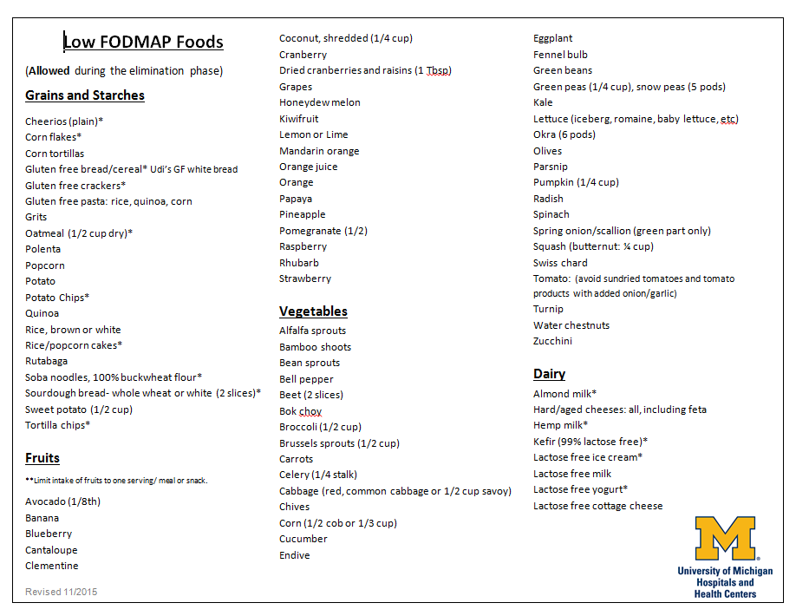

Slide 20
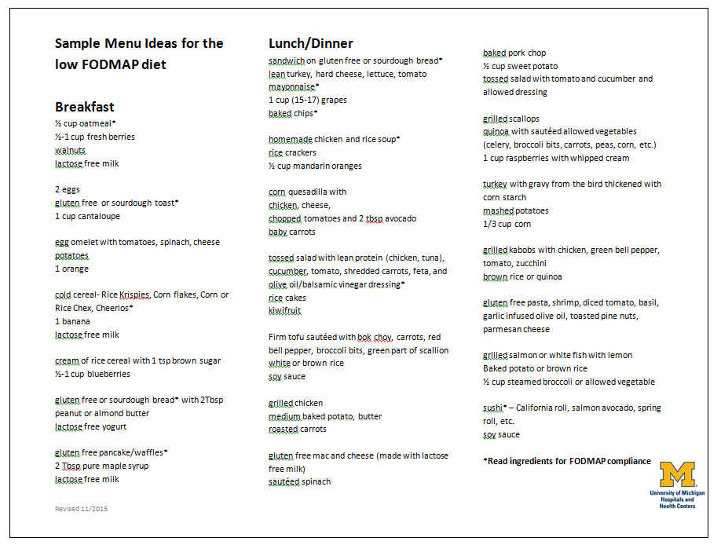

Slide 21
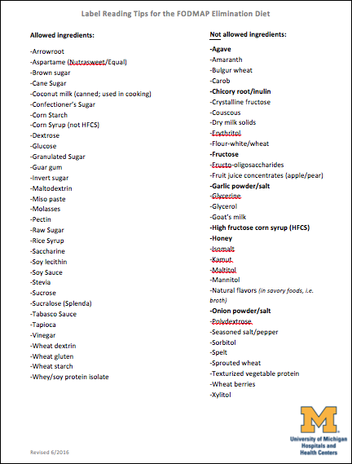
Notes:
-Bolded ingredients: agave, chickory/inulin…

Slide 22
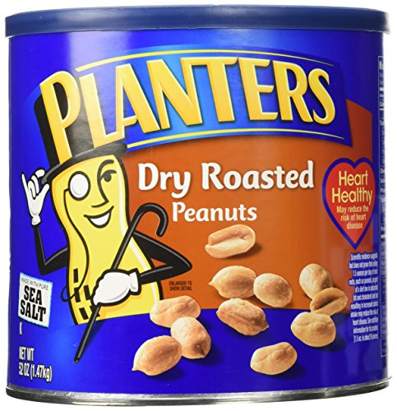
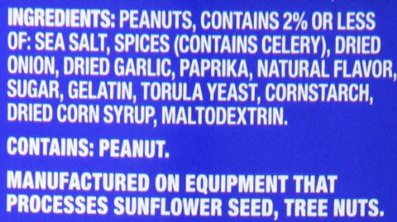
Hidden Sources of Onion/Garlic
Sauces and tomato products
Soups, broths, bouillon
Salad dressings, marinades
Seasoning packets/blends
Seasoned GF snack foods
Condiments
Deli meats
Frozen dinners
Prepared foods

Slide 23
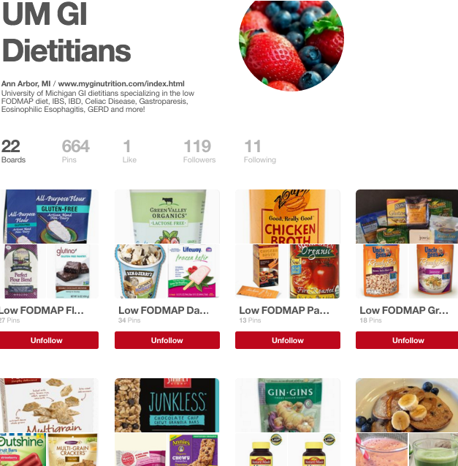
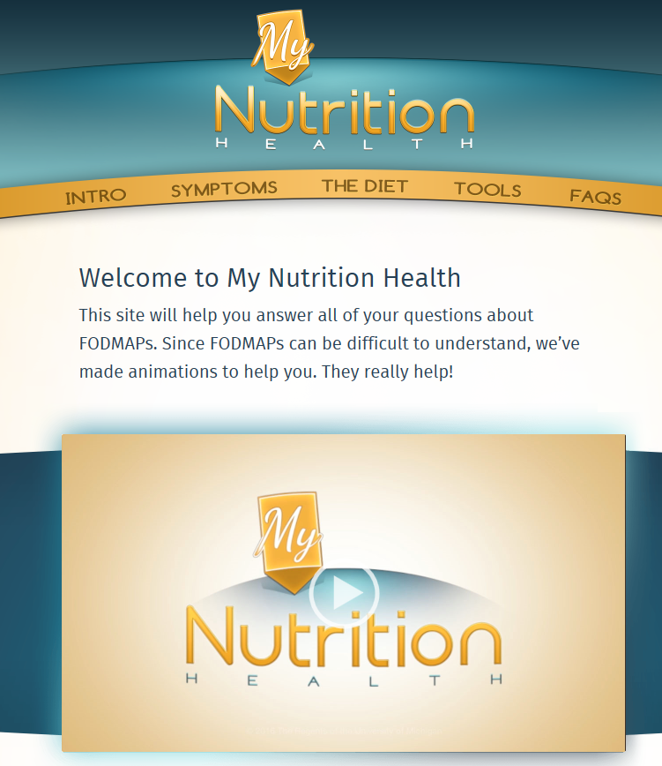
http://www.myginutrition.com
https://www.pinterest.com/UMGIdietitians/
Notes:
-We also provide a list of low FODMAP granola/snack bars and a list of local sourdough bread options with some general guidelines

Slide 24
Follow Up: Challenge Phase
Assess response and diet compliance
Make adjustments vs. start challenge phase
Challenge phase worksheet
  High FODMAP foods (and moderate foods) listed by FODMAP group. **Several foods have 2 FODMAPs
  Guidelines: Reintroduce 1 group at a time x 3 days
    For each challenge: Pick 1 food that has only 1 FODMAP; start with ½ portion on 1st day
    Example (Sorbitol Group): ½ peach→1 peach→1 peach

Slide 25
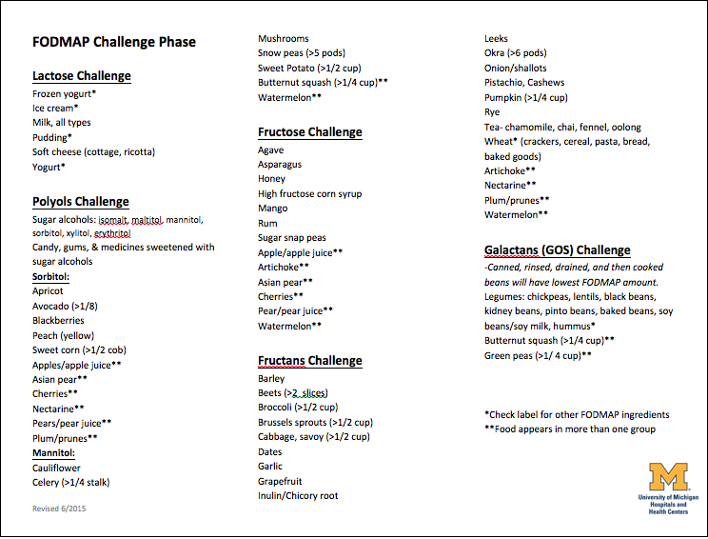

Slide 26
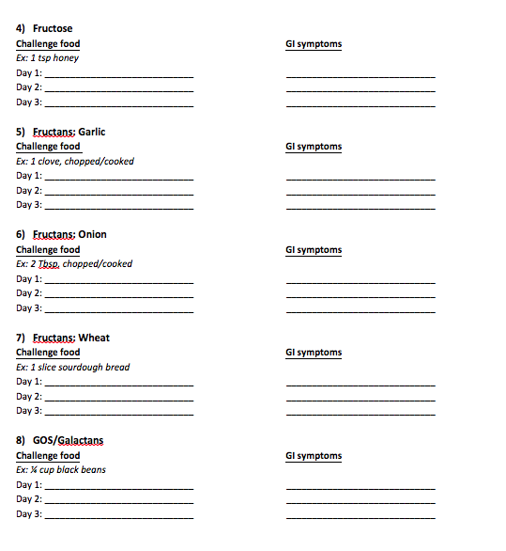
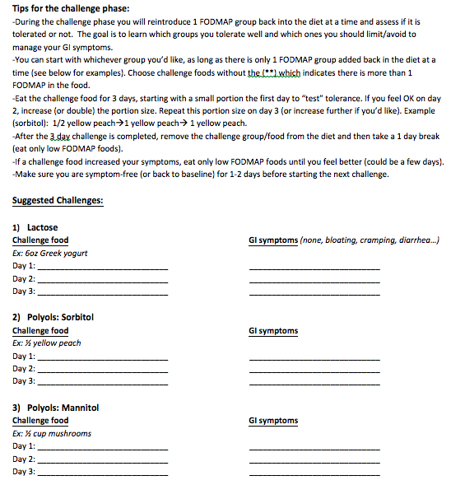

Slide 27
Follow Up: After Reintroduction
Review challenge phase results
Guide patient to other foods likely to tolerate
Continue to expand diet as tolerated
Revisit bucket concept
Retry failed challenge foods in smaller portions
Goal of most varied diet tolerated

Slide 28
Summary
The low FODMAP diet is an evidenced-based approach for managing IBS symptoms
May also be utilized in IBD, Celiac, Gastroparesis, and SIBO
Most effective when led by an experienced dietitian
Patients are willing to modify their diet to feel better!
Referrals at UMHS: “GI nutrition”

Slide 29

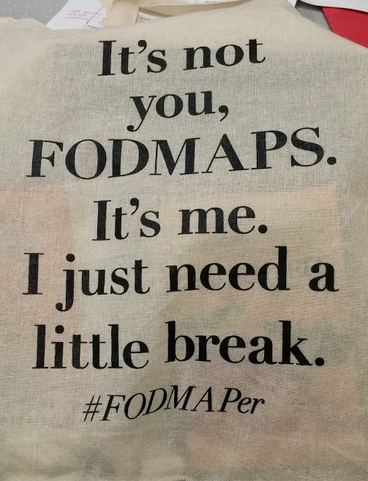
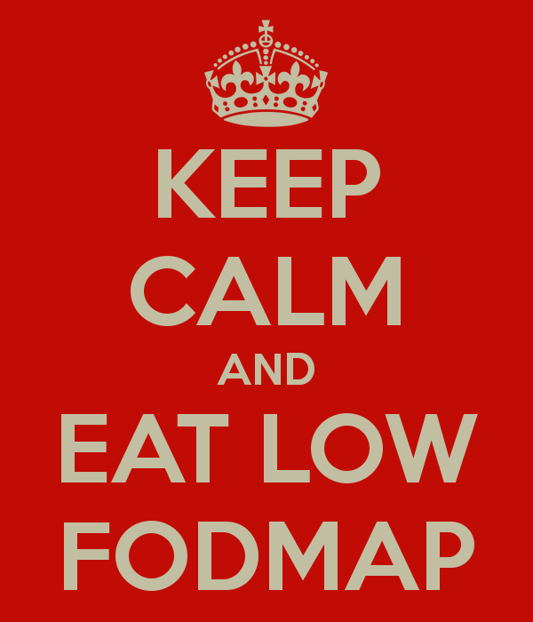
Thank you!
Questions

