Slide 1
Peripheral nerve disorders: A practical overview
Praveen Dayalu, MD
Clinical Associate Professor
Department of Neurology
University of Michigan

Slide 2
What is the Peripheral Nervous System?
CNS is confined to brain and spinal cord
PNS includes (in anatomical order)
Anterior horn cell (located within spinal cord)
Spinal nerve roots (radicles)
Plexi (brachial and lumbosacral)
Named peripheral nerves (e.g. median, peroneal)
Tiny nerve endings (sensory fibers and tiny branches of lower motor axons at the neuromuscular junction)
Neuromuscular junction and muscle

Slide 3
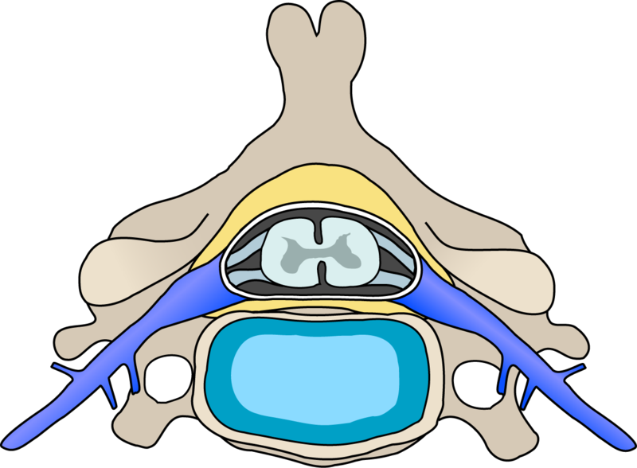
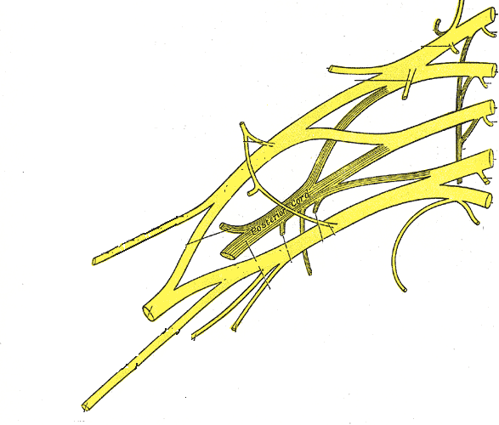
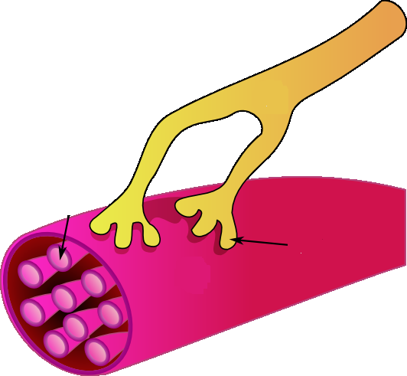
The PNS (Emphasizing Motor Structures)
Brachial
plexus
Anterior horn
cells (LMN)
C8 spinal nerve root
Ulnar nerve
Neuromuscular junction and muscle

Slide 4
Many peripheral axons are myelinated
Myelin (Schwann cells)

Slide 5
Symptoms of PNS Disease
Single focal lesions: weakness/numbness/ pain in one limb, often defined to one part of the limb
Multiple or diffuse lesions: weakness/ numbness/pain in more than one limb, usually bilateral and distal

Slide 6
Signs of PNS Disease
Lower motor neuron signs (atrophy, fasciculations)
Hyporeflexia or areflexia
Patch of sensory loss, or stocking-glove sensory loss
Not UMN signs (spasticity, hyperreflexia, upgoing toe) or “brain” signs (impaired consciousness, cognition, or language)

Slide 7
Reflexes… repeated
Hyperreflexia and spasticity occur with upper motor neuron lesions (CNS)
Hyporeflexia, fasciculations, atrophy with lower motor neuron lesions (PNS)

Slide 8
Workup
Serologies, especially for treatable causes
EMG helps localize and characterize lesions of PNS
Imaging for some focal lesions, or to exclude CNS mimics (such as cord lesion or stroke)
CSF analysis in demyelinating neuropathies, or polyradiculopathy
Nerve biopsy

Slide 9
Anterior Horn Cell

Slide 10
Amyotrophic lateral sclerosis
Anterior horn cells (lower motor neurons) and upper motor neurons degenerate
Mix of UMN and LMN signs/symptoms
Weakness, spasticity, multifocal muscle atrophy
No sensory loss from ALS!
Loss of speech, swallow, respiration→ Death in 2-5 years

Slide 11
Radiculopathy
Brachial plexus
C8 spinal nerve root
Ulnar nerve
Neuromuscular junction and muscle

Slide 12
Spinal Nerve Root Disorders
Most common: monoradiculopathy (cervical or lumbosacral)
Radiating pain, +/- weakness, +/- sensory loss. Reduced reflex for that root level
Commonest causes: disk herniation, minor trauma, degenerative change
Usually self-limited
Image if severe, worsening, or concern for cancer, infection

Slide 13
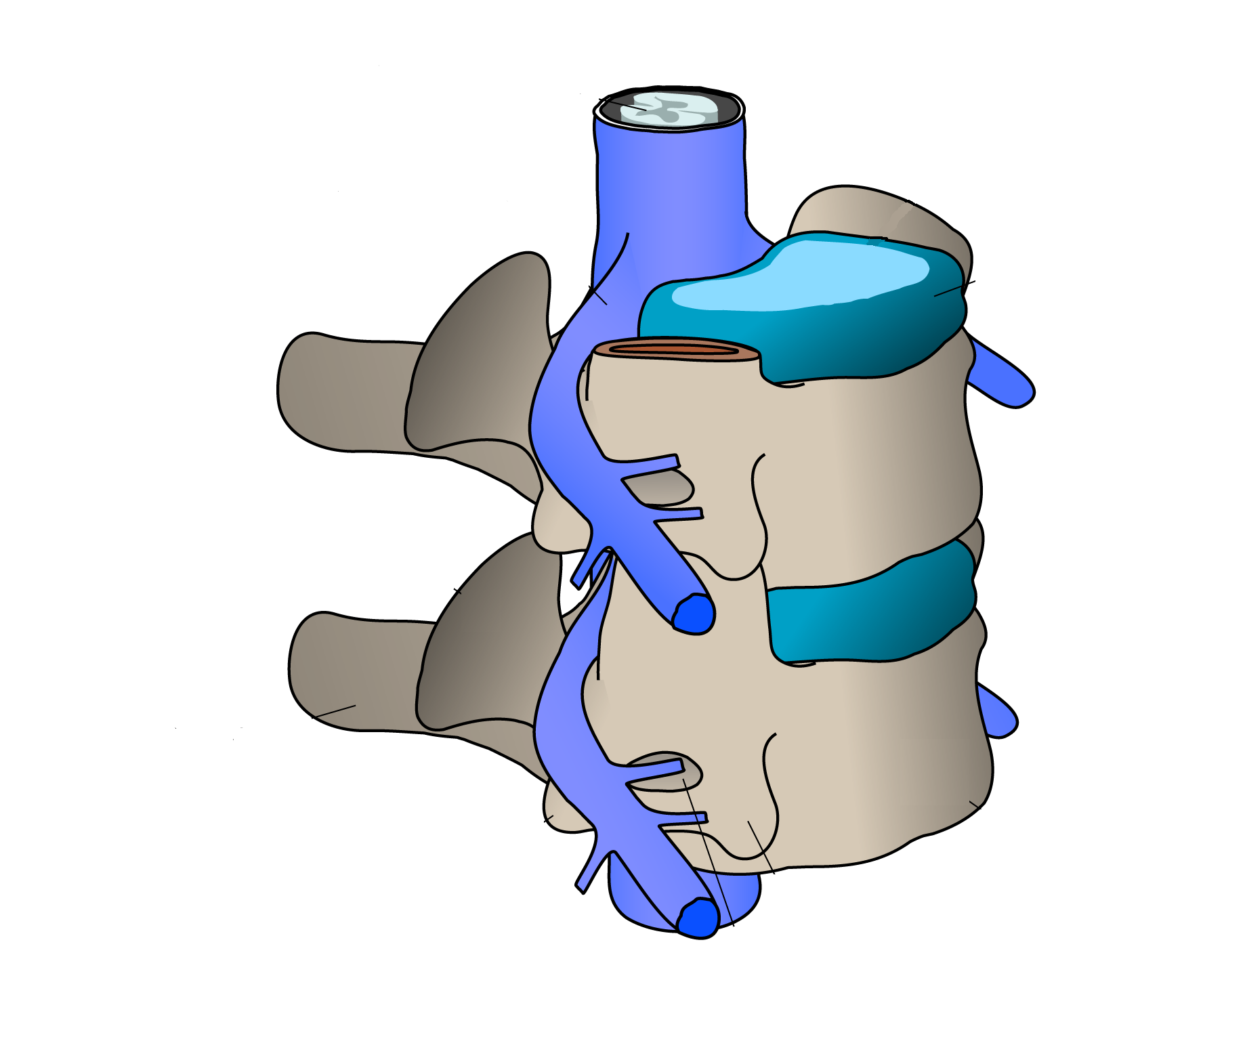

Slide 14
Plexopathy
Brachial plexus
C8 spinal nerve root
Ulnar nerve
Neuromuscular junction and muscle

Slide 15
Plexopathy
PNS syndrome in one limb not explained by a single spinal root, or by a single “named” peripheral nerve
Causes: trauma or stretch, compression by tumor or hematoma, radiation, diabetic
EMG confirms plexopathy
Image if compressive lesion suspected

Slide 16
Brachial Plexus behind clavicle, in upper thorax

Slide 17
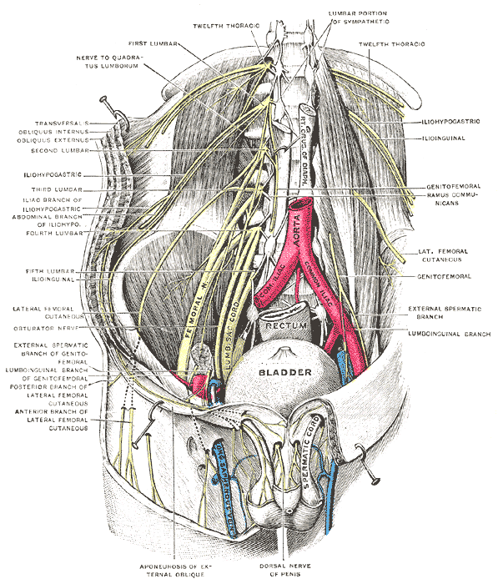
Lumbosacral Plexus: Pelvic, Retroperitoneal

Slide 18
Mononeuropathy
Brachial plexus
C8 spinal nerve root
Ulnar nerve
Neuromuscular junction and muscle

Slide 19
Mononeuropathy
Weakness, numbness, pain, paresthesias confined to the distribution of
UE: median nerve, radial n., ulnar n.
LE: femoral n., sciatic n., peroneal n.
Most common causes: entrapment, trauma, prolonged limb immobility (e.g., surgery)

Slide 20
Important Mononeuropathies
Median mononeuropathy at the wrist (carpal tunnel syndrome)
Ulnar mononeuropathy at the elbow (cubital tunnel syndrome)
Radial mononeuropathy (“Saturday night palsy”)→ wrist and finger drop
Peroneal mononeuropathy (e.g., from leg crossing)→ one cause of footdrop

Slide 21
Named peripheral nerves have well-defined sensory territories (and muscle targets)
Ulnar n.
Median n.
Peroneal n.

Slide 22
Peripheral Polyneuropathy

Slide 24
“Peripheral Neuropathy”
Distal symmetric polyneuropathy
Affects longest sensory/ motor/ autonomic nerves
Nerves are “dying back”
Length dependent (“stocking glove”)
Symmetric loss of pin/ temp / vibration/ proprioception; distal reflex loss
Usually chronic. Many possible causes!

Slide 25
Peripheral polyneuropathy symptoms
Initially, feet numb with paresthesia/ pain
Symptoms ascend: → legs→ fingertips
Distal weakness (feet, or fingers/grip), atrophy,
Severe sensory loss can cause “steppage gait”, “sensory ataxia”, imbalance, falls
Feet prone to injuries, ulcers, deformation (e.g., “Charcot foot”)
Autonomic: orthostasis, bladder and erectile dysfunction

Slide 26
Causes of peripheral polyneuropathy
Usually toxic or metabolic
#1 cause: diabetes & impaired glucose tolerance
B₁₂
Hematologic (e.g., multiple myeloma) or other immunoglobulin disorders (check SPEP)
Drugs: Li, chemotherapy
Alcoholic neuropathy
Liver or kidney disease
HIV and neurosyphilis
Inflammatory causes: connective tissue disease

Slide 27
Workup for peripheral neuropathy?
For typical distal symmetric sensory > motor neuropathy: glucose / a1c, B12, SPEP with ifix
Need EMG and more if rapid or severe, prominent weakness, asymmetry, young patient

Slide 28
AIDP = Acute Inflammatory Demyelinating Polyneuropathy
Develops over ~2 weeks
Follows viral infection or vaccination
Weakness/ numbness/ paresthesia start in legs and ascend; reflexes lost early
Intubate if severe weakness
Autonomic instability, arrhythmia
Rx: plasma exchange & IVIG
Most have good long-term recovery

Slide 29
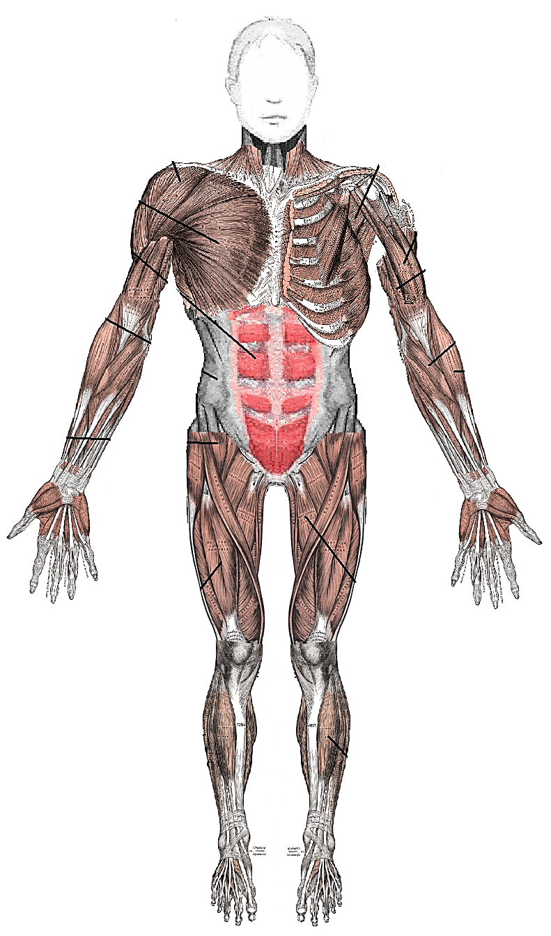
Myopathy = muscle disease
“Can’t raise arms up”
“Tough to comb my hair”
“Hard to get out of a chair”
“Can’t climb stairs”

Slide 30
Clues to a Myopathy
Usually cause symmetric proximal limb weakness (upper/lower)
Other possible sx: muscle pain, tenderness, atrophy; fatigue; change in urine color
Extensive list of causes: TSH, CK, and med review are a good place to start

Slide 31
Time for review questions?

Slide 32
Over 3 days, a 42 y.o. RN rapidly weakens in all four limbs. She says “I think I have Guillain-Barré!” Which is the most urgent first step?
EMG
Spinal cord imaging
Lumbar puncture
Brain imaging

Slide 33
A 61 y/o woman wakes up with a weak right arm. Zero strength in finger extensors, wrist extensors, and trace elbow extension. Flexion muscles are 5/5. Which is the most likely diagnosis?
Left frontal stroke affecting motor cortex
Carpal tunnel syndrome
Right radial mononeuropathy
Peripheral polyneuropathy

Slide 34
Decreased reflexes are seen in all of the following except:
AIDP
Peripheral polyneuropathy
Carcinomatous polyradiculopathy
Alcoholic neuropathy
Steroid myopathy

Slide 35
Weakness and sensory loss in the left hand can be caused by all of the following except:
Right hemisphere stroke
Lung cancer invading brachial plexus
Median mononeuropathy
Amyotrophic lateral sclerosis
Cervical herniated disk

Slide 36
Which is the commonest symptom of radiculopathy in the general public?
Weakness
Radiating pain down a limb
A patch of distinct sensory loss
Bladder incontinence

