Slide 1

U ……
What hundred???
Heidi L. Diez, PharmD, BCACP
University of Michigan Hospitals and Health Centers, Family Medicine
Clinical Assistant Professor
University of Michigan College of Pharmacy

Slide 2
CME Disclosures
I have no disclosures relevant to today’s presentation

Slide 3
Objectives
Demonstrate understanding of dose conversion for each concentrated insulin
Distinguish the ideal patient population for each concentrated insulin
Evaluate safety concerns of concentrated insulins
Summarize cost saving options for concentrated insulins

Slide 4
Diabetes and Obesity Epidemics
29.1 million Americans have diabetes¹
90% of patients with type 2 diabetes are overweight or obese²
  Progressively higher doses of insulin over course of care³
National Health Survey, 2010-2012, adults >18 yo⁴
  14% on insulin only
  14.7% on insulin and oral medications
1. www.diabetes.org/diabetes-basics/statistics/
2. www.who.int/dietphysicalactivity/media/en/gsfs_obesity.pdf
3. Watson et al. Diabetes, Obesity, and Metabolism. 2011; 13: 823-831
4. www.cdc.gov/diabetes/pubs/statsreport14/
Notes:
Ref for 29.1 million: http://www.diabetes.org/diabetes-basics/statistics/ -→ NOTES: only 1.25 million are Type 1
SAY and as you know it has been projected that by 2050, 1 in 3 americans will have diabetes
http://professional.diabetes.org/content/fast-facts-data-and-statistics-about-diabetes/?loc=dorg_statistics → its estimated that 95% are Type 2
Ref for 85.2% are obese → CDC Morbidity and Mortality Weekly Report MMWR 2003; above fact sheet
Ref for health Survey: https://www.cdc.gov/diabetes/pubs/statsreport14/national-diabetes-report-web.pdf (of NOTE: with diagnosed diabetes)

Slide 5
Obesity and Insulin Resistance
Insulin Secretion
Insulin Resistance
Insulin doses
Lamos E. Therapeutics and Clinical Risk Management. 2016; 12: 389-400
Notes:
Ref: Concentrated Insulins article by E. Lamos in Therapeutics and Clinical Risk Management. 2016
NOTES: In someone in which type 2 diabetes mellitus is diagnosed, insulin resistance is usually accompanied by a defect in insulin secretion. Initially, someone who is insulin resistant can compensate for decreased insulin responsiveness by secreting more insulin. In fact, another way to reveal insulin resistance is to look at the amount of circulating insulin. Hyperinsulinemia is the term that describes a higher than normal concentration of insulin in the blood. When beta cells can no longer secrete enough insulin to compensate for reduced insulin function, then a relative insulin deficiency will ensue, and the person will begin to have episodes of hyperglycemia.

Slide 6
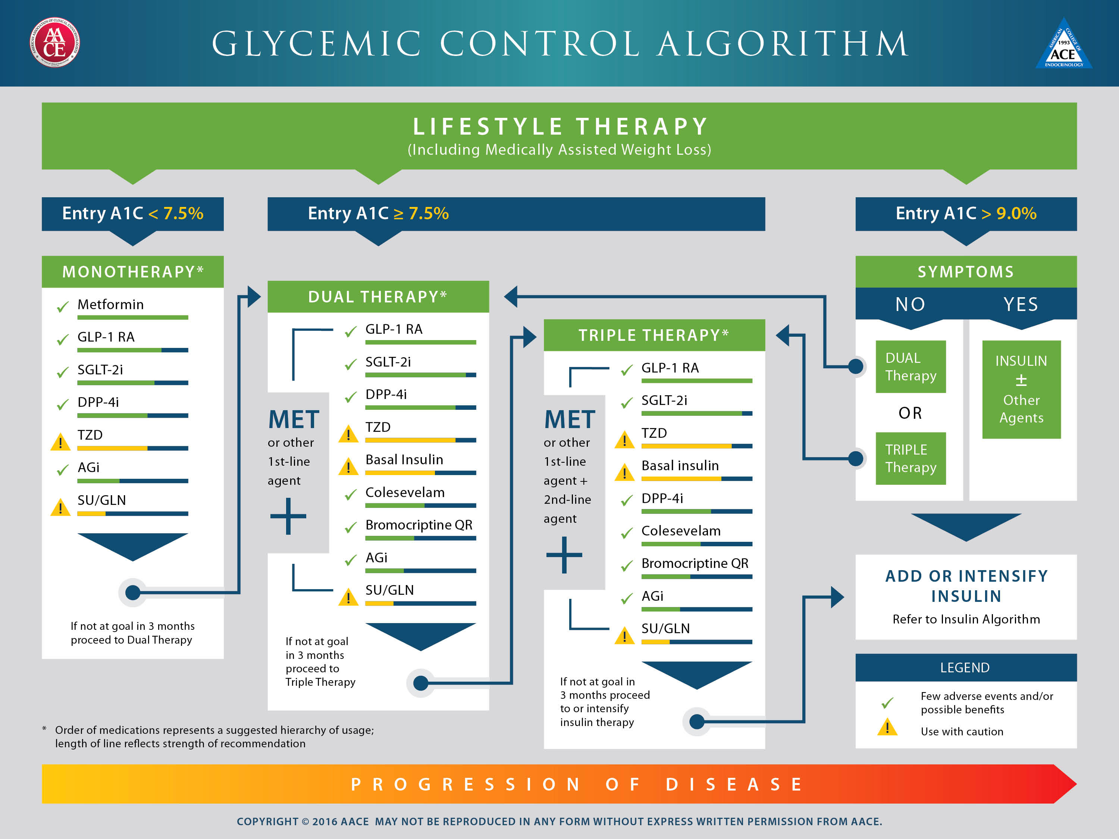
Notes:
AACE (American Assoc of Clinical Endocrinologists) and ACE (American College of Endocrinology) 2016
https://www.aace.com/publications/algorithm

Slide 7

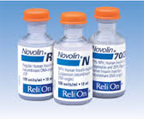


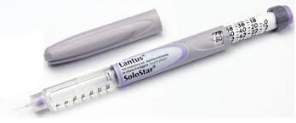

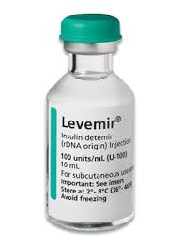

The Usual Suspects….
Notes:
ADA: Joint task force; evidence based; not prescriptive, non-alorithm

Slide 8
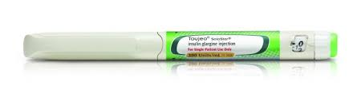
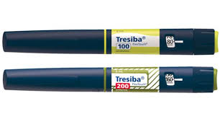
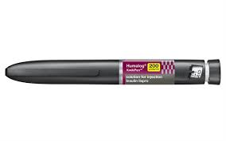
But Wait! There is More….
Notes:
ADA: Joint task force; evidence based; not prescriptive, non-alorithm

Slide 9
Toujeo®
Glargine U-300
  FDA approved in Feb 2015
  Available as pen only
1 unit
Lantus®
1 unit
Toujeo®
Lantus® to Toujeo® → 1 : 1
Notes:
ADA: Joint task force; evidence based; not prescriptive, non-alorithm

Slide 10
Pharmacodynamics: Glargine
 | U-300 (Gla-300) | U-100 (Gla-100)
Onset¹ | 6 hours | 3 – 4 hours
Duration of Action | 36 hours² | ~24 hours (10.8 to < 24 hours)¹
Steady State | 5 days³
Glargine. Facts and Comparisons: Wolters Kluwer. Indianapolis, IN.
http://www.wolterskluwercdi.com/facts-comparisons-online.
Accessed September 9, 2016.
2. Becker et al. Diabetes Care. 2015; 38:637-643
3. Toujeo (glargine) [prescribing information]
Notes:
Find studies about Lantus shorter duration of action
Some studies show up to 30 hours
TOUJEO duration of action: Tight BG (less or equal to 105) was maintained for approximated 5h longer (median 30h) with U300 to U100
Split dosing: Many prescribers limit the volume of insulin injected for a dose to 0.5 mL (50 units), but further research is needed to determine the maximum volume of insulin that can be
administered without affecting absorption as this practice is not evidence-based. Ref: Strategies for insulin injection therapy in diabetes selfmanagement.
American Association of Diabetes Educators. https://www.diabeteseducator.org/docs/default-source/legacydocs/_ resources/pdf/research/aade_meded.pdf?sfvrsn=2.

Slide 11
Dosing in Type 2 Diabetes
 | Gla-300¹ | Gla-100²
Initial Dosing (insulin naïve) | 0.2 units/kg | 0.2 units/kg or up to 10 units
Dose Conversion | Glargine U-100 to U-300 → Same dose NPH BID to U-300 → Reduce NPH total daily dose (TDD) by 20%
Dose Titration | 3 – 4 days
Toujeo (glargine) [prescribing information]
Lantus (glargine) [prescribing information]
Notes:
This is for Type 2

Slide 12
Glycemic Efficacy
Conversion dose is the same
Overall Gla-300 doses are higher than Gla-100:
 | Gla-300 (units/kg/day) | Gla-100 (units/kg/day)
EDITION 1¹ | 0.97 | 0.88
EDITION 2² | 0.92 | 0.84
EDITION 3³ | 0.62 | 0.53
Riddle et al. Diabetes Care. 2014; 37: 2755-2762
Yki-Jarvinen et al. Diabetes Care. 2014; 37: 3235-3243
Bolli et al. Diabetes, Obesity and Metabolism. 2015; 17: 386-394
Notes:
Find studies about Lantus shorter duration of action
Some studies show up to 30 hours
TOUJEO duration of action: Tight BG (less or equal to 105) was maintained for approximated 5h longer (median 30h) with U300 to U100
ED 1: T2 → using Basal and mealtime insulin
ED 2: → using oral and basal
ED 3: → using oral, insulin naive

Slide 13
Outcomes via EDITION Trials: Glargine
EDITION 1 Trial¹
EDITION 2 Trial²
12 wks
6 mo
EDITION 3 Trial³
12 wks
6 mo
Reference 1., 2., 3. See previous slide
Notes:
Inferiority trials: All demonstrated non-inferiority
ED 1: 6 months → solid line is U-300 and dotted is U-100
ED 2: 6 months → solid line is U-300 and dotted is U-100
ED 3: 6 months → solid line is U-300 and dotted is U-100

Slide 14
Safety: Glargine
 | Edition 1¹ |  | Edition 2² |  | Edition 3³
 | U-300 | U-100 | U-300 | U-100 | U-300 | U-100
Severe Nocturnal Hypoglycemia | 36% | 46% | 30.5% | 41.6% | 18% | 24%
Hypoglycemia over 24 Hours | 5% | 5.7% | 71.5% | 71.5% | 46% | 53%
Weight Gain | + 0.9kg |  | + 0.08kg | + 0.66kg | + 0.49kg | + 0.71kg
Riddle et al. Diabetes Care. 2014; 37: 2755-2762
Yki-Jarvinen et al. Diabetes Care. 2014; 37: 3235-3243
Bolli et al. Diabetes, Obesity and Metabolism. 2015; 17: 386-394
Notes:
Hypoglyemia: anytime

Slide 15
Dosage Form Considerations
 | Gla-300 | Gla-100
Maximum Single Dose | 80 units | 80 units
Units per Pen | 450 units/1.5mL (3 pens per box) | 300 units/3mL (5 pens per box)
Room Temperature Expiration | 42 days | 28 days
Toujeo (glargine) [prescribing information]
Lantus (glargine) [prescribing information]

Slide 16
Cost Saving Options
 | U-300 | U-100
Goodrx.com Cost | 3 pens: $343.15 | Vial: $256.26
 | 5 pens: $600.07 | Pen: $380.39
Manufacturer Saving Card | $15 per fill x 1 year | $25 per fill
 | Max: $500/pack | Max: $100/fill
Manufacturer Patient Assistance | -No prescription ins, ineligible for state/fed programs -Part D: on exception basis -Income: < 250% of FPL -Supply: varies -Sent to: PCP office within 2-4 days
www.goodrx.com Accessed 9/10/16
www.needymeds.org Accessed 9/10/16
Notes:
3 pens of Toujeo = 1350 units/carton
5 pens of Touheo = 2250 ($80 savings)

Slide 17
Clinical Pearls/Place in Therapy
Pros to Glargine U-300
  Less volume = less pain
  Improved duration of action
  Improved nocturnal hypoglycemia risk
  Copay card offers more cost savings
Cons to Glargine U-300
  Single max dose is still 80 units
  Patent is expiring soon; good marketing of new brand?
  Toujeo doses 10-15% higher to achieve same glucose control¹

Slide 18
Tresiba®
Degludec U-100 and U-200
  FDA approved in Sept 2015
  Ultra-long acting
  Available as pens only
Notes:
ADA: Joint task force; evidence based; not prescriptive, non-alorithm

Slide 19
Pharmacokinetics: Degludec
Korsatko et al. Clinical Drug Investigation. 2013; 33 (7): 515-521

Slide 20
Pharmacodynamics: Degludec
Korsatko et al. Clinical Drug Investigation. 2013; 33 (7): 515-521
Notes:
One of the issues with

Slide 21
Deguldec vs Glargine: Less Variability
Heise et al. Diabetes, Obesity and Metabolism. 2012; 14: 859--864
Notes:
One of the issues with

Slide 22
Comparison Pharmacodynamics
 | Degludec U-200 | Gla-300
Onset^{1,2} | 1 hour | 6 hours
Duration of Action³ | 42 hours | > 30 hours
Steady State³ | 2 – 3 days | 5 days
Degludec. Facts and Comparisons: Wolters Kluwer. Indianapolis, IN. http://www.wolterskluwercdi.com/facts-comparisons-online. Accessed September 9, 2016.
Glargine. Facts and Comparisons: Wolters Kluwer. Indianapolis, IN. http://www.wolterskluwercdi.com/facts-comparisons-online.
Accessed September 9, 2016.
3. Lamos et al. Therapeutics and Clinical Risk Management. 2016; 12: 389-400

Slide 23
Dosing in Type 2 Diabetes
 | Degludec U-100 and U-200¹
Initial Dosing (insulin naïve) | 10 units
Dose Conversion | Same TDD as long or intermediate-acting insulin
Dose Titration | 3 – 4 days
Tresiba (degludec) [prescribing information]
Notes:
This is for Type 2

Slide 24
Evidence Based Dosing Conversion
Recommendations
Type 2 insulin naïve 26 week target to treat trial¹
  Randomized to U-100 degludec or glargine
  Dose adjusted to pre-breakfast target of 70-90mg/dL
  Results: Degludec = 19 units vs. glargine = 24 units
Type 1 basal-bolus 52 week target to treat trial²
  Randomized to U-100 degludec or glargine + aspart
  Results: Basal doses 14% lower in degludec group
20-30% dose reduction clinically seen for degludec when converted from other basal insulins³
Onishi et al. Journal of Diabetes Investigation. 2013; 4 (6): 605-612
Heller et al. Lancet. 2012; 379: 1489-1497
Kalra and Gupta. North American Journal of Medical Science. 2015; 7: 81-85
Notes:
ADA: Joint task force; evidence based; not prescriptive, non-alorithm

Slide 25
Outcomes via BEGIN Trials: Degludec
BEGIN BB Trial¹
BEGIN OL Trial²
16 wks
40 wks
Garber et al. Lancet. 2012; 379: 1498-1507
Zinman et al. Diabetes Care. 2012; 35: 2464-2471
Notes:
Changes reported in reference to placebo
Sitagliptin: 1262 patients, 2 double blind, placebo-controlled studies of 18 and 24 weeks. Anti-DM drugs DC’d, with diet, exercise, drug washout of 7 weeks.
Saxa: 766 patients, 2- 24 week double blind placebo controlled trials for efficacy and safety. 2 week single blind diet, exercise, placebo lead-in period.
Lina: 730 patients, of 18 and 24 week double blind placebo controlled trials for efficacy and safety. Anti-DM drugs DC’d, with diet, exercise, drug washout of 6 weeks.
Alo: 1768 patients, 3 double blind placebo controlled trials for efficacy and safety. All 3 had 4 week, single-blind, ,placebo run-in period followed by a 26 week randomized treatment period.

Slide 26
Variable Dosing Time
A1c over time
FBG over time
Meneghini et al. Diabetes Care 2013; 36: 858-864
Notes:
Several non-inferiority studies, demonstrated comparable reductions in A1c

Slide 27
Safety: Degludec
Pre-planned Meta Analysis of Seven Phase 3 Trials (5 in Type 2)¹
  25% reduction in overall confirmed hypoglycemia
  38% reduction in nocturnal hypoglycemia
BEGIN Low Volume Trial²
  Nocturnal Hypoglycemia: 6.1% (IDeg-200) vs. 8.8% (IGlar-100)
  Overall Hypoglycemia: 28.5% (IDeg-200) vs. 30.7% (IGlar-100)
  Weight gain: +1.8kg (IDeg-200) vs. +1.5kg (IGlar-100)
Meta Analysis of Elderly Patients (Type 2)³
  24% reduction in overall confirmed hypoglycemia
  36% reduction in nocturnal hypoglycemia
Ratner et al. Diabetes, Obesity and Metabolism. 2013; 15: 175-184
Glough et al. Diabetes Care. 2013; 36: 2536-2542
Sorli et al. Drugs Aging. 2013; 30: 1009-1018
Notes:
**Interesting w/ BEGIN LowVOL= Ideg statistically significant lower FBG (105) vs 113 with glargine
Hypoglyemia: anytime
Severe nocturnal (midnight to 6am) Hypo = 70
ED 1: 21% decr in RR from weeks 9 to month 6
Read ED 2 p. 3242 for lowered risk in earlier weeks during titration

Slide 28
Cardiovascular Safety: Degludec
No conclusive data currently
Phase 3 trials in 2012 reported potential cardiovascular risk with degludec¹
Design of DEVOTE 1 Trial²
  Will report the evaluation of cardiovascular safety of degludec versus glargine in Type 2 at high risk of cardiovascular events
  Glargine was selected as the comparator, given cardiovascular safety established in ORIGIN trial
Thuillier et al. Diabetes, Metabolic Syndrome and Obesity: Targets and Therapy. 2015; 8: 483-493
Marso et al. American Heart Journal. 2016; 179: 175-183
Notes:
Changes reported in reference to placebo
Sitagliptin: 1262 patients, 2 double blind, placebo-controlled studies of 18 and 24 weeks. Anti-DM drugs DC’d, with diet, exercise, drug washout of 7 weeks.
Saxa: 766 patients, 2- 24 week double blind placebo controlled trials for efficacy and safety. 2 week single blind diet, exercise, placebo lead-in period.
Lina: 730 patients, of 18 and 24 week double blind placebo controlled trials for efficacy and safety. Anti-DM drugs DC’d, with diet, exercise, drug washout of 6 weeks.
Alo: 1768 patients, 3 double blind placebo controlled trials for efficacy and safety. All 3 had 4 week, single-blind, ,placebo run-in period followed by a 26 week randomized treatment period.

Slide 29
Dosage Form Considerations
 | Degludec U-100 | Degludec U-200
Maximum Single Dose | 80 units | 160 units
Units per Pen | 300 units/3mL (5 pens per box) | 600 units/3mL (3 pens per box)
Dose Increment | 1 unit | 2 unit
Room Temperature Expiration | 56 days
Tresiba (degludec) [prescribing information]

Slide 30
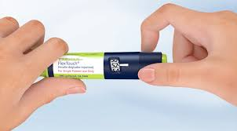
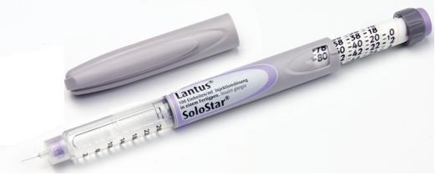
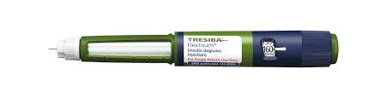
Administration Considerations

Slide 31
Combination Product Pipeline
Ryzodeg® 70/30
  FDA approved in 2015, not yet available
  70% degludec and 30% aspart
Degludec + Liraglutide
  FDA extended review period to Dec 2016
  Available in Europe (Xultopy®) since Sept 2014
Notes:
MORE time is needed to review NDA (NEW DRUG APPLICATION)

Slide 32
Cost Saving Options
 | Degludec pen | Glargine U-100
Goodrx.com Cost | U-100: $451.41 | Vial: $256.26
 | U-200: $540.08 | Pen: $380.39
Manufacturer Savings Card | $15 per fill x 24 months | $25 per fill
 | Max: $500/fill | Max: $100/fill
Manufacturer Patient Assistance | Not listed on site | -No rx ins, ineligible for state/fed programs -Exceptions for Part D -Income: < 250% of FPL -Supply: varies -Sent to: PCP office
www.goodrx.com Accessed 9/10/16
www.needymeds.org Accessed 9/10/16

Slide 33
Clinical Pearls/Place in Therapy
Pros to Degludec
  Lower doses, less injections, ease of use
  Improved duration of action
  Improved nocturnal hypoglycemia risk
  Copay card offers more cost savings
  Combination pipeline drugs
Cons to Degludec
  Unknown conclusive cardiovascular risk
  Cost; no patient assistance program
Notes:
Improved duration of action: flexibility in dosing, could lead to less than daily dosing

Slide 34
Another Option for Meal Time
  Apidra®
  ^{(Glulisine)}
  Humalog®
  ^{(Lispro)}
  Novolog®
  ^{(Aspart)}
Rapid Acting
Lispro U-100
Lispro U-200
  Humulin R®
  Novolin R®
  Reli-On R®
Short Acting
Notes:
Lispro U-200 was approved in May 2015

Slide 35
Why Another Concentration?
Over 60% of US population use > 20 units/day of rapid acting insulin¹
Overweight/obese individuals has increased from 857 million (1980) to 2.1 billion (2013)²
As volume of U-100 increases, changes in onset, peak and duration can occur³
Rees et al. Journal of Diabetes Science and Technology. 2015; 9(2): 316-319
Ng et al. Lancet. 2014; 384: 766-781
Cochran E. Diabetes Spectrum. 2009, 22 (2): 116-122
Notes:
Improved duration of action: flexibility in dosing, could lead to less than daily dosing

Slide 36
Bioequivalence: Lispro U-200
Open-label, randomized, 4-period crossover
  Dose: 20 units
Pharmacokinetics
Pharmacodynamics
De La Pena et al. Clinical Pharmacology in Drug Development. 2016; 5(1): 69-75
Notes:
8-HOUR CLAMP study in healthy subjects
BioEquivalence was established
Dose = 20 units was selected, as it is clinically relevant meal time dose for either type 1 or type 2
Figure A demonstrated PK simiarlities

Slide 37
Outcomes and Tolerability:
Bioequivalence study
  Efficacy and safety already established via lispro U-100
  AUC and C_{max} were similar
  No difference in tolerability between either formulation
    No clinically significant changes in vital signs
De La Pena et al. Clinical Pharmacology in Drug Development. 2016; 5(1): 69-75
Notes:
8-HOUR CLAMP study in healthy subjects
BioEquivalence was established
Dose = 20 units was selected, as it is clinically relevant meal time dose for either type 1 or type 2
Figure A demonstrated PK simiarlities

Slide 38
Dosing and Administration
 | Lispro U-200 | Lispro U-100
Initial Dosing | 0.5 to 1 unit/kg/day
Dose Conversion | 1 : 1
IV Administration Pump Administration | NO | YES
Mix with NPH (in syringe for SubQ injection) | NO | YES (vial only)
Lispro. Facts and Comparisons: Wolters Kluwer. Indianapolis, IN. http://www.wolterskluwercdi.com/facts-comparisons-online. Accessed September 9, 2016.
Notes:
It was developed as an option for diabetic patients on higher daily mealtime insulin doses
→ CALL Lilly, can U-200 be mixed in syringe with NPH??? Always draw rapid acting first

Slide 39
Dosage Form Considerations
 | Lispro U-200 |  | Lispro U-100
Max Single Dose | 60 units
Units per Pen | 600 units/3mL (2 pens per box) |  | 300 units/3mL (3 pens per box)
Room temperature expiration | 28 days
Duration of Single Pen Use* | 7 days | 14 days
*Assuming dose of 15 units three times daily
Humalog U-200 Kwikpen. http://www.humalog.com/humalog-u200-hcp.aspx Accessed September 9, 2016.
Notes:
Verify MAX SINGLE DOSE

Slide 40
Cost Saving Options
 | Lispro U-200 | Lispro U-100
Goodrx.com Cost | 2 pens: $401.21 | 5 pens: $499.51
Manufacturer Coupon | $25 per fill x 2 years | No longer available
 | Max: $100/month
Manufacturer Patient Assistance | -No prescription insurance -Part D: Case by case -Income: varies -Supply: up to 120 days; no specified limits -Sent to: PCP office with 4 weeks
www.goodrx.com Accessed 9/10/16
www.needymeds.org Accessed 9/10/16

Slide 41
Clinical Pearls/Place in Therapy
Pros to lispro U-200
  Improved adherence, less frequent pen use
  Lower volume of injection, less injection force
Cons to lispro U-200
  Cost if not covered by commercial insurance
  Medicare patients, limited coverage
  Incompatibility with NPH
Notes:
ADA: Joint task force; evidence based; not prescriptive, non-alorithm

Slide 42
Basaglar®
Glargine U-100 by Eli Lilly
  Approved via FDA’s abbreviated approval pathway¹
  Per FDA: NOT a biosimilar
  Available in Dec 2016
Will the price be lower??
  In other countries, 15-20%² lower than Lantus®
Other companies are working on biosimilar glargine alternatives
http://www.fda.gov/NewsEvents/Newsroom/PressAnnouncements/ucm477734.htm
http://diatribe.org/fda-approves-new-insulin-glargine-basaglar-first-biosimilar-insulin-us
Notes:
This approval comes as no surprise, as the FDA had tentatively approved Basaglar in August 2014, pending a patent lawsuit between Lilly/BI and Sanofi. That lawsuit is now settled, allowing Lilly/BI to launch Basaglar starting December 15, 2016. - See more at: http://diatribe.org/fda-approves-new-insulin-glargine-basaglar-first-biosimilar-insulin-us#sthash.Y3mw8gUV.dpuf

Slide 43
Humulin R U-500
(for awareness only)
137% increase in prescribing from 2007 to 2009¹
Longer action of duration (~7 hours)²
  Often can be used without basal insulin
Decreased daily injections
  2-3 injections per day³
Segal et al. Journal of Diabetes Science and Technology. 2015; 9(2): 331-338
Lamos et al. Therapeutics and Clinical Risk Management. 2016; 12: 389-400
Cochran et al. The Diabetes Educator. 2014; 40 (2): 153-165
Notes:
Staggering increase in U-500 use

Slide 44
Summary
New insulin concentrations offer alternatives to improve tolerability, adherence, and safety
All health care professionals need to be aware of the safety risks than can occur due to prescribing and dispensing of concentrated insulins
Patient education is imperative
Cost of insulin therapy needs to be discussed and readdressed at each visit

