Slide 1
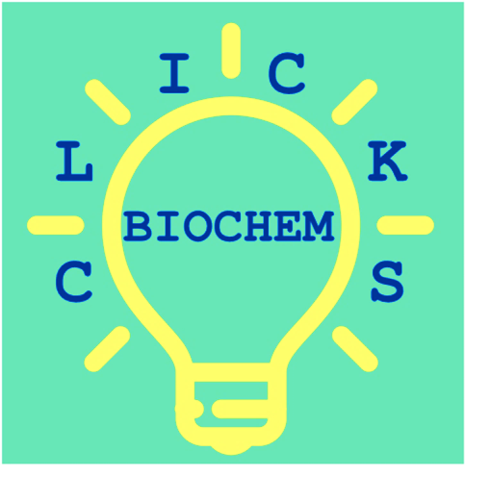
CLICKS: Complementary Lessons in Community K-12 Schools
Fall 2019 Communiqué

Slide 2
Mission Statement
CLICKS promotes science education in underserved and diverse schools by bringing biochemistry focused lab activities to classrooms in order to supplement students’ education, engage them in science, and build their confidence as emerging scientists.

Slide 3
Fall 2019 Logistics
We visited Ypsilanti Community High School from December 2nd – 5th.
We served all five sections of Mr. McCaman’s Forensics course.
The lab was performed over two class periods. Students were guided in small groups of ~4 students per teaching assistant.
89 students participated in at least one day of the lab.

Slide 4
Who volunteered?
CLICKS is made possible by Post-docs, Graduate students, Techs, and Undergrads associated with Biological Chemistry. Their donated time and effort are greatly appreciated.
Beth Rousseau
Anjali Patwardhan, PhD
Karl Koebke, PhD
Kip Kaitany
Fabienne Birkle
Cassie Dutcher
Cara Loomis
Benjamin Ide
Rosa Romero
Yun Zhang
Allison Maebius
Emily Roberts

Slide 5
What was the lab activity?
The lab was purchased from MiniPCR and adapted to align with the curriculum of the Forensics course.
The lab is titled “Forensics Lab: Analysis of the D1S80 VNTR”
The students collected their own DNA samples, assembled PCR reactions, and analyzed their PCR products on an agarose gel.

Slide 6
What were the learning objectives?
Objectives:
◦Students learn the purpose and mechanism of PCR (Polymerase Chain Reaction)
◦Students learn the purpose and mechanism of gel electrophoresis
◦Students learn about VNTRs (Variable Number Tandem Repeats) and how they can be used to differentiate between individual’s DNA samples.

Slide 7
How was student learning assessed?
Assessed student knowledge pre-lab and post-lab through a multiple choice (ABCD) quiz.
Q1: What technique is used to amplify DNA?
Q2: What is the correct order of events for DNA amplification?
Q3: Which DNA fragment will run faster through an agarose gel?
Q4: How can VNTRs help to differentiate the DNA samples of two people?

Slide 8
Students’ Quiz Scores Increased Post-lab

Slide 9
Students’ Confidence Increased Post-lab
How confident do you feel conducting PCR and gel electrophoresis?

Slide 10
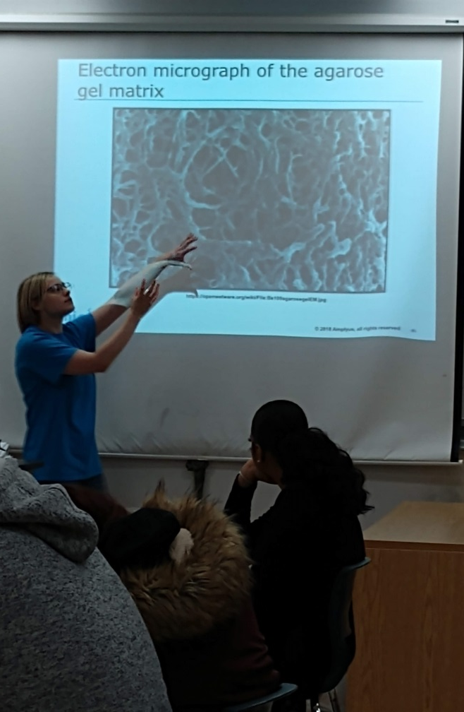
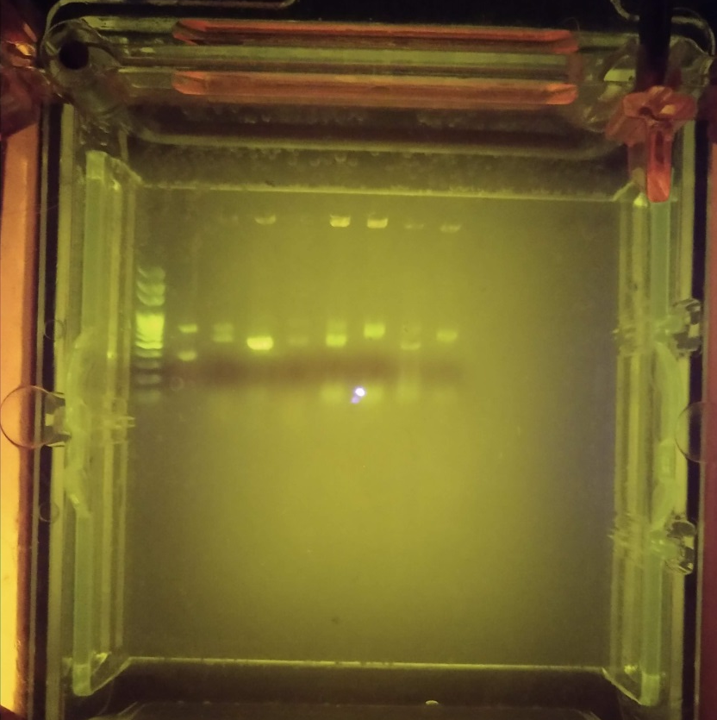
CLICKS in Action!
Beth teaches the students about agarose gels.
A gel the students loaded.

Slide 11
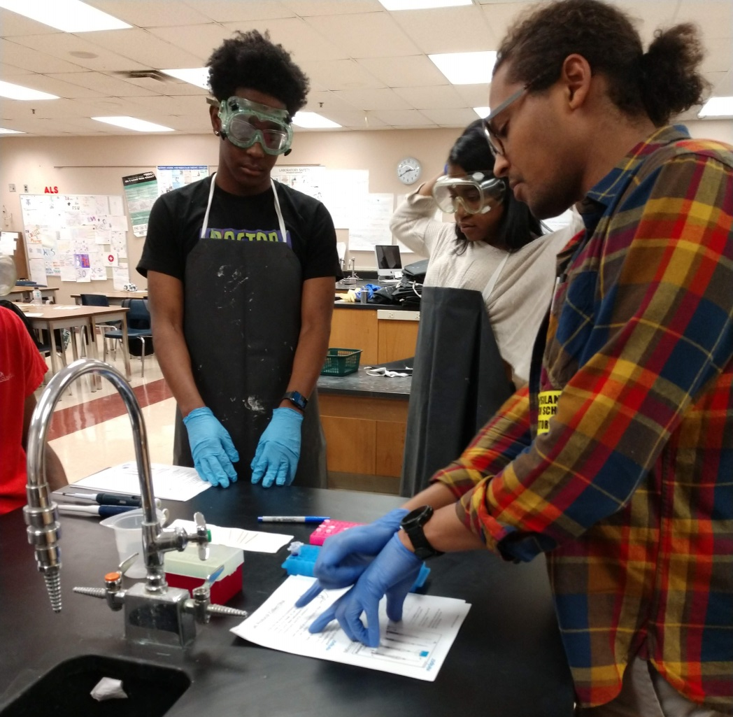
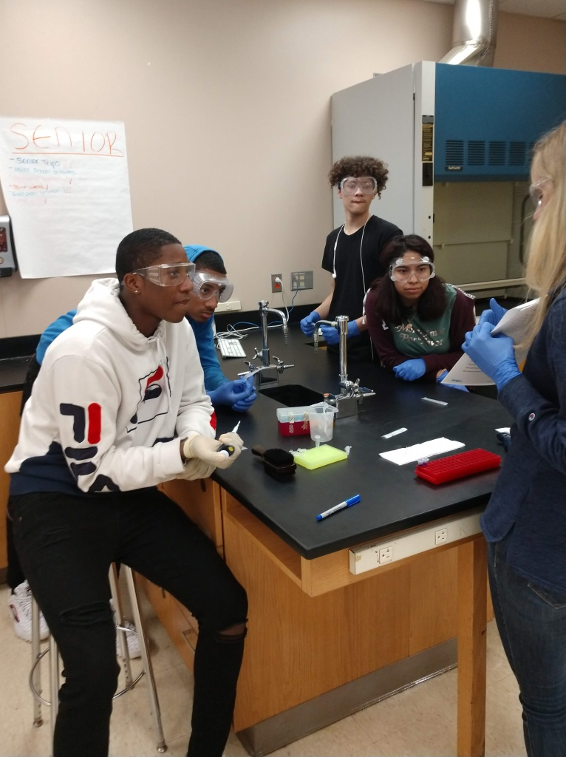
CLICKS in Action!
Fabienne and Kip explain the lab protocol to the students.

Slide 12
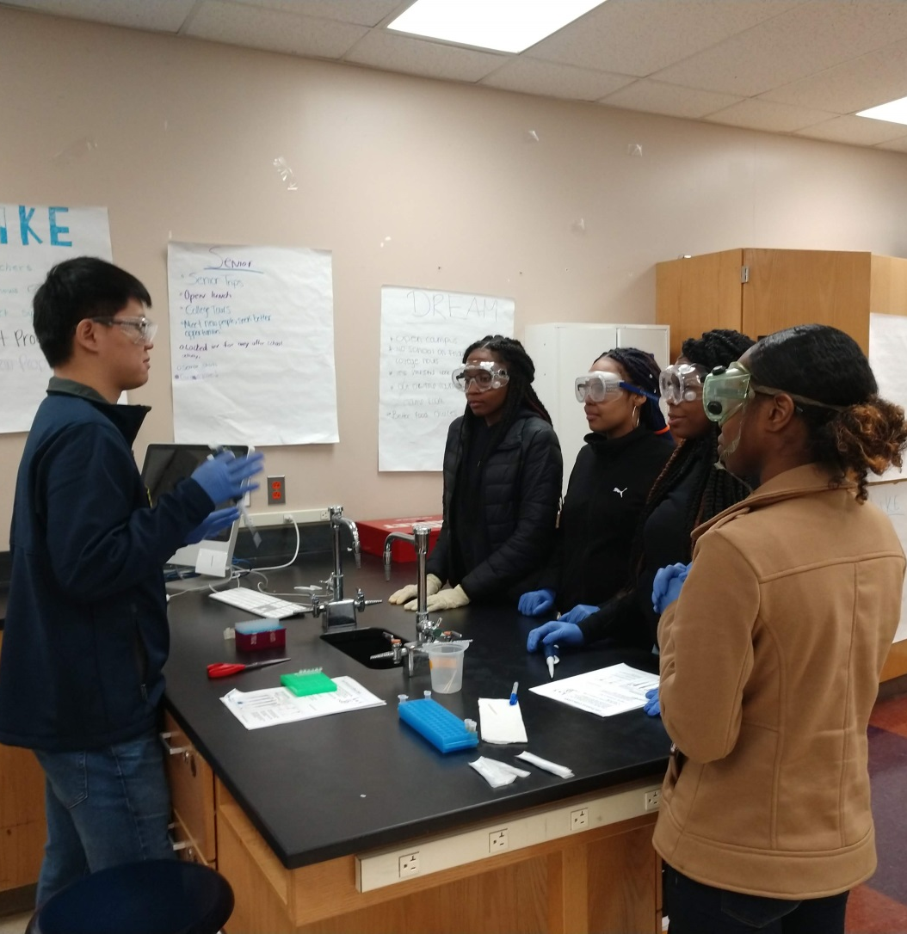
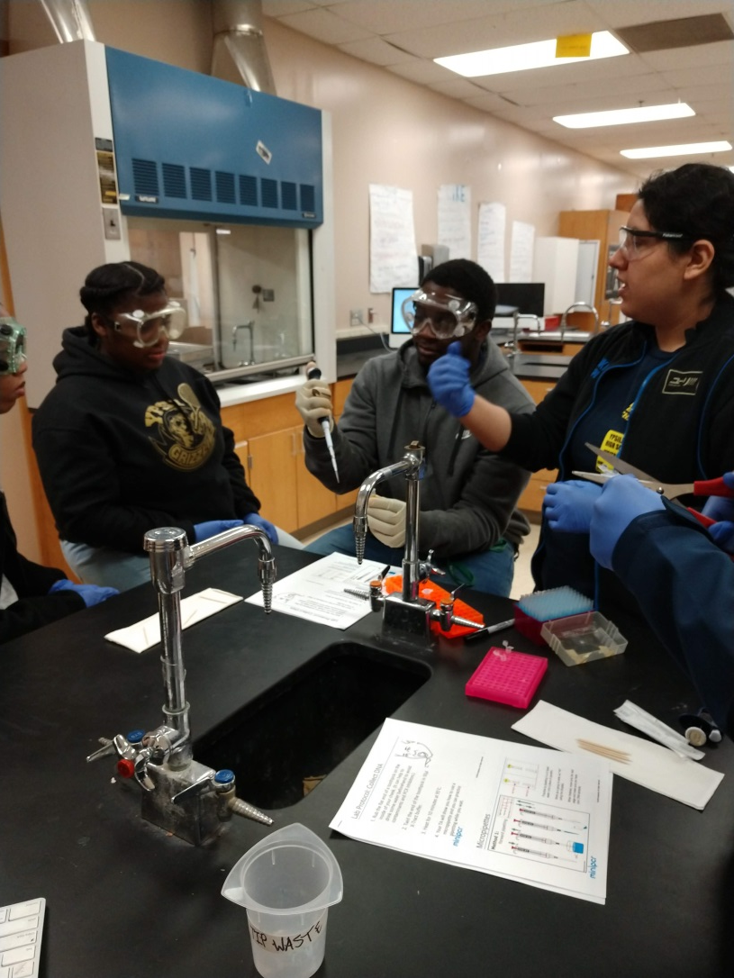
CLICKS in Action!
Rosa and Yun teach students how to pipet.

Slide 13
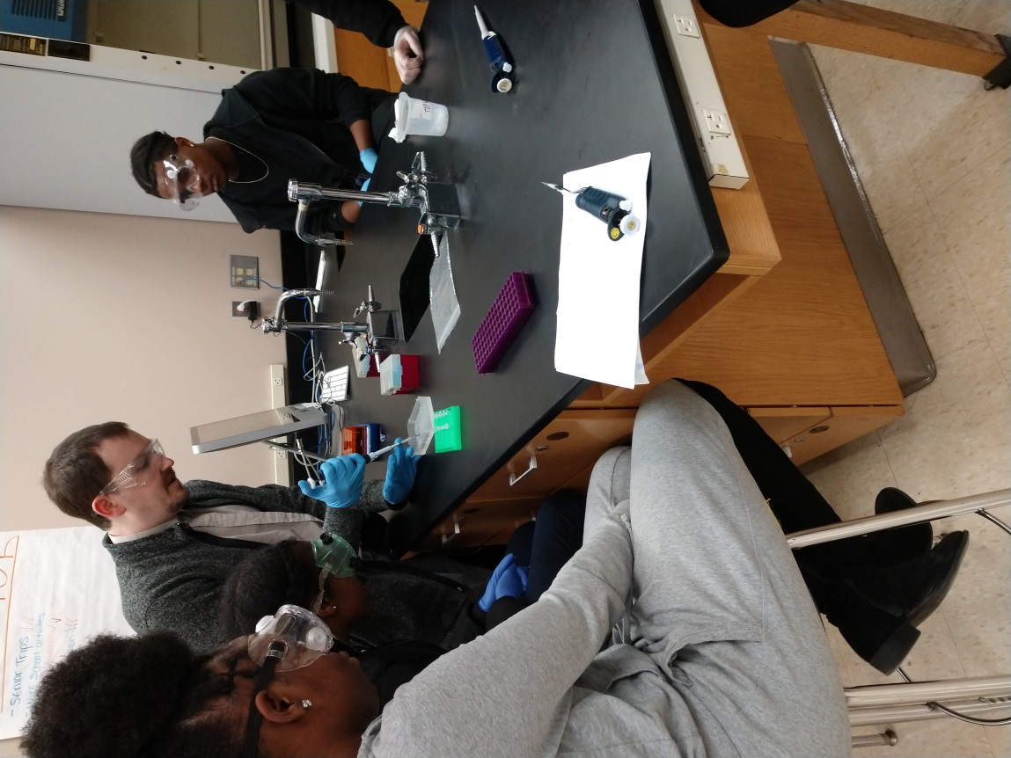
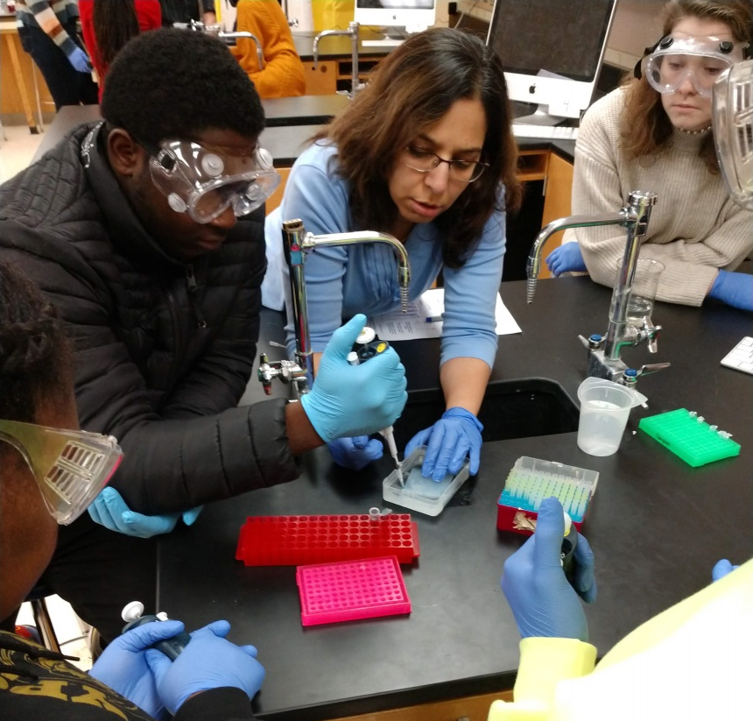
CLICKS in Action!
Karl and Anjali teach students how to load a gel.

Slide 14
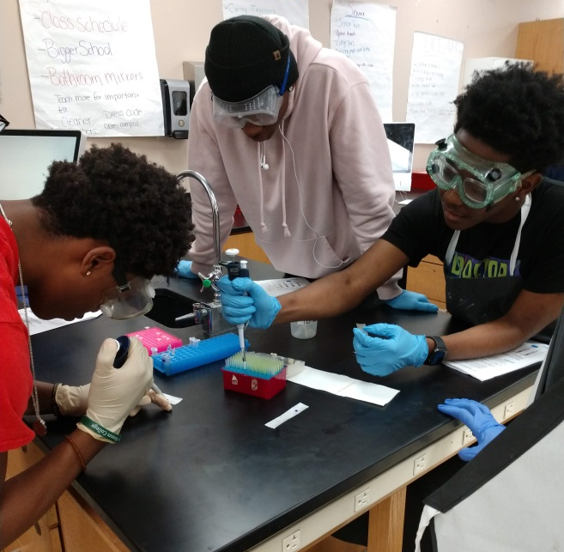
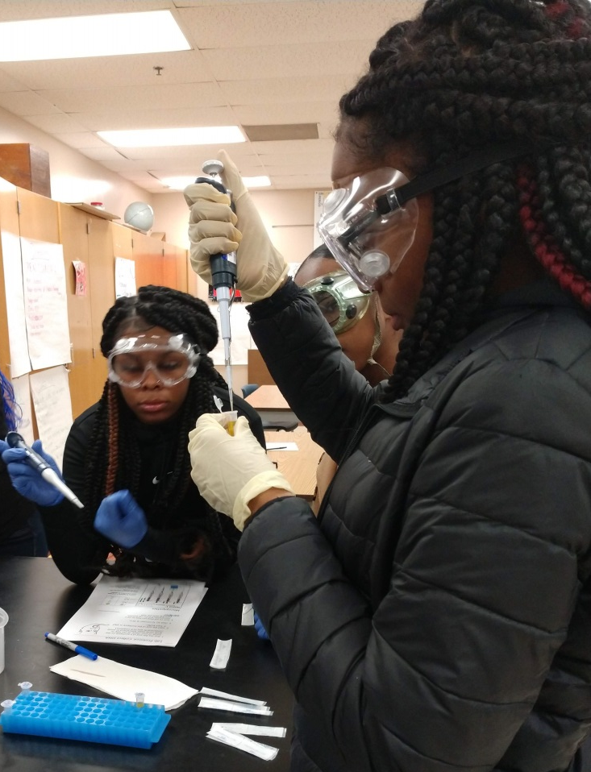
Students Practice Their Lab Skills

Slide 15
What did students like about CLICKS?

Slide 16
Future Directions
Mr. McCaman invited CLICKS back in the spring. He said that the students loved the lab and that we had provided a very important supplement to their curriculum because the science department had their budget cut this year.
The spring lab will likely take place in May. Spring 2020 is a great time to be a volunteer!
Volunteers looking to take on a leadership role are welcome to be assistant directors. Please contact the director of CLICKS, Beth Rousseau bapoppe@umich.edu to be put on the mailing list.

Slide 17
Acknowledgements
Support:
Department of Biological Chemistry DEI Committee
NSF CHE 1905267

